Slide 1
A.R.T.
(Autonomous Robot Toy)
Ricky Ng-Adam /伍思力
Xinchejian.com
2011

Slide 2
Who am I?
Ricky Ng-Adam
伍思力
rngadam@gmail.com

Slide 3
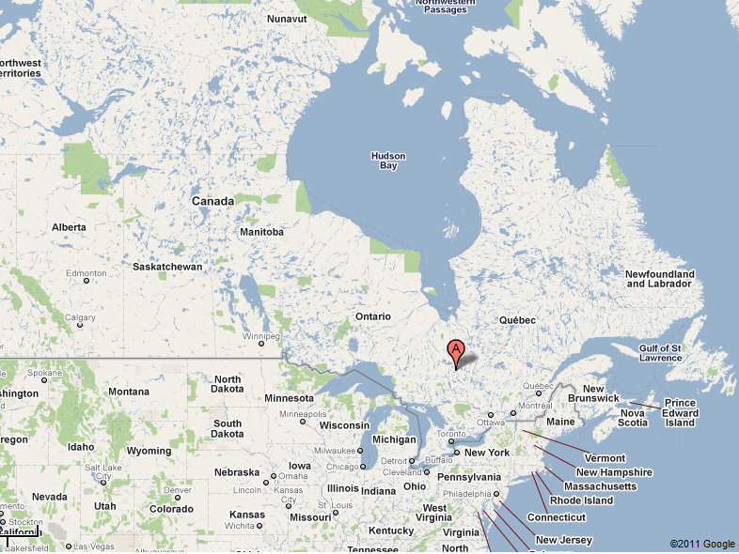
Quebec, Canada

Slide 4
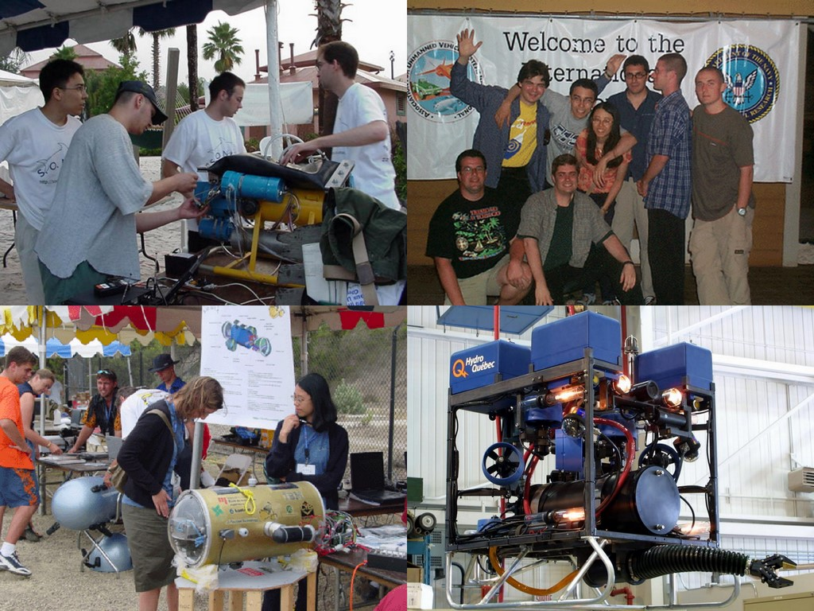
Ricky and Robots!

Slide 5
A.R.T.
Autonomous 自主
Robot 机器人
Toy 玩具

Slide 6
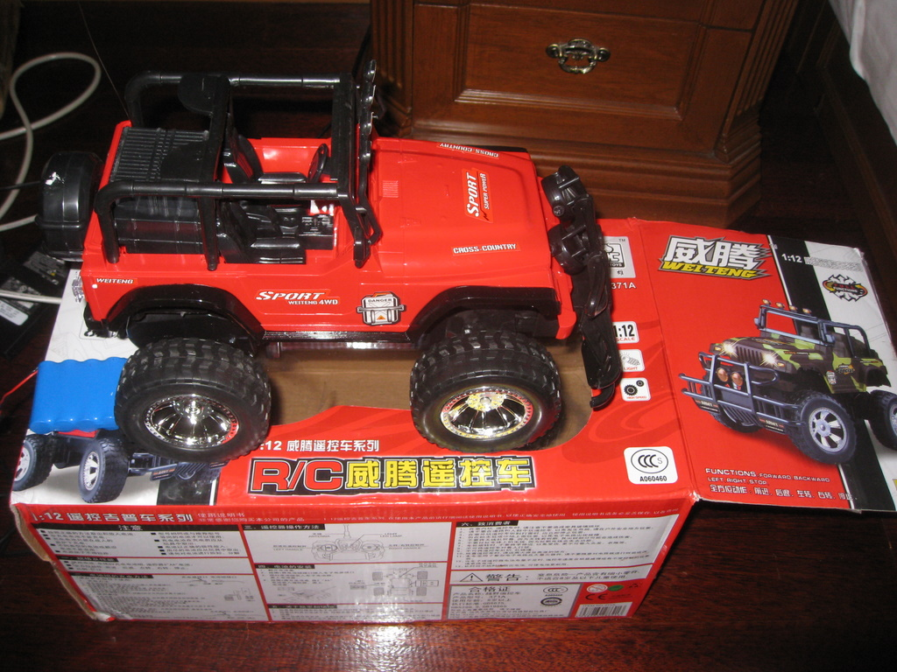
Before

Slide 7
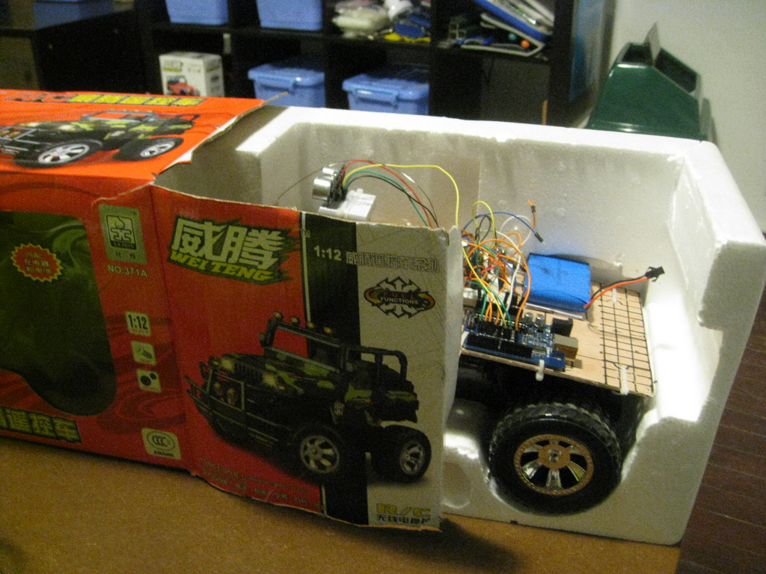
After

Slide 8
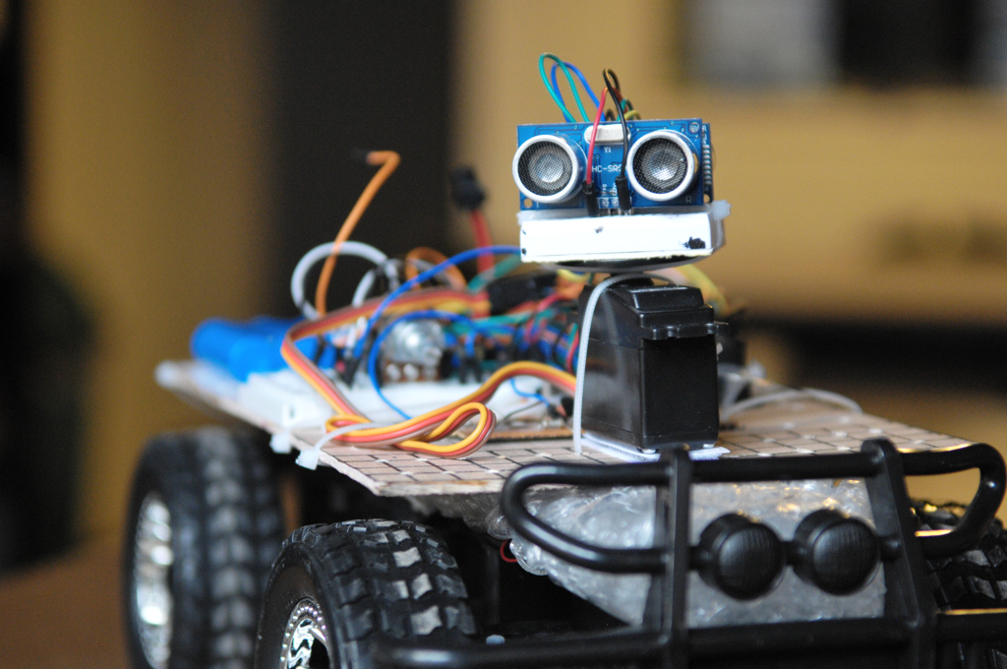
Current state

Slide 9
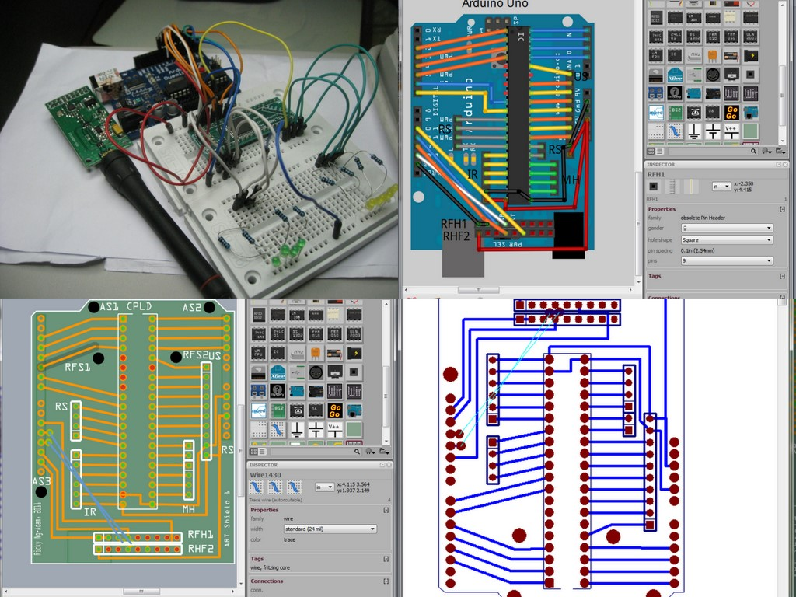
ART v5

Slide 10
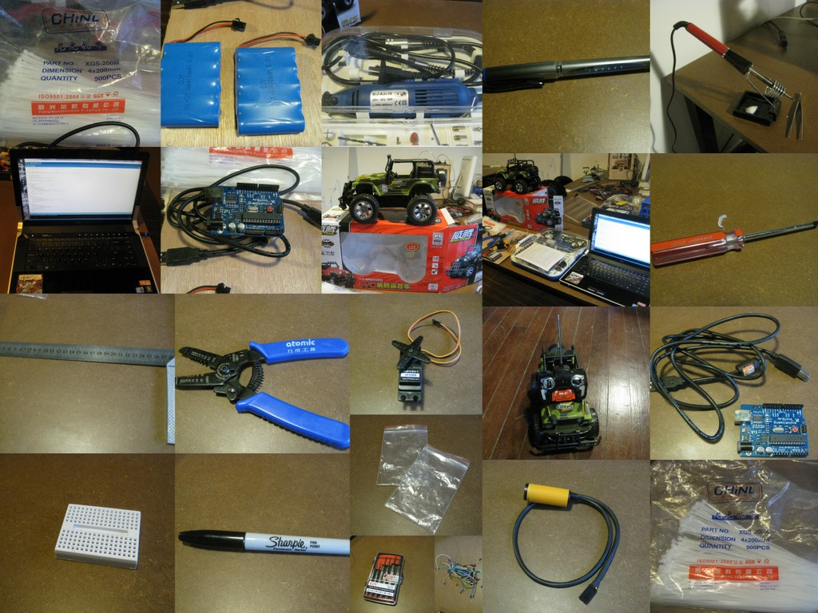
Tools and Parts 材料&工具

Slide 11
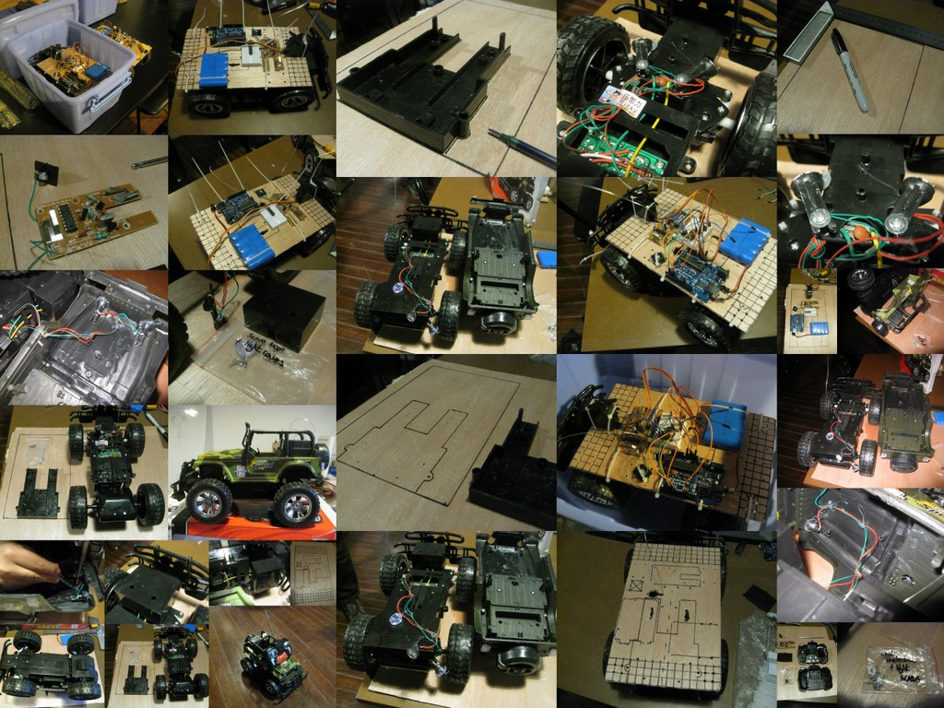
Steps 过程

Slide 12
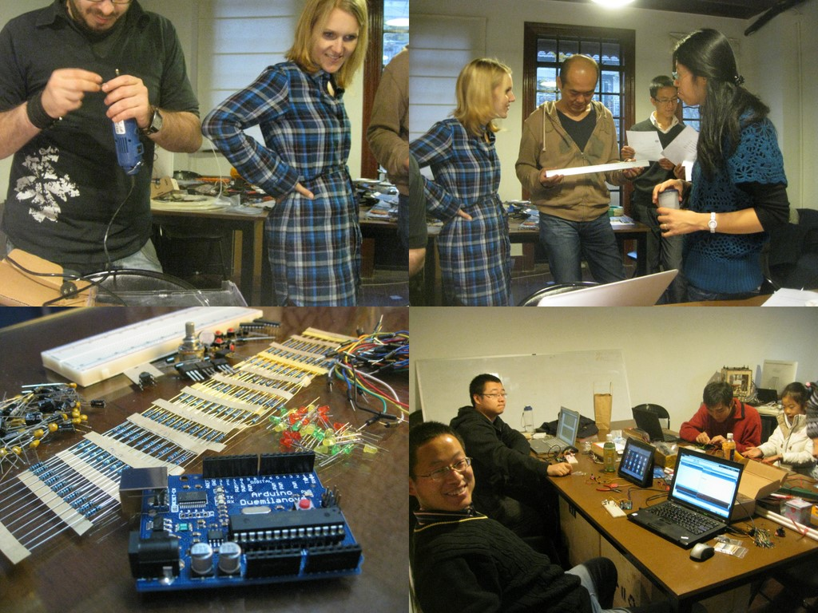
People involved

Slide 13
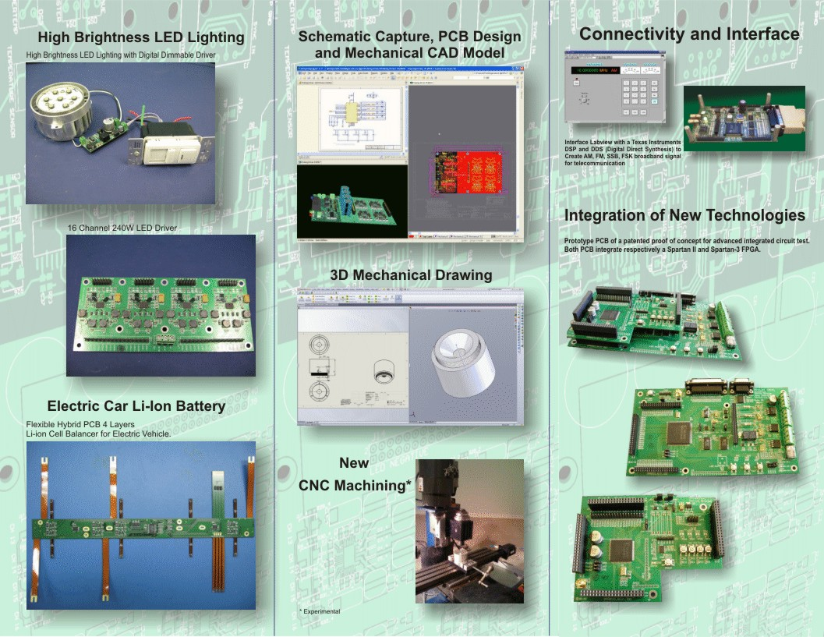
Others...
www.pbelconsulting.ca

Slide 14
Budget 材料费
Description | Price/Unit | Quantity | Total
RC Toy Car (with 400mAh battery) | 67.00 | 1 | 67.00
Arduino Uno (with Atmega 328p) | 178.00 | 1 | 178.00
RFC1100-A CC1101 RF Transceiver with Power Amplifier | 70.00 | 1 | 70.00
4 * Ultrasonic sensors HC-SR04 | 37.00 | 4 | 148.00
4 * Infrared sensors E18-D80NK | 30.00 | 4 | 120.00
Xilinx XC9536 CPLD in a 40 DIP pin package | 42.00 | 1 | 42.00
Mini-breadboard | 3.00 | 1 | 3.00
700mAh, 6V, Rechargeable NiCad | 15.00 | 1 | 15.00
Cabling | 12.00 | 1 | 12.00
Motor shield (L298N) | 68.00 | 1 | 68.00
Arduino I/O expansion board | 48.00 | 1 | 48.00
Total |  | 116.64 | 771.00
 |  | USD | RMB

Slide 15
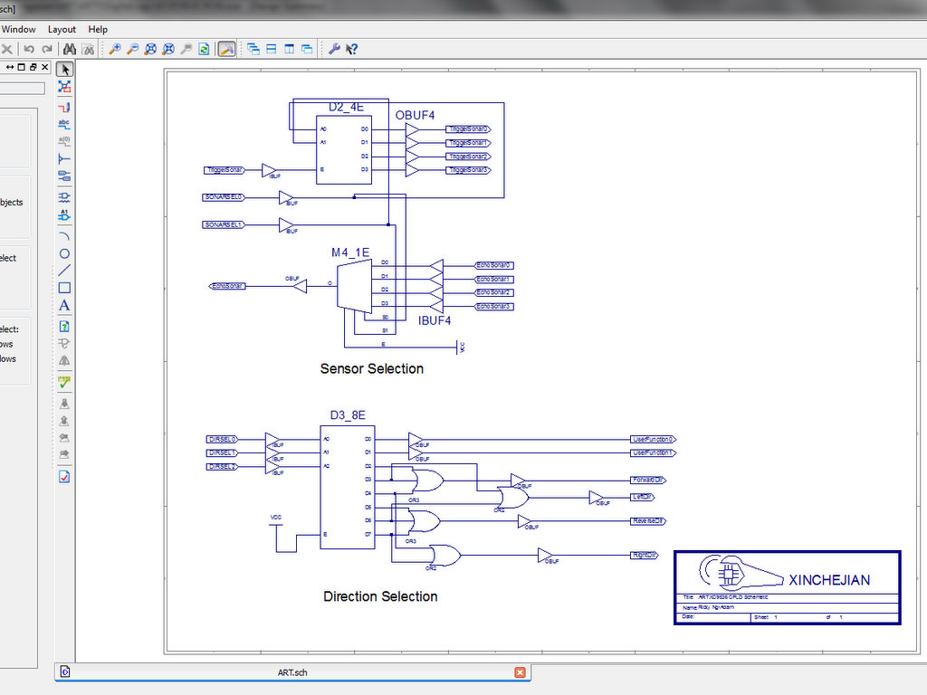
EE Degree?

Slide 16
More information
Ricky Ng-Adam, rngadam@gmail.com
http://www.xinchejian.com
https://github.com/rngadam/ART
http://xindanwei.com

