Slide 1
Numpy
.

Slide 2
Introduction
Numpy stands for numerical python.
It is the core library for numeric and scientific computing.
It consists of multi dimensional array and a collection of routines for processing those arrays.

Slide 3
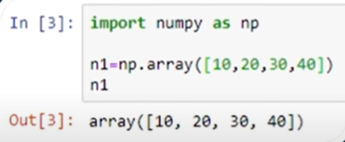
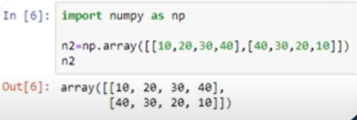
Create Numpy arrays
Single dimensional array Multi dimensional array

Slide 4
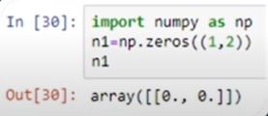
Initializing numpy Array
Initializing numpy array with zeros.

Slide 5
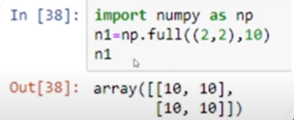
Initializing numpy array with same number
Intializing numpy array with same number.

Slide 6
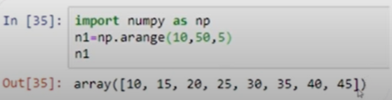
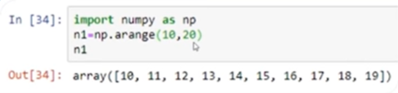
Initializing numpy array within a range
.

Slide 7
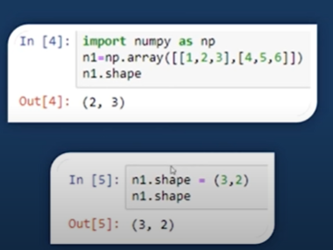
Numpy shape
.

Slide 8
Joining Numpy arrays
vstack()
hstack()
coloumn_stack()

Slide 9



Numpy intersection and difference

Slide 10
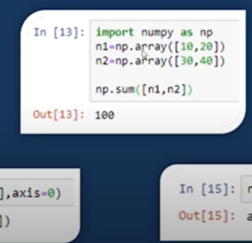
Numpy array mathematics
Addition of numpy arrays.

Slide 11
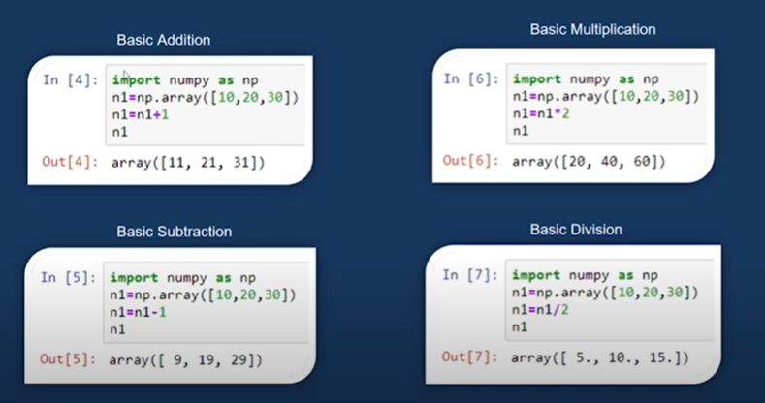
Numpy array mathematics
.

Slide 12
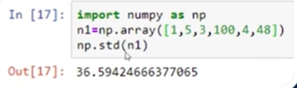
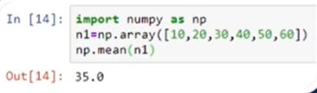

Numpy math functions

Slide 13
Pandas

Slide 14
Introduction
Panda stands for panel data.
It is the core library for data manipulation and data analysis .
It consists of single and multidimensional data structures for data manipulation.

Slide 15

Pandas Data structures
Single dimensional :- Series object
Multi dimensional :- Data frame

Slide 16
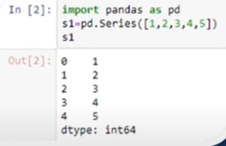
Pandas series object
Series object is one dimensional labeled array.

Slide 17
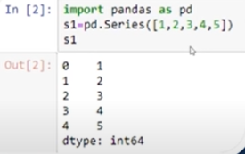
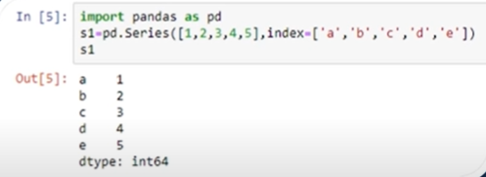
Changing index

Slide 18
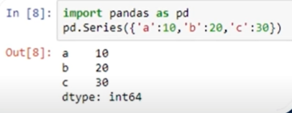
Series object from Dictionary
.

Slide 19
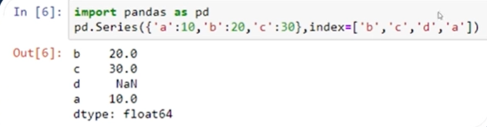
Changing index position
.

Slide 20
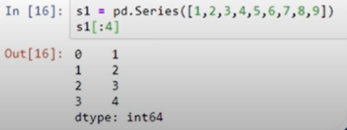
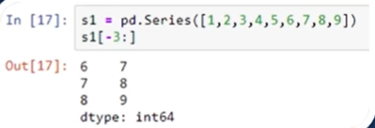

Extracting individual elements

Slide 21
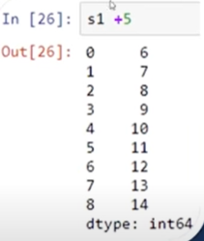
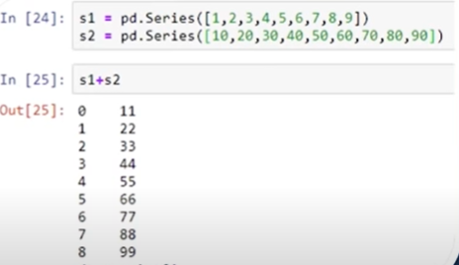
Basic math operation on series

Slide 22
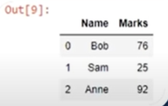
Pandas dataframe
Dataframe is a 2 dimensional labelled data structure.
Dataframe composes of rows and coloumns .

Slide 23

Creating a dataframe
This is how we can create dataframe.

Slide 24

DataFrame In-Built functions
Head()
1
Tail()
2
Shape()
3
Describe()
4

Slide 25
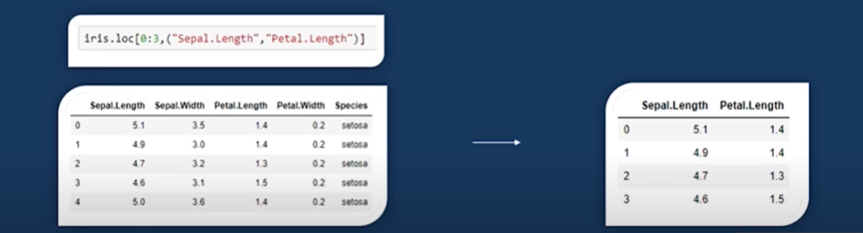
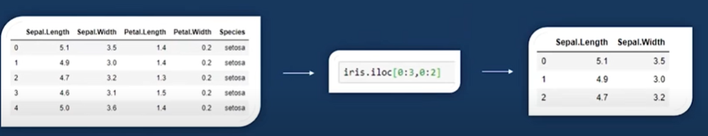
Iloc[ ] and loc[]

Slide 26
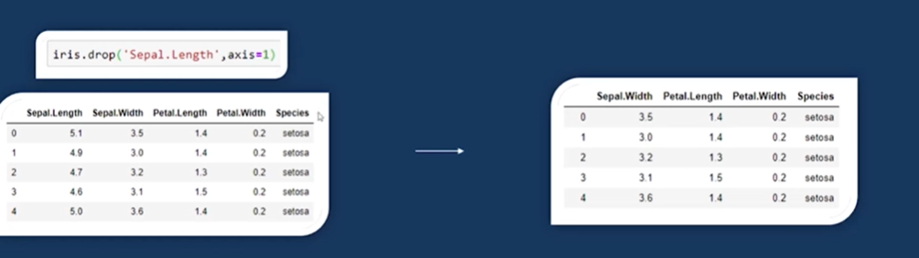
Dropping Coloumns

Slide 27
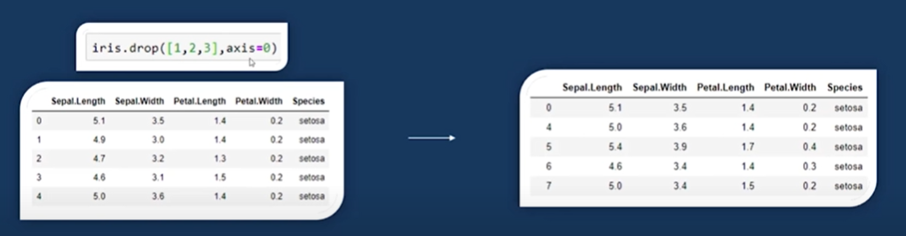
Dropping rows

Slide 28
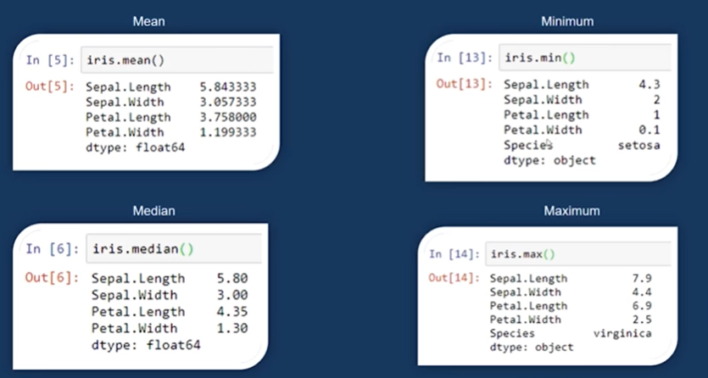
Pandas functions

Slide 29
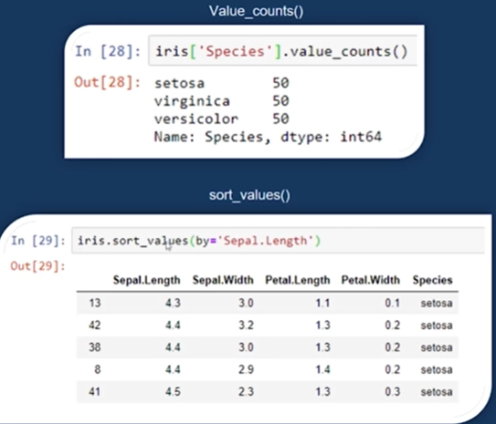
Pandas functions

Slide 30
Matplotlib
It is a python library used for data visualization.
We can create bar plots,scatter plots,histogram and a lot more with matplotlib.

Slide 31
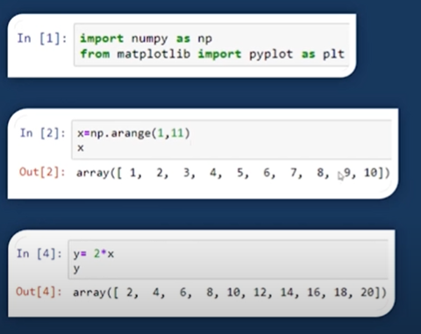
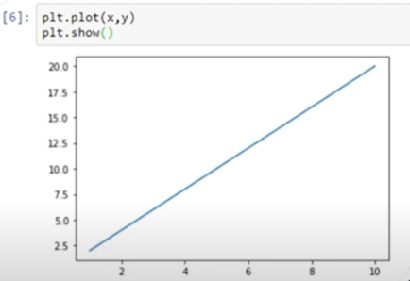
Line plot

Slide 32
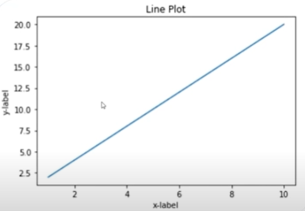
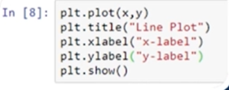
Adding titles and labels in line plot

Slide 33
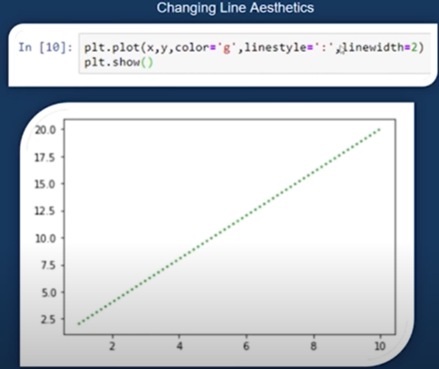
Line plot

Slide 34
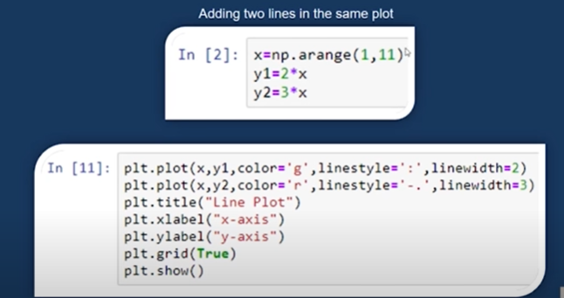
Line plot

Slide 35
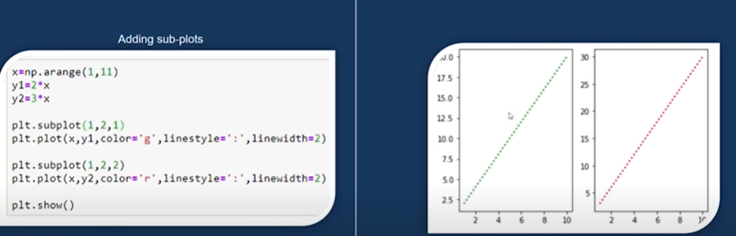
Adding sub plots

Slide 36
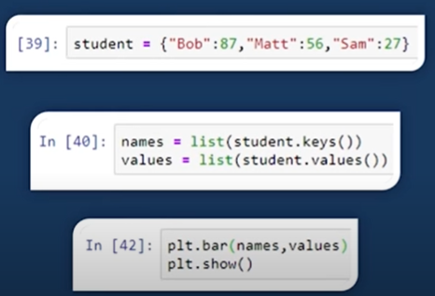
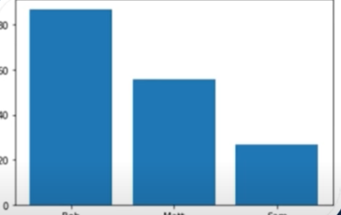
Bar plot

Slide 37
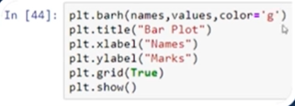
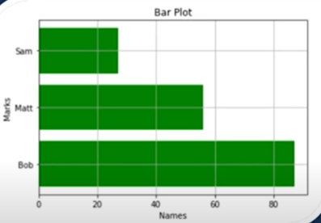
Horizontal bar plot

Slide 38
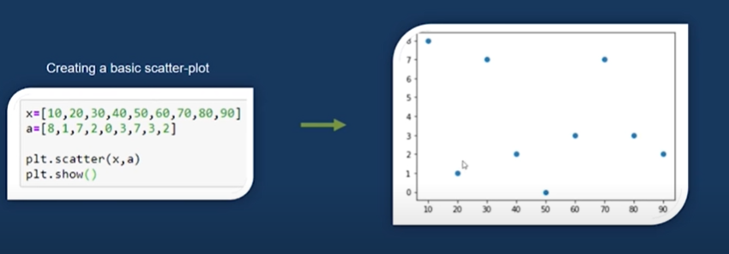
Scatter plot

Slide 39
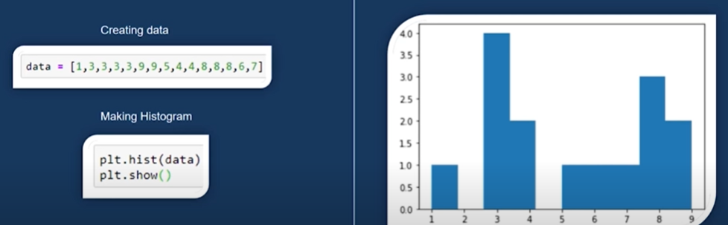
Histogram

Slide 40
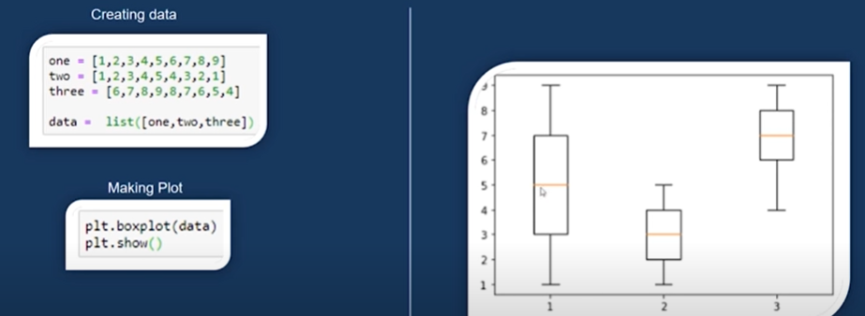
Box plot

Slide 41
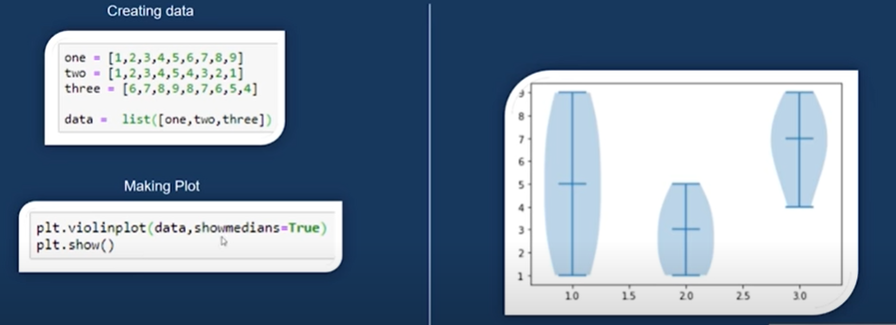
Violin plot

Slide 42
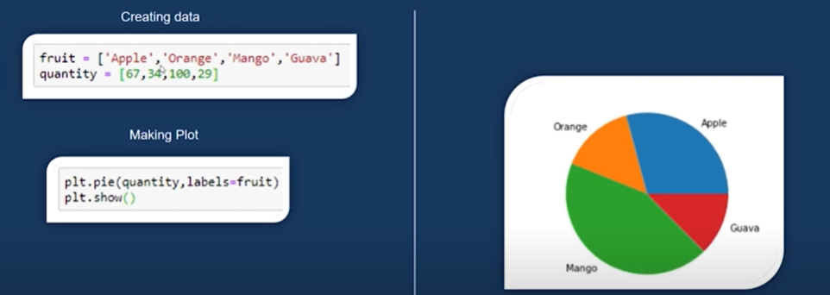
Pie chart

Slide 43
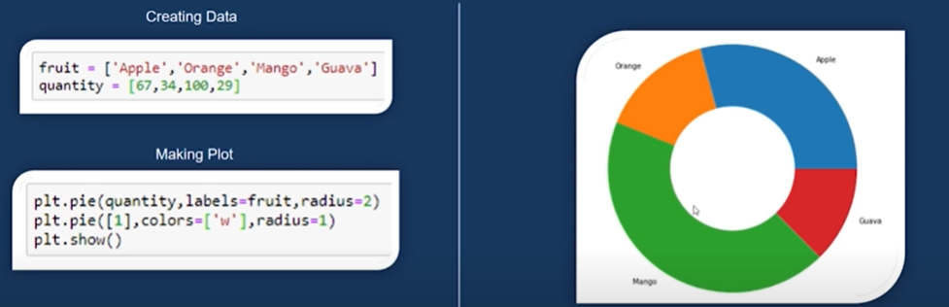
DoughNut chart

Slide 44

Thank you
.

