Slide 1
OpenShift on AWS
Ryan Niksch – Partner Solutions Architect, Amazon Web Services.

Slide 2

OpenShift on AWS with Shadow-Soft
Rich open source and integration experience
Outcome-based methodology
Certified Red Hat OpenShift and AWS engineers
Successful OpenShift deployments under our belt

Slide 3
WE NEED MORE THAN JUST CONTAINERS
Scheduling Decide where to deploy containers
Security Control who can do what
Lifecycle and health Keep containers running despite failures
Scaling
Scale containers up and down
Discovery Find other containers on the network
Persistence
Survive data beyond container lifecycle
Monitoring Visibility into running containers
Aggregation
Compose apps from multiple containers

Slide 4
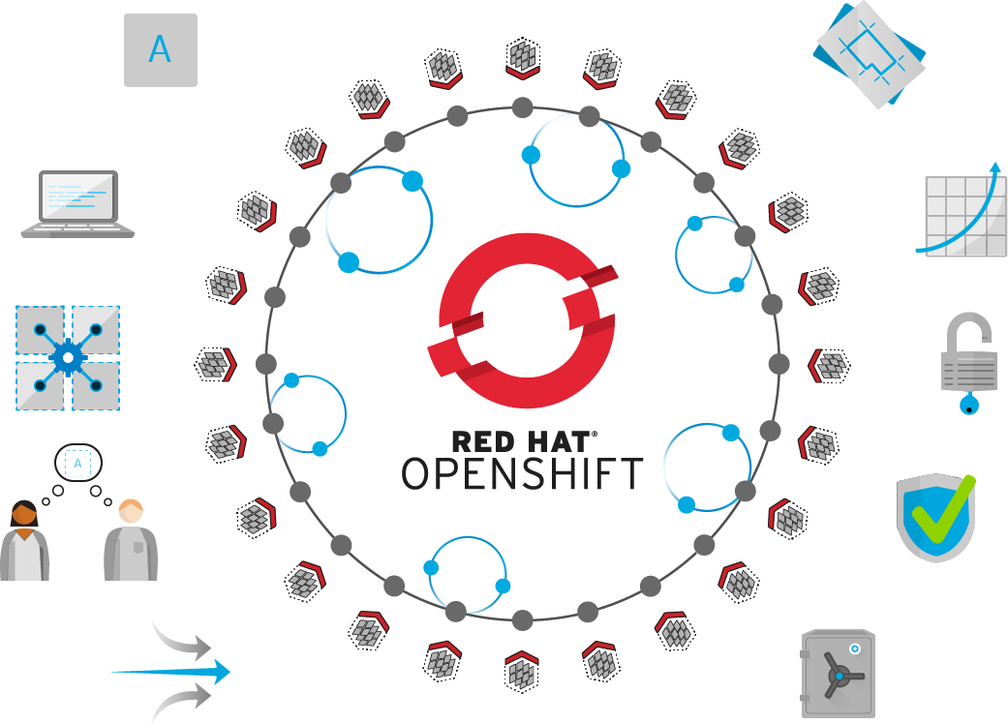
Self-Service
Standards-based
Multi-language
Web-scale
Automation
Open Source
Collaboration
Enterprise Grade
Multi-tenant
Secure

Slide 5








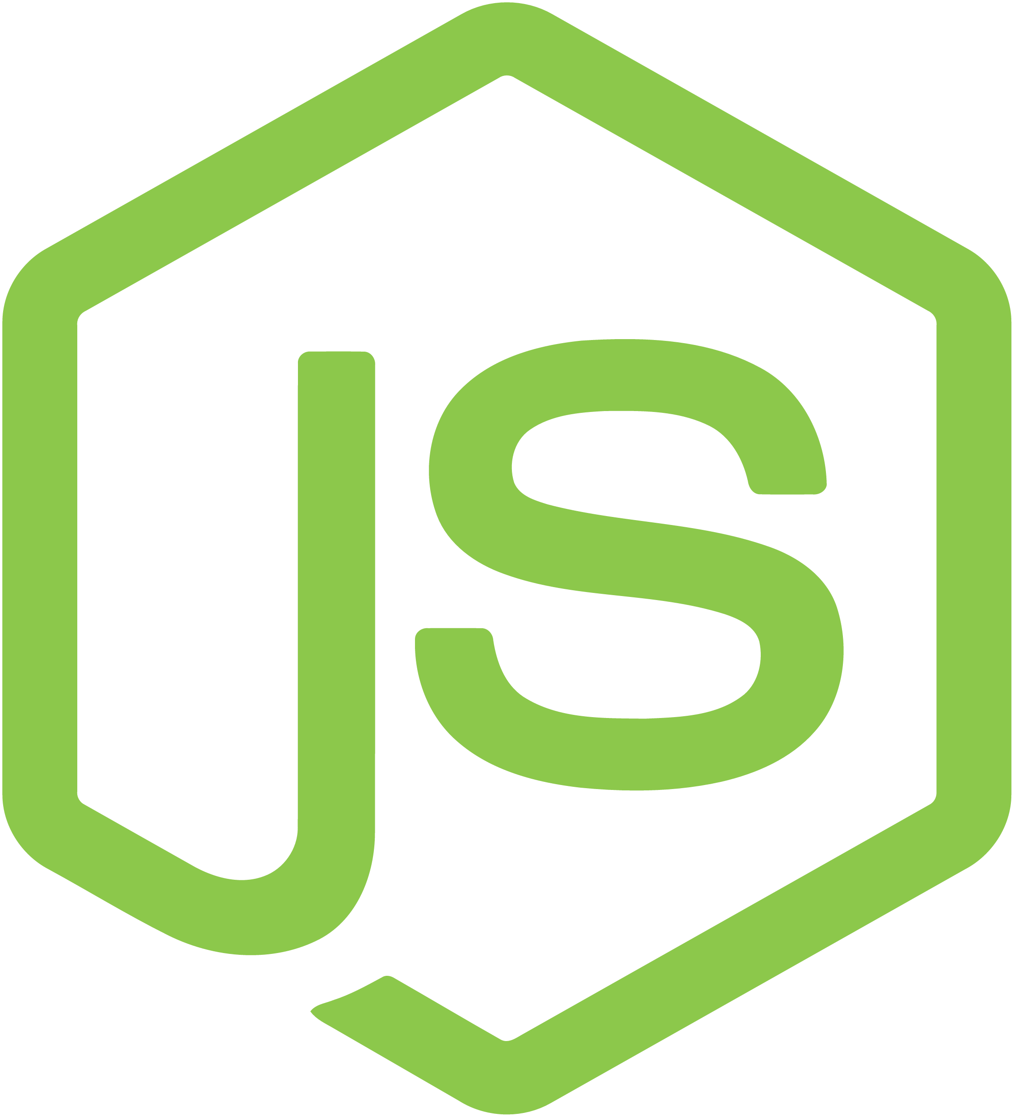


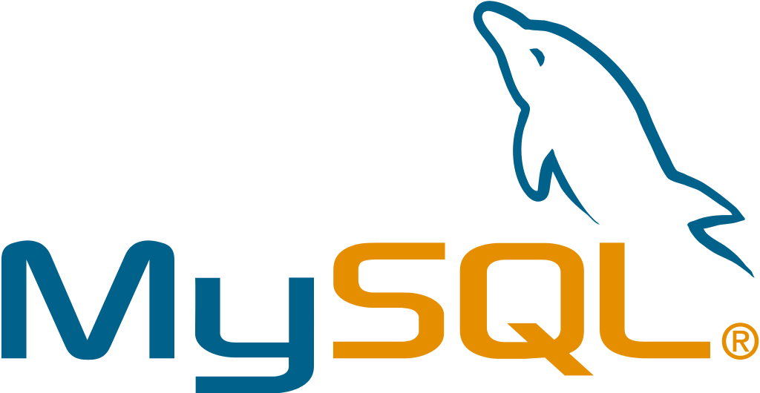
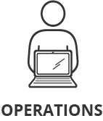






ACCESS VIA WEB, CLI, IDE AND API
ROUTING LAYER
SERVICE LAYER
RED HAT
ENTERPRISE LINUX
NODE
NODE
NODE
PERSISTENT
STORAGE
SCM
(GIT)
MASTER
C
C
API/AUTHENTICATION
c
CI/CD
C
C
C
DATA STORE
RHEL
RHEL
RHEL
SCHEDULER
NODE
NODE
NODE
REGISTRY
EXISTING AUTOMATION TOOLSETS
HEALTH/SCALING
C
C
C
C
C
RHEL
RHEL
RHEL
PHYSICAL
VIRTUAL
PRIVATE
PUBLIC
HYBRID

Slide 6



AMAZON WEB SERVICES (AWS)
A high-performance, scalable, and comprehensive cloud platform
AVAILABILITY
Global mesh of availability zones
ELASTICITY
Automatic, on-demand resource provisioning
AGILITY
Support for existing and cloud-based apps
SECURITY
Built-in security and compliance certifications
Notes:
AWS is a high-performance, scalable, and comprehensive cloud platform that provides the availability, elasticity, and agility needed to run both modern and existing applications. Adapt quickly to changing demand with automatic resource provisioning and retirement. Protect your applications and environment with included security features — and more than 50 compliance certifications and accreditations .
AWS is a high-performance, scalable, and comprehensive cloud platform.
Availability - AWS provides a mesh of geographically dispersed availability zones and transit centers that ensure reliability without increasing latency.
Elasticity - AWS lets you adapt to changing demand by automatically provisioning and retiring resources as needed.
Agility - AWS lets you run both existing and cloud-based applications and integrate new technologies quickly and easily.
Security - Built-in security features—and more than 50 compliance certifications and accreditations—protect your applications and environment.

Slide 7
Availability
AWS Regions.
Availability Zones.
Auto Healing.
Monitoring.
Auditing and Management.
Notes:
Many customers moving from on premise to AWS are trying to compare AWS regions and Azs to traditional data centers or to similar terms of other cloud providers.
Region benefits:
Global access
Workloads closer to customer.
Important notes:
Regions are not the same as data centers.

Slide 8
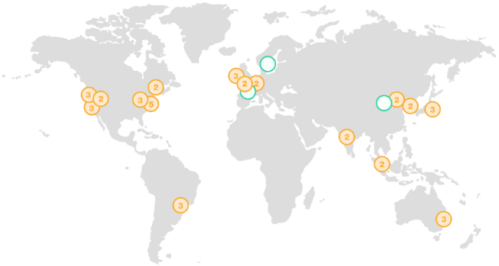
AWS Regions
AZ
Transit
Mesh of Availability Zones (AZ) and Transit Centers
Redundant paths to transit centers
Transit centers connect to:
Private links to other AWS regions
Private links to customers
Internet through peering & paid transit
AZs <2ms apart & usually <1ms
AZ
AZ
AZ
AZ
Transit
Notes:
Many customers moving from on premise to AWS are trying to compare AWS regions and Azs to traditional data centers or to similar terms of other cloud providers.
Region benefits:
Global access
Workloads closer to customer.
Important notes:
Regions are not the same as data centers.

Slide 9
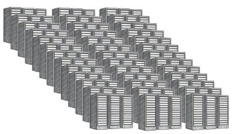
AWS Availability Zones
AZ
Transit
AZ
AZ
AZ
AZ
Transit
Regional cluster of discrete DCs
Separate redundant power, networking, connectivity and facility
All regions have 2 or more AZs
Each AZ is 1 or more DC
No data center is in two AZs
Some AZs have as many as 6 DCs
DCs in AZ less than ¼ ms apart
Data Center
Data Center
Data Center
Data Center
Notes:
Important points:
AZ is the closest construct to a data center. However they would consist of more than one data center,
NB notes:
HA through multi AZ
Far enough apart to protect against failure
Close enough together to mitigate latency issues
OpenShift infrastructure nodes such as the master and etcd should exist in more than one AZ
Recommended design 3 or more master nodes spread over three azs

Slide 10
Elasticity
Scaling – vertically or horizontally.
Pay as you use.
Notes:
Many customers moving from on premise to AWS are trying to compare AWS regions and Azs to traditional data centers or to similar terms of other cloud providers.
Region benefits:
Global access
Workloads closer to customer.
Important notes:
Regions are not the same as data centers.

Slide 11
Security
Compliance
Roll based access control
Guard rails
Integrations with AWS security services
Trusted Platform
Image Signing
Secrets management
Notes:
Many customers moving from on premise to AWS are trying to compare AWS regions and Azs to traditional data centers or to similar terms of other cloud providers.
Region benefits:
Global access
Workloads closer to customer.
Important notes:
Regions are not the same as data centers.

Slide 12
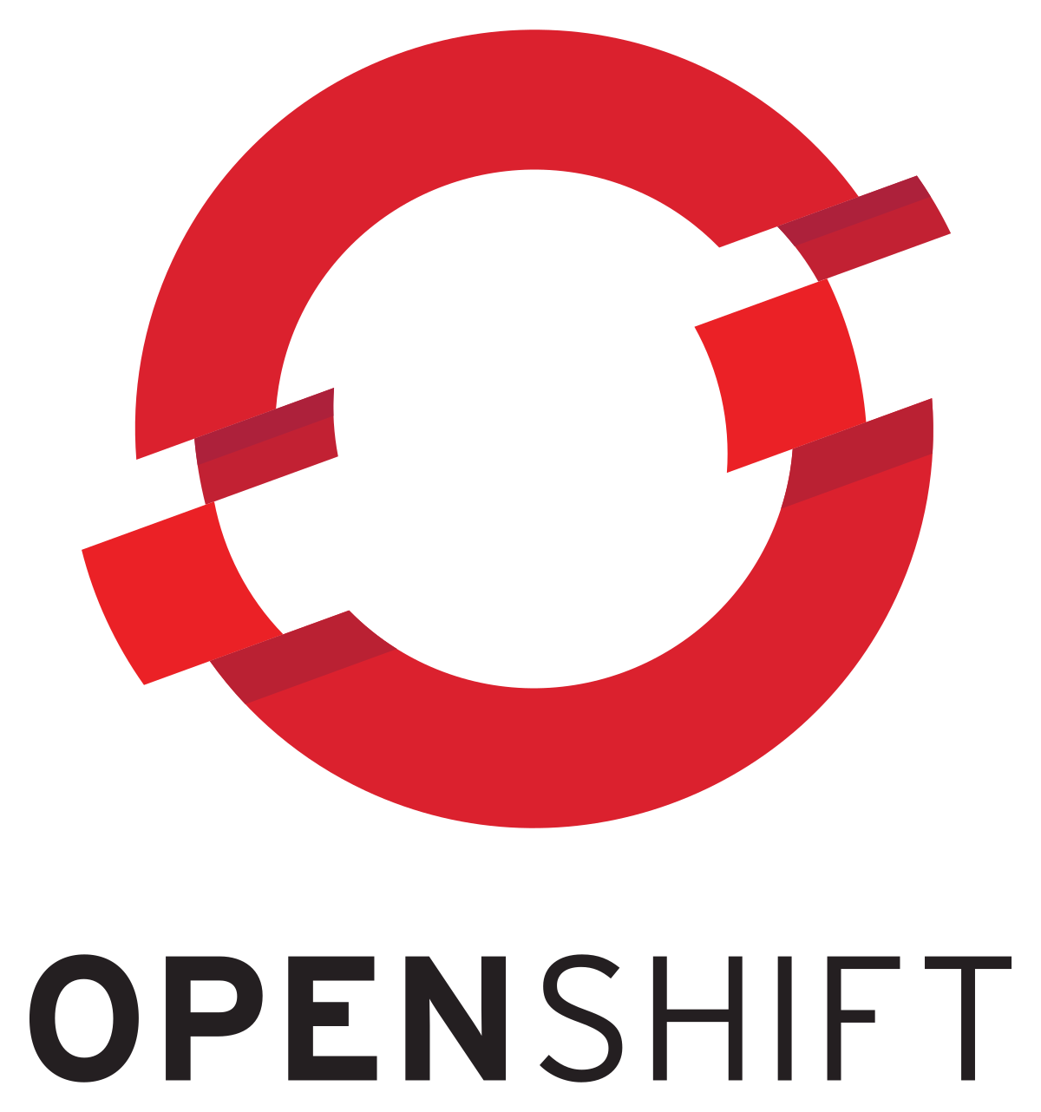

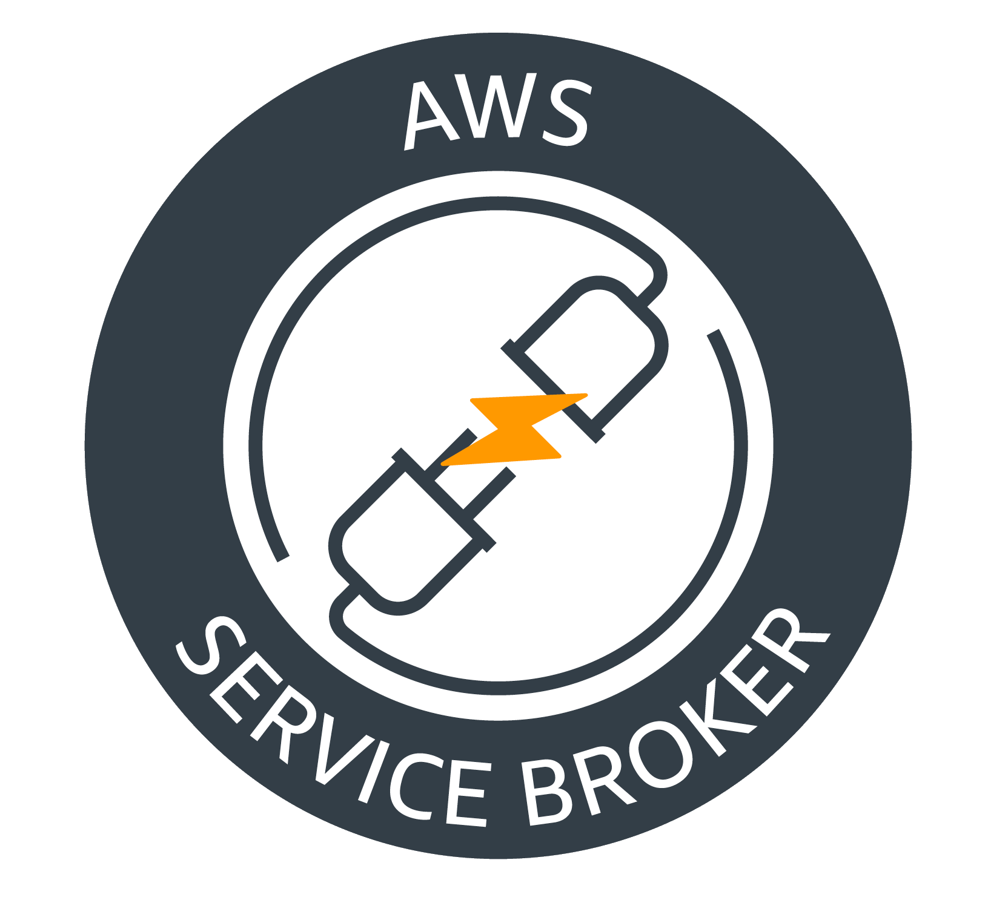


AWS Service Broker
Application
Catalog/Marketplace
Create
Provision
CreateStack
Create AWS Services
Application Created
Complete
CREATE_COMPLETE
AWS CloudFormation
Bind Service
Bind
DescribeStack/GetParameter
AWS CloudFormation
Secret
Bind Credentials
Connection Information
Application Platform
AWS KMS
AWS cloud
https://github.com/awslabs/aws-servicebroker/

Slide 13
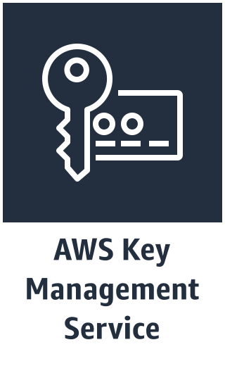
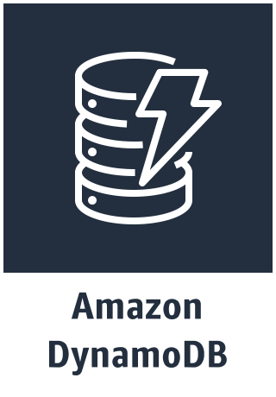
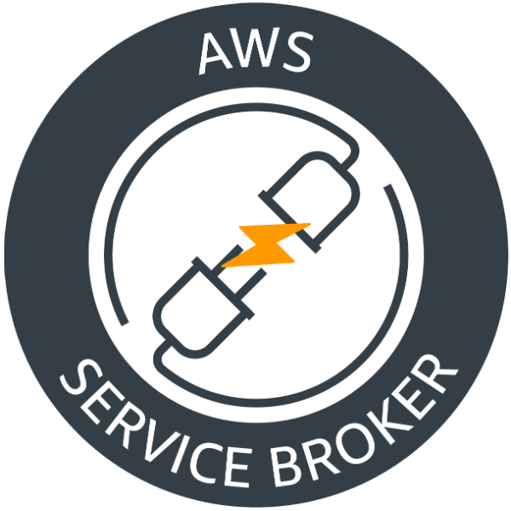
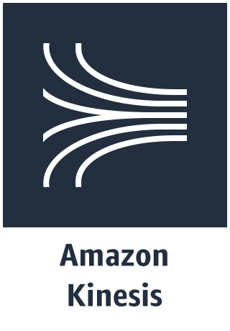
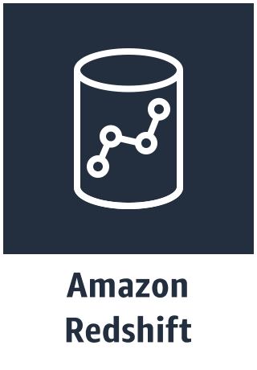
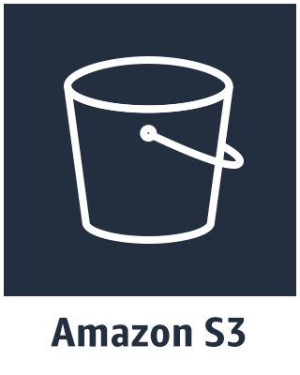
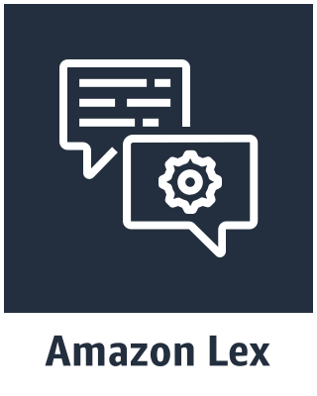
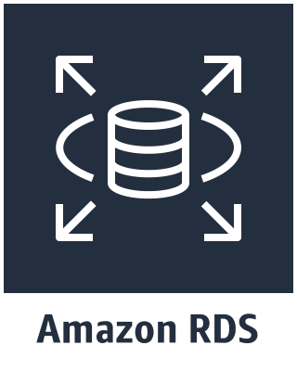
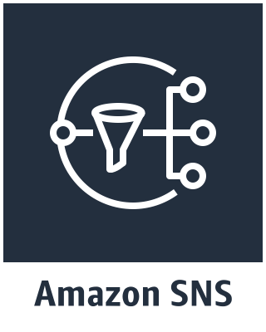
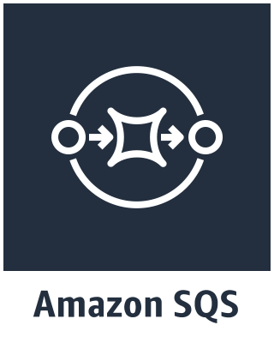
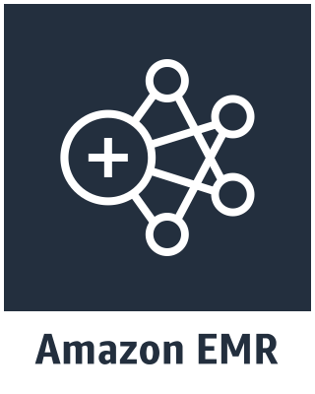
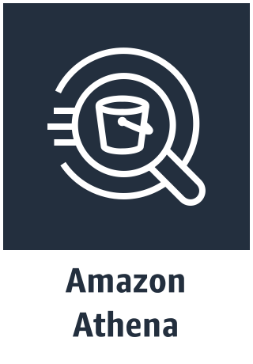
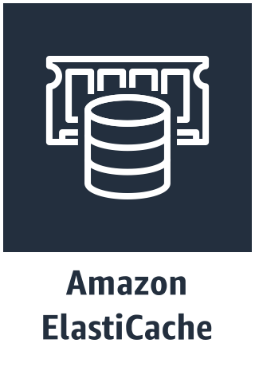
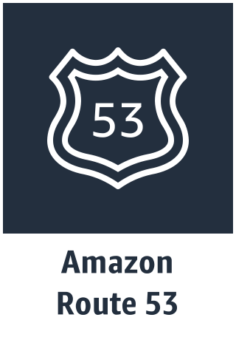
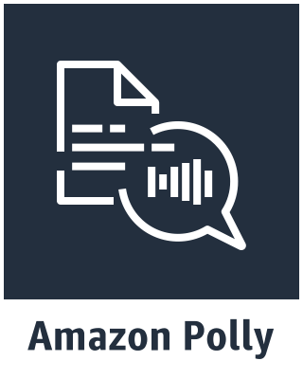
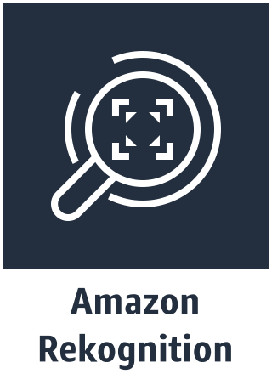
Notes:
Red Hat and AWS working
Provision and expose AWS services from within OpenShift.
Bind services to applications
Securely store connection details within OpenShift Secrets.
Accelerating the adoption of AWS services and allowing teams to modernize applications taking advantage of highly available scalable native AWS services.

Slide 14
Lab: Getting started
Immersion.openshift.awsworkshop.io
Notes:
Immersion.openshift.awsworkshop.io
Basic setup
Connecting to the lab env.
Building out pre reqs for later labs.

Slide 15
Lab: Deploy containers to Openshift
Immersion.openshift.awsworkshop.io
Notes:
Immersion.openshift.awsworkshop.io
Creating OpenShift templates
Deploying container workloads onto OpenShift

Slide 16
Lab: AWS Service Broker.
Immersion.openshift.awsworkshop.io
Notes:
Immersion.openshift.awsworkshop.io
Install and configure the AWS service broker
Deploy AWS SQS and sample app
Bind the service and application.

Slide 17
Lab: Modernize you application with AWS Services.
Immersion.openshift.awsworkshop.io
Notes:
Immersion.openshift.awsworkshop.io
Install and configure the AWS service broker
Deploy AWS SQS and sample app
Bind the service and application.

Slide 18
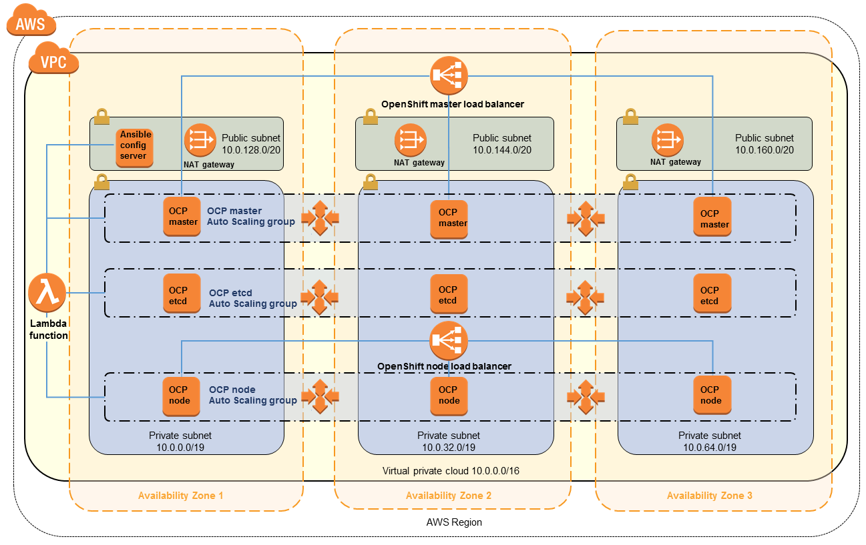
AWS Quick Start.

Slide 19
OpenShift on AWS POC / Assessment
Ensure stakeholder alignment
Avoid the stress of false starts
Enablement with best practices for using OpenShift and AWS
Integration experience with a vast array of DevOps tools
Performed by Red Hat and AWS Certified DevOps professionals

Slide 20


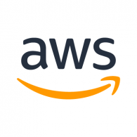
OPENSHIFT POC PROGRAM
Interested in running a POC with OCP deployed on AWS? Amazon is providing funding for qualified OpenShift customers.
Contact jmanasi@amazon.com for more information
Notes:
AWS and Red Hat helping customers to get into POC and move from POC to PROD.

Slide 21

What is OpenShift Dedicated?
High availability, multi-AZ OpenShift clusters on AWS
Deploy clusters into our AWS accounts or bring your own
Fully managed and supported by Red Hat, 24x7, with 99.5% uptime SLA
Deployment configuration based on the OpenShift Reference Architecture on AWS

Slide 22
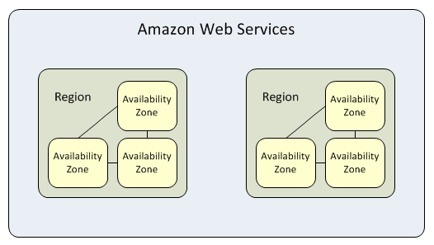

Multi-AZ stretched clusters
Feature: New cluster deployment across 3 availability zones (AZs)
Description: Maximize single cluster availability by distributing both the control plane and application nodes across 3 AZs.
How it Works:
Existing single-AZ customers will be given opportunity to move their apps to newly created multi-AZ cluster.
Note: Single-AZ clusters cannot be migrated to multi-AZ stretched clusters. Compute nodes must be added in 3’s. 3 node per AZ minimum.

Slide 23
Bring your own cloud account
Feature: Deploy OSD to customer-owned AWS account.
Description: By deploying to a customer-owned AWS account, the customer can leverage existing discounts and security profiles with AWS and self-service network configuration.
How it Works:
OSD can be deployed into an AWS account that will is part of a customer’s AWS Organization.
Note: The customer will own the account and pay Amazon directly for AWS services they consume.

Slide 24








AWS Cloud
Root Account
Customer
Account
Customer
Account
OSD
Account
OSD EC2 instances
Bastion host
Customer-admin-role
admin-role
Red Hat SRE
admin-role
AWS IAM
SSO

Slide 25
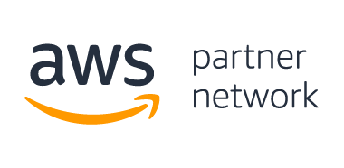
Better together

