Slide 1
OpenShift on AWS

Slide 2
WE NEED MORE THAN JUST CONTAINERS
Scheduling Decide where to deploy containers
Security Control who can do what
Lifecycle and health Keep containers running despite failures
Scaling
Scale containers up and down
Discovery Find other containers on the network
Persistence
Survive data beyond container lifecycle
Monitoring Visibility into running containers
Aggregation
Compose apps from multiple containers
Notes:
Though containers are popular there is not a large production adoption within the production space.
This is due to containers be difficult, to mange at scale.
How do you run a container workload across multiple hosts, how to scale up and down, how to heath check and monitor , how to manage networking and storage.
Parts of these are catered for by an orchestration layer such as Kubernetes.
Yes it is possible to address some of these by implementing and integrating either 3rd partly or AWS native services such as code commit, code pipeline , code build, EKS.
OpenShift however further extends on this offering further business integrations.

Slide 3
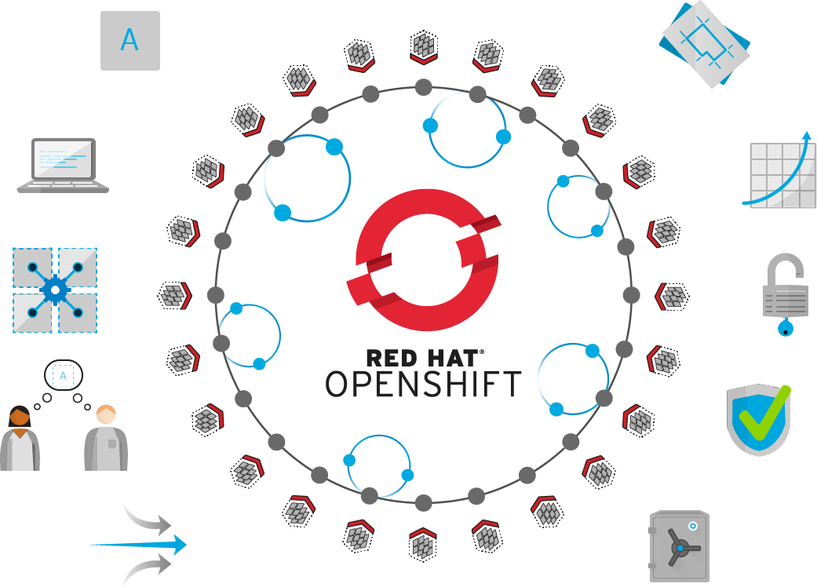
Self-Service
Standards-based
Multi-language
Web-scale
Automation
Open Source
Collaboration
Enterprise Grade
Multi-tenant
Secure
Notes:
Open Shift caters for all the functions within a traditional orchestration layer but extends upon this adding ent business functions which add value to devs, opps, sec and C level teams.

Slide 4
DIY COMPARISON
Category | DIY (Docker + Kubernetes) | OpenShift
Cluster Infrastructure | Requires third-party solutions for networking, registry, multi-tenancy, log management, container metrics | Industry-standard Kubernetes for orchestrating linux docker containers
Registry | Requires third-party solutions | Built-in Atomic Registry
Application lifecycle and services | Requires third-party solutions | Rich portfolio of JBoss middleware, databases, language runtimes and more. Built-in CI/CD support including Jenkins master/slave and plugins
Operational management | Requires third-party solutions | Provisioning via Ansible and ops management via CloudForms for provisioning, utilization, capacity management, chargeback, policy management, alerts, self-service and more
Security | Requires third-party solutions | RHEL security/patches, SELinux isolation, image scanning, encryption, unprivileged containers, secret management, role-based access control and granular control over container operations
Notes:
In order to deploy a container on your infrastructure, you need to answer a few question first:
Where do you store the container image so it is accessible to your hosts?
Which container should get deployed on which host?
Which host has more capacity?
How to monitor container health? What do you do if they have crashed?
How to scale them up?

Slide 5








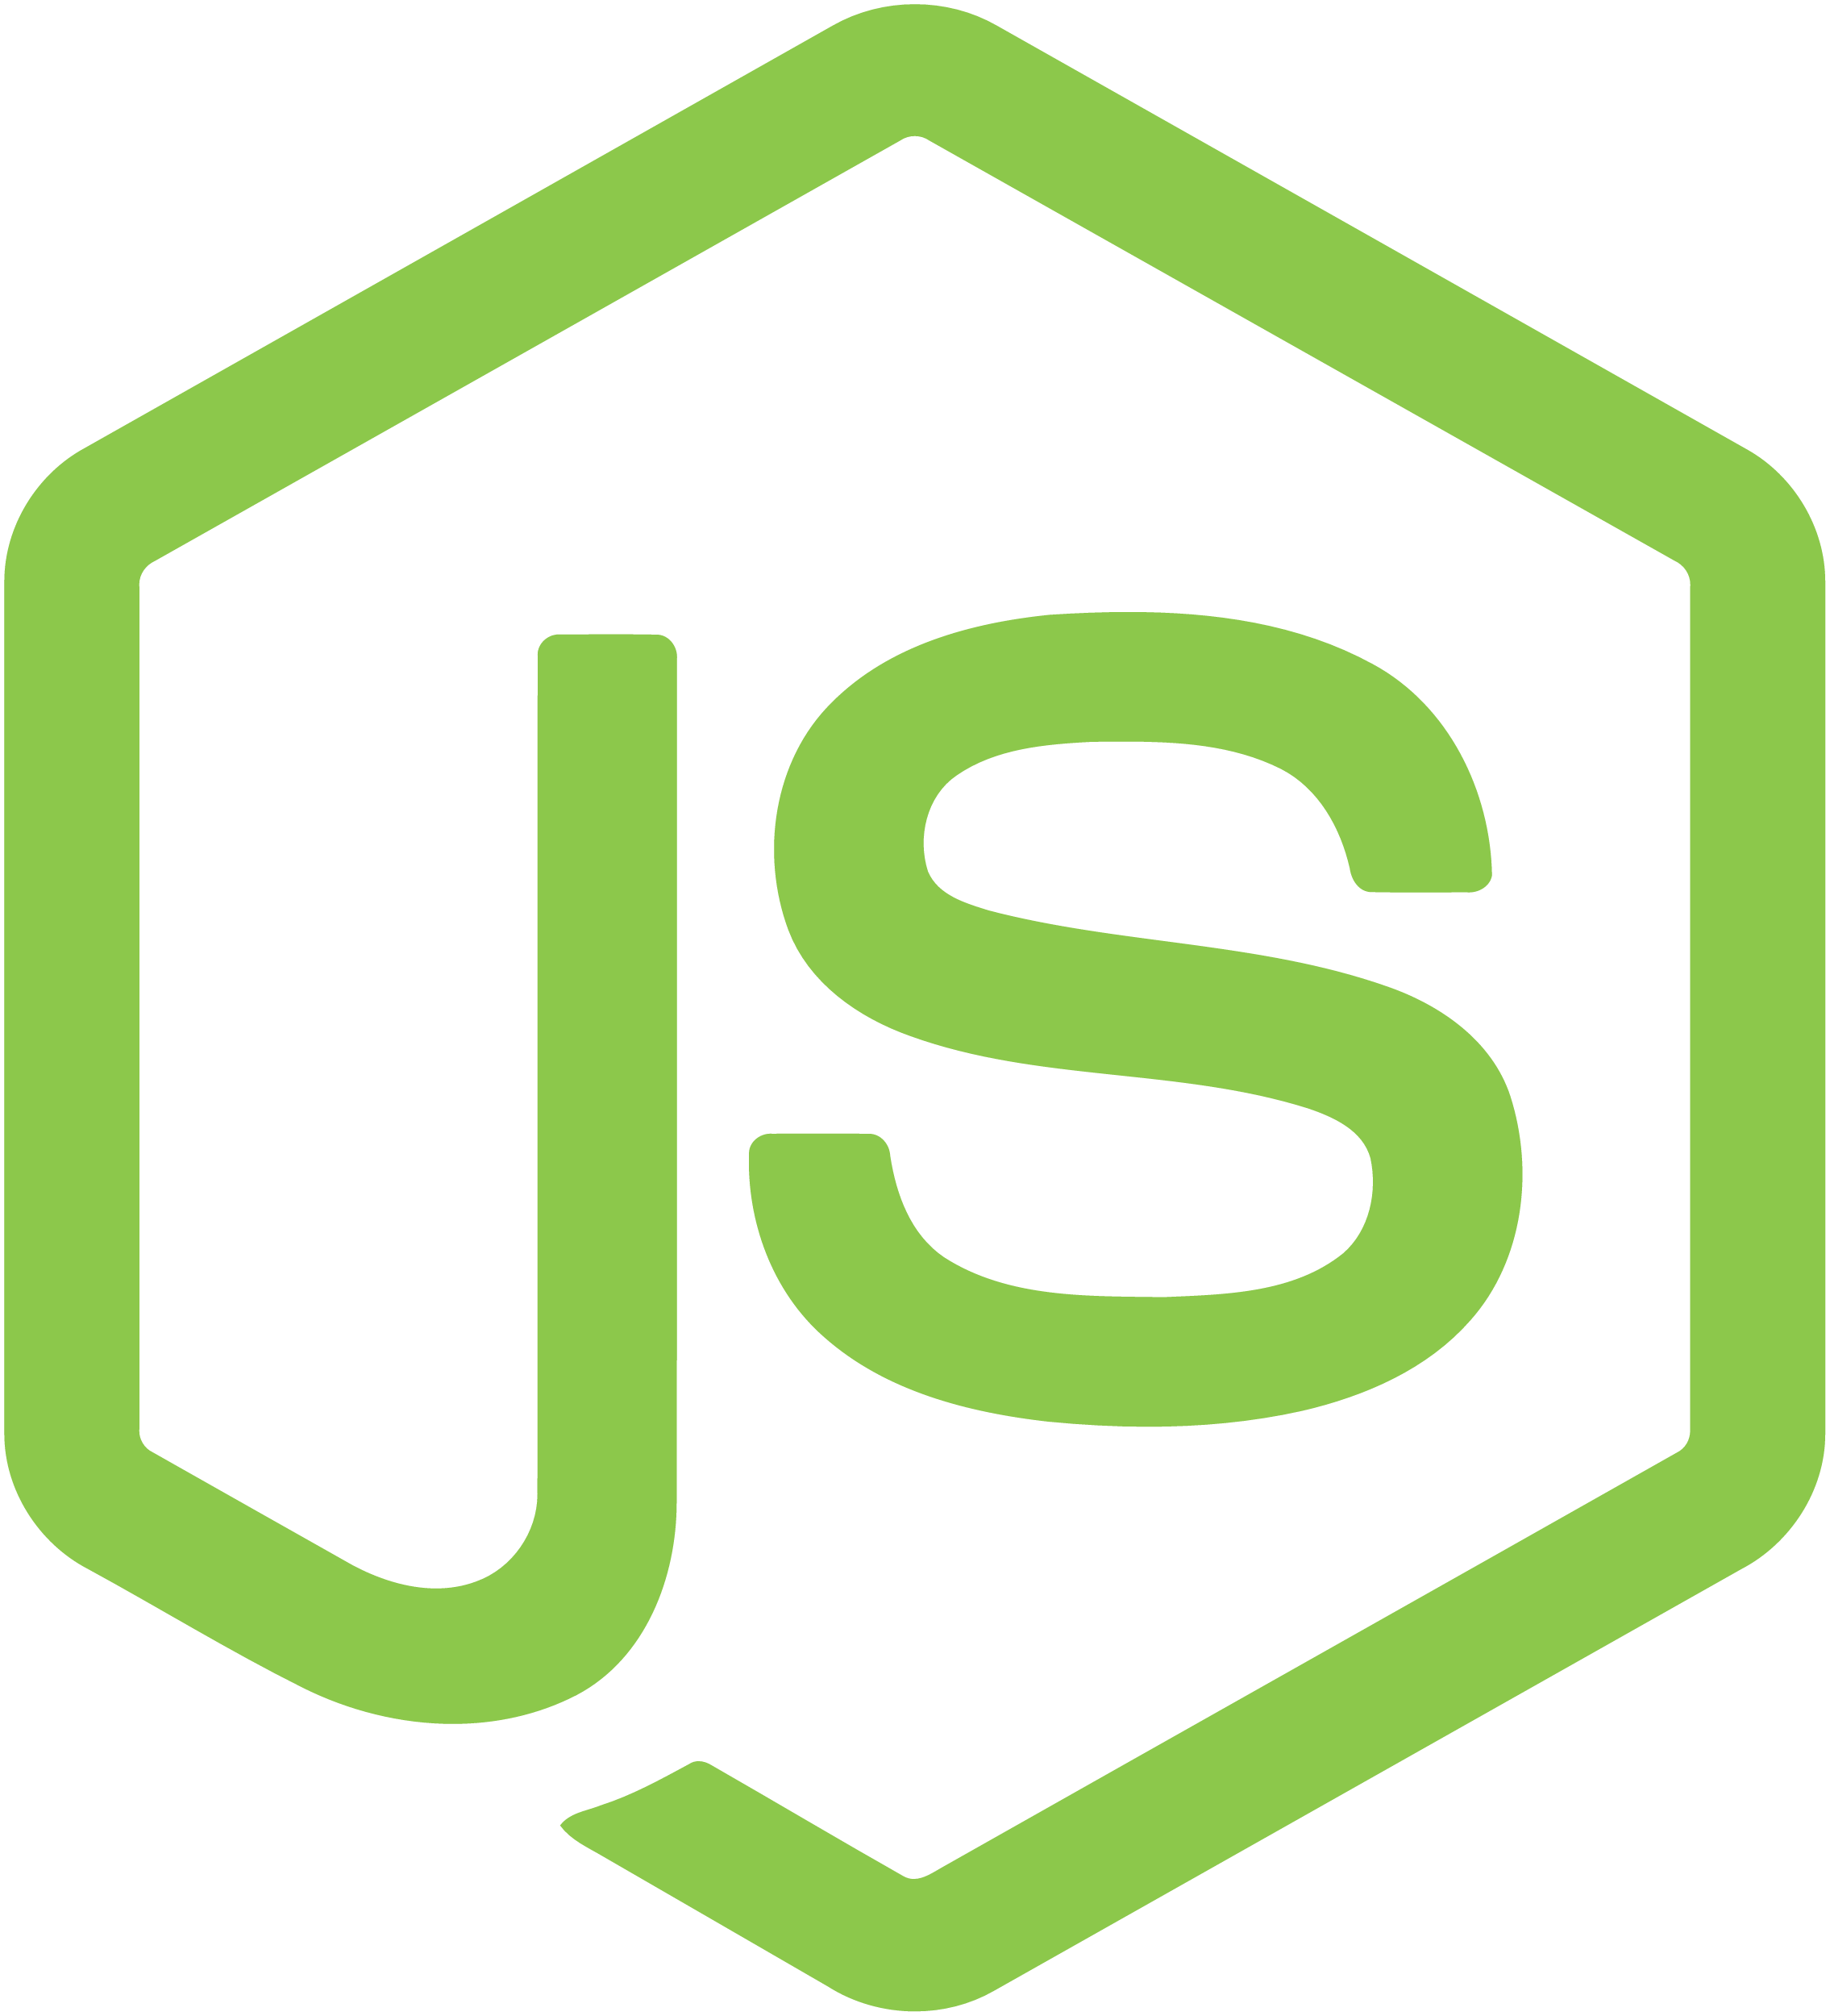


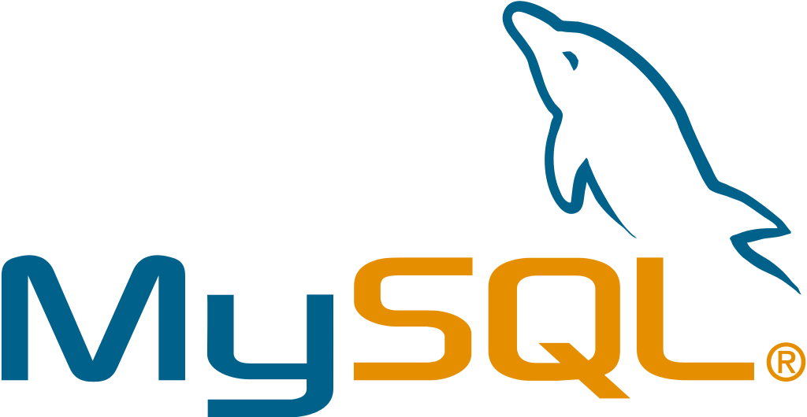







ACCESS VIA WEB, CLI, IDE AND API
ROUTING LAYER
SERVICE LAYER
RED HAT
ENTERPRISE LINUX
NODE
NODE
NODE
PERSISTENT
STORAGE
SCM
(GIT)
MASTER
C
C
API/AUTHENTICATION
c
CI/CD
C
C
C
DATA STORE
RHEL
RHEL
RHEL
SCHEDULER
NODE
NODE
NODE
REGISTRY
EXISTING AUTOMATION TOOLSETS
HEALTH/SCALING
C
C
C
C
C
RHEL
RHEL
RHEL
PHYSICAL
VIRTUAL
PRIVATE
PUBLIC
HYBRID
Notes:
Speaker:
* OpenShift has two types of systems. The first are called nodes.
* Nodes are instances of RHEL 7 or RHEL Atomic with the OpenShift software installed.
* Ultimately, Nodes are where end-user applications are run.
Discussion:
* The Nodes are what the Masters will orchestrate - you will learn about Masters shortly.
* Nodes are just instances of RHEL or Atomic.
* OpenShift’s node daemon and other software runs on a node.
Speaker:
* Application instances and application components run in linux containers. Linux container technologies are lightweight mechanisms for isolating running processes so that they are limited to interacting with only their designated resources. Many application instances can be running in containers on a single host without visibility into each others' processes, files, network, and so on.
* Containers in OpenShift are based on Docker-formatted container images. An image is a binary that includes all of the requirements for running a single container. Container images can be thought of as a packaging technology.
* Each OpenShift Node can run many containers
* A Pod is one or more containers deployed together as if they were deployed on one host and encapsulates storage resources and a unique network IP. Pod is the smallest unit that can be defined, deployed, and managed in OpenShift. A Pod might consist of either a single container or a small number of containers that are tightly coupled and that share resources.
Transcript:
OpenShift can use any native Docker image, and schedules and runs containers in a unit called a Pod. While Pods can have multiple containers, generally a Pod should provide a single function, like an app server, as opposed to multiple functions, like a database and an app server. This allows for individual application components to be easily scaled horizontally.
Speaker:
* The other type of OpenShift system is the Master
* Masters keep and understand the state of the environment and orchestrate all activities on the Nodes
* Masters are also instances of RHEL or Atomic, and multiple masters can be used in an environment for high availability
* Masters can be treated like any nodes and have apps deployed on them. However it is recommended to dedicate Masters to management processes and mark them as non-schedulable for application containers.
* Masters have four primary jobs or functions
Discussion:
* The OpenShift Master is the orchestrator of the entire OpenShift environment.
* The OpenShift Master knows about and maintains state within the OpenShift environment.
* Just like Nodes, Masters run on RHEL or Atomic
* You will discuss the four primary functions of the Master in the next slides
Transcript:
Just like Nodes, the OpenShift Master is installed on RHEL or Atomic. The Master is the orchestration and scheduling engine for OpenShift, and is responsible for knowing and maintaining the state of the OpenShift environment. The Master has four primary functions which you will now describe.
Speaker:
* The Master provides the single API that all tooling and systems interact with. Everything must go through this API.
* All API requests are SSL-encrypted and authenticated. Authorizations are handled via fine-grained role-based access control (RBAC)
* The Master can be tied into external identity management systems, from LDAP and AD to OAuth providers like GitHub and Google
Discussion:
* All requests go through the Master’s API
* The Master evaluates requests for both AuthentacioN (AuthN - you are who you say you are) and AuthoriZation (AuthZ - you’re allowed to do what you requested)
* The Master can be tied into external identity management systems like LDAP/AD, OAuth, and more
* Apache modules can also be used for authentication in front of the API
Transcript:
The Master is the gateway to the OpenShift environment. All requests must go through the Master and must be both authenticated and authorized. A wide array of external identity management systems can be the source of authentication information in an OpenShift environment.
Speaker:
* The desired and current state of the OpenShift environment is held in the data store which includes all objects such as builds, deployments, services, routes, etc
* The data store uses etcd, a distributed key-value store and stores the persistent master state while other components watch etcd for changes to bring themselves into the desired state.
* Other things like the RBAC rules, application environment information, and non-application-user-data are kept in the data store
Discussion:
* etcd holds information about the desired and current state of OpenShift
* Additionally, user account info, RBAC rules, environment variables, secrets, and many other bits of OpenShift information are held in the data store
* More generally, any OpenShift data object is stored in etcd
Transcript:
Etcd is another of the critical components of the OpenShift architecture. It is the distributed key-value data store for state and other information within the OpenShift environment. Reads and writes of information generally are going to hit the data store.
A container registry is a service for storing and retrieving Docker-formatted container images. A registry contains a collection of one or more image repositories.
OpenShift Container Platform provides its own internal registry for managing container images.
Red Hat also provides a registry at registry.access.redhat.com for subscribers which is called Red Hat Container Catalog
OpenShift can deploy images from the integrated image registry as well as Red Hat Container Catalog, Docker Hub and any other registry the customer might be using
OpenShift Container Platform registry can also be installed separately as a stand-alone container image registry.
Speaker:
* The scheduler portion of the Master is the specific component that is responsible for determining Pod placement
* The scheduler takes the current memory, CPU and other environment utilization into account when placing Pods on the various nodes
Discussion:
* The scheduler is responsible for Pod placement
* Current CPU, Memory and other environment utilization is considered during the scheduling process
Transcript:
The OpenShift scheduler uses a combination of configuration and environment state to determine the best fit for running Pods across the Nodes in the environment.
Speaker:
* The real-world topology of the OpenShift deployment (regions, zones, and etc) is used to inform the configuration of the scheduler
* Administrators can configure complex scenarios for scheduling workloads
Discussion:
* The scheduler is configured with a simple JSON file in combination with node labels to carve up the OpenShift environment to make it look like the real world topology
Transcript:
The topology of the real-world environment is used by platform administrators to determine how to configure the scheduler and the Node labels.
Speaker:
* The Master is responsible for monitoring the number of pods and automatically scaling them as desired
* Pods can be manually scaled stating the number of pods that should be running
* Pods can also be autoscaled based on metrics collected from the pods (cpu utilization) within the boundary of minimum and maximum number of pods that is configured for the autoscaler
Speaker:
* OpenShift’s service layer enables application components to easily communicate with one another
* The service layer provides for internal load balancing as well as discovery and code reusability
Discussion:
* The service layer is used to connect application components together
* OpenShift automatically injects some service information into running containers to provide for ease of discovery
* Services provide for simple internal load balancing across application components
Transcript:
OpenShift’s service layer is how application components communicate with one another. A front-end web service would connect to database instances by communicating with the database service. OpenShift would automatically handle load balancing across the database instances. Service information is injected into running containers and provides for ease of application
Speaker:
* Applications are only as useful as the data they can manipulate.
* Docker containers are natively ephemeral - data is not saved when containers are restarted or created.
* OpenShift provides a persistent storage subsystem that will automatically connect real-world storage to the right Pods, allowing for stateful applications to be used on the platform.
* A wide array of persistent storage types are usable, from raw devices (iSCSI, FC) to enterprise storage (NFS) to cloud-type options (Gluster/Ceph, EBS, pDisk, etc)
Transcript:
OpenShift’s persistent volume system allows end users to consume a wide array of storage types to enable stateful applications to be run on the platform. Whether OpenShift is running locally in the datacenter or in the cloud, there are storage options that can be used.
Discussion:
* OpenShift’s persistent volume system automatically connects storage to Pods
* The persistent volume system allows stateful apps to be used on the platform
* OpenShift provides flexibility in the types of storage that Pods can consume
Speaker:
* Not every consumer of applications exists inside the OpenShift platform. External clients need to be able to access things running inside OpenShift
* The routing layer is a close partner to the service layer, providing automated load balancing to Pods for external clients
* The routing layer is pluggable and extensible if a hardware or non-OpenShift software router is desired
Transcript:
OpenShift’s routing layer provides access for external clients to reach applications running on the platform. The routing layer runs in Pods inside OpenShift, and features similar load balancing and auto-routing around unhealthy Pods as the Service layer.
Discussion:
* The OpenShift router runs in pods on the platform itself, but receives traffic from the outside world and proxies it to the right pods
* The router uses the service endpoint information to determine where to load balance traffic, but it does not send traffic through the service layer
* The router is built with HAProxy, but is a pluggable solution. Red Hat currently supports F5 integration as another option.

Slide 6

OpenShift and AWS better together.
Elasticity
Agility
Availability
$
Faster Time to Market
Infrastructure cost investment
Security
Notes:
Elasticity:
Agility:
Availability:
Faster time to market:
Being able to manage a hybrid experience through openshift, allows application teams ready to move to the cloud to start this journey and not be hindered by other teams. Other teams can evolve and move at a later stage when ready. The unified dev exp allows for a consistent experience irrespective of where the workload is to be run.
Security:
AWS security and compliance footprint combined with the security benefits of OpenShift provide a aggregate security foot print attractive to fin institutions, Airlines, health care as well as public sector.
Reduced cost:
AWS: pay for what you use, reduced CAPX and OPEX, further. Ability to reduce cost through RI and Spot instance. Comprehension cost monitoring options.
Partner network:
AWS and Red Hat better together approach. Best success stories are those where the customer has taken advantage of this partnership.

Slide 7
Availability
AWS Regions.
Availability Zones.
Auto Healing.
Monitoring.
Auditing and Management.
Notes:
Running OpenShift on AWS customers can take advantage of the native AWS availability offering.

Slide 8
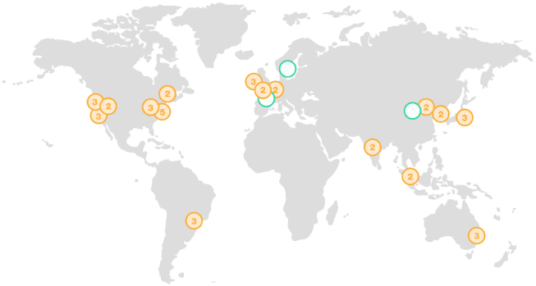
AWS Regions
AZ
Transit
Mesh of Availability Zones (AZ) and Transit Centers
Redundant paths to transit centers
Transit centers connect to:
Private links to other AWS regions
Private links to customers
Internet through peering & paid transit
AZs <2ms apart & usually <1ms
AZ
AZ
AZ
AZ
Transit
Notes:
Many customers moving from on premise to AWS are trying to compare AWS regions and Azs to traditional data centers or to similar terms of other cloud providers.
Region benefits:
Global access
Workloads closer to customer.
Important notes:
Regions are not the same as data centers.

Slide 9
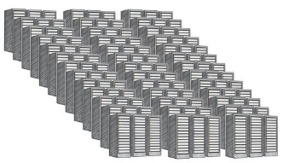
AWS Availability Zones
AZ
Transit
AZ
AZ
AZ
AZ
Transit
Regional cluster of discrete DCs
Separate redundant power, networking, connectivity and facility
All regions have 2 or more AZs
Each AZ is 1 or more DC
No data center is in two AZs
Some AZs have as many as 6 DCs
DCs in AZ less than ¼ ms apart
Data Center
Data Center
Data Center
Data Center
Notes:
Important points:
AZ is the closest construct to a data center. However they would consist of more than one data center,
NB notes:
HA through multi AZ
Far enough apart to protect against failure
Close enough together to mitigate latency issues
OpenShift infrastructure nodes such as the master and etcd should exist in more than one AZ
Recommended design 3 or more master nodes spread over three azs

Slide 10
Elasticity
Scaling – vertically or horizontally.
Pay as you use.
Notes:
Running OpenShift on AWS offers the ability to scale out as desired with out concern for infrastructure CAPX.
EC2 and autoscaling allows for dynamic scaling.
Autoscaling launch config can be configured to boot strap OCP software and register with the cluster.
The Launch config can also make use of Spot instance for bring your own subscription RHEL.

Slide 11
Security
Compliance
Roll based access control
Guard rails
Integrations with AWS security services
Trusted Platform
Image Signing
Secrets management
Notes:
Compliance:
For customers looking to meet compliance requirements AWS has a rich list of certifications.
This is why many ent customers in fin, health care, air line, public sector are running their workloads on AWS.
Red Hat OpenShift caters for auditing and monitoring and control mechanisms which further compliment meeting compliance requirements.
Role Based access control and integration with directory services such as MS AD allow for simple access control and integration with current business security and access control process.
Guard rails:
Customers are looking for guidance on how to implement security practice, what to configure where.
Openshift implements these practices so customers have a guided approach:
Roll based access control.
Trusted OS platform,
Ways to manage access credentials through a build in secret store.
Build in container image repo
Build on top of Selinux which protects against containers running in a root context and exposing the underlying container hosts.
AWS have a rich set of security solutions which can be used to further extend the security posture while on AWS:
AWS config and config rules
AWS WAF
Cloud watch logs and Cloud Trail.
AWS Inspector.
All in all the combined security offering of AWS combined with OpenShift is the reason customers are selecting to use OpenShift and run on AWS as their preferred provider.

Slide 12
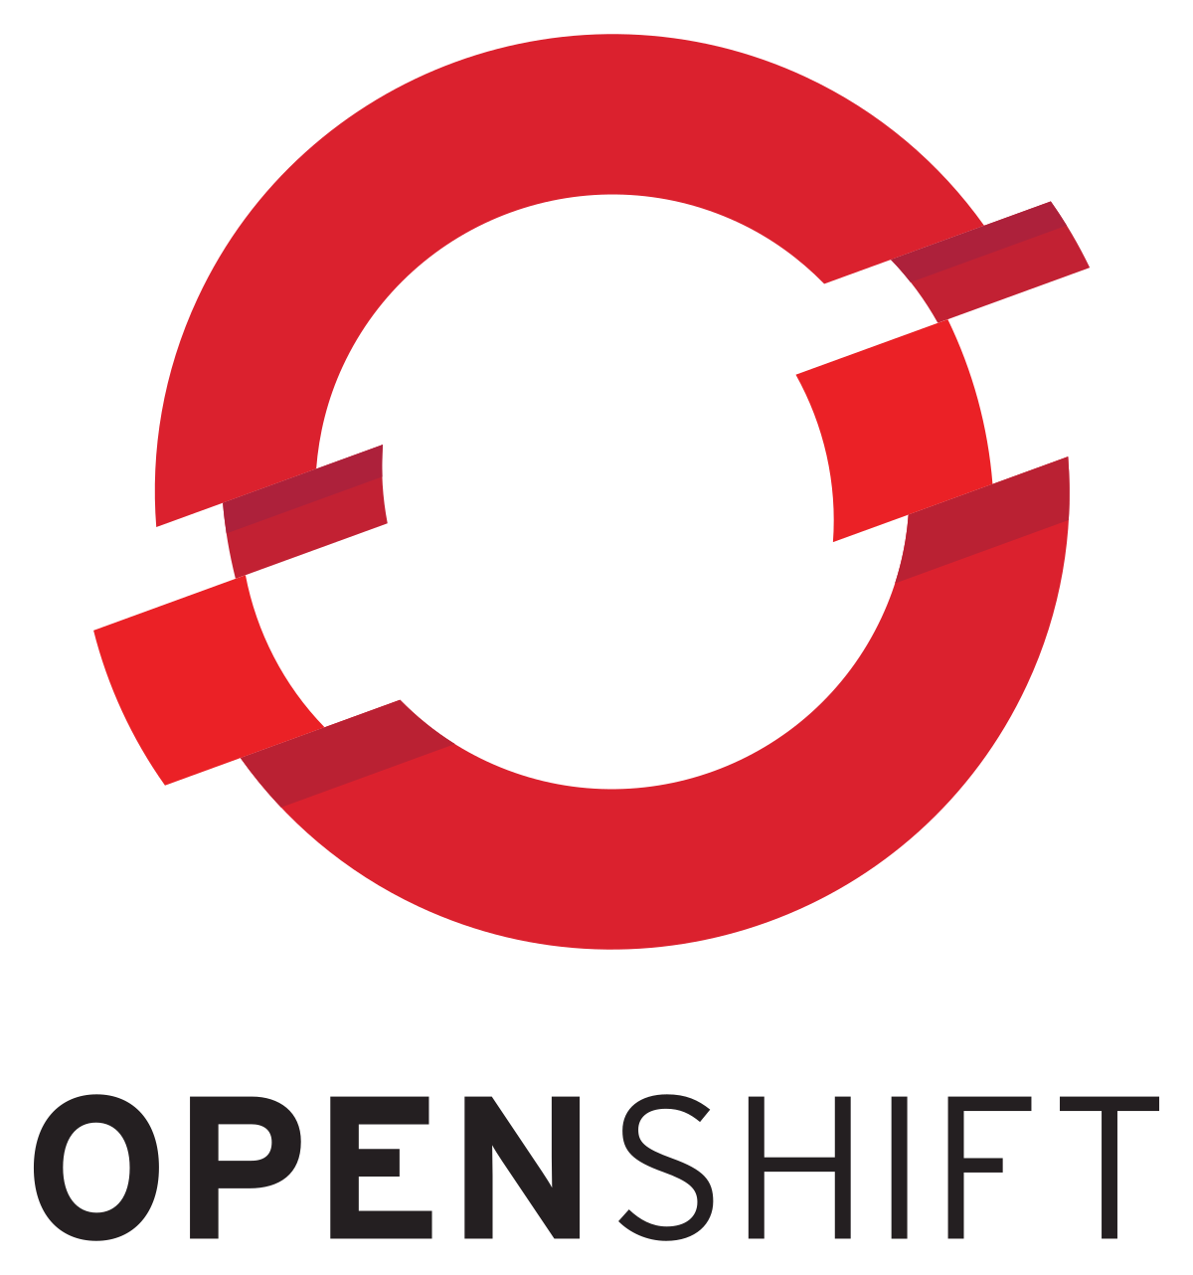

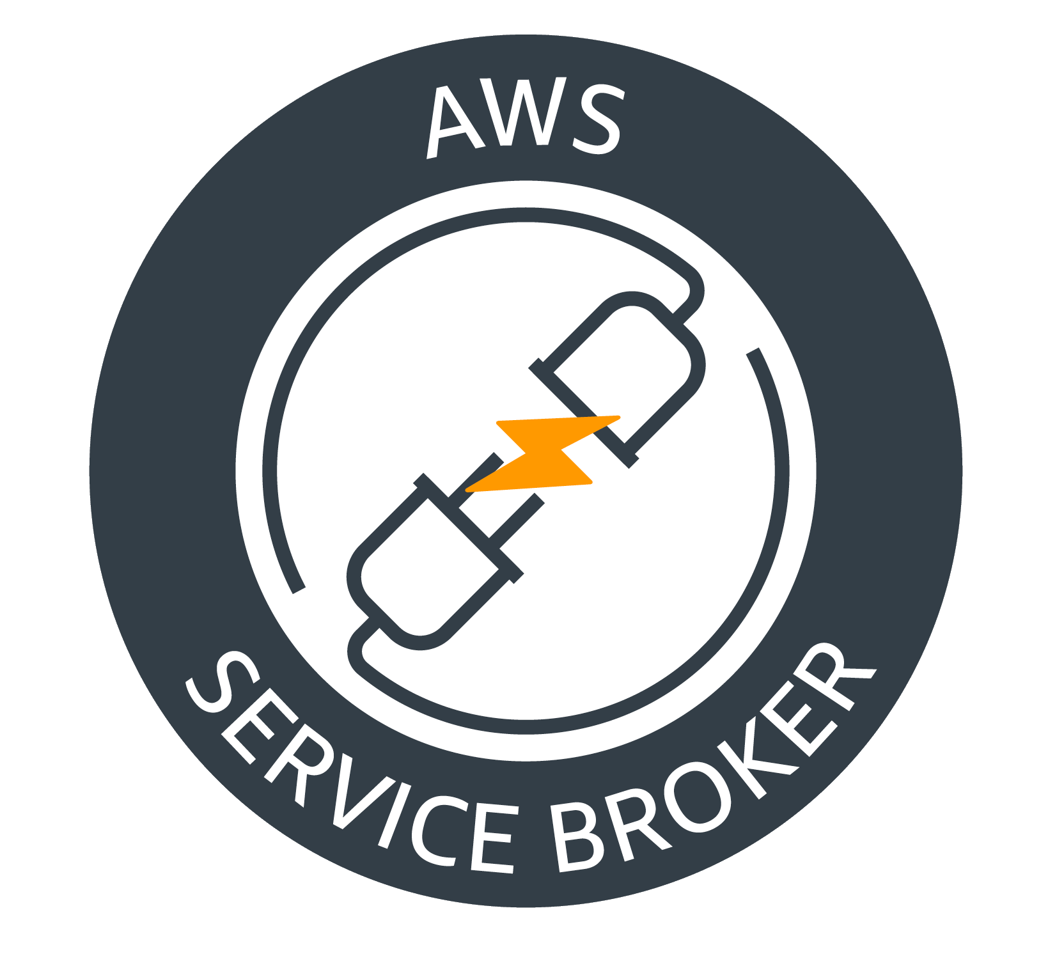
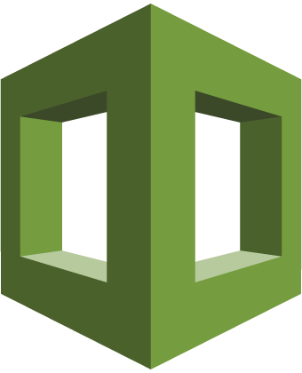

AWS Service Broker
APP PLATFORM
Application
Catalog/Marketplace
Create
Provision
CreateStack
Create AWS Services
Application Created
Complete
CREATE_COMPLETE
AWS CloudFormation
Bind Service
Bind
DescribeStack/GetParameter
AWS CloudFormation
Secret
Bind Credentials
Connection Information
Application Platform
AWS KMS
AWS cloud
Notes:
Hybrid customers select openshift as a means of managing application workloads both on prem and in the cloud via a unified and consistent experience.
Existing AWS customer adopting OpenShift have voiced concerns about losing the native AWS service ability.
Existing OpenShift customer new to AWS show concerns about how long it would take to ramp up on AWS services before their teams can start modernizing their applications through the adoption of native AWS services such as RDS, DynamoDB, SQS, SNS etc.
The AWS Service Broker addresses both these concerns.
The broker allows dev teams to provision and expose AWS services directly to application workloads with out needing to depend and wait on infrastrure, ops , cloud teams to build these out and then provide the dev team with connection details such as end point and creds.
Dev teams do not have to context or interface switch: No need for a dev to leave the dev env, go to the AWS console and provision an AWS service and then come back to the dev env and consume it.
The service broker makes use of cloudformation templates to build out the various AWS services.
Service plans cater for best practice recommended deployments: deploying RDS into prod assuming multi AZ will be used and data will be encrypted.
Customers can override the properties or even modify the CFN template for their use case.
Or use them as is for agile implementation of AWS services without having to become familiar with VPC and each property of the service.

Slide 13
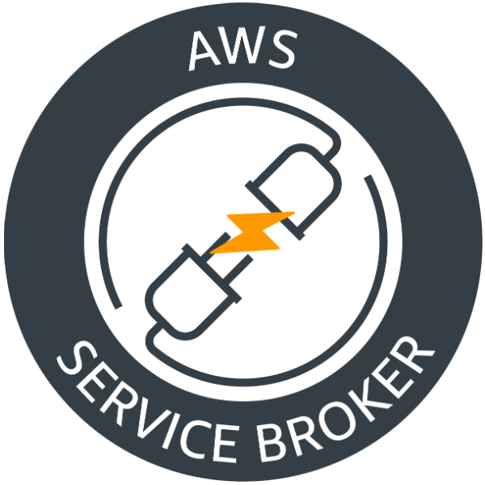


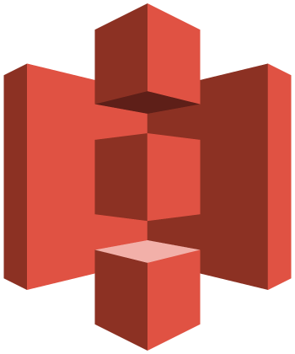
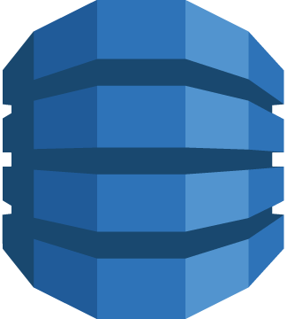
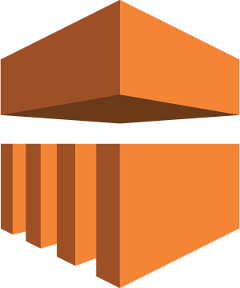

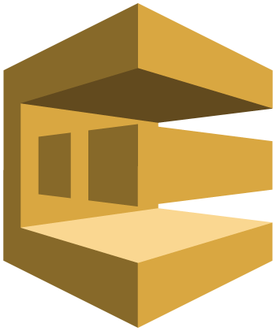



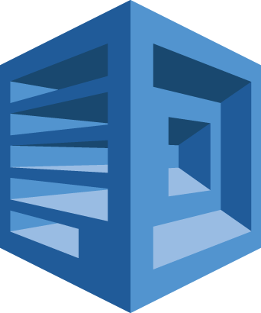
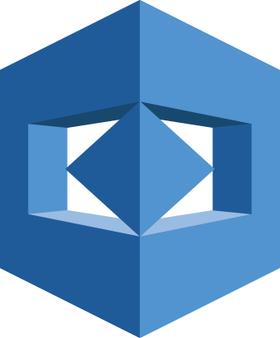

Amazon RDS
Postgres
Amazon RDS
MariaDB
AWS KMS
Amazon
Lex
Amazon S3
Amazon DynamoDB
Amazon EMR
Amazon Kinesis
Amazon SQS
Amazon SNS
Amazon Athena
Amazon Redshift
Amazon RDS
MySql
Amazon Route 53
Amazon
Polly
Amazon Rekognition
Notes:
18 services currently available via the AWS service broker:
With a cross section of networking storage database both relational and NoSQl, queing and messaging, and AIML services such as speech, text and object recognition.

Slide 14
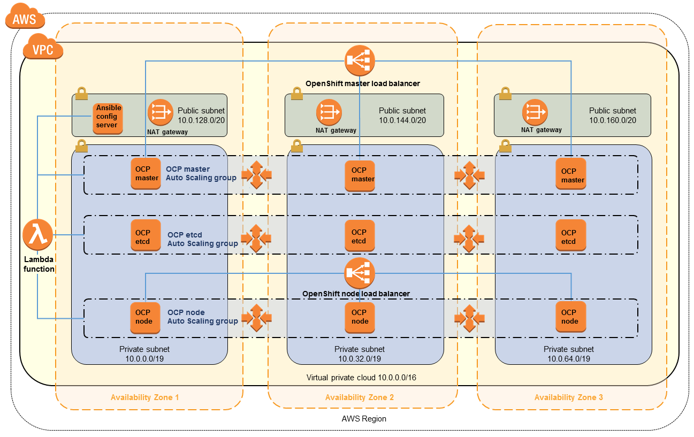
AWS Quick Start.
Notes:
Ref arch build be AWS and Red Hat, as recommended practice evolves this design is updated.
Build out scalable resilient openshift solution on AWS in 2 hours.
NOTE:
3 masters spread across 3 Azs
Master separate from ETCD, this is not a latency concern on AWS, these solutions scale very differently so having these as separate layers allows for easier management of scaling.
Database layer catered for by AWS managed RDS in multi AZ config.

Slide 15
Managing costs
Right sizing
Reserved instances
Bring your own subscription RHEL Spot.
Notes:
Infrastructure nodes are pervasive workloads – effective use of Right sizing to determine the ideal instance types for load and the buy RIs.
Spot instances can be used for application nodes.

Slide 16
Lab: Getting started
Immersion.openshift.awsworkshop.io
Notes:
Immersion.openshift.awsworkshop.io
Basic setup
Connecting to the lab env.
Building out pre reqs for later labs.

Slide 17
Lab: Deploy containers to Openshift
Immersion.openshift.awsworkshop.io
Notes:
Immersion.openshift.awsworkshop.io
Creating OpenShift templates
Deploying container workloads onto OpenShift

Slide 18
Lab: AWS Service Broker.
Immersion.openshift.awsworkshop.io
Notes:
Immersion.openshift.awsworkshop.io
Install and configure the AWS service broker
Deploy AWS SQS and sample app
Bind the service and application.

Slide 19


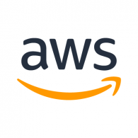
OPENSHIFT POC PROGRAM
Interested in running a POC with OCP deployed on AWS? Amazon is providing funding for qualified OpenShift customers.
Contact jmanasi@amazon.com for more information
19
Notes:
AWS and Red Hat helping customers to get into POC and move from POC to PROD.

Slide 20
Better together

