Slide 1
Bottom of Layer 2 Elevation Interpolation Options
7/30/20

Slide 2
Chosen interpolation

Slide 3
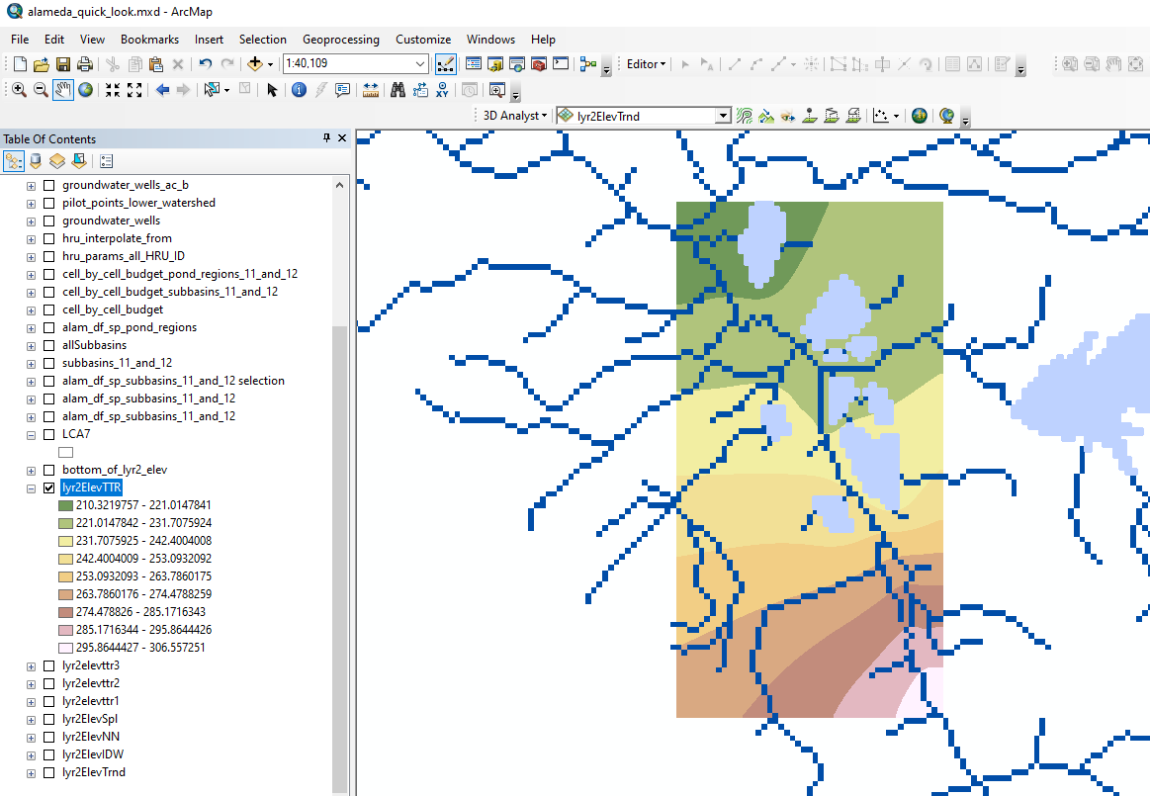
Topo to Raster Interpolation

Slide 4
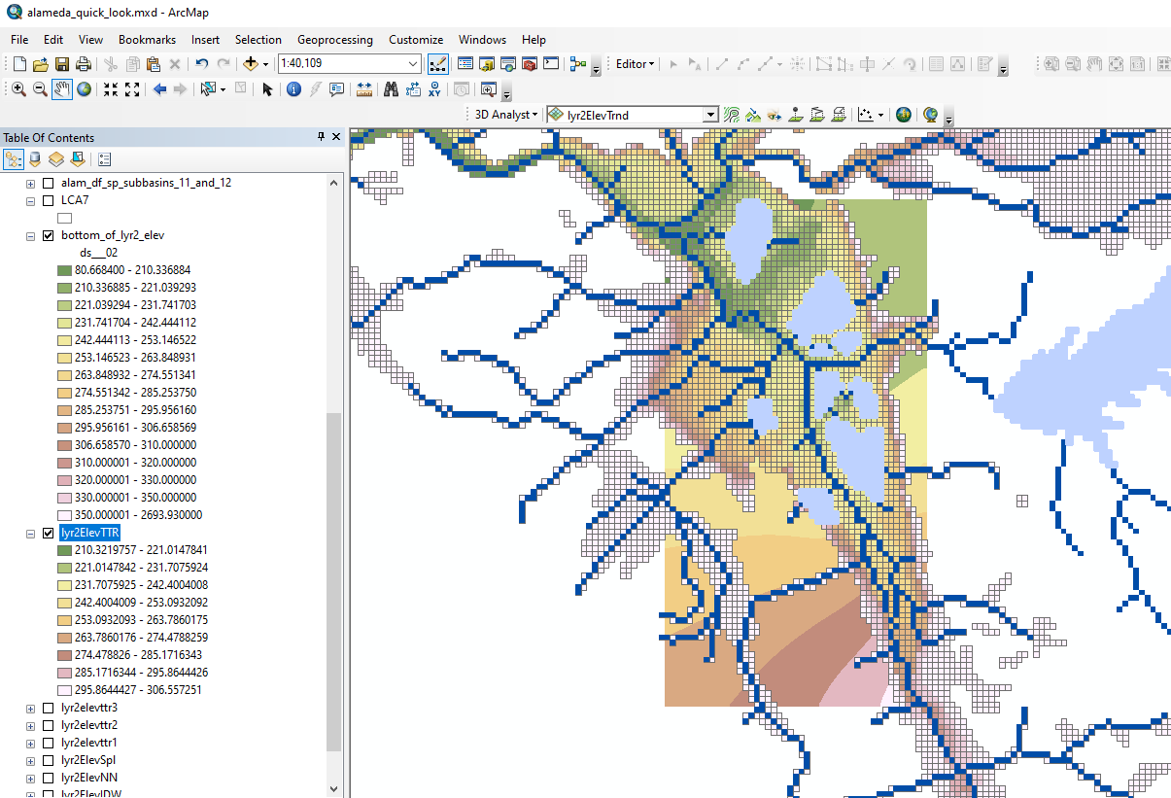
Topo to Raster Interpolation: comparison with current bottom of layer 2 elevations

Slide 5
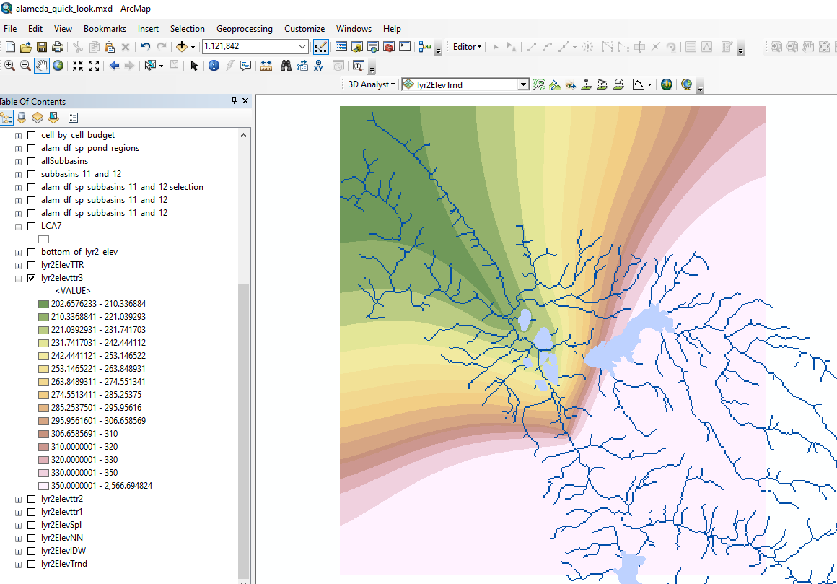
Topo to Raster Interpolation – with extrapolation throughout entire lower watershed

Slide 6
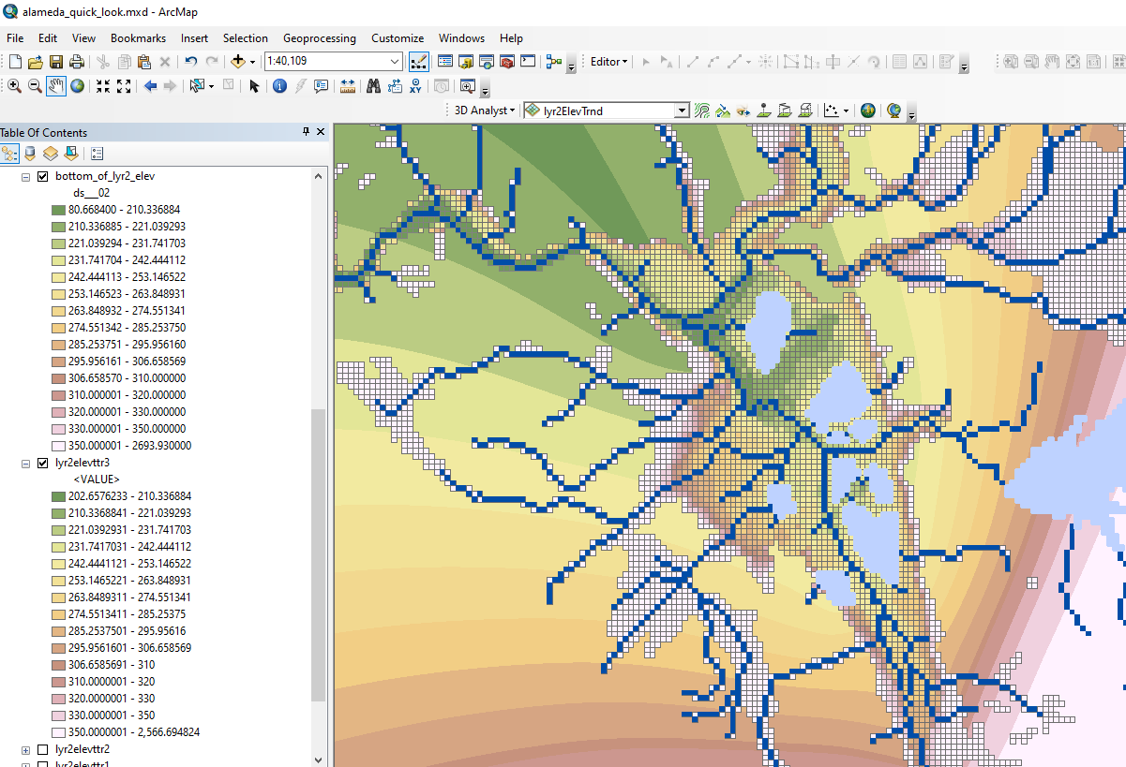
Topo to Raster Interpolation – with extrapolation throughout entire lower watershed: comparison with current bottom of layer 2 elevations

Slide 7
Other interpolations

Slide 8
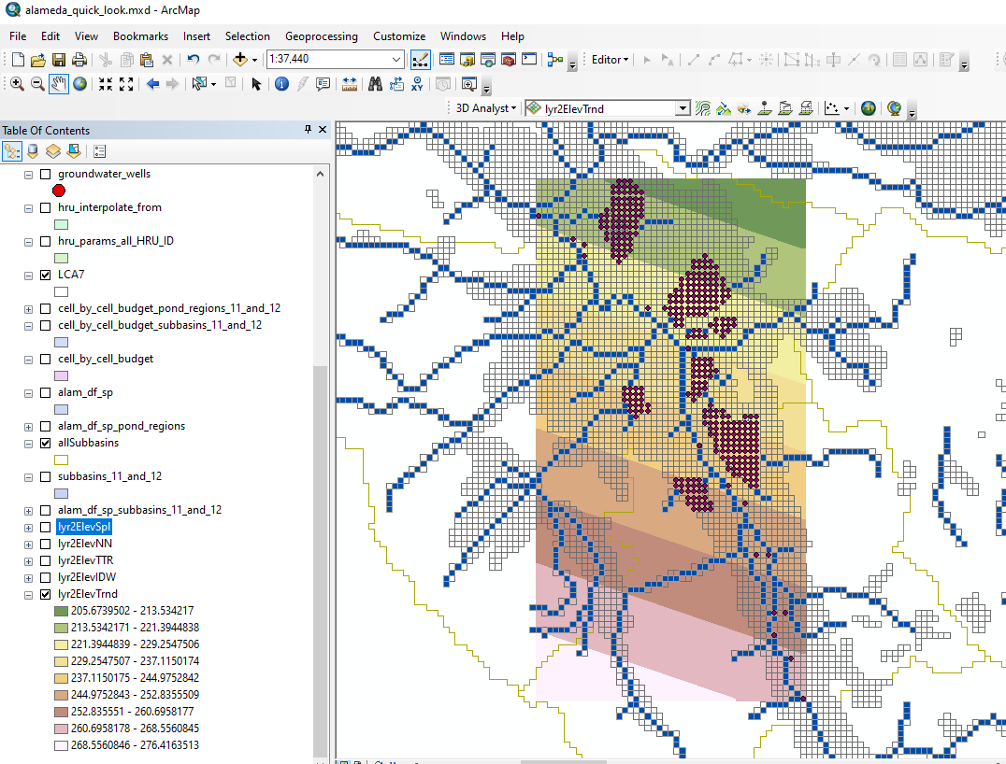
Linear Trend Interpolation

Slide 9
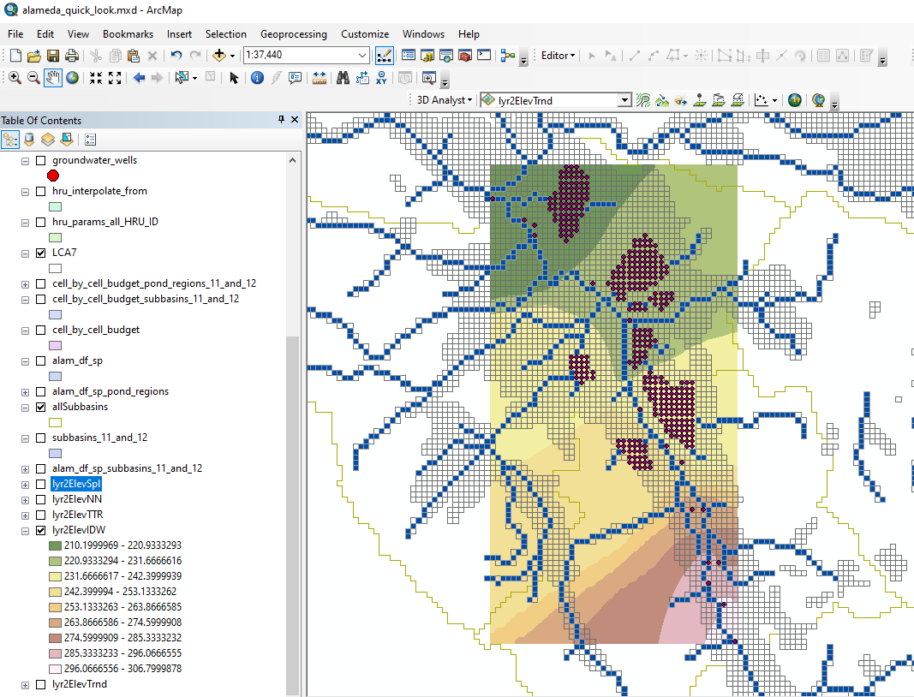
Inverse Distance Weighted Interpolation

Slide 10
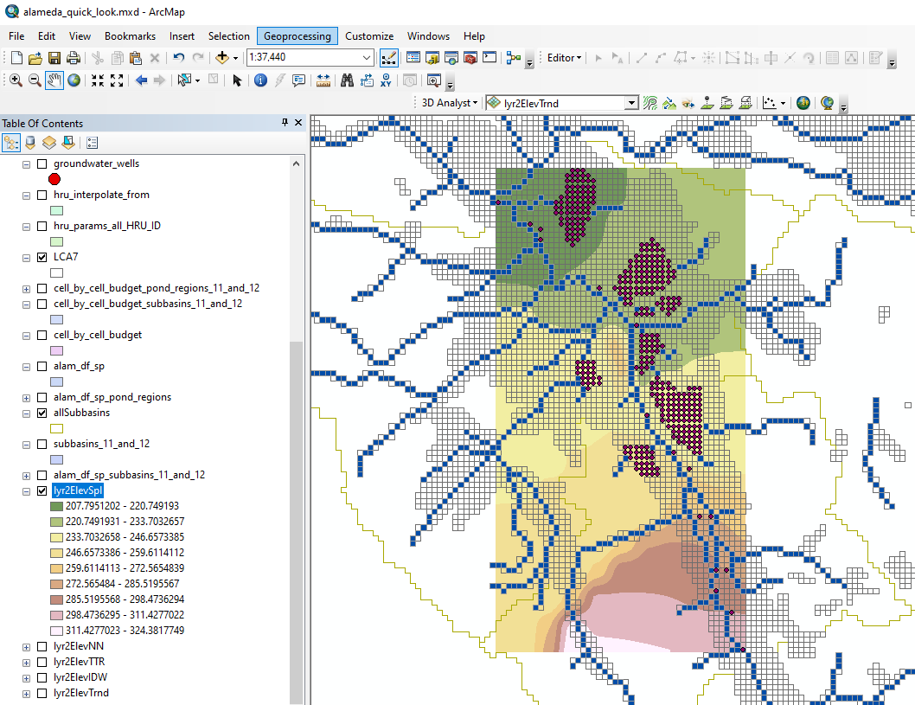
Spline Interpolation

Slide 11
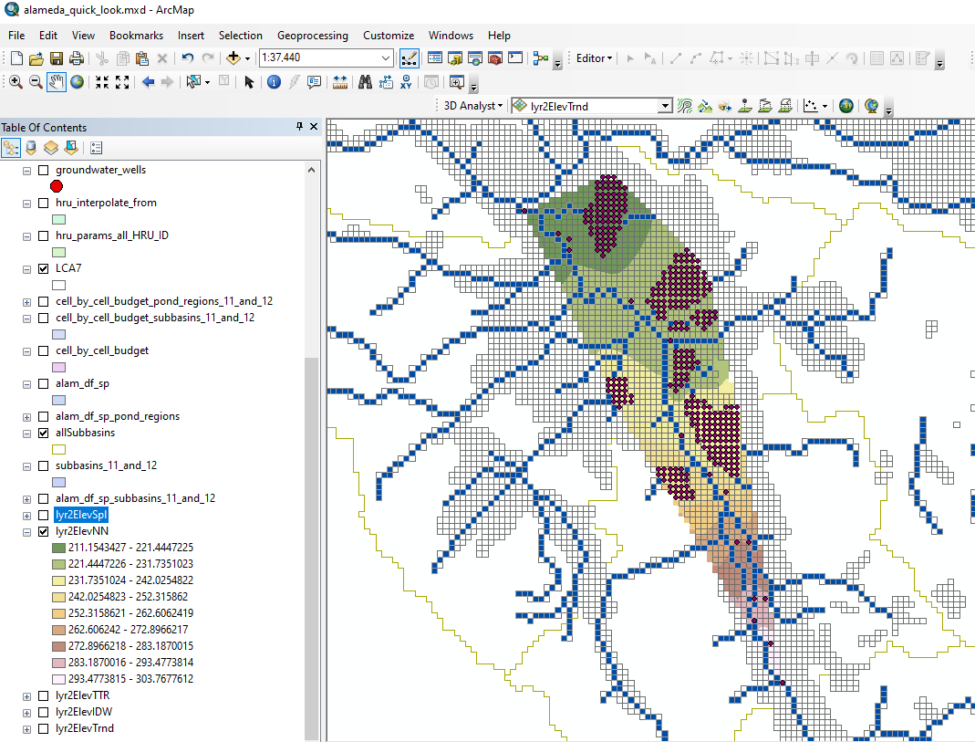
Natural Neighbor Interpolation

