Slide 1
Groundwater level vs. streamflow

Slide 2
A couple notes
There are two plots for each groundwater level – the top with streamflow vs. groundwater and the bottom with log(streamflow) vs. groundwater. I used the groundwater elevation from the log(streamflow) plot in my calculations.
Vertical red lines denote groundwater elevations that separate the connected and disconnected regions – based on a visual assessment
All groundwater levels were plotted against streamflow at the Alameda Creek below Welch Creek gauge to assess the groundwater “elevation of connection”. Groundwater data above/below this elevation were averaged to generate groundwater “disconnected averages”/“connected averages”.
[NOT SHOWN IN THESE SLIDES] After this, each lower watershed streamflow gauge was matched with the closest groundwater well. Streamflows from the dates on which the groundwater elevations were above/below the “elevation of connection” were used to calculate streamflow “connected averages”/“disconnected averages”.

Slide 3
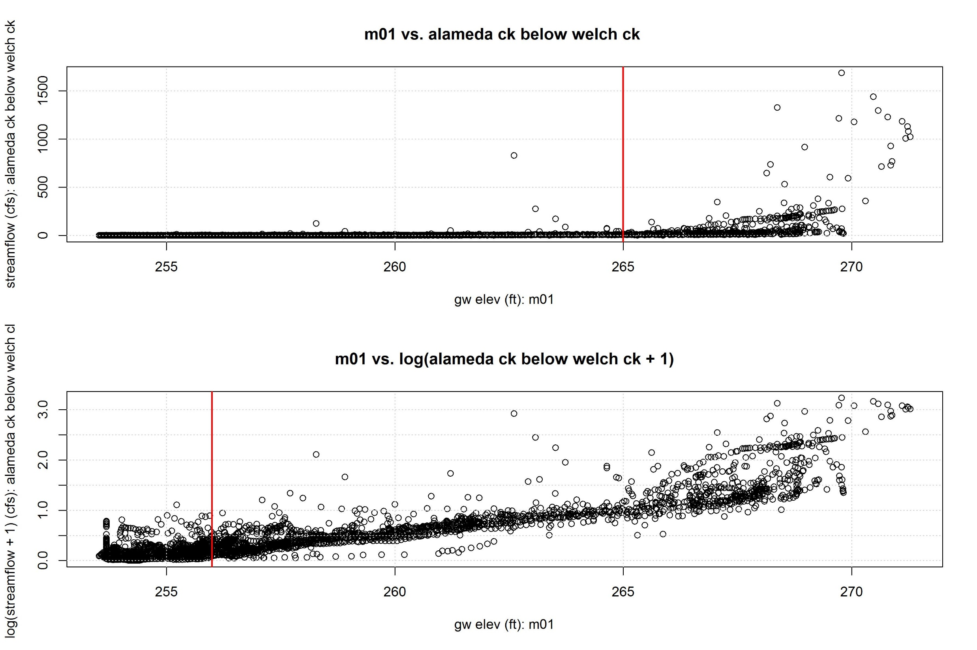

Slide 4
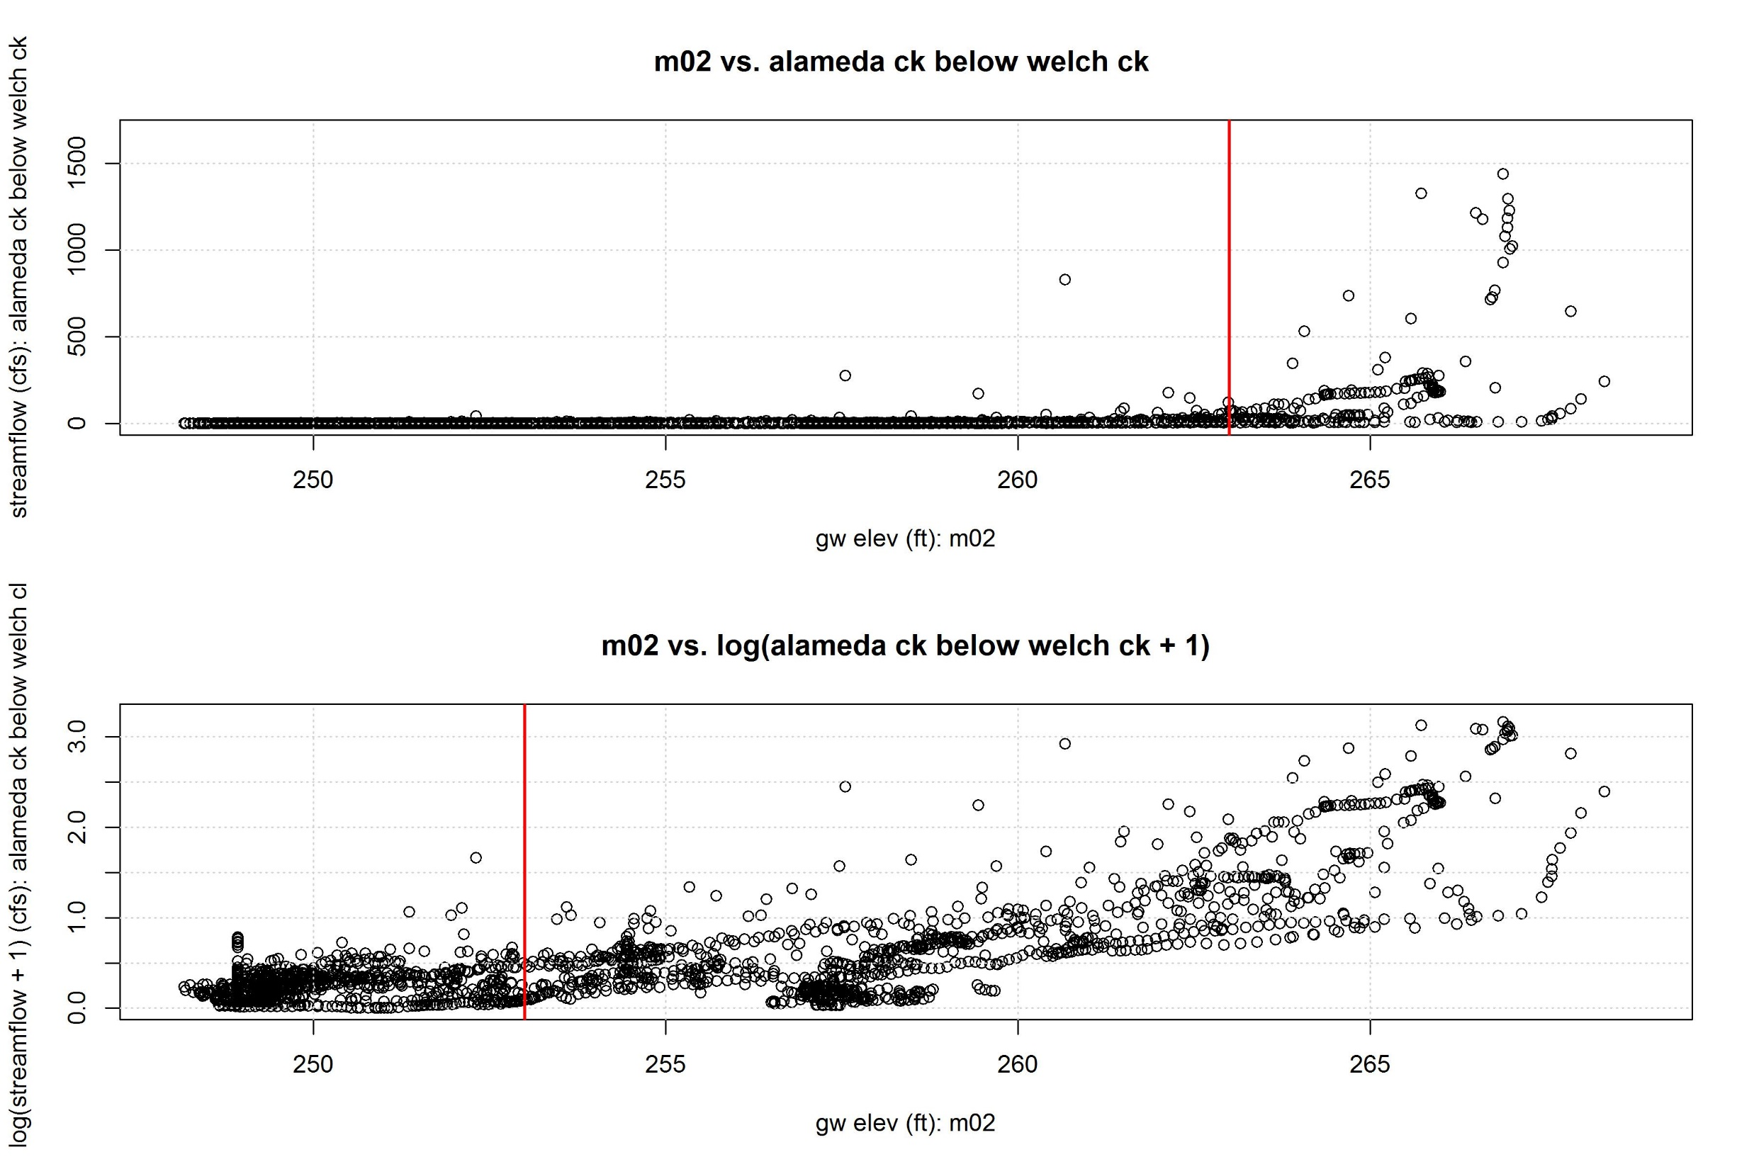

Slide 5
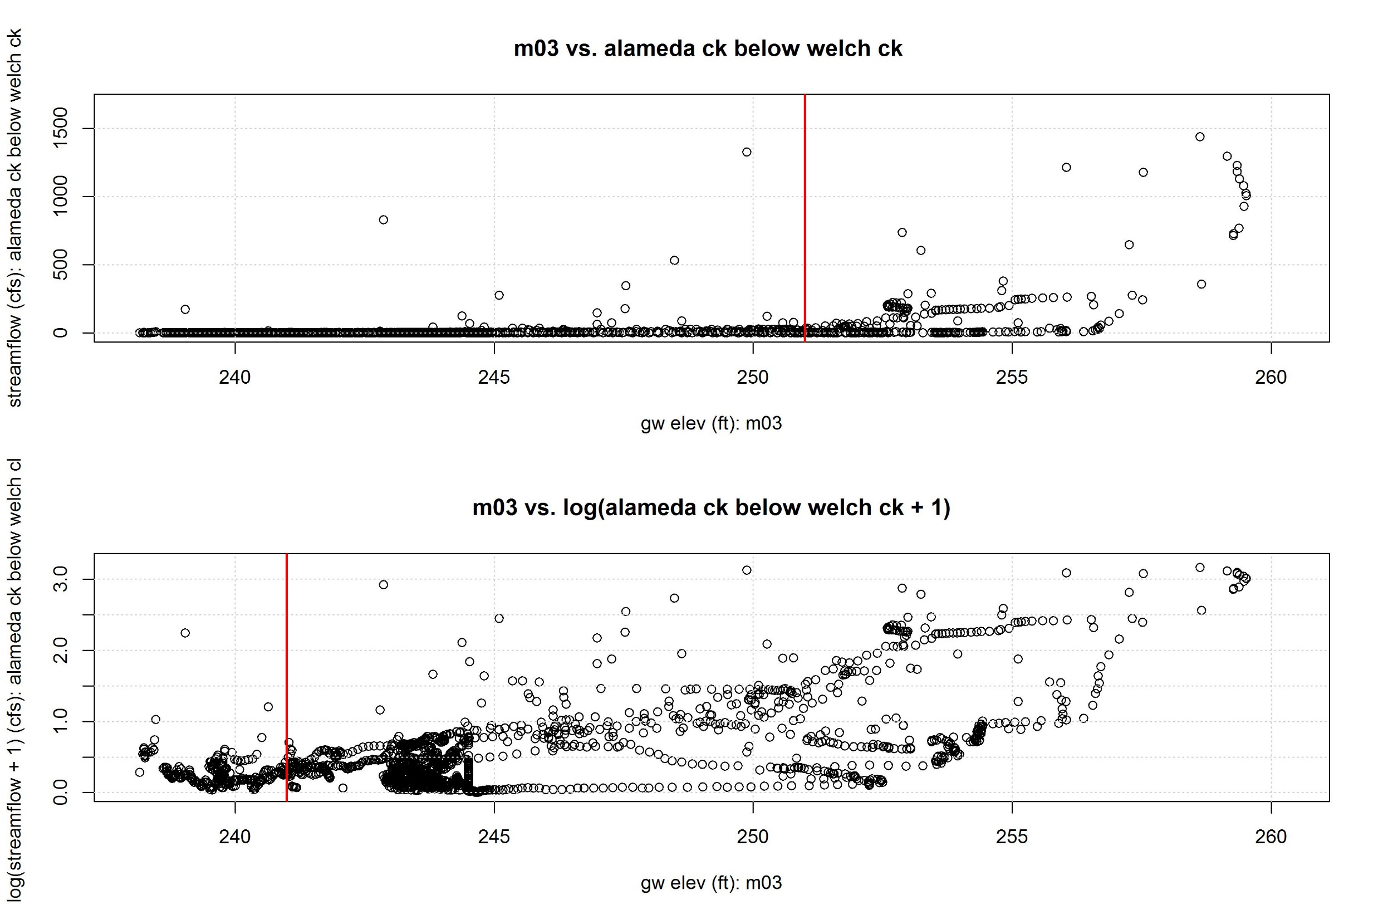

Slide 6
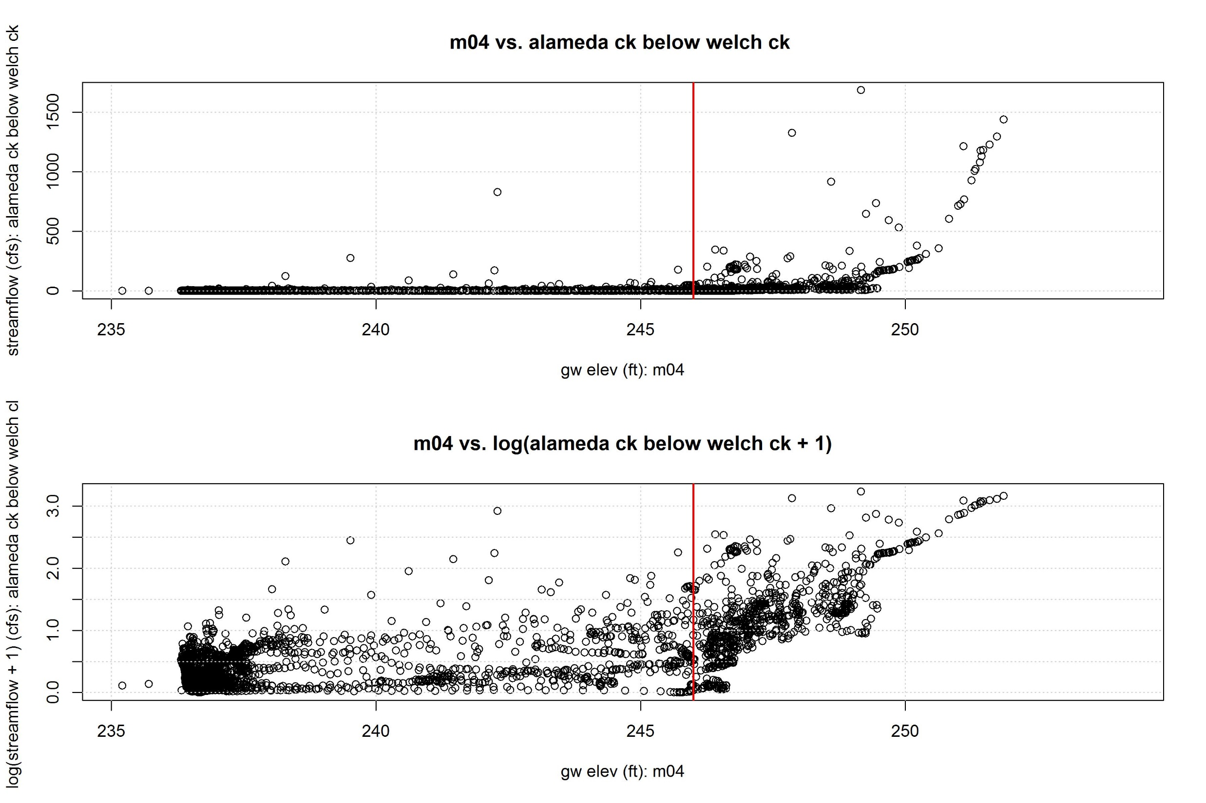

Slide 7
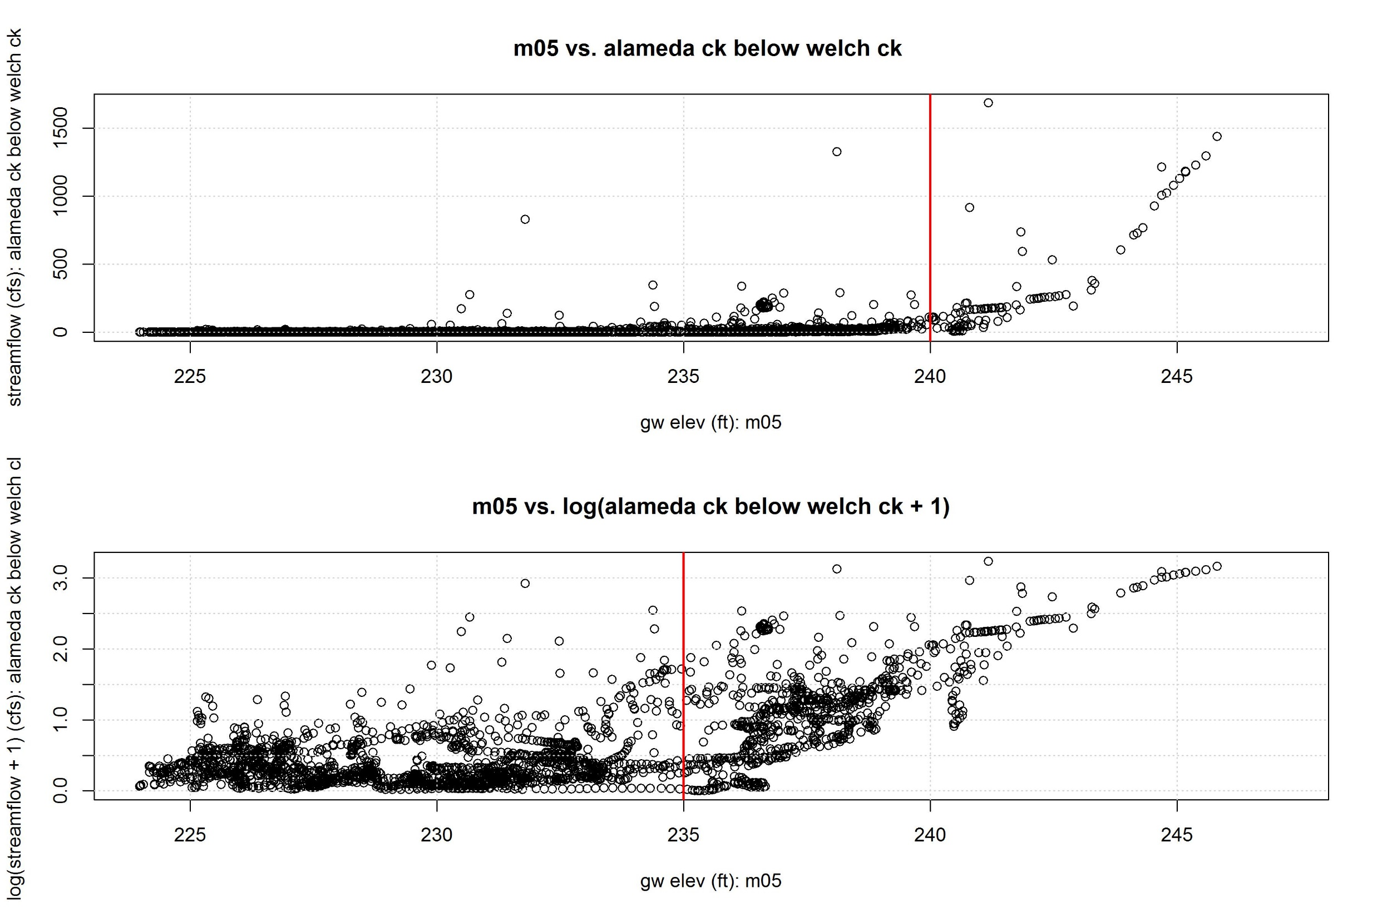

Slide 8
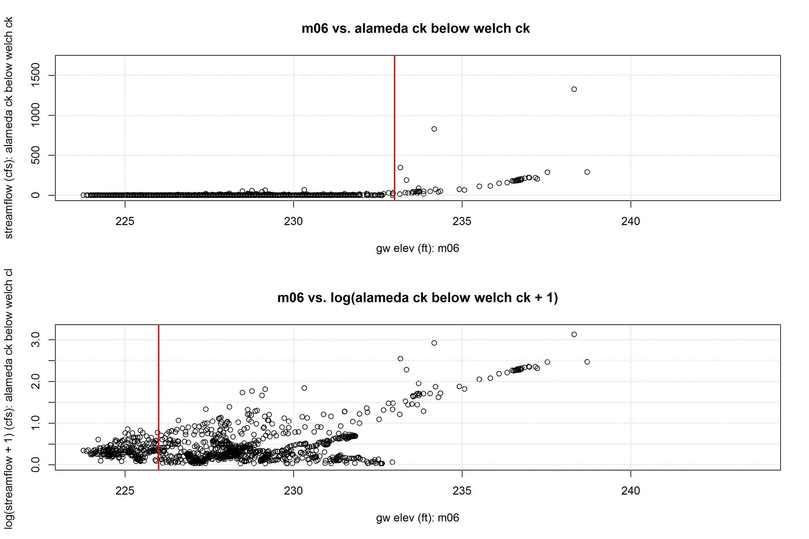

Slide 9
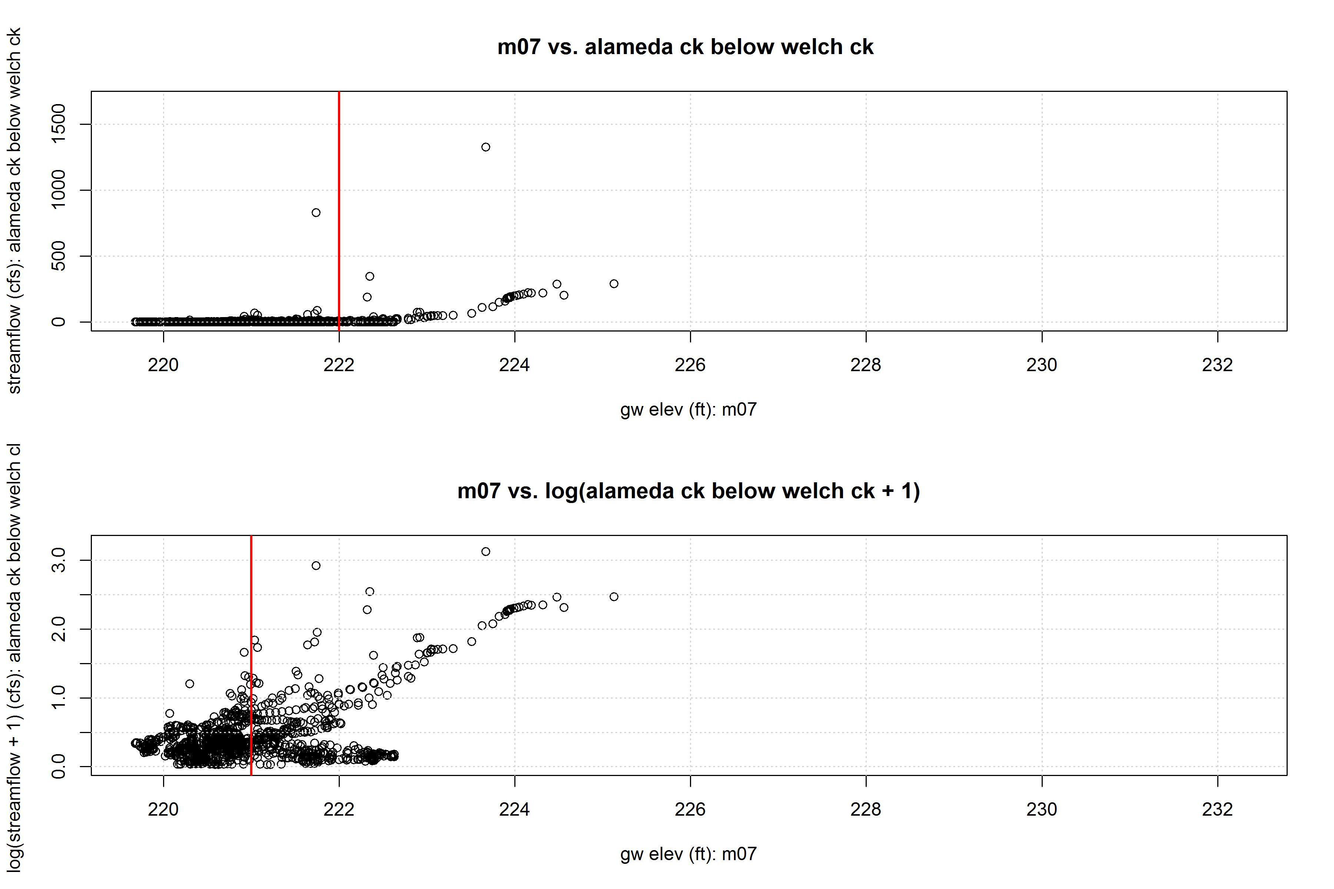

Slide 10
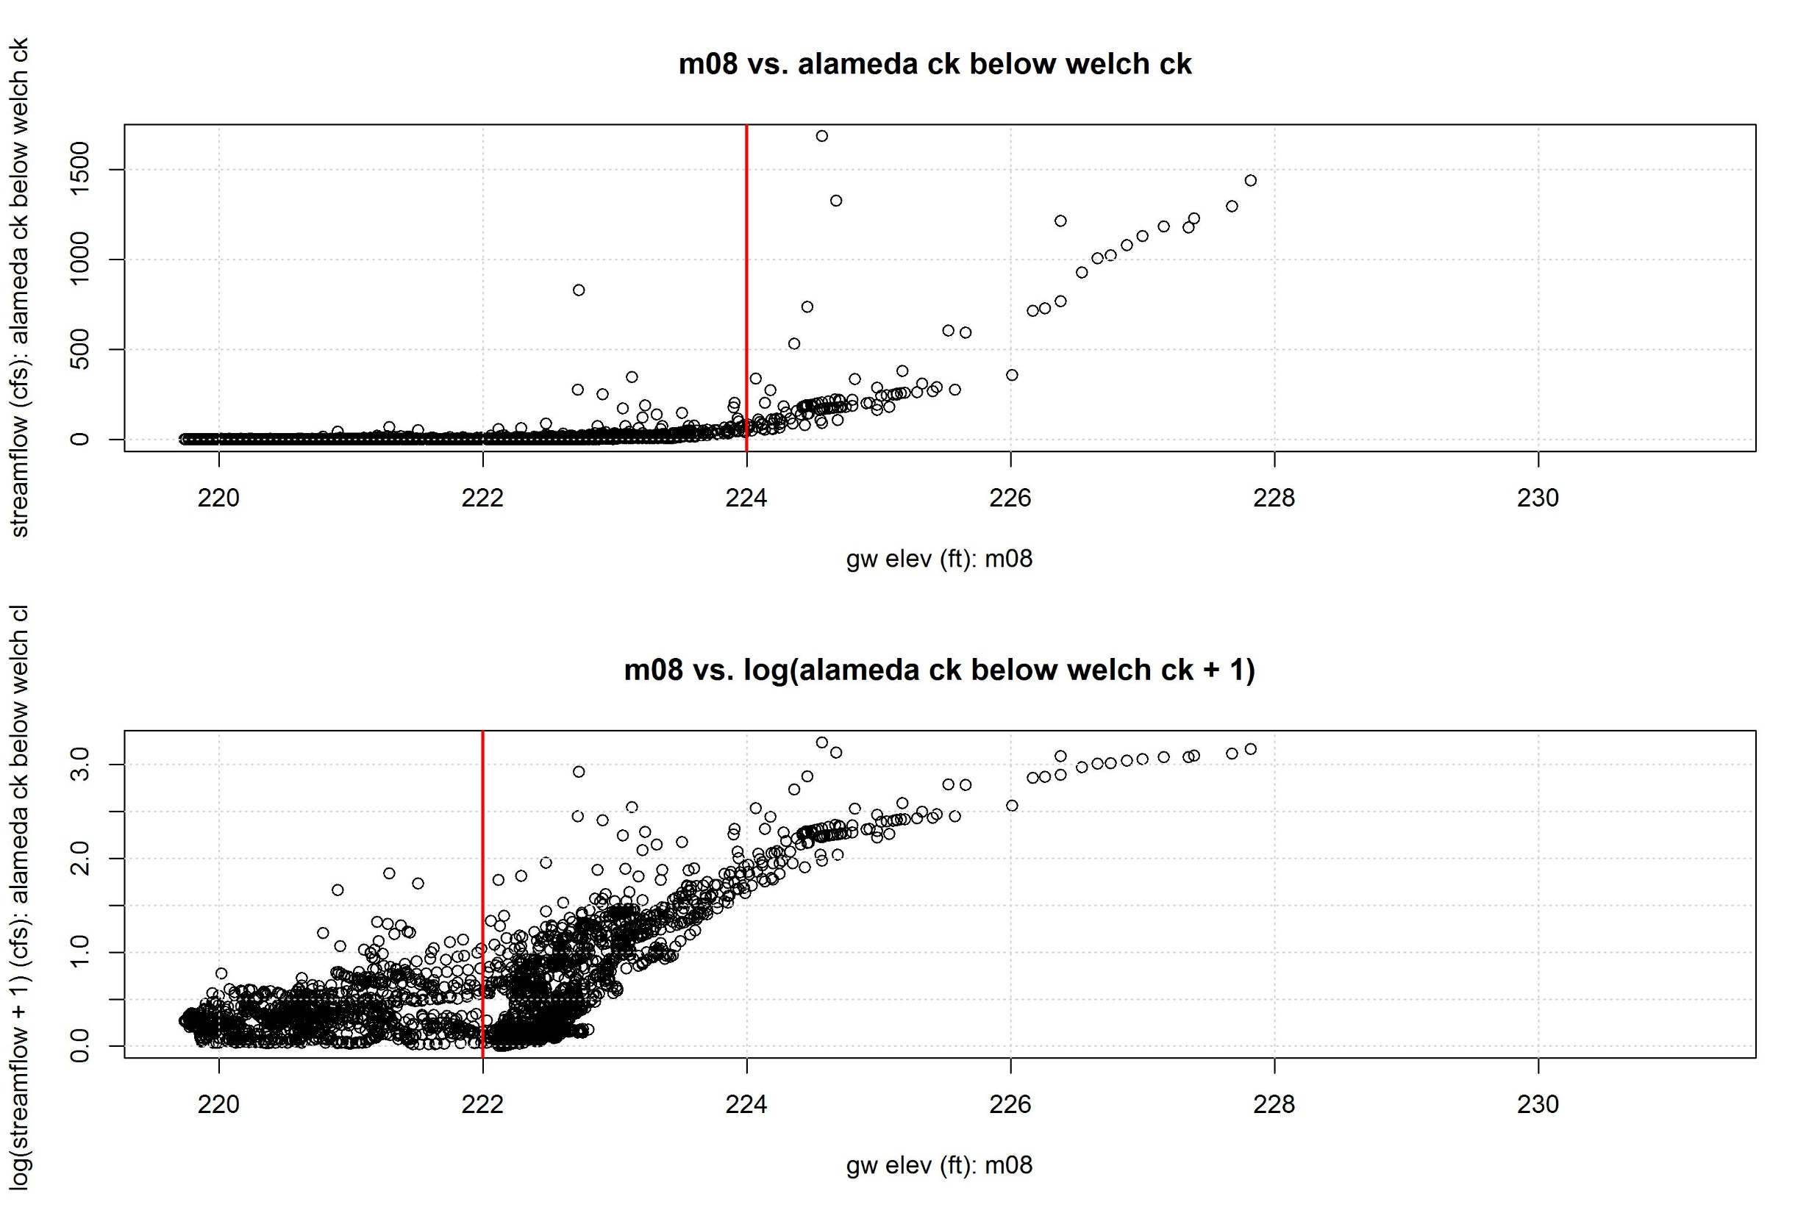

Slide 11
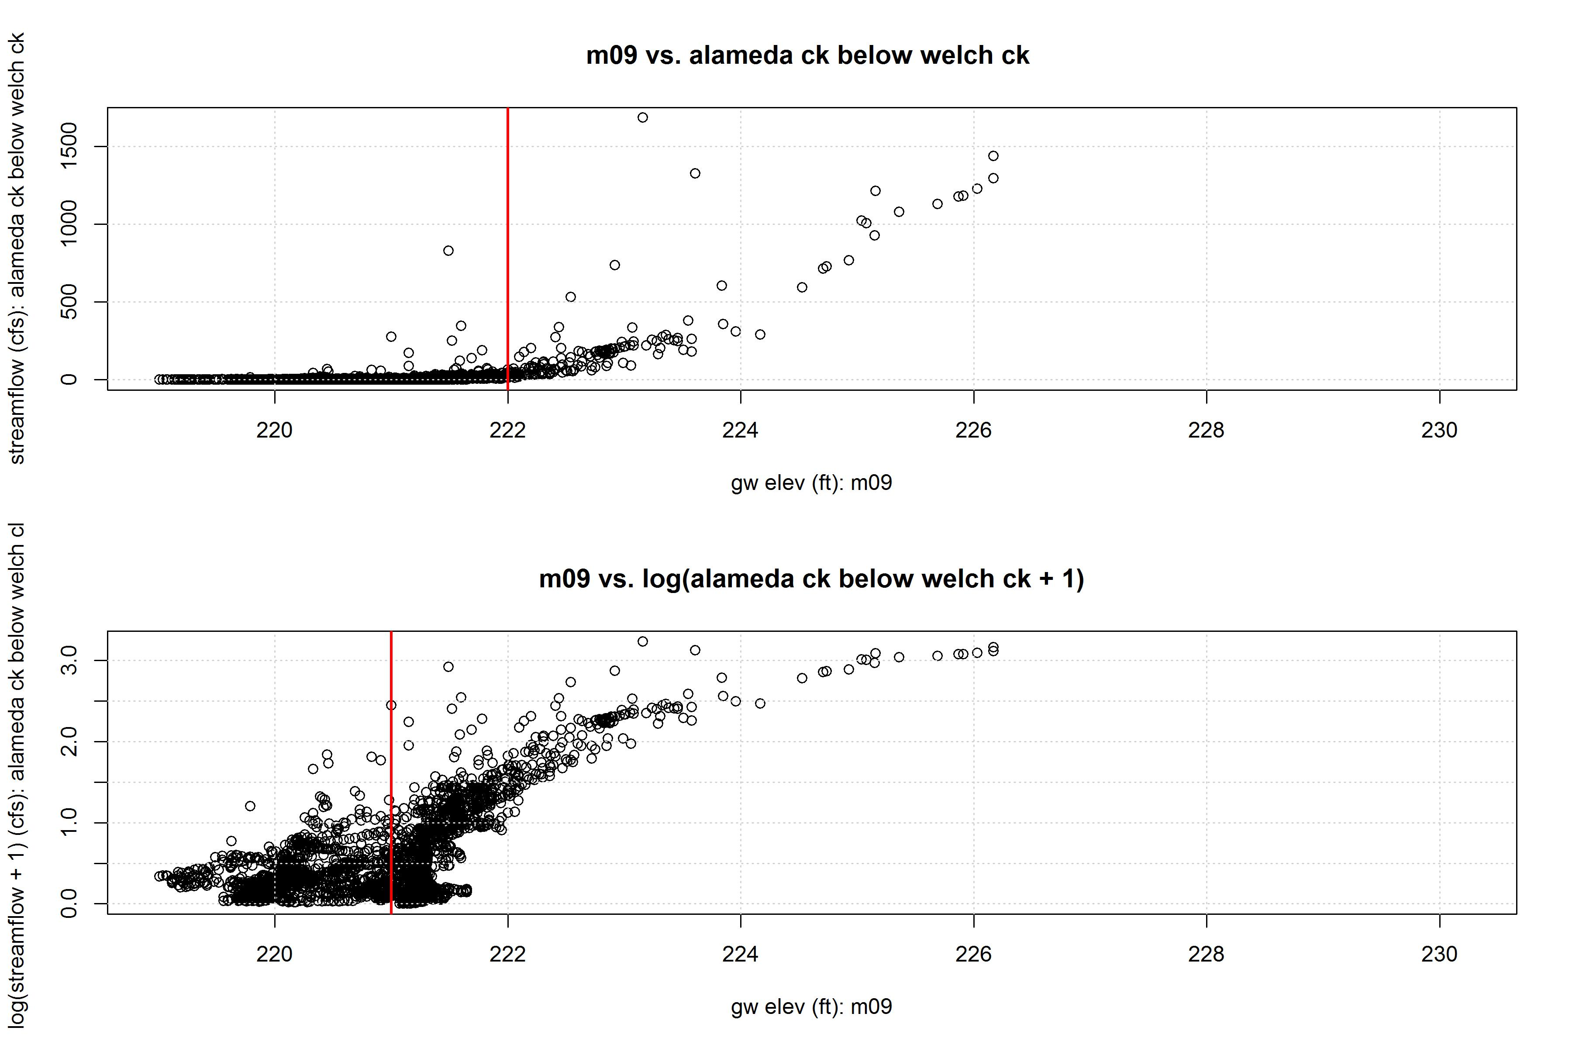

Slide 12
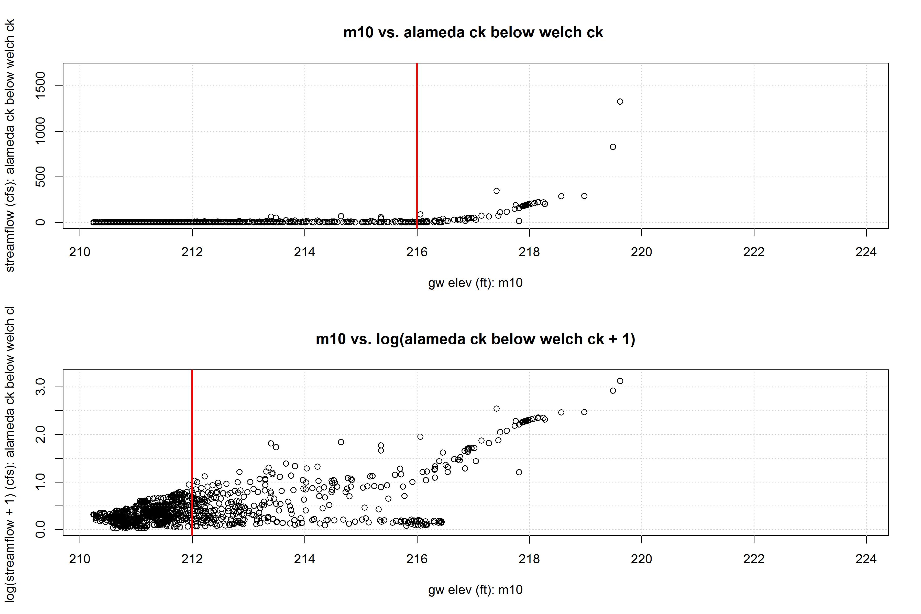

Slide 13
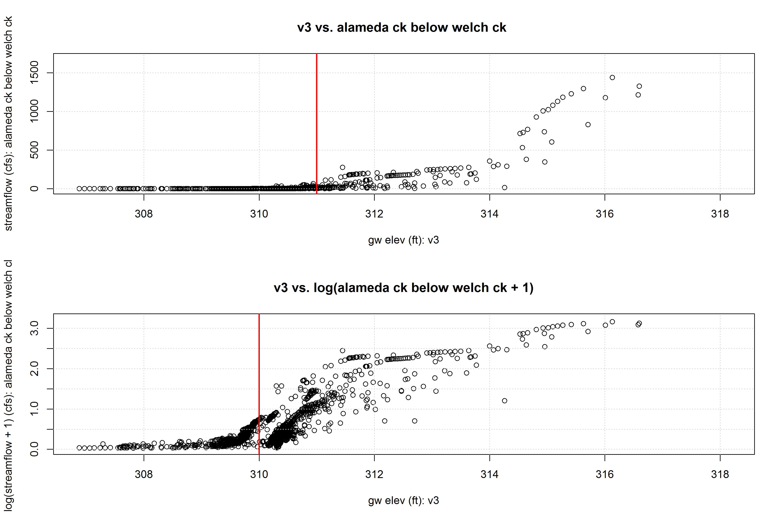

Slide 14
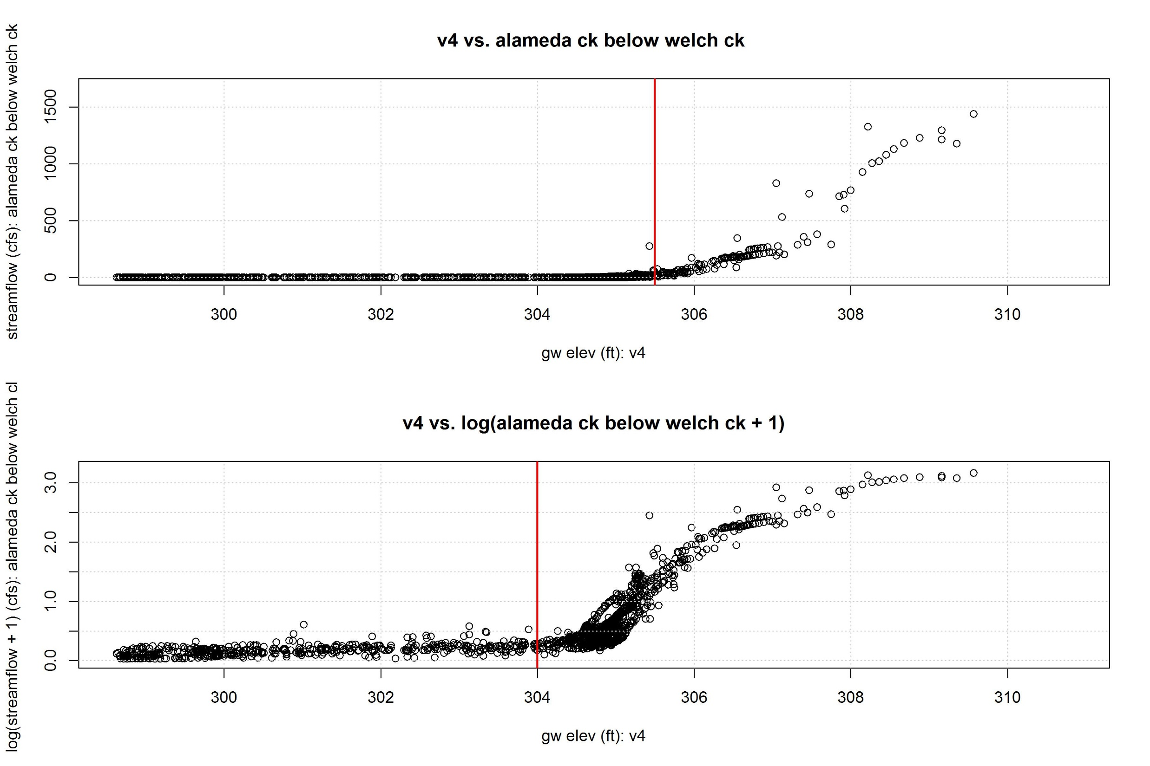

Slide 15
