Slide 1
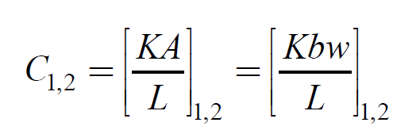
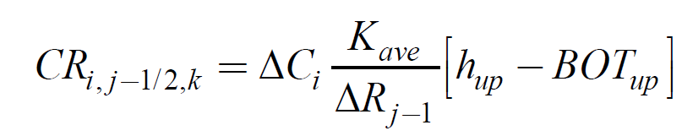
Aquifer Transmissivity (T)
T=Kb
b
Aquifer Conductance (CC,CR,CV)

Slide 2
After substituting Darcy’s Law and Applying Finite Differences
Can be written as Ah=B (Harbaugh, 2005)

Slide 3
Hybrid Newton/Picard Method
Newton:
Picard:
Hybrid:
*This allows MF Packages to be linearized using either Newton
or Picard, while GW solved with Newton

Slide 4
Spatial Discretization
Can be written as Ah=B (Harbaugh, 2005)

Slide 5

For GFLOW best to keep all Cells Active
Consider two adjacent cells one dry and one partially wet:
$b_{ave}=\frac{100−100+95−90}{2}$ = 2.5
dry
H=100
H=95
wet
z=90
*Using standard inter-cell averages of conductance
based on saturated thickness will cause water to flow
From a dry cell to a wet one.

Slide 6

Solution: Full Upstream Weighting
dry
$b_{up}=100−100$= 0
Hup=100
H=95
wet
Conductance is calculated based on saturated thickness
of cell with higher head only. Thus, flow will not leave a dry cell

Slide 7
Second Problem: Conductance Transitions from Head Dependent to Constant
Cmax
Kw/L
C
dC/dh
0
0
Cell
bottom
Cell
top
h
This transition causes dC/dh to change from
1 to zero, a discontinuous derivative

Slide 8
Solution: Smooth Saturated Thickness Function over the Discontinuity

Slide 9
Newton Solver for MODFLOW
Newton method is more robust than Picard for strongly nonlinear problems.
Cost: Newton method typically results in a asymmetric matrix (Picard results in a symmetric matrix).
This leads to Newton-Krylov methods (i.e., iterative linear solvers that rely on Krylov subspace methods such as GMRES and Orthomin acceleration methods.

Slide 10
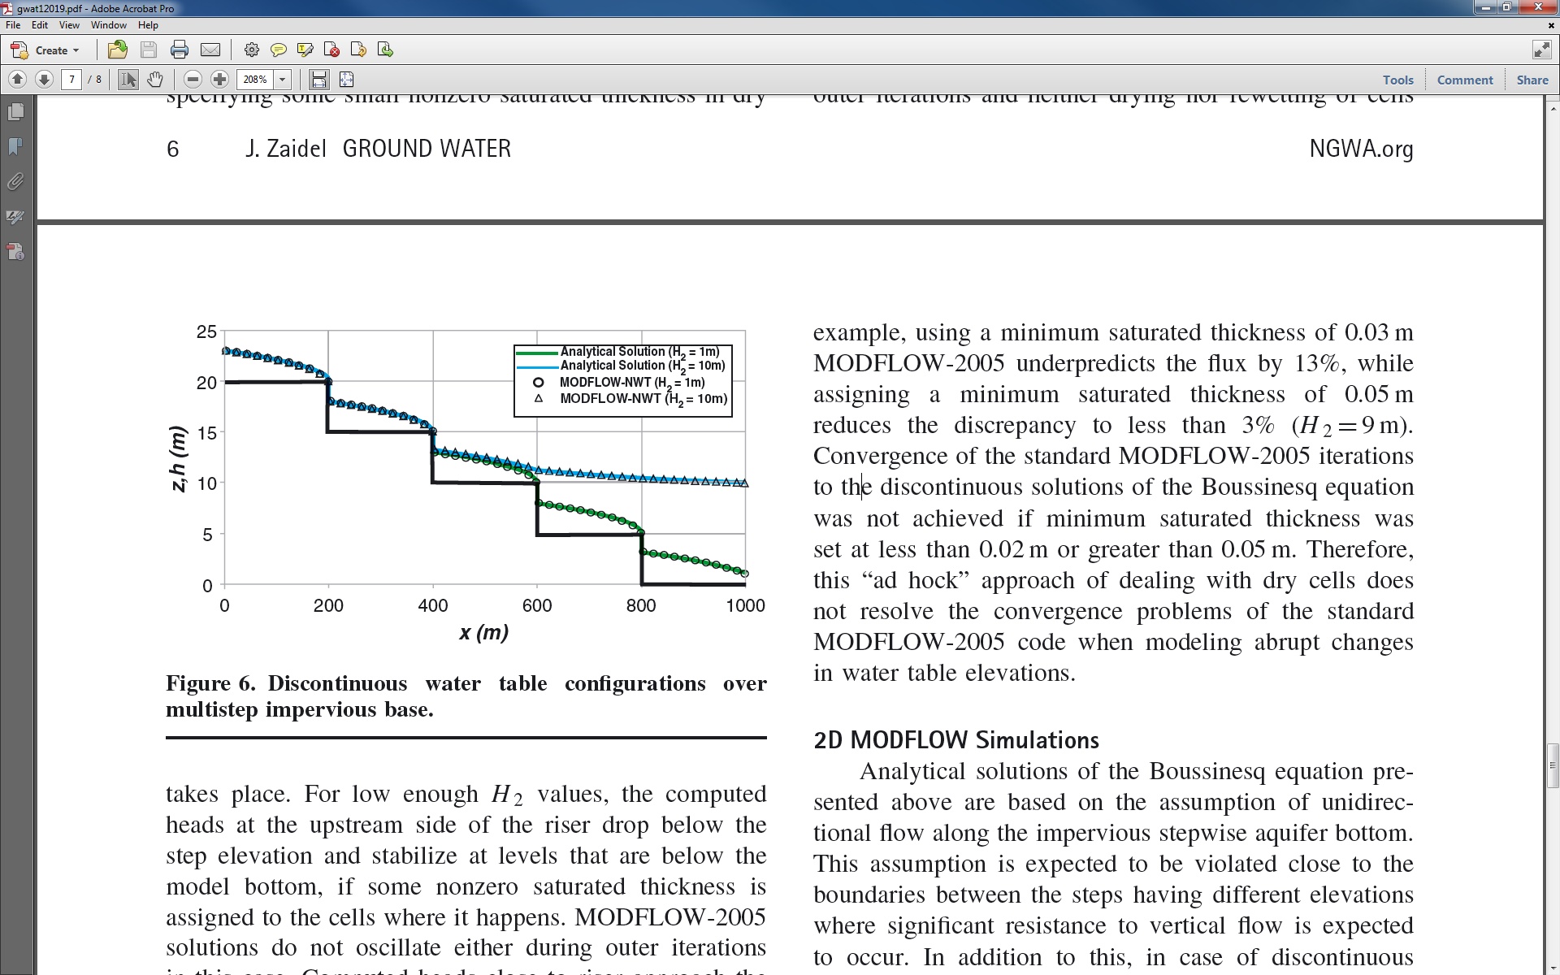
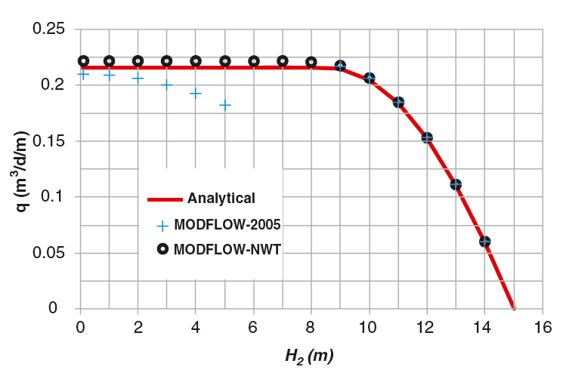
MODFLOW-NWT—GW Engine for GSFLOW
Suited for modeling mountains (sloped, thin, unconfined aquifers, Dupuit assumption)
Jaidel, J, Groundwater, 2013

Slide 11
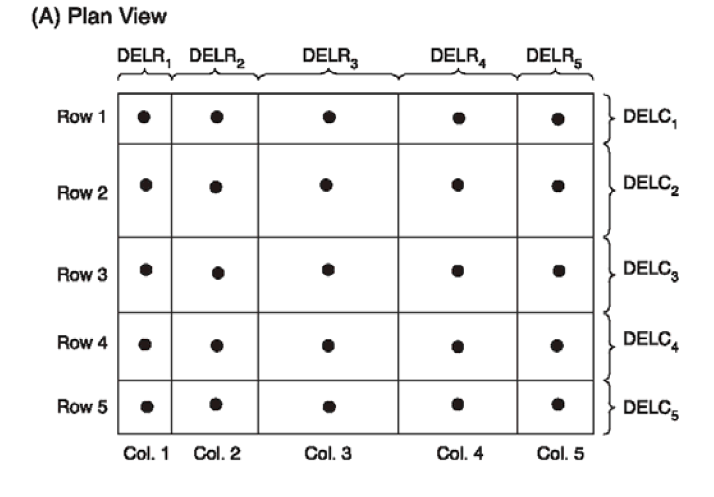
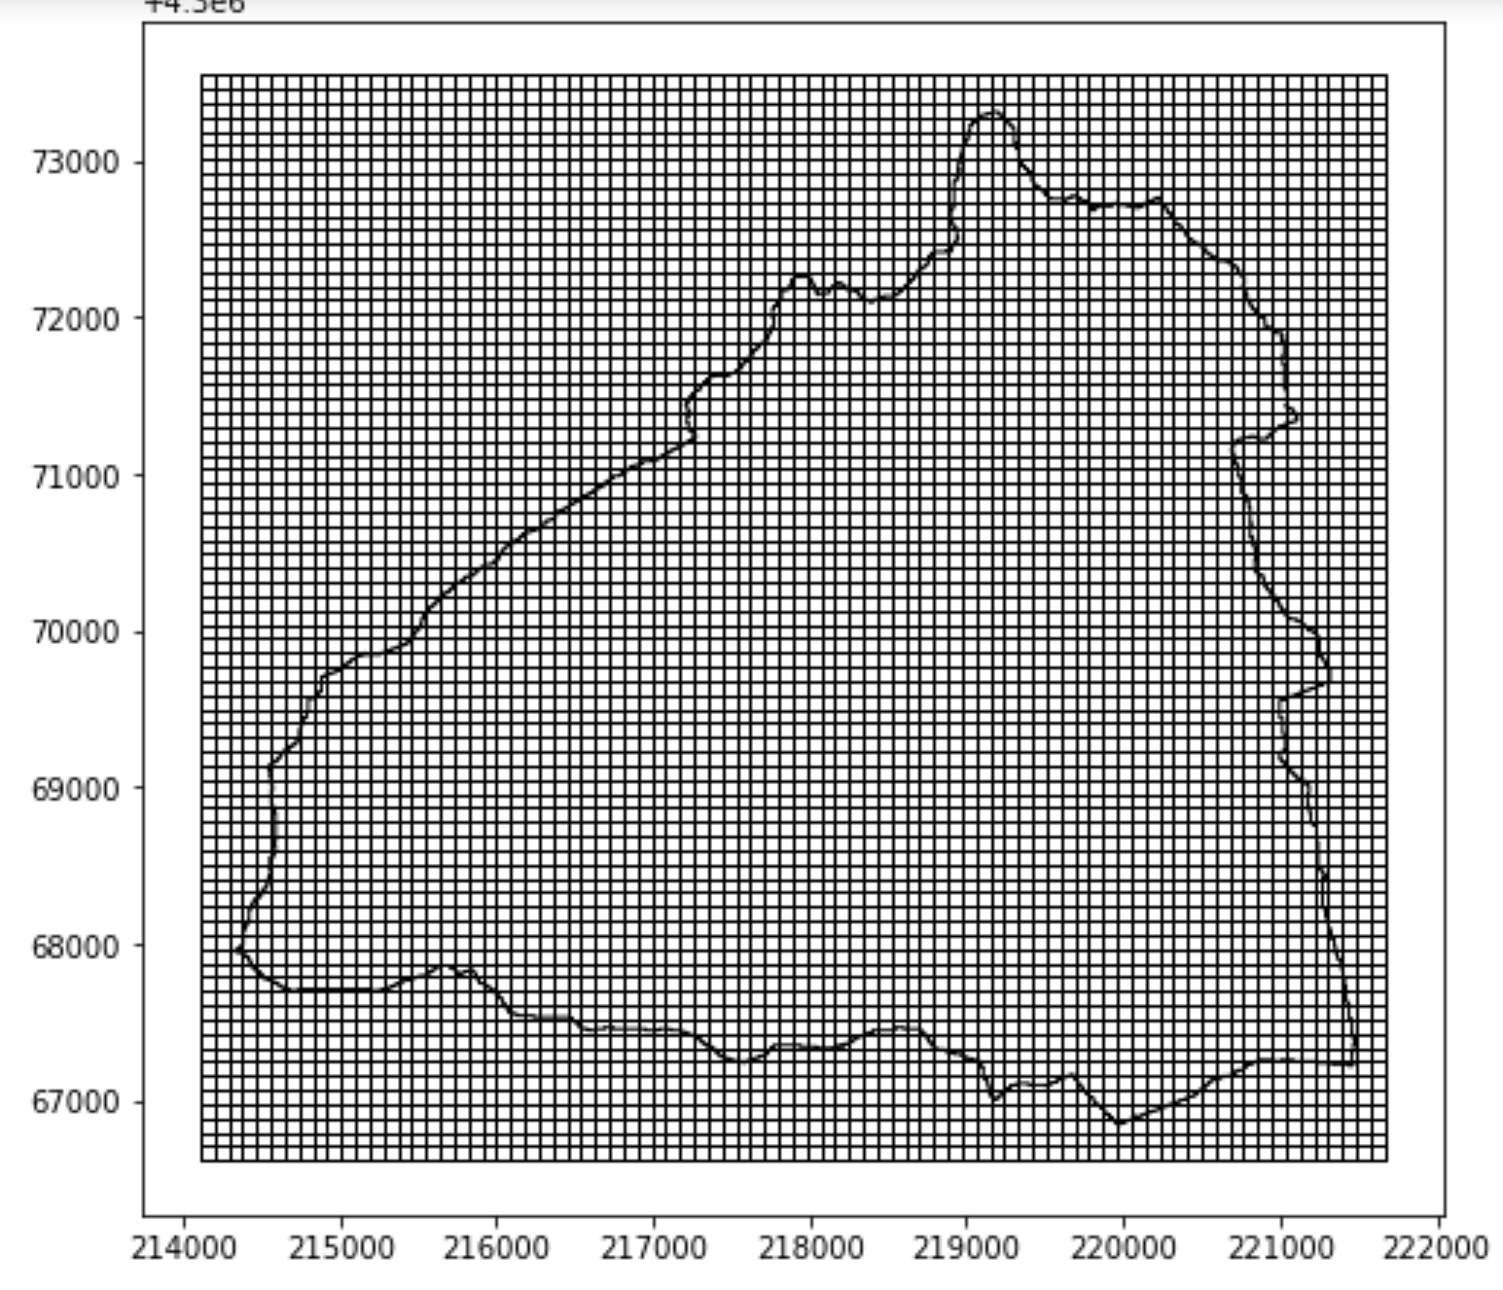
Discretization of Space-Horizontal
All GSFLOW applications tend to use constant cell sizes.
Horizonal cells divided into rows (“delr”) and columns (“delc”).

Slide 12
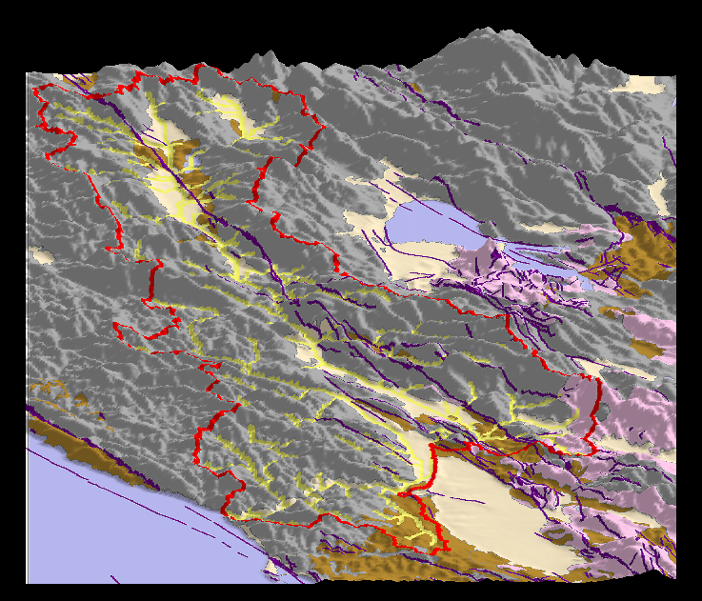
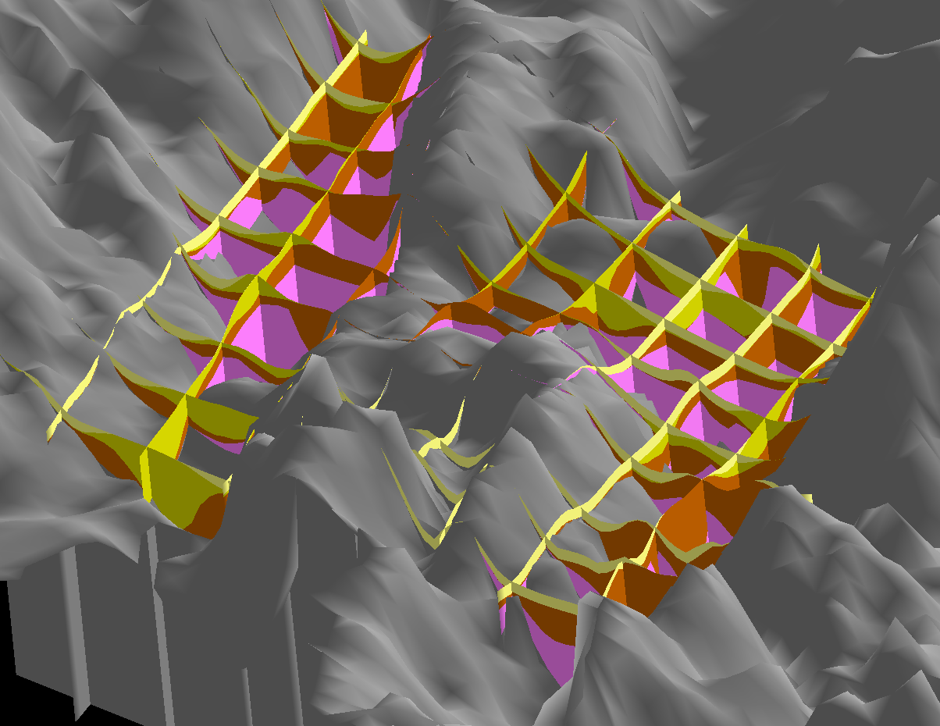
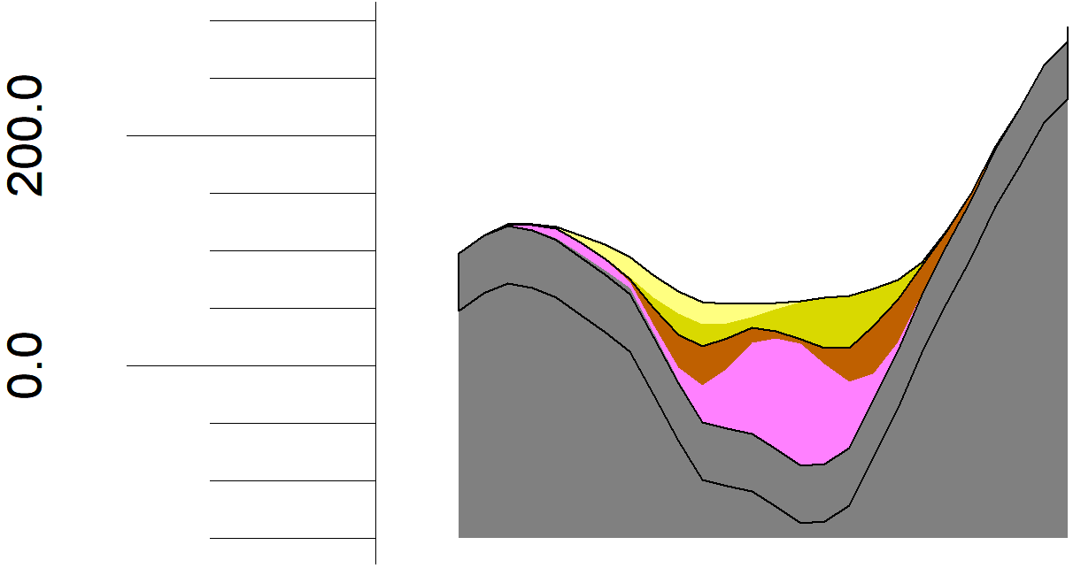
Discretization of Space-Vertical
Channel Alluvium
Unconsolidated sediment
Consolidated sediment
Sonoma Volcanics
Franciscan Basement
300
200
Meters above
sea level
Layer 1
100
0
Layer 2
-100
Layer 3

Slide 13
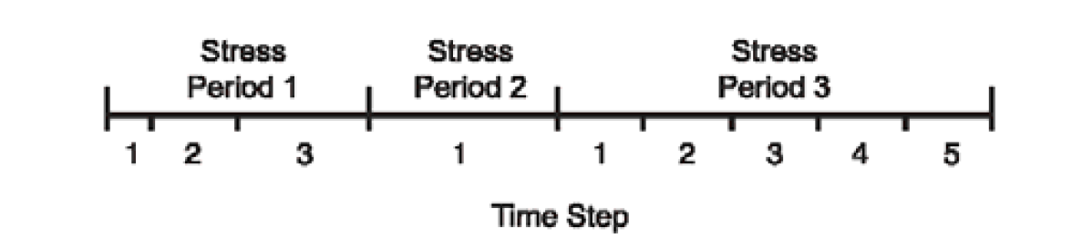
Discretization of Time
Stress periods--period of constant boundary conditions. Stress periods not needed for GSFLOW
Time step--time over which an individual groundwater computation is made. Must be 1 day in GSFLOW

Slide 14
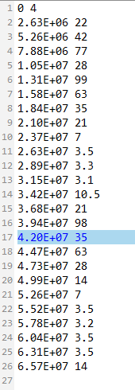
Discretization of Time
Stress periods—Replaced by boundary conditions implemented at the time step level
Coupling to PRMS—exchanges occur during each daily time step
Surface water—flows and lake storages change on a daily basis
Water use (GW pumping, SW diversions) interpolated from tabular time series file on a time step basis
Tabfile
Time Flow

