Slide 1
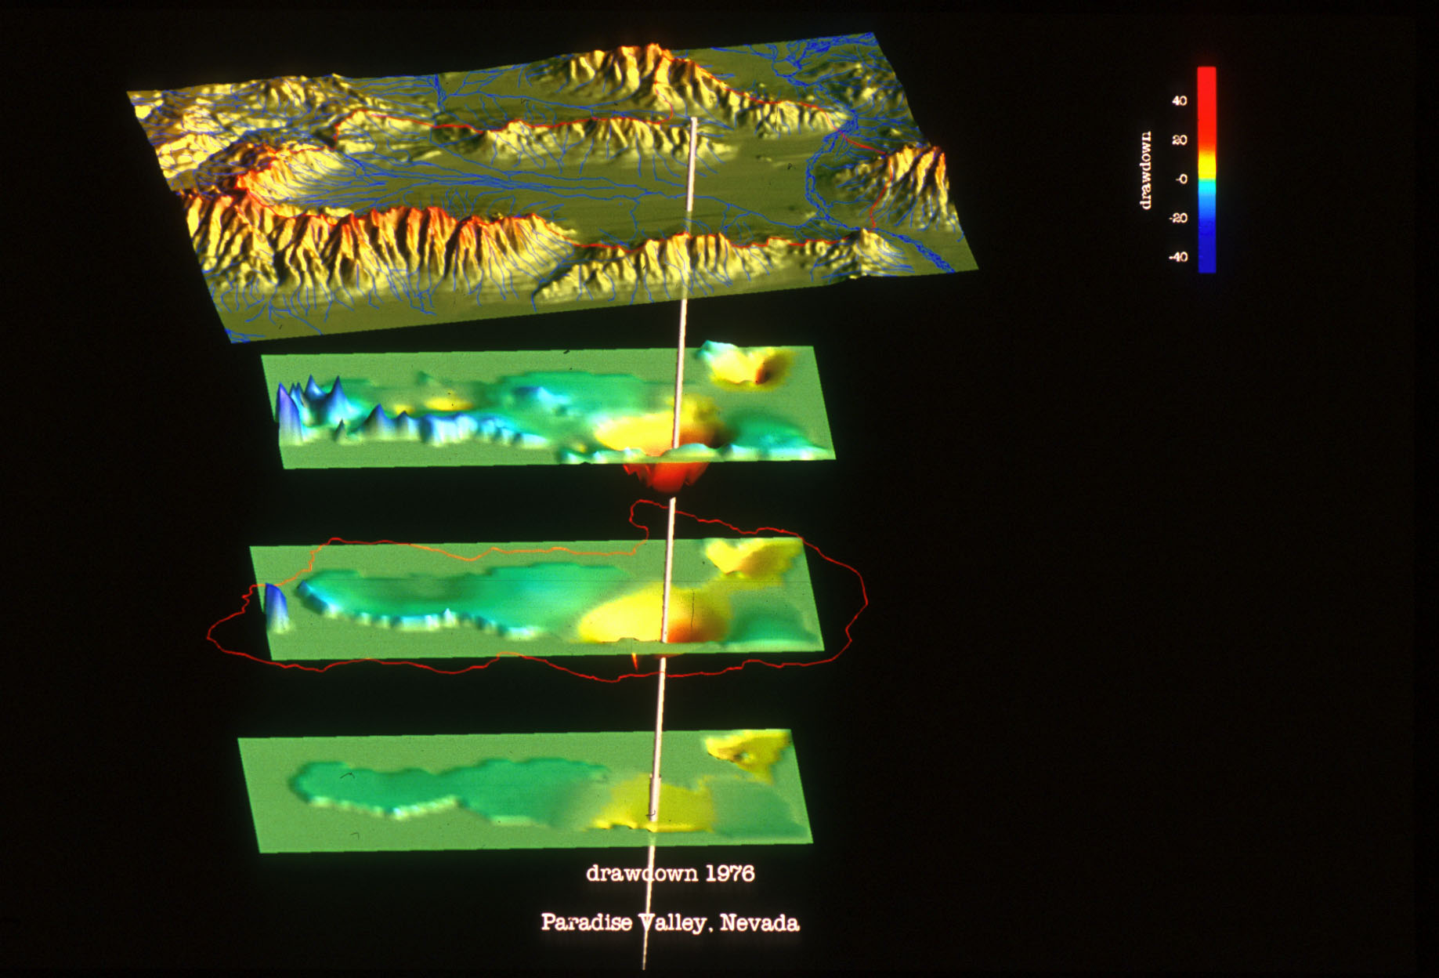
Flow in Channels (SFR) and Reservoir Storage (LAK)

Slide 2
Channel Flow (SFR)
SFR simulates streamflow using continuity
Simulating flow and depth is important for estimating SW-GW interactions
Wetting and drying of channels, impacts of capture by wells
Simulate flows where there are no measurements
Inflows and outflows from reservoirs

Slide 3
Channel Flow (SFR)
Solves steady-flow
Kinematic-wave
Diversions, releases, floodplain

Slide 4
Channels are Represented at Sub-grid Level
Streams divided into segments and reaches
Reach is a length of stream within one MODFLOW grid cell that has constant streambed properties.
Segments are groups of reaches that have
Uniform overland flow, precipitation, ET
Tributary inflow
Point inflow or outflow at beginning
Diversions from downstream end

Slide 5
Stream Network and Channel Geometry

Slide 6
Channel Flow (SFR) and Reservoir Storage (LAK)

