Slide 1
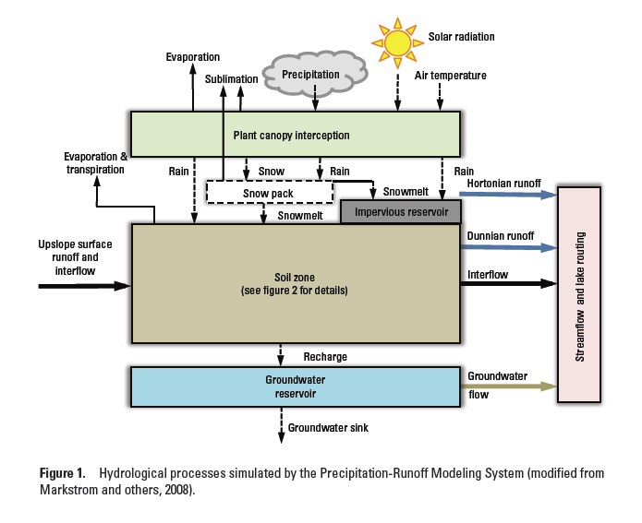
Precipitation Runoff Modeling System PRMS
Overview

Slide 2
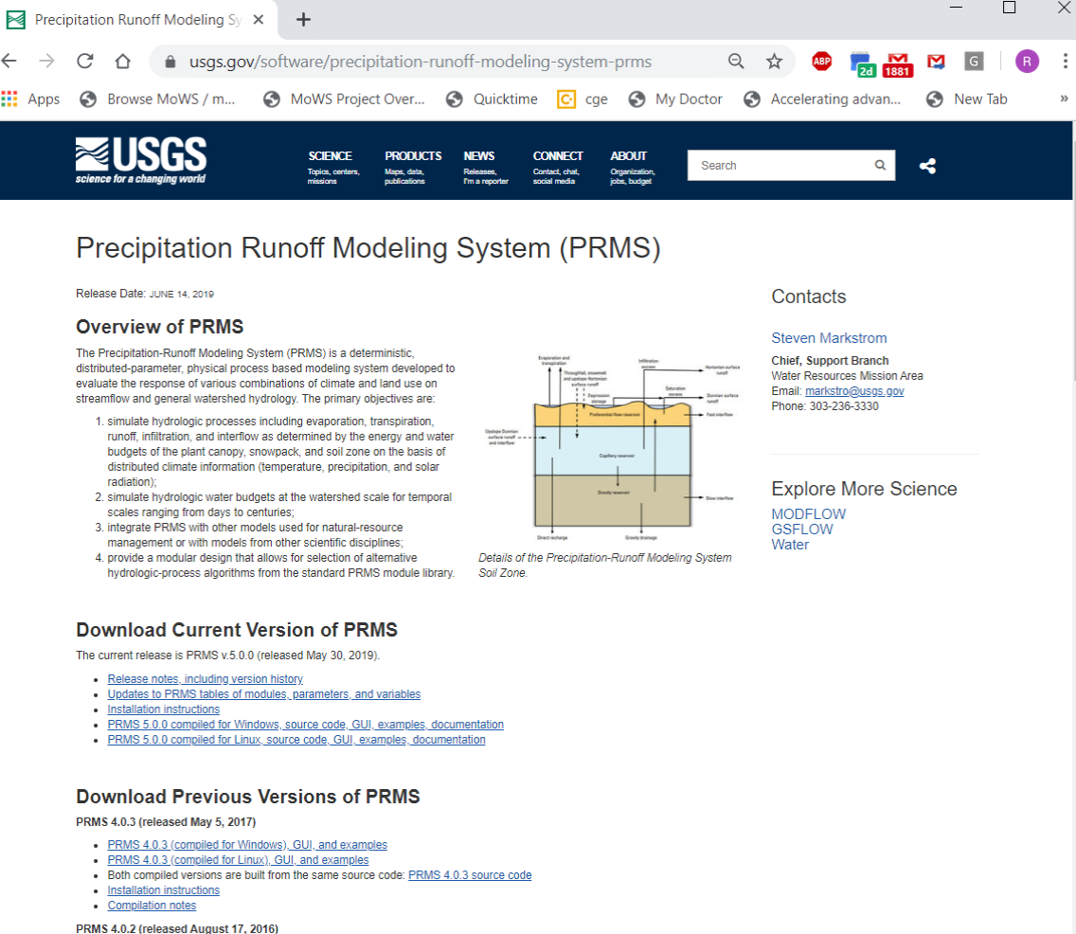
Current Web Page

Slide 3
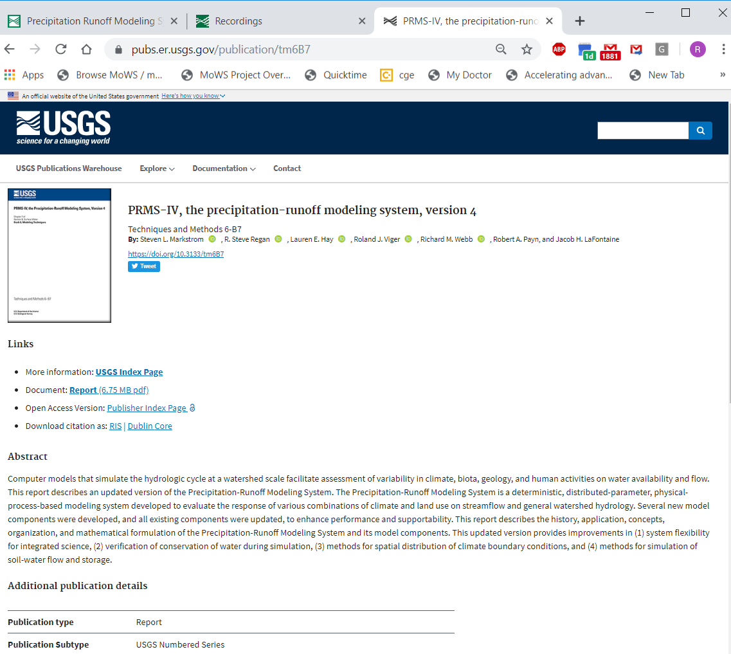
Documentation
Users’ manual

Slide 4
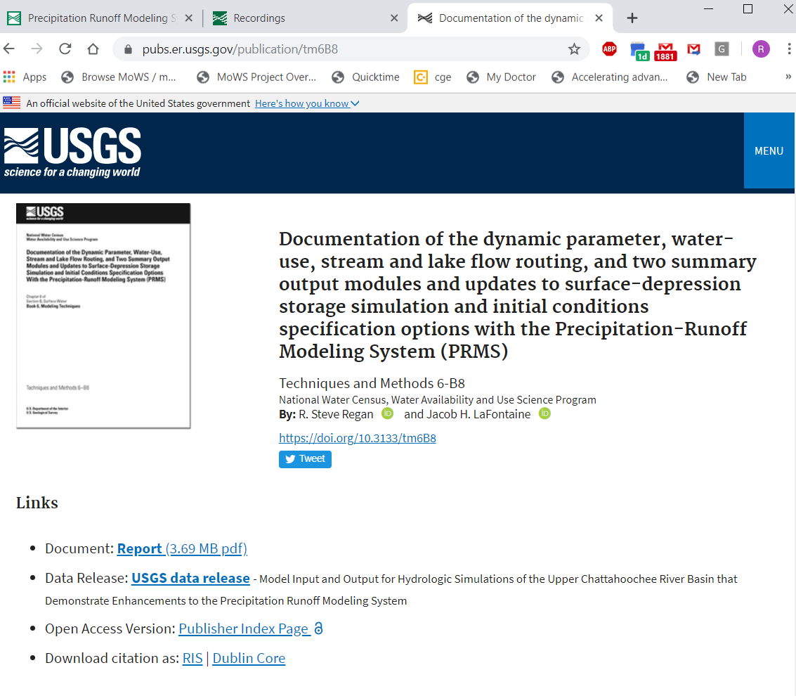
https://pubs.er.usgs.gov/publication/tm6B8

Slide 5
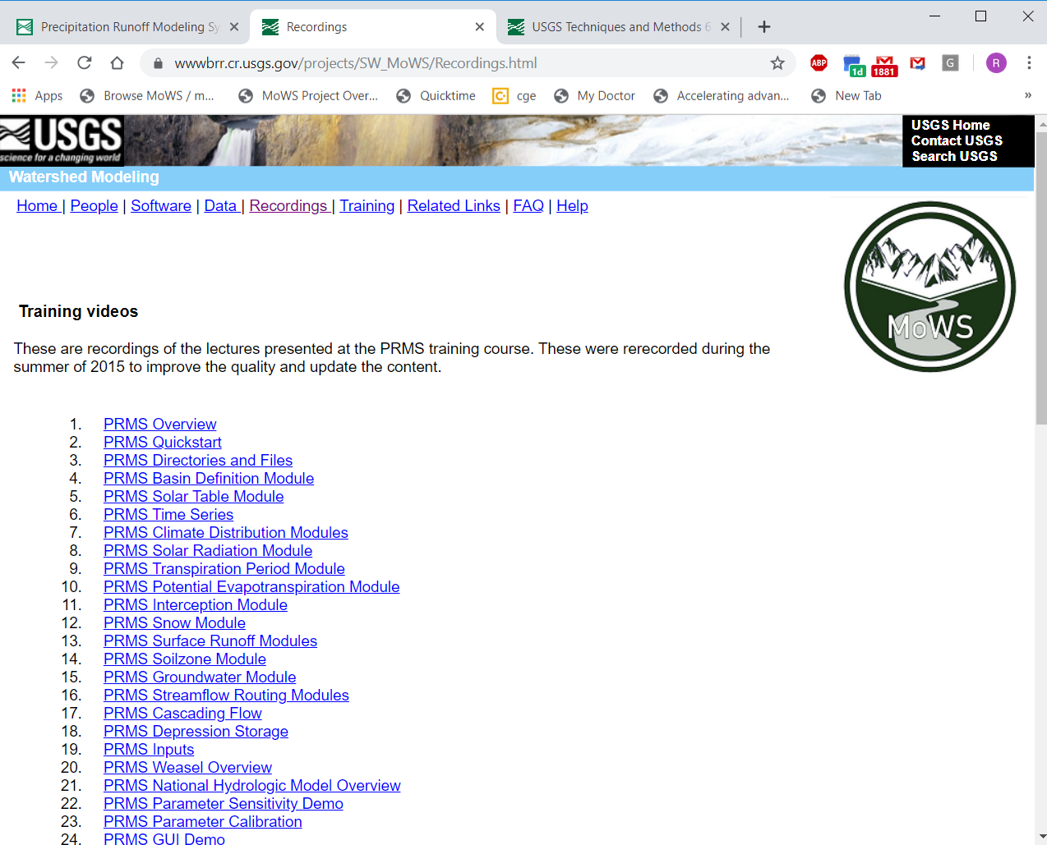
Documentation
http://wwwbrr.cr.usgs.gov/projects/SW_MoWS/Recordings.html

Slide 6
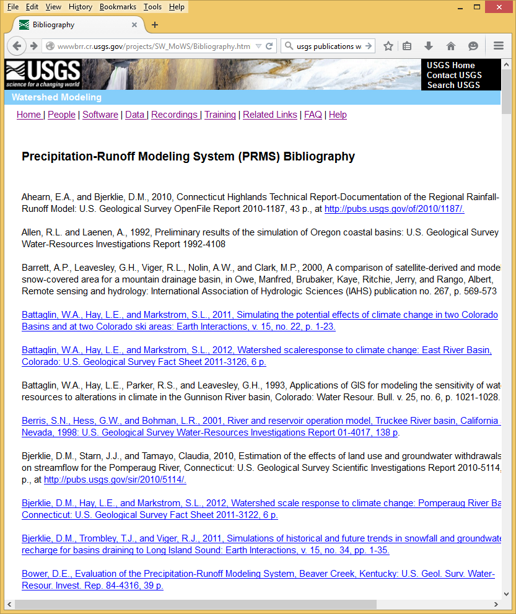
Documentation
Users’ manual
Web page
Training videos
Reports and articles (137)
http://wwwbrr.cr.usgs.gov/projects/SW_MoWS/Bibliography.html

Slide 7
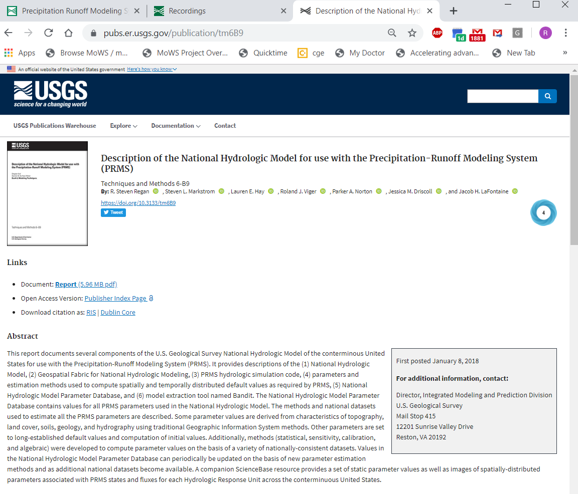
https://pubs.er.usgs.gov/publication/tm6B9

Slide 8
PRMS Conceptual Diagram

