Slide 1
Watershed Modeling Terminology
United States Geological Survey
Modeling of Watershed Systems Project (MOWS)

Slide 2
PRMS Specific Usage
Process – major hydrologic processes
Module – computer source code used to simulate a process
Parameter – input value that does not change during a simulation
Variable – value that can change with time during a simulation
Data – input variable
Dimension – value that sets the number of values of a parameter or variable
Reservoir – conceptual water-storage mechanism (not necessarily a physical lake used for the storage and regulation of water)
Control Variable (or Parameter) –input value used by the model to control the simulation

Slide 3
Application Setup
Processing of spatial and temporal information to create the input files necessary to run the model

Slide 4
Spatial Setup
Domain – geographical extent of the application (polygon)
Points of interest (POI) – meaningful, real world locations (points)
Stream segments – model features that conveys stream flow (arcs)
Hydrologic response unit (HRU) – model features used for simulation of hydrologic response of the land (polygon)
Grid cells – HRUs delineated as regular rectangles (polygon)
Connectivity for routing – HRUs are connected to stream segments; stream segments are connected to other stream segments; POIs are on the end points of stream segments.
Scale – larger or smaller domain
Resolution – more or less POIs, stream segments and HRUs

Slide 5
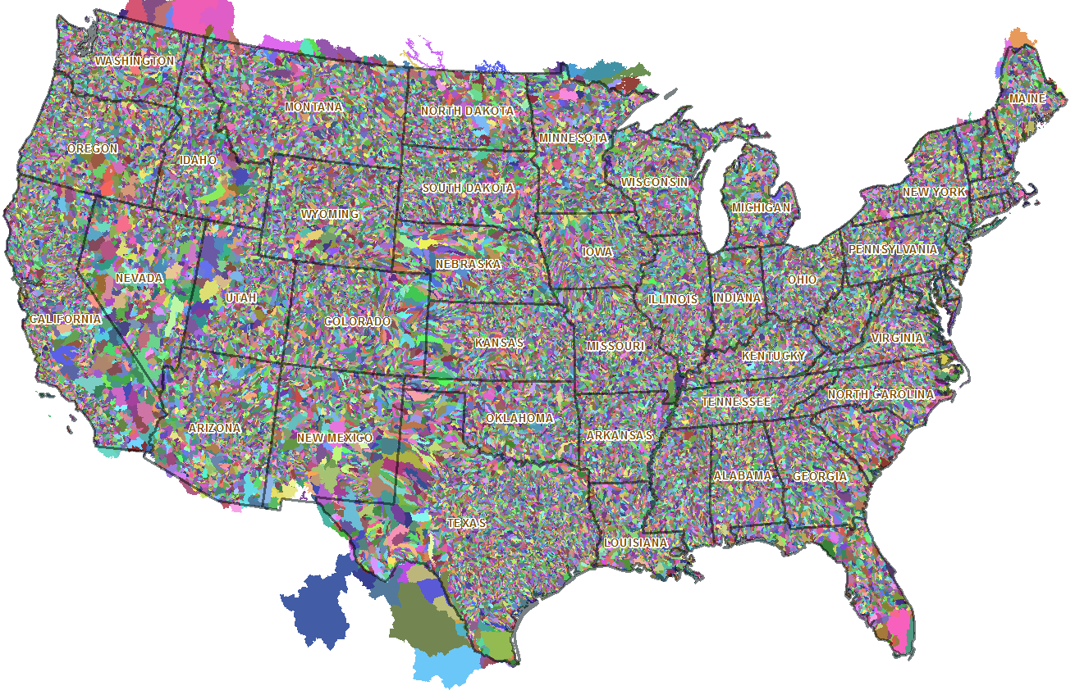
Geospatial Fabric

Slide 6
Temporal Setup
Measured vs. simulated – “data” typically means measured input values
Climate data – time series of weather data (temperature, precipitation, etc.)
Station data – climate or stream flow data that has been measured at a station
Gridded station data (GSD) – climate data that has been interpolated to regular grid cells
PRISM/Daymet/Maurer – GSD produced by PRISM Climate Group, ORNL/NASA, or Ed Maurer, respectively
General circulation model (GCM) – simulation model of the atmosphere. Can be used to generate climate “data.”
Downscale – procedure to convert coarse resolution climate data to a finer resolution
Current (or historical) conditions – simulations of time periods that have already occurred
Future projections – simulations of time periods in the future

Slide 7
Calibration Terminology
Calibration – adjusting parameters so that simulated variables more closely match measured data
Verification – process of comparing simulated variables to measured data to assess simulation performance
Sensitivity – how simulated variables change as parameters change
Uncertainty – variability in simulated variables when some characteristics of the input data and/or behavior of the processes are not completely known
Error – measured value minus the corresponding simulated value
Objective function – an equation to be optimized to reduce error
Ungaged – a watershed without measured stream flow data
Regionalization – a method to transfer calibrated parameters to ungaged areas
Local vs. accumulated – single HRU output vs. aggregated output for all HRUs above a point on a stream segment network
Mean monthly – 12 mean values, computed for a time series after the values have been partitioned into their respective month.
Monthly mean – a time series of mean values with a monthly time step

Slide 8

U.S. Geological Survey
Modeling of Watershed Systems (MOWS)
http://wwwbrr.cr.usgs.gov/mows

Slide 9
Terminology
Model – Compiled simulation code
Simulation – a single run of a model
Application – Setup of a model at a specific location for simulation. Includes input and output files.

Slide 10
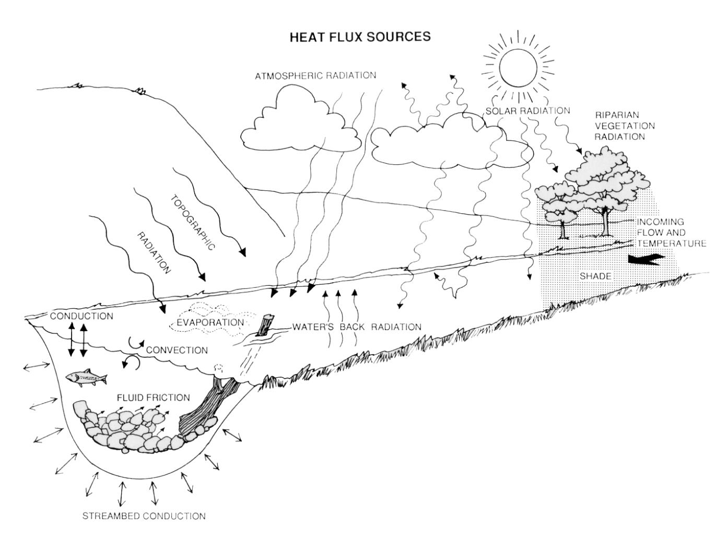
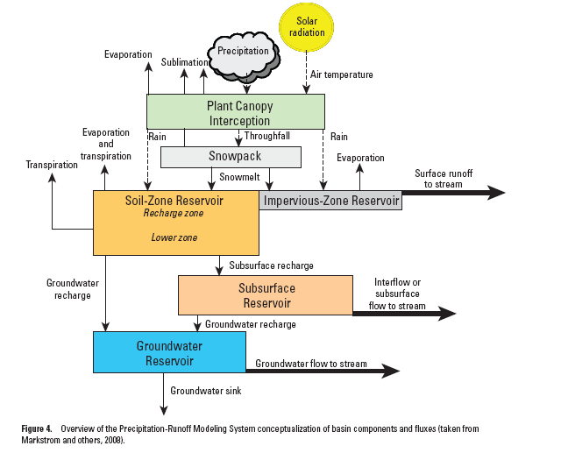
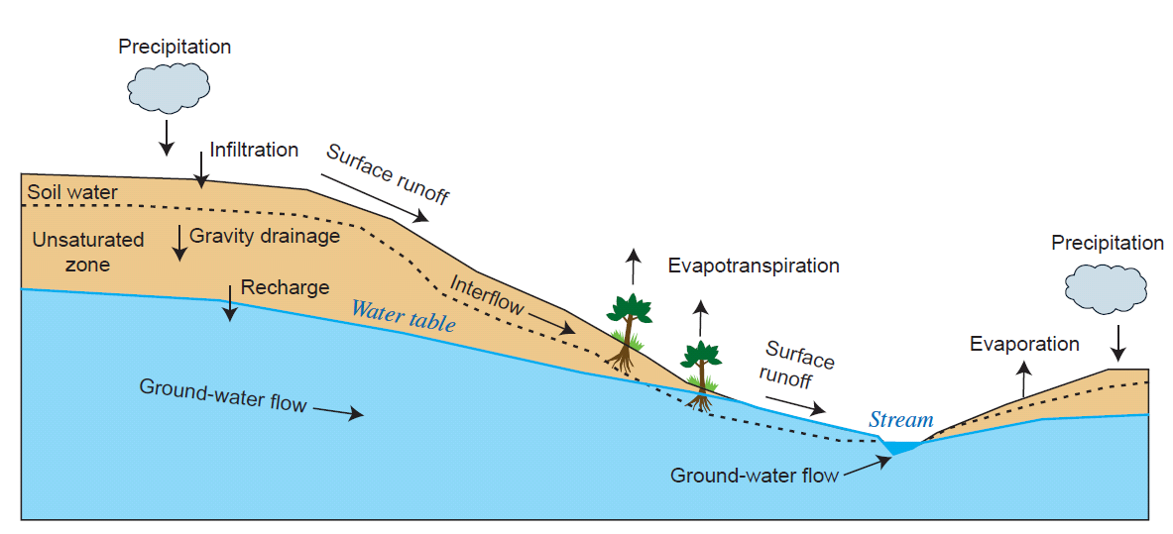
Watershed Models
Monthly Water Balance Model
Temperature
Precipitation
Potential Evapotranspiration
Snow
PRMS
Precipitation Runoff Modeling System
GSFLOW
Coupled ground-water and surface-water flow model based on the integration of
PRMS and MODFLOW (Modular Ground-Water Flow Model)
SNTEMP
Stream Network TEMPerature model
MWBM
Monthly Water Balance Model
Actual
Evapotranspiration
Snow Melt
Rain
Snow
Storage
Direct Runoff
U.S. Geological Survey
Modeling of Watershed Systems (MOWS)
http://wwwbrr.cr.usgs.gov/mows
Surplus Runoff
Soil-Moisture Storage Capacity
Soil-Moisture Storage
The coupling of PRMS with SNTemp will allow scientists and watershed managers to evaluate the effects of historical climate and projected climate change, landscape evolution, and resource management scenarios on watershed hydrology and in-stream water temperature.
PRMS Conceptualization of Basin Components
Modular, deterministic, distributed-parameter, physical-process, daily time-step watershed model that simulates watershed response to various combinations of climate and land use.

