Slide 1
Precipitation Runoff Modeling System
Model Construction

Slide 2
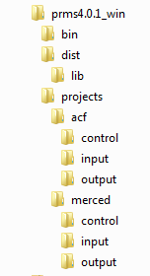
File structure
bin
contains PRMS executable
dist
contains supporting files to run PRMS files and GUIs
projects
contains applications of PRMS

Slide 3
File structure
acf
control
input
output
batch files for execution of model and supporting software

Slide 4
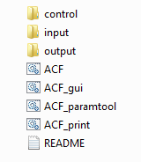
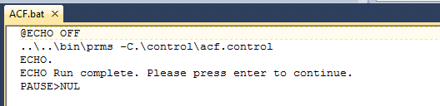
Files in projects/acf folder
Files in acf folder
ACF is a batch file that executes PRMS in command line mode

Slide 5
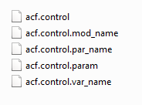
Files in projects/acf/control folder
acf.control is the PRMS control file that specifies the model configuration

Slide 6
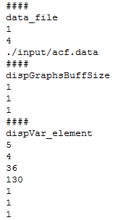
Example of control parameter
Specification of master data file (data_file)
1 – one file
4 – type ‘string’
./input/acf.data is the path to that file (can be absolute or relative)

Slide 7
Files in projects/acf/control folder
acf.control.param is a functional PRMS parameter file that includes values specified in the parameter file and default values for any parameters used by the modules but not specified in the parameter file. (Created by executing ACF_print)

Slide 8
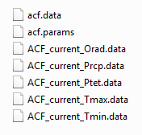
Files in projects/acf/input folder
acf.data is the master data file that typically includes observations of streamflow, temperature, and precipitation

Slide 9
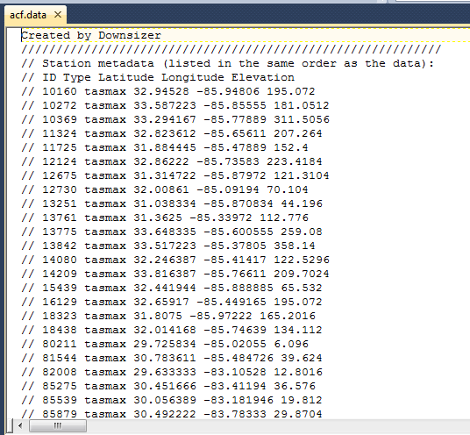
Example data file

Slide 10
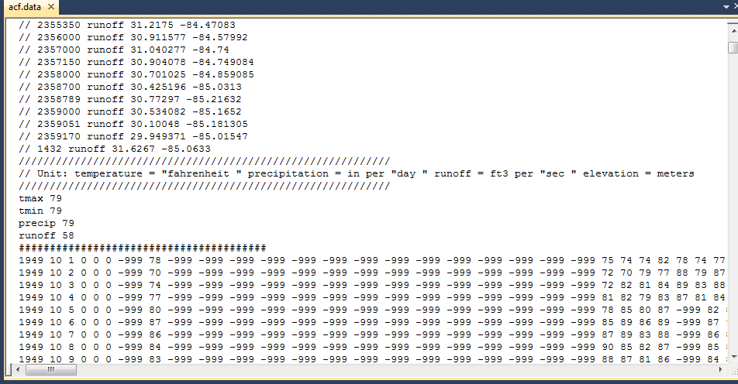
Example data file

Slide 11
Files in projects/acf/input folder
acf.params is the PRMS parameter file

Slide 12
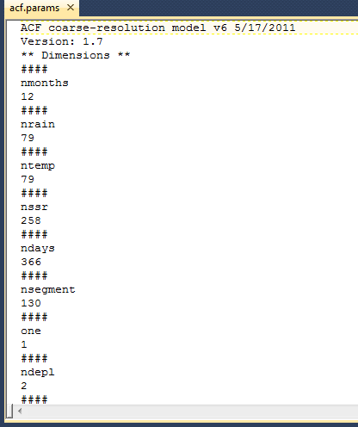
Example parameter file

Slide 13
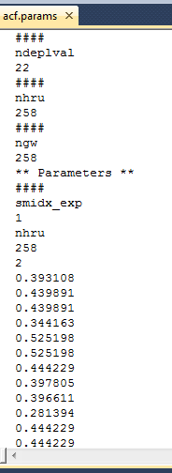
Example parameter file
** Parameters **
####
Splits parameter file between dimensions and parameters

Slide 14
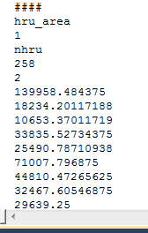
Example parameter file
#### - defines start of parameter field
Parameter name (smidx_exp)
Number of dimensions (1)
Dimension name (nhru)
Size of dimension (258)
Value type (2 = float)
Parameter values……..

Slide 15
Example parameter file
#### - defines start of parameter field
Parameter name
Number of dimensions
Dimension name
Size of dimension
Value type
Parameter values……..

Slide 16
Example parameter file
#### - defines start of parameter field
Parameter name
Number of dimensions
Dimension name
Size of dimension
Value type
Parameter values……..

Slide 17
Example parameter file
#### - defines start of parameter field
Parameter name
Number of dimensions
Dimension name
Size of dimension
Value type
Parameter values……..

Slide 18
Example parameter file
#### - defines start of parameter field
Parameter name
Number of dimensions
Dimension name
Size of dimension
Value type
Parameter values……..

Slide 19
Example parameter file
#### - defines start of parameter field
Parameter name
Number of dimensions
Dimension name
Size of dimension
Value type
Parameter values……..

Slide 20
Example parameter file
#### - defines start of parameter field
Parameter name
Number of dimensions
Dimension name
Size of dimension
Value type
Parameter values……..

Slide 21
Files in projects/acf/input folder
Preprocessed climate-by-HRU (CBH) files for:
Orad – solar radiation
Prcp – precipitation
Ptet – potential ET
Tmax – max air temperature
Tmin – min air temperature

Slide 22
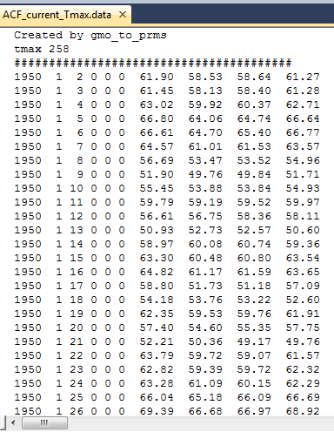
Example CBH file
Comment line
Dimension and size
#### - start of data
Data time series

Slide 23
Example CBH file
Comment line
Dimension and size
#### - start of data
Data time series

Slide 24
Example CBH file
Comment line
Dimension and size
#### - start of data
Data time series

Slide 25
Example CBH file
Comment line
Dimension and size
#### - start of data
Data time series

Slide 26
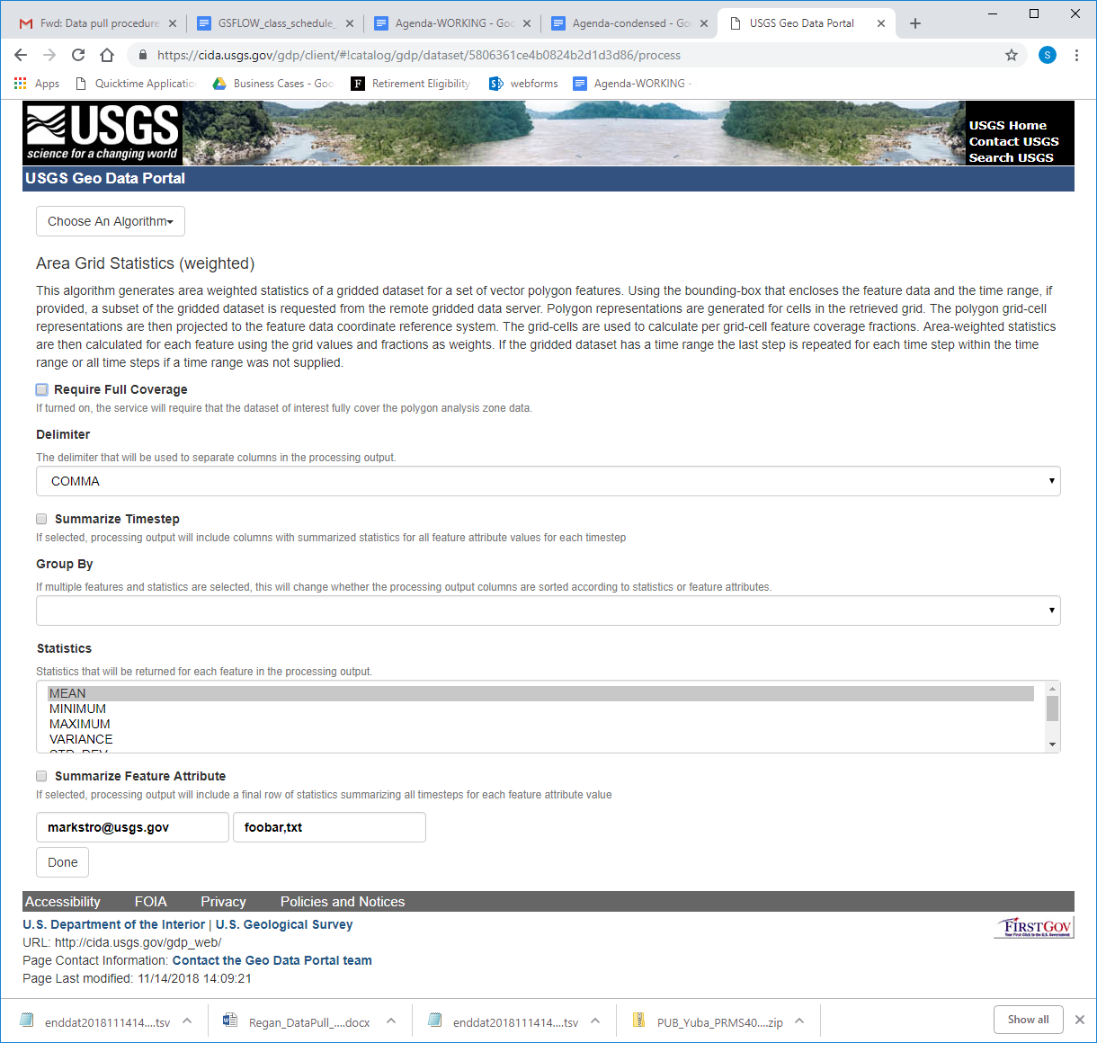
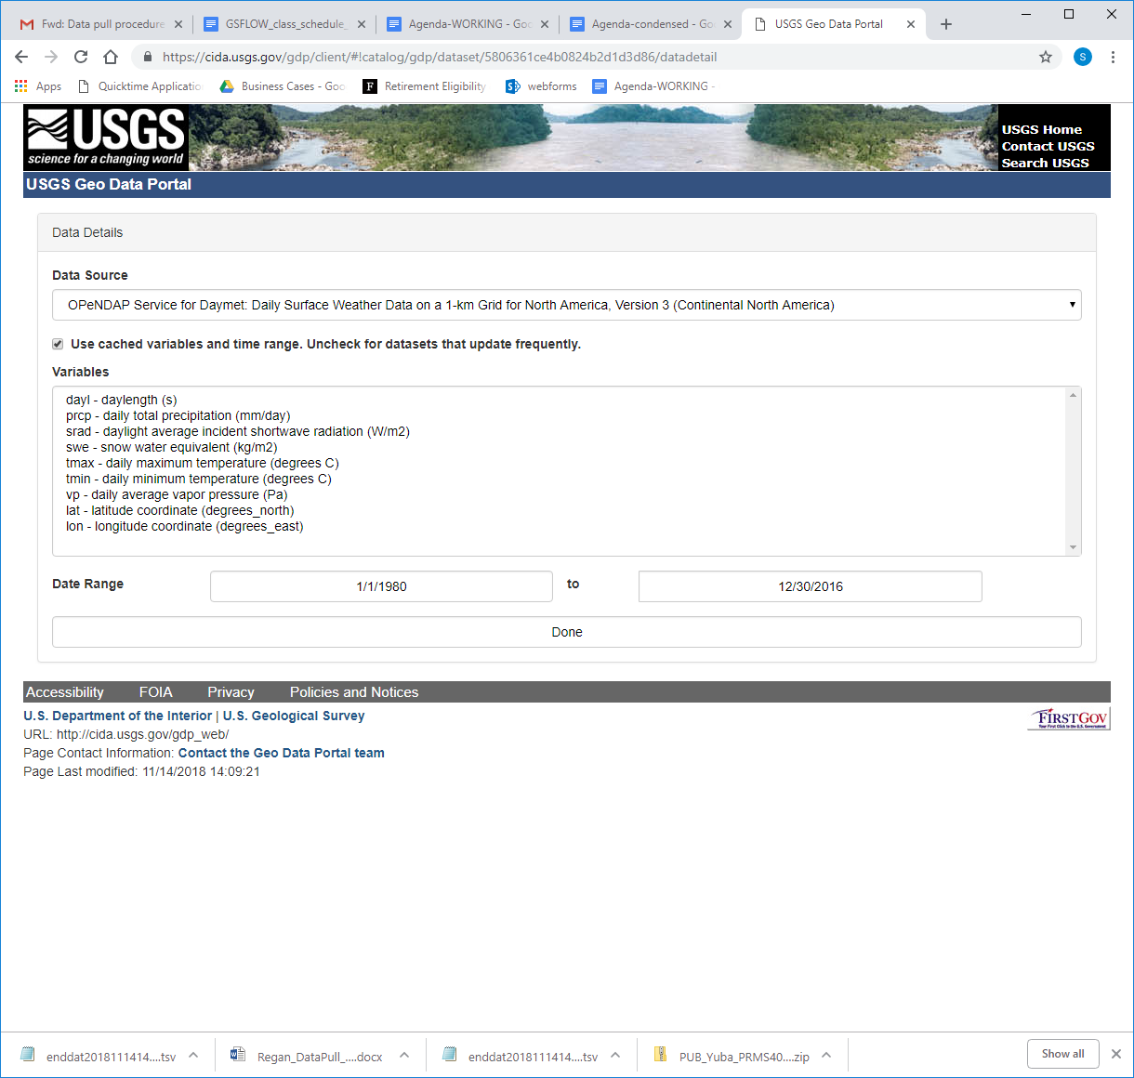
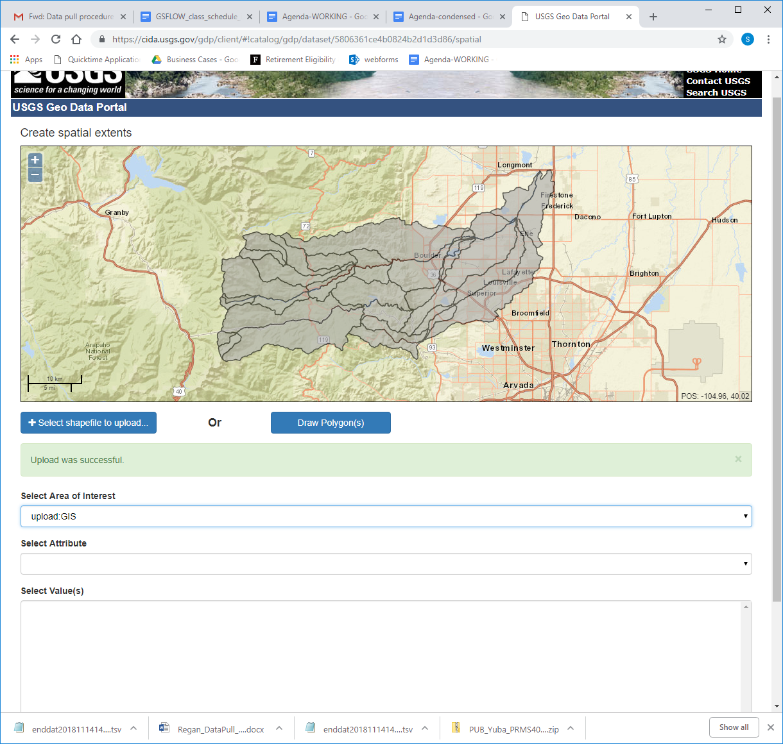
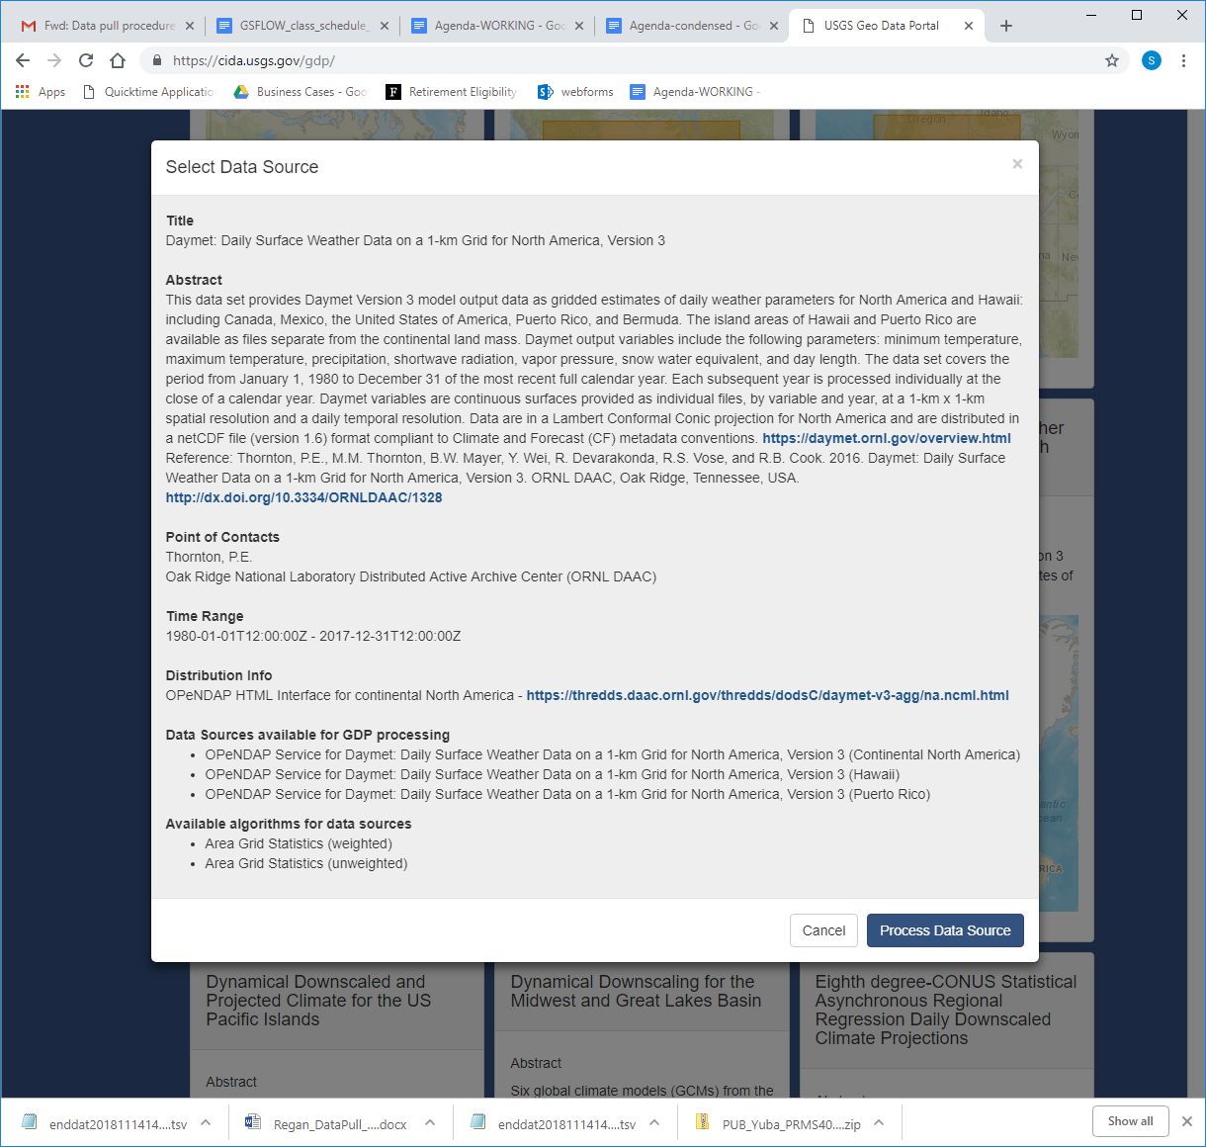
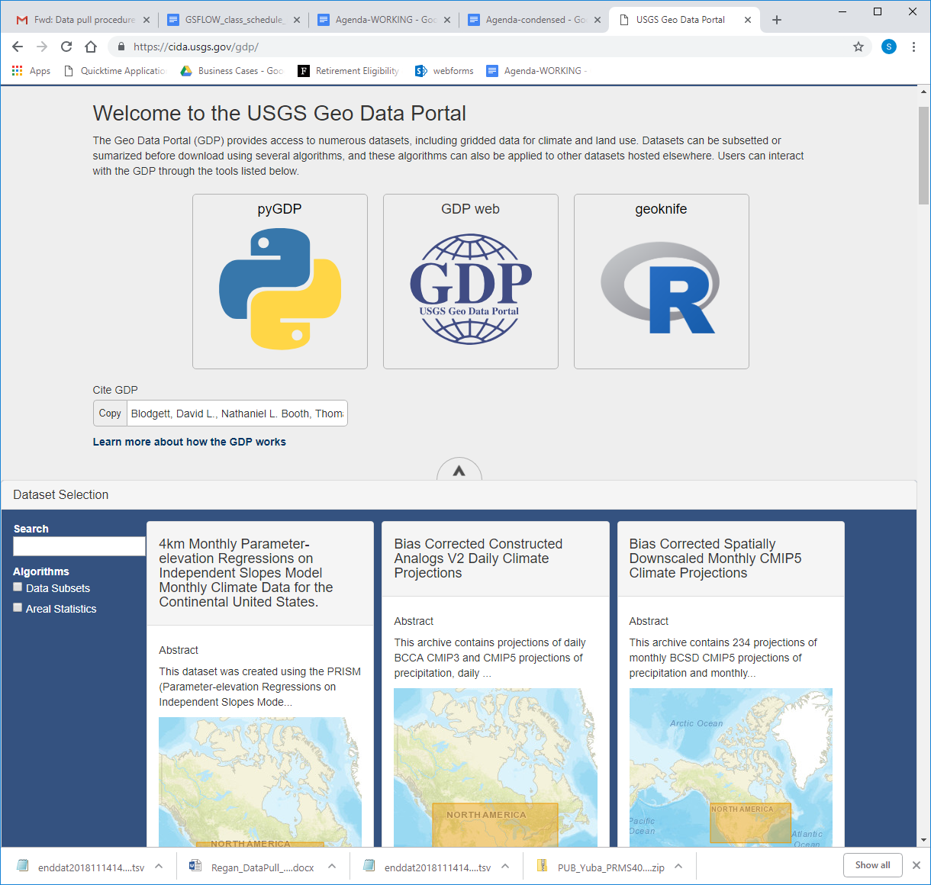
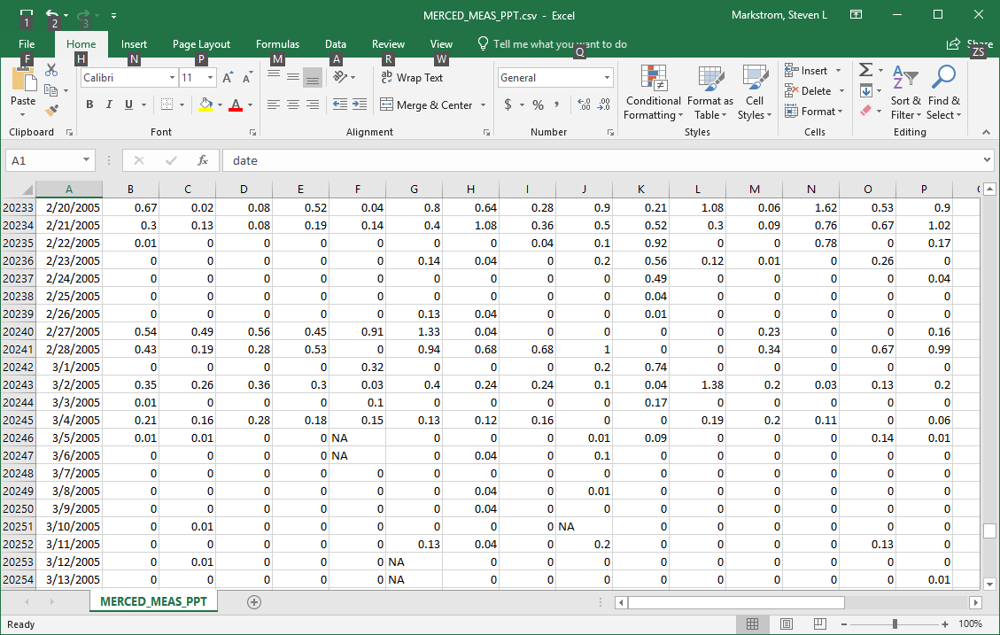
Geo Data Portal
https://cida.usgs.gov/gdp/

