Slide 1
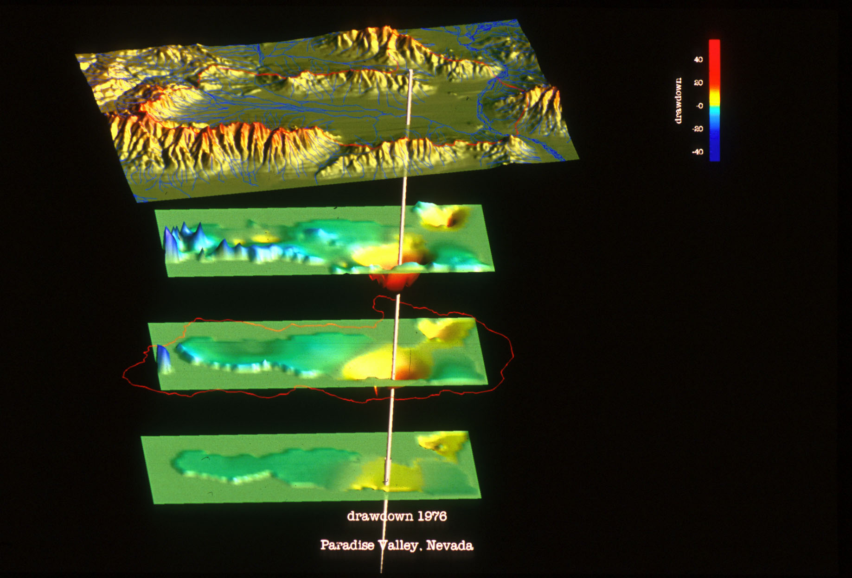
Flow in Channels (SFR) and Reservoir Storage (LAK)

Slide 2
Channel Flow (SFR)
SFR simulates streamflow using continuity
Simulating flow and depth is important for estimating SW-GW interactions
Wetting and drying of channels, impacts of capture by wells
Simulate flows where there are no measurements
Inflows and outflows from reservoirs

Slide 3
Channel Flow (SFR)
Solves steady-flow
Kinematic-wave
Diversions, releases, floodplain

Slide 4
Channels are Represented at Sub-grid Level
Streams divided into segments and reaches
Reach is a length of stream within one MODFLOW grid cell that has constant streambed properties.
Segments are groups of reaches that have
Uniform overland flow, precipitation, ET
Tributary inflow
Point inflow or outflow at beginning
Diversions from downstream end

Slide 5
Stream Network and Channel Geometry
Model grid
Inflow
Segment 1
Diversion
Inflow
Segment 3
Segment 5
Canal
Segment 2
Point diversion
Segment 4
Segment
junction
Canal delivery
for irrigation
Segment 6
Segment 7

Slide 6
Channel Flow (SFR) and Reservoir Storage (LAK)
Joining reaches
Parallel reaches
Flow into and out of each reach calculated during every MODFLOW iteration
Multiple stream reaches simulated for a model cell
Does not simulate multiple model cells for one stream reach
1
2
1
2
GW node
3
Only one cell per reach
1
2
3

Slide 7
Stream Inflows
1
2
3
Pipeline
Start of segment 4
Inflow = pipeline + sum of tributary flows
Reach
Overland runoff
(L³/T)
w= width
L = channel length
Streambed

Slide 8
Stream Outflows
pipeline
Start of segment
End of segment
Diversionary flow
Reach
w= width
L = channel length
Streambed

Slide 9
Diverting Flow into a Segment
Specified diversion
Diversion rate reduce to available flow
Diversion rate reset to zero when available flow less than specified diversion
Specified fraction of flow in stream
Flow diverted only when available flow exceeds a specified flow rate

Slide 10
Big Challenge: How to Create Stream Network
Creating a stream network is tricky, especially in areas with significant relief
Issues are caused by the model grid scale DEM; causes low lying cells to shift. Can’t use NHD stream network
Solution is to use combination of NHD and ARC tools to create network
Stream network and model grid DEM must be consistent

Slide 11
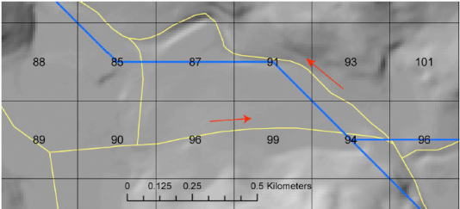
NHD+ Networks not Consistent with Resampled DEM (Model Top)
Circular Flows

Slide 12
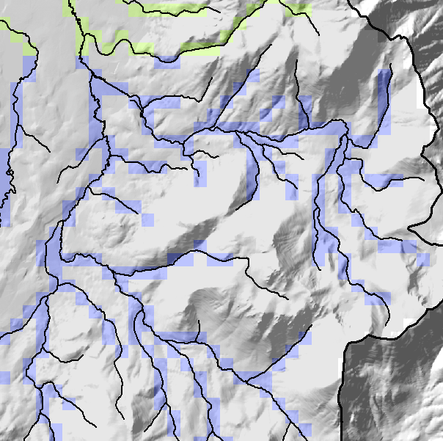
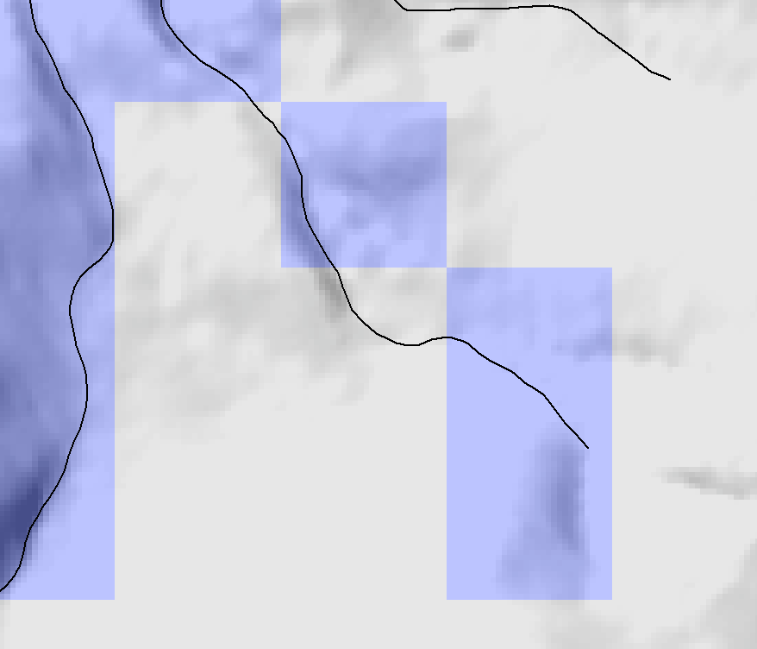
NHD+ Networks not Consistent with Resampled DEM (Model Top)
NHD streams cut across cells above the stream canyon defined by model cells

Slide 13
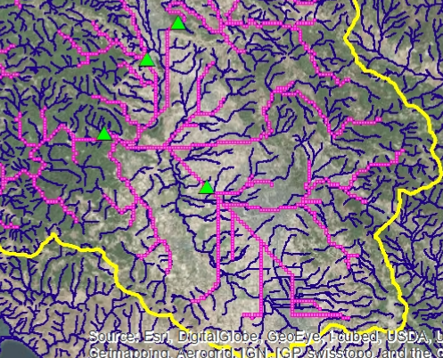
Difficulties Developing Stream Networks
Alternatively, use ArcHydro flow direction (FD) and flow accumulation (FA) tools based on model cell altitudes.
This causes problems in flat areas

Slide 14
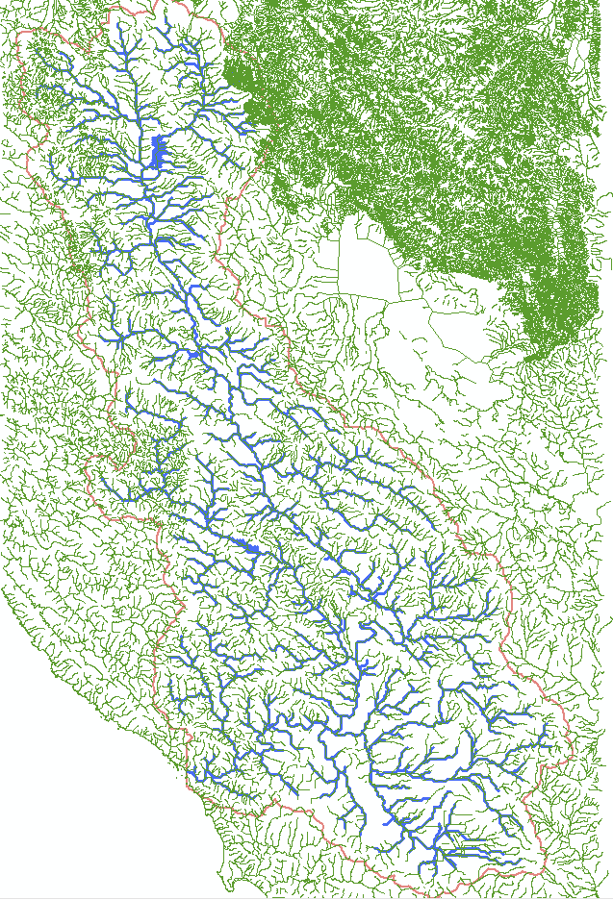
Hybrid NHD/ArcHydro Approach
Sequential process
Buffer model cells around NHD streams (4 cells wide)
Apply DEM (model scale) conditioning (CRT), assure continuous down-sloping paths, lower cells to deal with “holes”
Use conditioned DEM to develop streams using ArcHydro (FD+FA)
Much better!

Slide 15
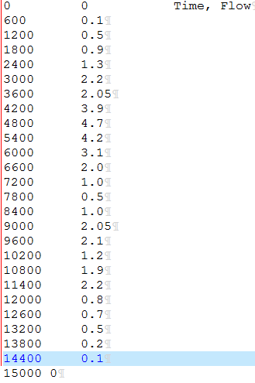
New SFR2 Features
Time series inflow to stream reach (can be any arbitrary time interval)
OPTIONS
Tabfiles 716 13219 #tabfiles, numtab, maxval
END

Slide 16
Channel Flow (SFR)
Solves steady-flow
Kinematic-wave
Diversions, releases, floodplain

Slide 17
Channel Flow (SFR)
Solves steady-flow
Kinematic-wave
Diversions, releases, floodplain

