Slide 1
Hydrologic Cycle
Air Temperature
Solar Radiation
Potential
Evapotranspiration
evaporation
ET
ET
surface
depressions
or lake
ET
impervious
Infiltration
pervious
runoff
Preferential flow
Interflow
Dunnian runoff
Interflow
Recharge
Recharge
Infiltration includes net precipitation, snowmelt, and cascading Hortonian runoff
Runoff includes impervious and pervious infiltration excess, saturation excess, and surface depression seepage and near surface flow
Precipitation text and arrows need to be white
Notes:
This cartoon illustrates flow paths in the hydrologic cycle. The yellow lines represent flows computed by the soilzone module. Flows computed are: soil evapotranspiration, interflow, preferential flow, Dunnian runoff, and recharge.

Slide 2
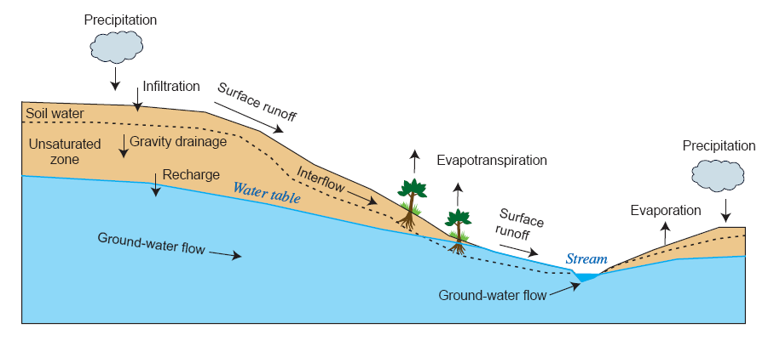
Solar Radiation
Air Temperature
Potential
Evapotranspiration
Hortonian Runoff
Dunnian
Runoff

Slide 3
Land HRU
Solar Radiation
Air Temperature
Sublimation
Precipitation
Evaporation
Potential
Evapotranspiration
Plant Canopy Interception
Evaporation
Throughfall
Evapotranspiration
Snowmelt
Snowpack
Hortonian Runoff
Snowmelt
Impervious Surfaces
Soil Zone
Cascading Surface Runoff and Interflow
Streams and Lakes
Dunnian Runoff
and Interflow
Recharge
Groundwater Storage
Groundwater Flow
Groundwater Sink
Throughfall = Net Rain plus Net Snow
Surface Depression Storage not shown
Swale HRUs are the same except they do not produce lateral flows (Interflow, Hortonian Runoff, or Dunnian Runoff)

Slide 4
Soilzone of Land HRU
Unsatisfied Potential
Evapotranspiration
Evaporation and
Transpiration
Fraction of Pervious and Impervious Hortonian Runoff
Inflow
Preferential-Flow Reservoir
(full HRU)
Dunnian Runoff and
Fast Interflow
Cascading Dunnian Runoff and Interflow
Evaporation and
Hortonian Runoff
Capillary Reservoir (pervious fraction)
Surface Depression
Impervious
Hortonian Runoff
Evaporation, Spillage,
and Interflow
Gravity Reservoir
Slow Interflow
Recharge
Recharge
Recharge
Inflow = throughfall, snowmelt, and cascading Hortonian runoff

Slide 5
Surface Depressions
Potential
Evapotranspiration
Net Rain and Net Snow
Evaporation
Snowmelt
Fraction of Pervious and Impervious Runoff
Spillage and Interflow
Surface Depressions
Soil Zone
Streams and Lakes
Recharge
Groundwater Storage

