Slide 1
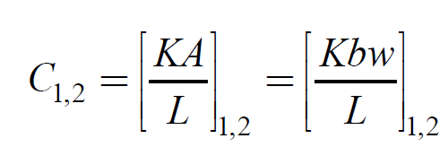
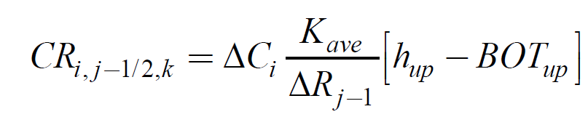
Aquifer Transmissivity (T)
T=Kb
b
Aquifer Conductance (CC,CR,CV)

Slide 2
After substituting Darcy’s Law and Applying Finite Differences
Can be written as Ah=B (Harbaugh, 2005)

Slide 3
Hybrid Newton/Picard Method
Newton:
Picard:
Hybrid:
*This allows MF Packages to be linearized using either Newton
or Picard, while GW solved with Newton

Slide 4
Spatial Discretization
Can be written as Ah=B (Harbaugh, 2005)

Slide 5

For GFLOW best to keep all Cells Active
Consider two adjacent cells one dry and one partially wet:
$b_{ave}=\frac{100−100+95−90}{2}$ = 2.5
dry
H=100
H=95
wet
z=90
*Using standard inter-cell averages of conductance
based on saturated thickness will cause water to flow
From a dry cell to a wet one.

Slide 6

Solution: Full Upstream Weighting
dry
$b_{up}=100−100$= 0
Hup=100
H=95
wet
Conductance is calculated based on saturated thickness
of cell with higher head only. Thus, flow will not leave a dry cell

Slide 7
Second Problem: Conductance Transitions from Head Dependent to Constant
Cmax
Kw/L
C
dC/dh
0
0
Cell
bottom
Cell
top
h
This transition causes dC/dh to change from
1 to zero, a discontinuous derivative

Slide 8
Solution: Smooth Saturated Thickness Function over the Discontinuity

Slide 9
Newton Solver for MODFLOW
Newton method is more robust than Picard for strongly nonlinear problems.
Cost: Newton method typically results in a asymmetric matrix (Picard results in a symmetric matrix).
This leads to Newton-Krylov methods (i.e., iterative linear solvers that rely on Krylov subspace methods such as GMRES and Orthomin acceleration methods.

Slide 10
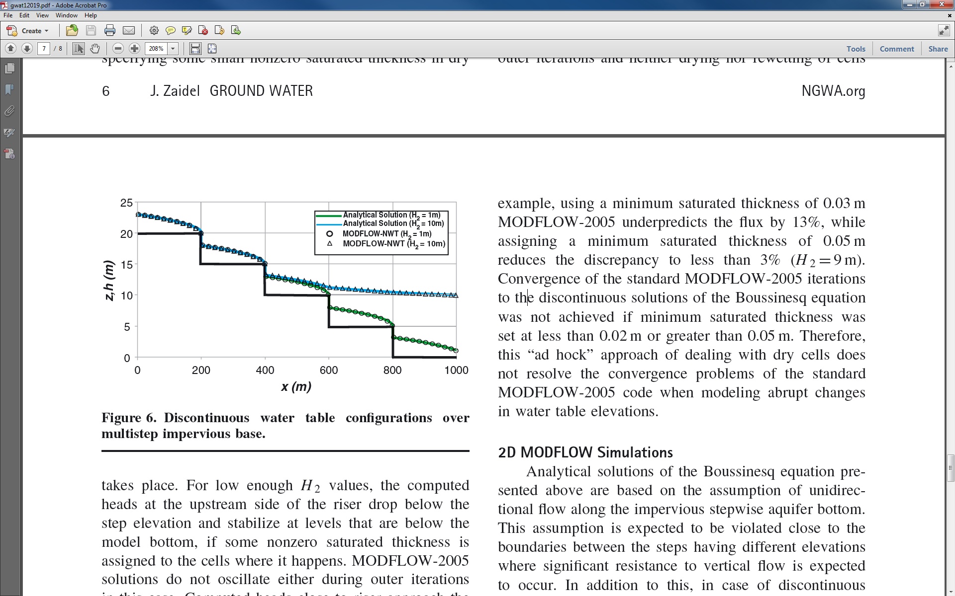
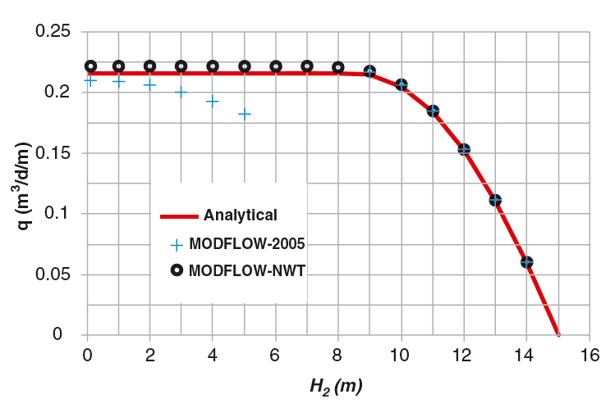
MODFLOW-NWT—GW Engine for GSFLOW
Suited for modeling mountains (sloped, thin, unconfined aquifers, Dupuit assumption)
Jaidel, J, Groundwater, 2013
Notes:
Not long after MODFLOW-NWT was published, a paper by Jaidel came out in the Groundwater journal that introduced a new analytical solution for discontinuous groundwater flow down steep aquifers. Jaidel’s paper provides an independent appraisal of MODFLOW-NWT for simulating mountain-type groundwater flow processes, while illustrating the difficulties of applying the classical MODFLOW solution to these systems.

Slide 11
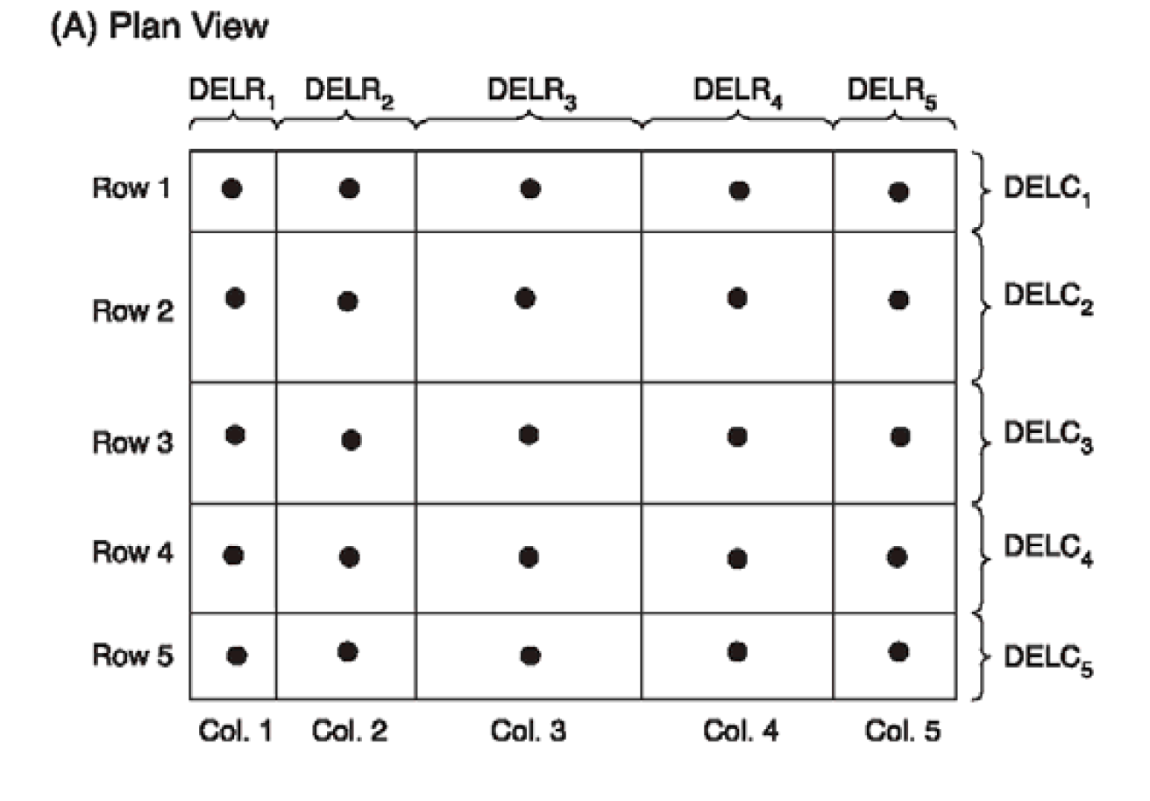
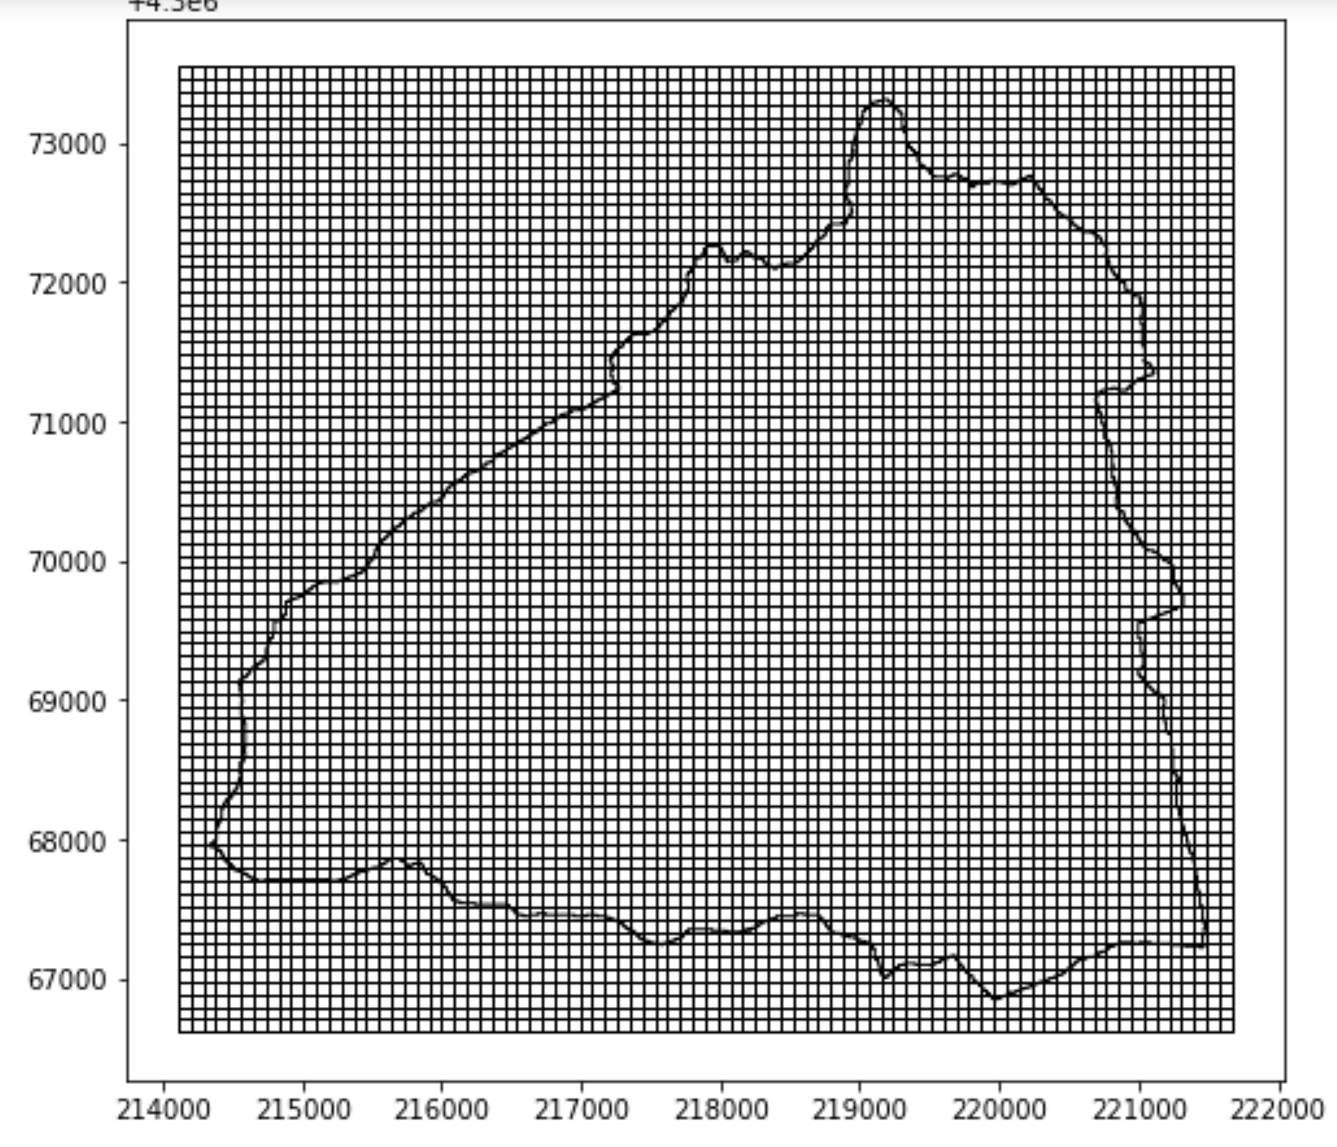
Discretization of Space-Horizontal
All GSFLOW applications tend to use constant cell sizes.
Horizonal cells divided into rows (“delr”) and columns (“delc”).
Notes:
Not long after MODFLOW-NWT was published, a paper by Jaidel came out in the Groundwater journal that introduced a new analytical solution for discontinuous groundwater flow down steep aquifers. Jaidel’s paper provides an independent appraisal of MODFLOW-NWT for simulating mountain-type groundwater flow processes, while illustrating the difficulties of applying the classical MODFLOW solution to these systems.

Slide 12
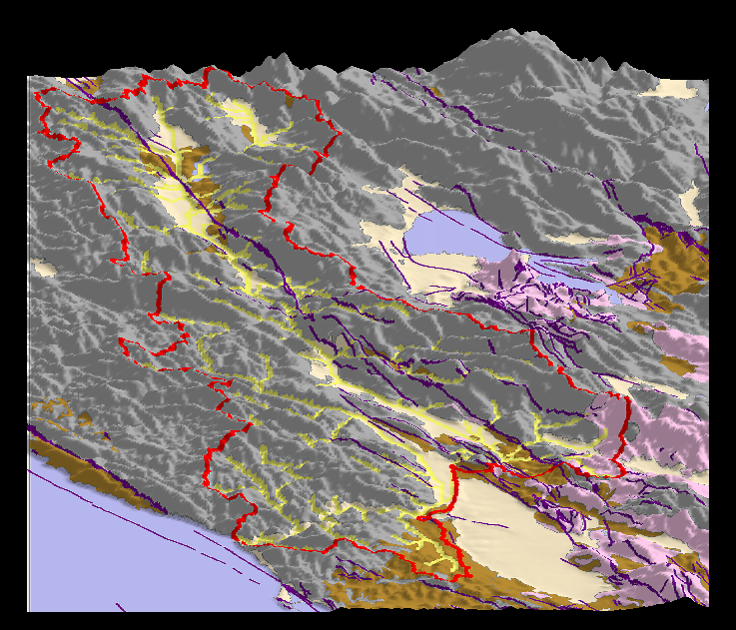
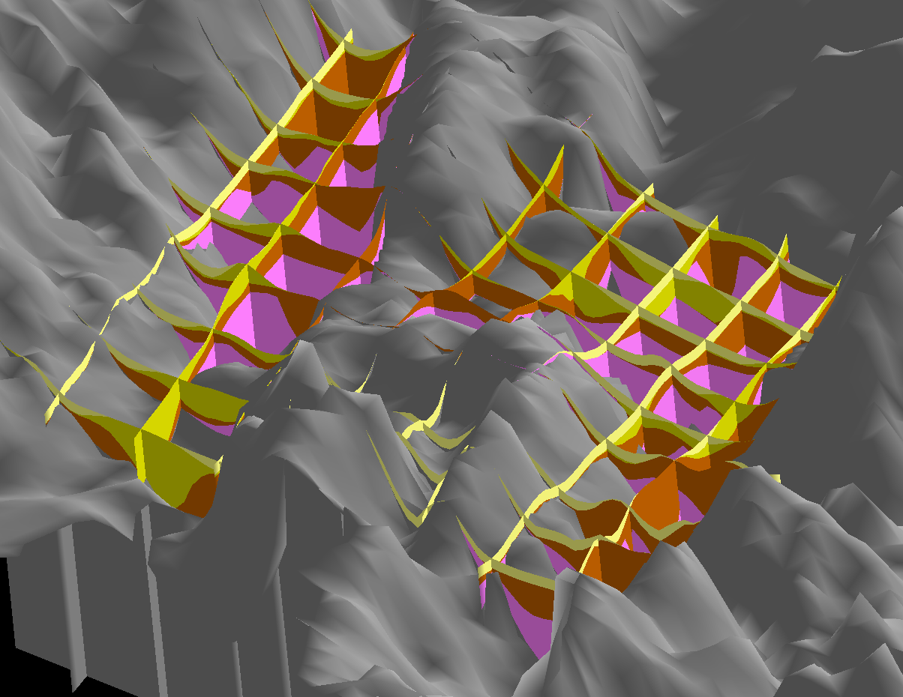
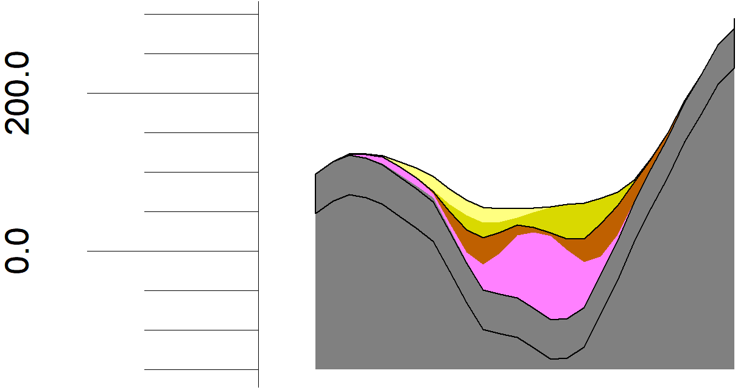
Discretization of Space-Vertical
Channel Alluvium
Unconsolidated sediment
Consolidated sediment
Sonoma Volcanics
Franciscan Basement
300
200
Meters above
sea level
Layer 1
100
0
Layer 2
-100
Layer 3

Slide 13
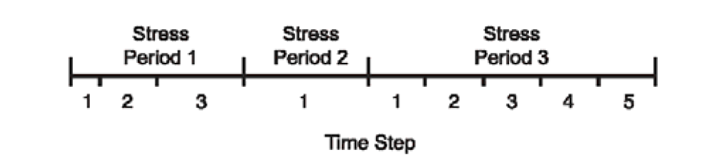
Discretization of Time
Stress periods--period of constant boundary conditions. Stress periods not needed for GSFLOW
Time step--time over which an individual groundwater computation is made. Must be 1 day in GSFLOW
Notes:
Not long after MODFLOW-NWT was published, a paper by Jaidel came out in the Groundwater journal that introduced a new analytical solution for discontinuous groundwater flow down steep aquifers. Jaidel’s paper provides an independent appraisal of MODFLOW-NWT for simulating mountain-type groundwater flow processes, while illustrating the difficulties of applying the classical MODFLOW solution to these systems.

