Slide 1
Unsaturated Flow (UZF1) Package
1-D vertical flow beneath the soil zone.
Regional groundwater models; delay and attenuation of recharge.
Simulates ET, groundwater discharge to soil zone, and rejection of infiltration caused by shallow water table.

Slide 2
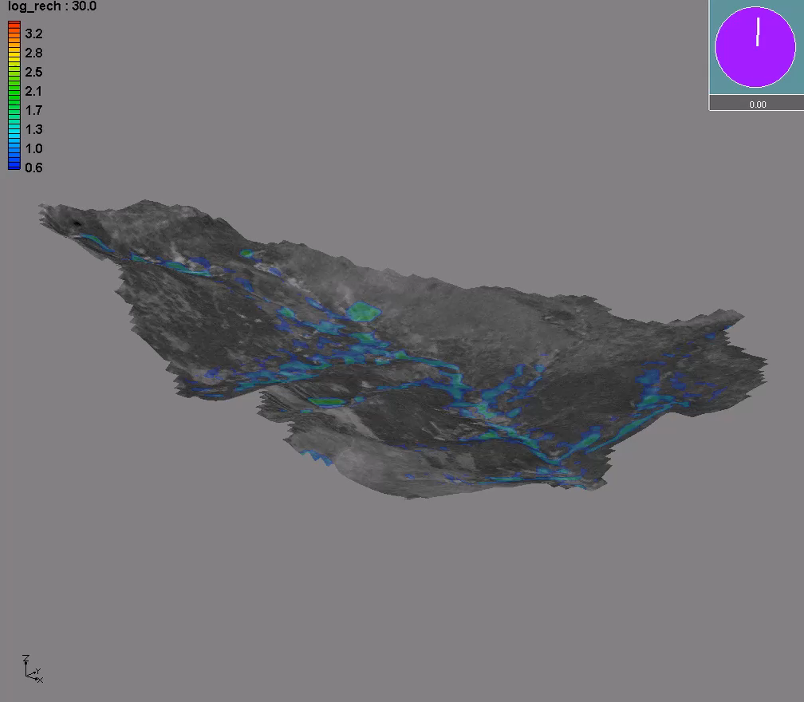
Unsaturated Flow
Important for simulating recharge processes in regional hydrology models

Slide 3
Why Use 1-D Kinematic-Wave Equation?
There are several reasons. A review of other approaches for simulating unsaturated flow provides impetus and justification.

Slide 4
Difficulties with Applying Numerical Solution of Richards’ Equation for Regional Studies
Constitutive parametric models: K(Ψ) and θ(Ψ); laboratory scale.
Requires small cells (cm) to resolve infiltration and drainage.
Data limitations.

Slide 5
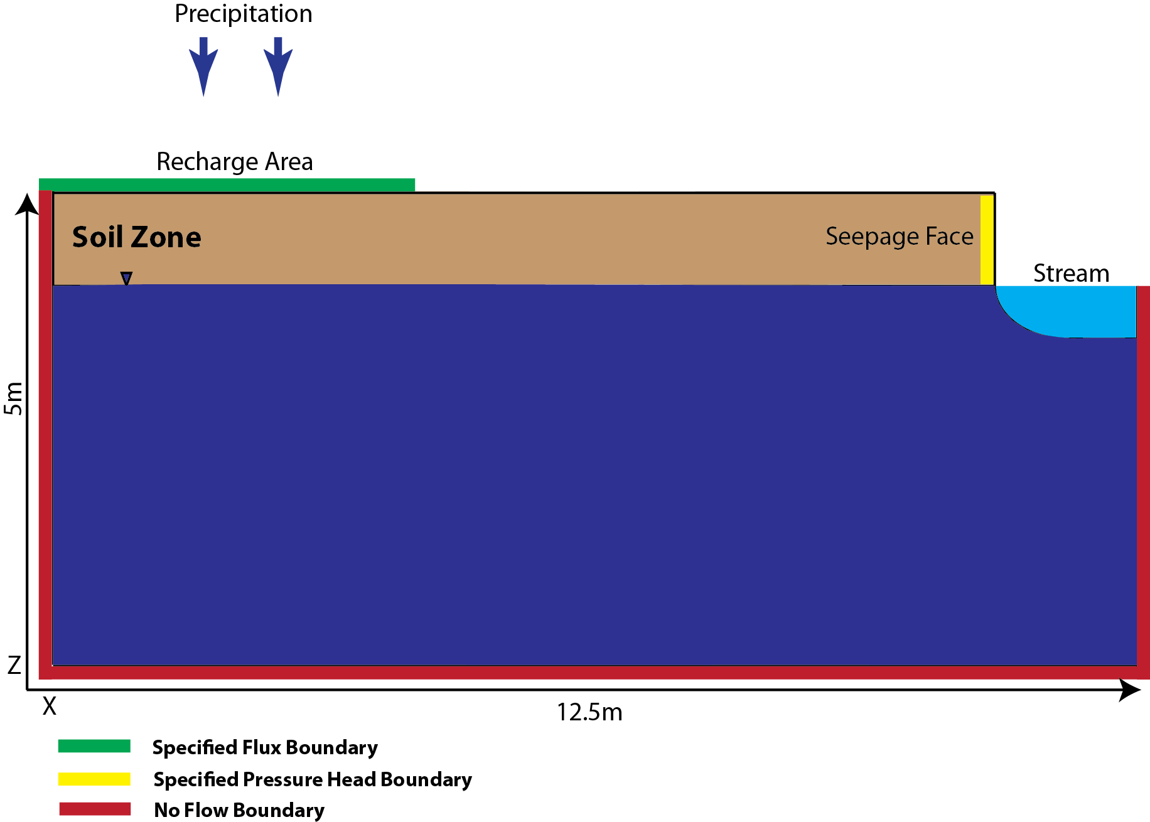
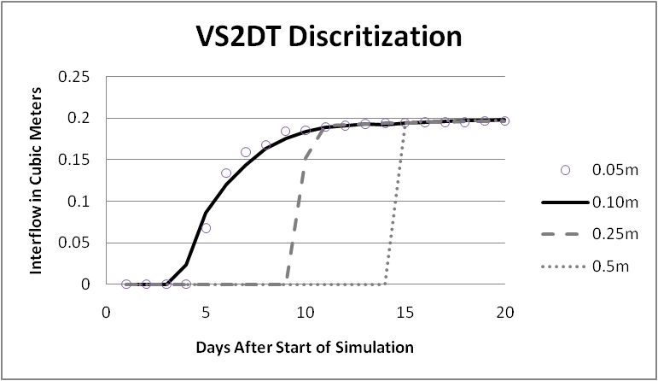
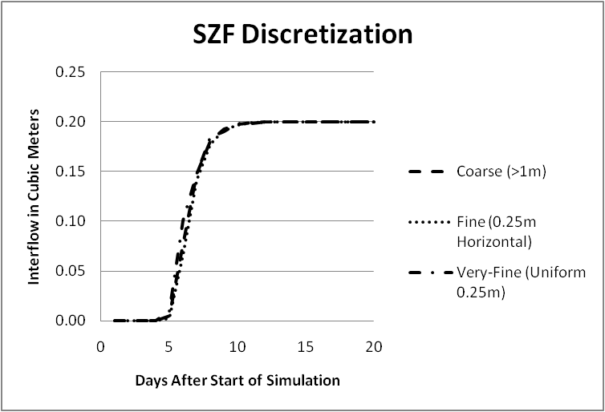
Comparison between Richards-based and GSFLOW Models
Model setup
Richards’ Equation
GSFLOW
Henson, 2013
GSFLOW less influenced by grid cell size

Slide 6
What Have We Learned from Stochastic Modeling:
“With respect to regional-scale flow processes, the solutions showed that at sufficiently large scales and in the absence of interflow, the average lateral flow component is negligible, so that the large-scale Richards’ equation becomes one-dimensional”
“The tendency of homogenizing soil water content reduces
soil water flux variability, thereby providing a justification for one-dimensional or simple bucket-type flow models to simulate regional-scale soil water flow”
Quotes from a literature review by Harter and Hopmans (2004)

Slide 7
Derivation of Kinematic-Wave Equation
0
1D Richards’
Equation
Like wave celerity in
streamflow
Chain rule

Slide 8

Unsaturated Flow Beneath Soil Zone— Kinematic-Wave Equation
Kinematic wave simplification of Richards’ Equation:
Equation of variation for θ:
Matrix form:
USGS
science for a changing world
Notes:
Lose the hydraulic diffusivity term from Richard’s equation.

Slide 9
Method of Characteristics Solution
Wave-velocity characteristic
Theta-loss characteristic (ET)
Cramer’s rule
Wave-profile characteristic
USGS
science for a changing world
Notes:
Cramer’s Rule: if there exits a set of n linear equations, then the system has a unique solution if the determinate of the system is not equal to zero. We are looking for the discontinuity at the wave front (non-unique solution). Thus, the characteristics are found by setting the determinates to zero.

Slide 10
Water Table is Below Land Surface: Water Table Rises
Infiltration
Increasing
t+Δt
New water table
level
t

Slide 11
Water Table is Below Land Surface: Water Table Falls
Infiltration
Increasing
Water table
falls faster
than wetting
front
t
Old water table
level
t+Δt

Slide 12
UZF1 Compared to Observed Field Data and Richard’s Equation
From Twarakavi et al. (2008) 7 (2) Vadose Zone Journal

Slide 13
Comparison to Vauclin et al. (1979) Laboratory Experiment
Richards’ equation (Hydrus)
UZF1
From Twarakavi et al. (2008) 7 (2) Vadose Zone Journal
Lab experiment: Vauclin, D Khanji, G Vachaud - Water Resources Research, 1979

