Slide 1
Changes to MODFLOW
Changes were made to facilitate coupling to PRMS.
Changes were made to simulate hydrologic processes.

Slide 2
Model Connections Occur where Regions Overlap

Slide 3
Flow Connections Between PRMS and MODFLOW
4 main connections
Surface runoff and streams/lakes (1 way).
Soil zone and streams/lakes (1 way).
Soil zone and unsaturated/saturated zone (2 way).
Streams/lakes and unsaturated/saturated zone (2 way)

Slide 4
Region Connections Between PRMS and MODFLOW

Slide 5
Changes Made to Facilitate Coupling to PRMS
Deep percolation only occurs when the water table is below the soil-zone base. GW Discharge only occurs when the water table is above the soil-zone base.
—Method assumes that topographic undulations create a gradual transition between recharge and discharge conditions.

Slide 6
Transition between recharge and discharge conditions
Due to undulations, the area where recharge/discharge occurs is a function of GW head, which affects conductance:
Fig. 20 from GSFLOW doc.

Slide 7
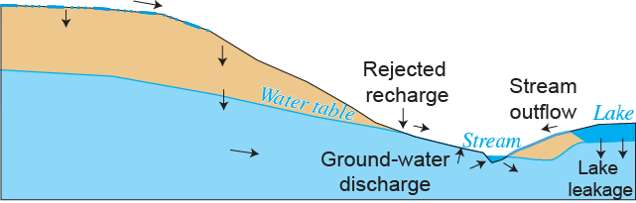
Changes Made to Simulate Hydrologic Processes
Refined interaction between lakes, streams, and groundwater.
Added capability to simulate groundwater discharge areas (e.g. springs and saturation excess).

Slide 8
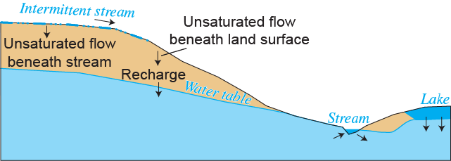
Changes Made to Simulate Hydrologic Processes
Unsaturated flow beneath land surface (soil-zone base).
Intermittent streams with unsaturated seepage.

Slide 9
Unsaturated-Flow Beneath Soil Zone (Deep Percolation)
Kinematic-wave solution for gravity driven downward unsaturated flow.
Infiltration fluctuations are attenuated and shifted as they percolate through the unsaturated zone.

Slide 10
Head-Dependent Recharge (UZF)
Infiltration
Increasing
t+Δt
New water table
level
t

Slide 11
Streamflow Routing and Surface-/Ground-water Interaction
GSFLOW uses the MODFLOW Stream Package because it simulates GW/SW interactions.
Simulates recharging and discharging streams, intermittent streams, and unsaturated flow beneath streams.
Transient Routing based on Kinematic-wave.

Slide 12
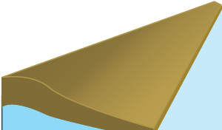
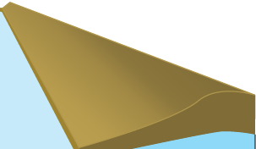
Simulating Streams
Flood
wave
S
u
r
f
a
c
e
S
u
r
f
a
c
e
I
n
r
un
o
ff
r
un
o
ff
t
e
r
f
l
o
w
Interflow
ET
St
r
e
a
m reach
Seepage
Finite-di
f
ference cell

Slide 13
Unsaturated flow beneath streams
Unsaturated flow beneath streams for simulating stream seepage though thick unsaturated zones.
—Present version neglects capillary potential gradients during the onset of streamflow.

Slide 14
4. Modifications to Lake Package
Newton iteration during transient stress periods.
Lakes can rewet from surface inflow, precipitation, and/or ground-water inflow; mass is conserved.
Lake area is a continuous function of lake depth.
More robust method for calculating lake outflow to streams was implemented.
Unsaturated flow can be simulated beneath lakes.

