Slide 1
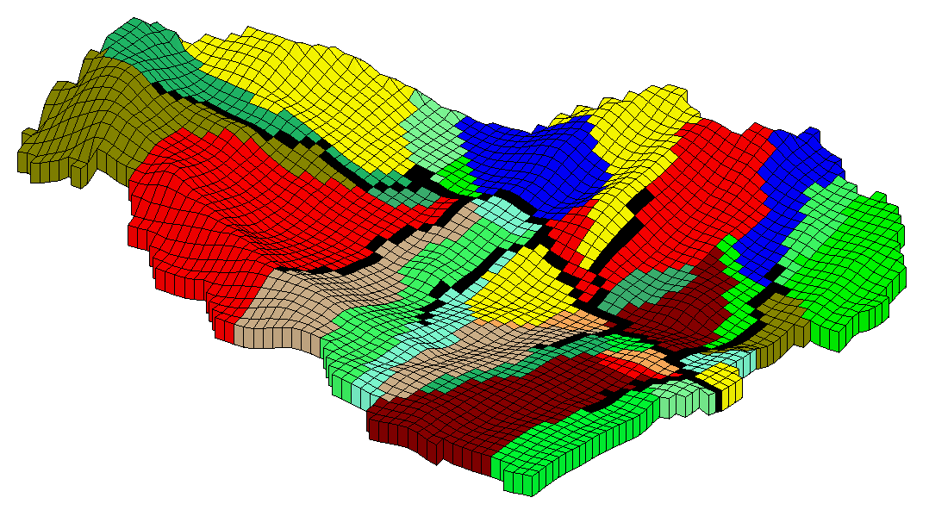
GSFLOW: Integration of PRMS with MODFLOW-NWT

Slide 2
Discretization of Time
Daily time step
  Daily climate forcings
    temperature, precipitation, solar radiation, potential ET
  Computes mean daily values
  Some processes have internal sub-daily time steps
    Snow (2, 12 hour periods), streamflow (depends on Module or Package options)
  Some parameters can have monthly or winter/summer values
  Dynamic parameters and water-use input on any time step, similar to stress periods
MODFLOW ITMUNI with stress periods
GSFLOW sets conversions between models
Future: support different time steps in MODFLOW
Notes:
Changes to solrad/soltab

Slide 3
Units
PRMS: Mixed Bag for input and algorithms
  See PRMS_tables_5.0.0.docx in “doc” directory
  Some parameters have specific units others must be specified based on units parameters
  temp_units (0=Fahrenheit; 1=Celsius)
  elev_units (0=feet; 1=meters)
  precip_units (0=inches; 1=millimeters)
Most PRMS output in English units, some metric
  Inches per unit area, cfs, acre-inches
MODFLOW consistent
  LENUNI (1=feet; 2=meters; 3=centimeters)
GSFLOW set conversions between models
  Most GSFLOW specific output in MODFLOW units
Notes:
Changes to solrad/soltab

Slide 4
Discretization of Space
MODFLOW regular grid cells
  Computational efficiency
  Numerical stability
PRMS HRUs
  Appropriate to module algorithms
  Homogeneous with respect to input parameters, fluxes, and storages
  Any combination of shapes (topography, points of interest, surface-water features, land-use, biologic, grid)
  Complicating factors
    Typical PRMS, left and right HRU per stream segment
    Mapping between irregular HRUs and cells could introduce issues such as spreading groundwater discharge upslope
    Cascading flow easier to determine based on grids
Notes:
Changes to solrad/soltab

Slide 5




PRMS Conceptualization
Surface
Infiltration
Hydrologic
Response
Units
(HRUs)
Subsurface
Streamflow
Recharge
Groundwater
Notes:
Make sure to discuss that once flows reach the stream, a routing scheme is in place.

Slide 6
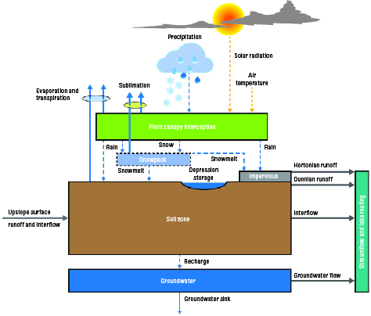
PRMS HRU

Slide 7
PRMS Spatial Features
Hydrologic Response Units (HRUs)
    Shape is arbitrary
    Parameters represent central tendency
    Homogenous for hydrologic response
    Understand how much detail is adequate and necessary to simulate dominant processes
    What resolution does data support
  hru_type
    0 = Inactive
    1 = Land
    2 = Lake
    3 = Swale
    4 = Glaciers (not in GSFLOW yet)

Slide 8
PRMS Spatial Features
Hydrologic Response Units (HRUs)
  Sub-HRU
    Depression storage (Volume and surface area dynamically computed)
    Impervious area
    Pervious area (capillary reservoir, must be at least 0.001 fraction)
    Canopy density
    Canopy storage (winter/summer)
    Snowpack (Volume and surface area dynamically computed)
    Preferential flow reservoir
    Gravity reservoir

Slide 9
PRMS Spatial Features
Stream segments
  segment_type (not used in GSFLOW yet)
  0 = normal
  1 = headwater
  2 = lake
  3 = replacement flow
  4 = inbound to nation
  5 = outbound from nation
  6 = inbound to region
  7 = outbound from region
  8 = drains to ocean
  9 = sink (terminus to soil)
  10 = inbound from Great Lakes
  11 = outbound to Great Lakes
  12 = ephemeral

Slide 10

HRU Examples
Flow-planes
Grid Cells
Soils
Elevation bands
Land use
Surface water features
Geology
Anything important

Slide 11

HRU Examples
Flow-planes
Grid Cells
Soils
Elevation bands
Land use
Surface water features
Geology
Anything important

Slide 12

HRU Examples
Flow-planes
Grid Cells
Soils
Elevation bands
Land use
Surface water features
Geology
Anything important

Slide 13
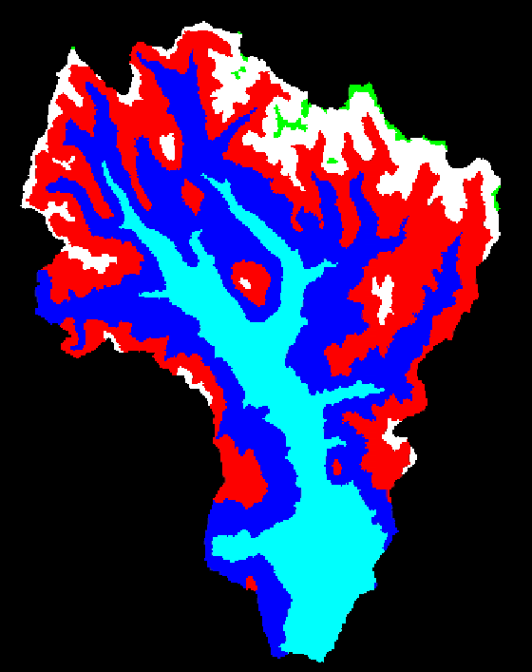
HRU Examples
Flow-planes
Grid Cells
Soils
Elevation bands
Land use
Surface water features
Geology
Anything important

Slide 14
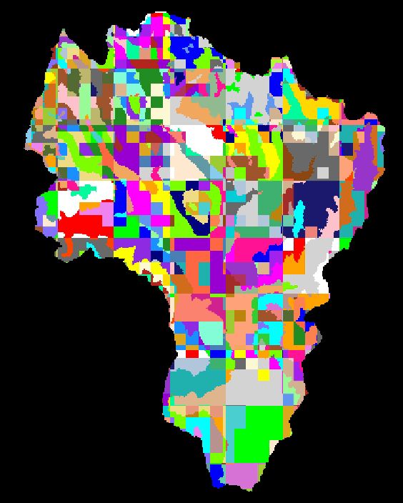
HRU Examples
Flow-planes
Grid Cell
Soils
Elevation bands
Land use
Surface water features
Geology
Anything important

Slide 15
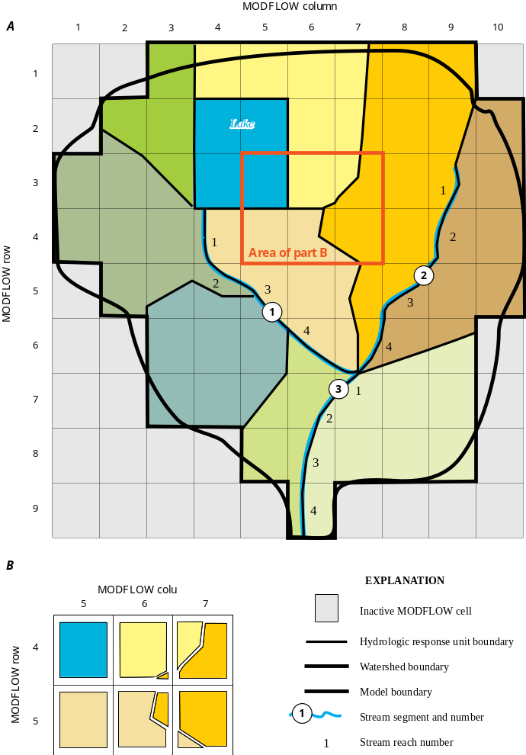
Start with Streams and Lakes
“Jagify” Gravity Cells
Notes:
GVRs

Slide 16
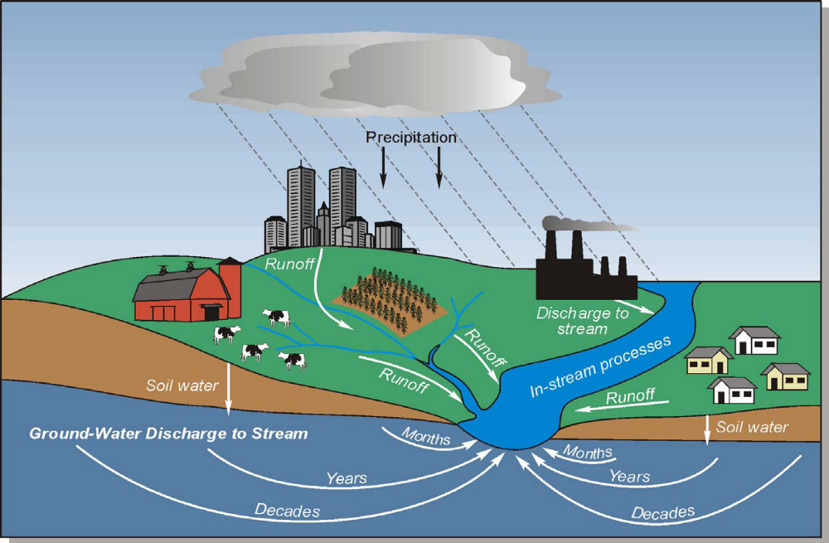
cascade Module
What pathway does water take to the stream channel?

Slide 17
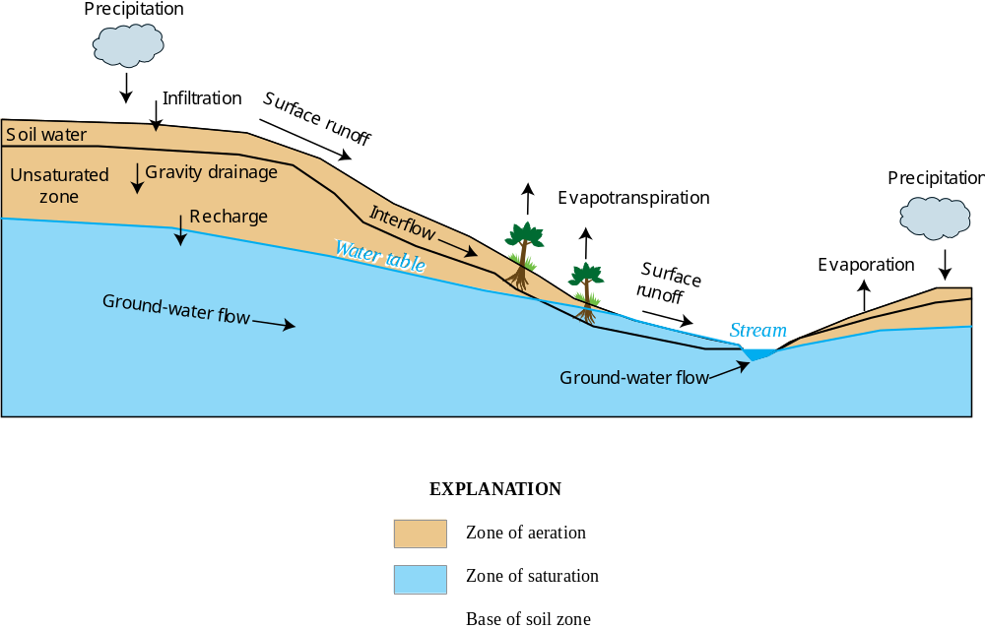
cascade Module

Slide 18
cascade Module
  Reasons to use the cascading flow options:
  Specify realistic flow paths to account for the storage and timing effects of:
  topography, topology, geology, land-use, land cover, etc. on hydrologic drainage patterns
    Optional, but recommended for all GSFLOW applications
    Depression storage captures HRU specific Hortonian Flow
  Allows for simulating divergent and convergent flows that can result in reinfiltration of Hortonian (infiltration excess) overland runoff, Dunnian (saturated excess) runoff, fast and slow interflow, and groundwater flow down a flow plane
    Throughfall and snowmelt either infiltrates into the soil or moves laterally over the surface, where it can infiltrate further down the slope.

Slide 19
cascade Module
Lateral flow paths progress through successive HRUs and GWRs to stream segments, swale HRUs, and lake HRUs using spatial continuity
Groundwater cascades flow to each other and stream segments, but, not to swale and lake HRUs
  Land-surface cascades provide a good initial approximation of groundwater cascades

Slide 20
cascade Module
Directed, acyclic flow network (no circles)
Code checks for circles and determines routing order
1
2
3
HRUs
4
5
6
7
9
8
10
stream
segments
3
3
4
1
4
1
2
2

Slide 21
Cascade Links
hru_up_id
hru_down_id
hru_down_pct
strmseg_down_id
1 | 2 | 3 | 3 | 5 | 5 | 6 | 6 | 7 | 10
2 | 5 | 5 | 6 | 7 | 6 | 7 | 10 | 0 | 0
1. | 1. | .3 | .7 | .8 | .2 | .4 | .6 | 1. | 1.
0 | 0 | 0 | 0 | 0 | 0 | 0 | 0 | 1 | 2
1
2
3
4
5
6
7
10
9
8
1
2
3
4

Slide 22
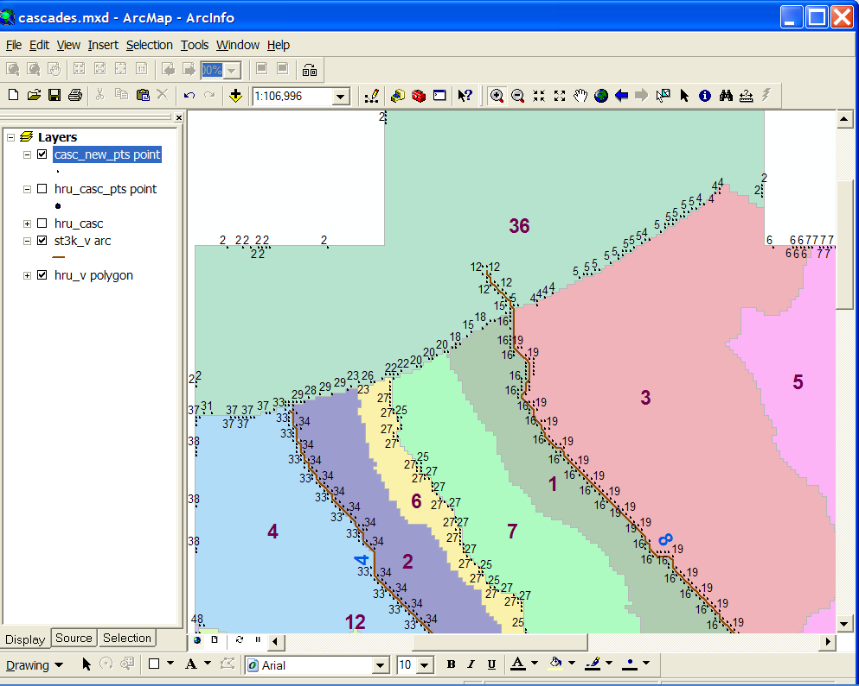
cascade Module
Links determined by contributing area and adjacency
Intersection of stream segments (extended to top of headwaters)
with adjacent HRUs take precidence

Slide 23
Cascading Flow
CRT provides a method to compute cascade paths for PRMS when HRUs are grid based.
Cascade links determined by relative difference between HRU elevations, thus it assumes lateral hydrologic gradients for up to 4 adjacent HRUs are equal to land-surface gradients and that the flow paths represent the effects of gravity on the flow
Henson, W.R., Medina, R.L., Mayers, C.J., Niswonger, R.G., and Regan, R.S., 2013, CRT—Cascade Routing Tool to define and visualize flow paths for grid-based watershed models: U.S. Geological Survey Techniques and Methods 6-D2, 28 p.
http://pubs.usgs.gov/tm/tm6d2/pdf/tm6-D2.pdf

Slide 24
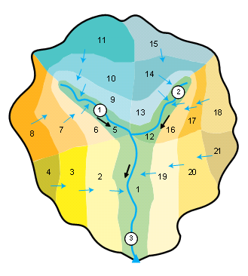
One-to-One Cascade Links
HRUs cut by
elevation bands
cascade_flag
circle_switch
cascade_tol
Ignore cascade link if it’s area is
< cascade_tol and < 7.5% of HRU area

Slide 25
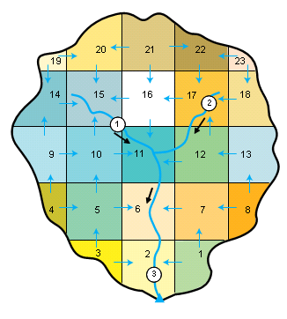
One-to-Many Cascade Links
Grid-based HRUs

Slide 26
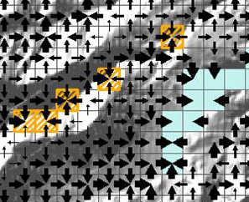
One-to-Many Cascade Links
Local Depressions Shown in Yellow
(swale HRUs)
Lake shown in light green

Slide 27
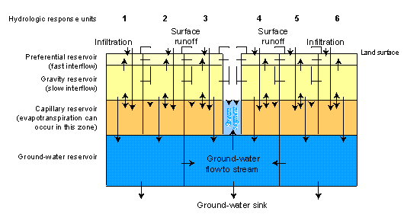
Cascading Flow Example
Interflow
Groundwater flow
Hortonian and Dunnian Overland Runoff

Slide 28
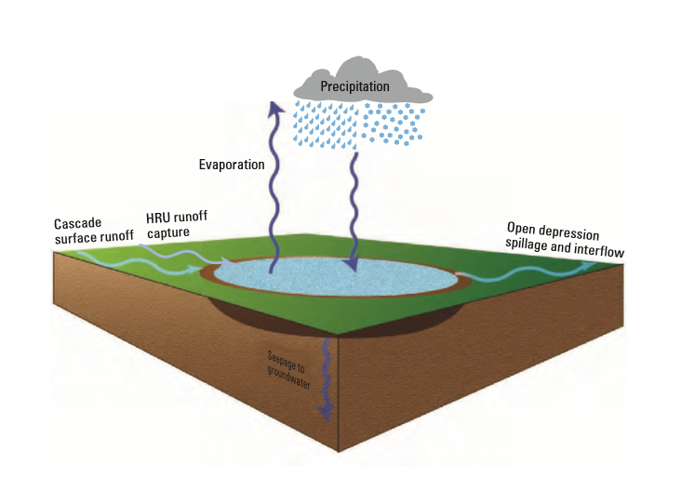
PRMS feature being used more
  Surface Depression Storage (Ag ponds, prairie potholes, sink holes, etc.)
  Regan, R.S., and LaFontaine, J.H., 2017, Documentation of the dynamic parameter, water-use, stream and lake flow routing, and two summary output modules and updates to surface-depression storage simulation and initial conditions specification options with the Precipitation-Runoff Modeling System (PRMS): U.S. Geological Survey Techniques and Methods, book 6, chap. B8, 60 p.
Captures
  Surface Runoff (cascade, infiltration excess, snowmelt)
  Precipitation (as open surface, i.e., no ice)
Outflow
  Evapotranspiration
  Seepage
  Interflow
  Spillage

Slide 29
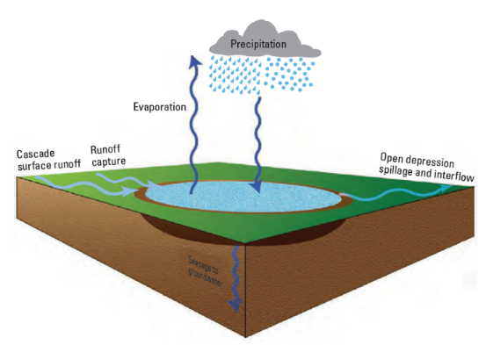
Surface-water depression storage
‘merge, fill, and spill’
PRMS uses a ‘lumped’ configuration of the surface-water depressions within each HRU, preventing ‘fill and spill’ connectivity between individual surface-water depressions.
evaporation
External spill point
Evaporation
dprst_et_coef
Surface Runoff
op_flow_thresh
dprst_flow_coef
conceptualization for rectangular bottom surface-water depression.
dprst_et_coef - fraction of PET
dprst_seep_rate_open - used in linear seepage flow equation
dprst_flow_coef - used in linear flow routing equation
op_flow_thresh - fraction of storage above which surface runoff occurs; any water above max open storage capacity spills as surface runoff
dprst_depth_avg - average depth of storage depressions at maximum storage capacity
Interflow
dprst_depth_avg
dprst_seep_rate_open
Groundwater Recharge
recharge

Slide 30

https://onlinelibrary.wiley.com/doi/abs/10.1002/hyp.11416

Slide 31
Restart Option
Write and read antecedent conditions (also referred to as initial conditions)
Can be used in MODFLOW-only, PRMS-only, GSFLOW modes
Supports medium range forecasts, extended streamflow prediction (ESP)
Reduces simulation execution time by establishing hydrologic memory
Write states of last time step of spin-up simulation to binary files
Read as antecedent conditions for any number of restart simulations
Can change most PRMS modules for restart
modflow_time_zero, IWRT and IRED in Name File
save_vars_to_file, var_save_file, init_vars_from_file, var_init_file
Regan, R.S., Niswonger, R.G., Markstrom, S.L., and Barlow, P.M., 2015, Documentation of a restart option for the U.S. Geological Survey coupled groundwater and surface-water flow (GSFLOW) model: U.S. Geological Survey Techniques and Methods, book 6, chap. D3, 19 p., http://dx.doi.org/10.3133/tm6D3.

Slide 32
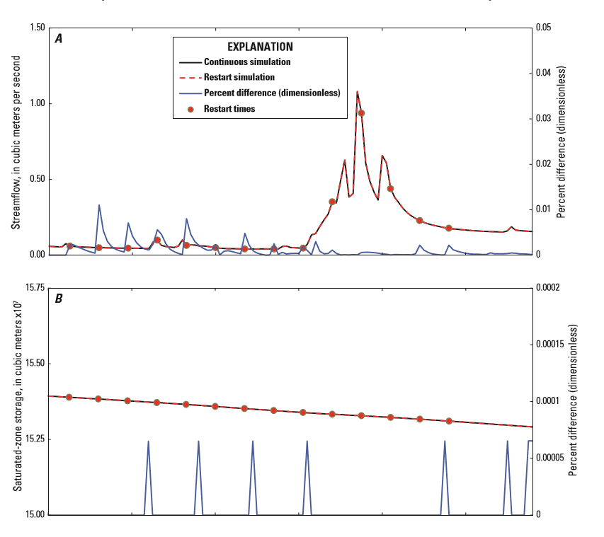
Restart Option

