Slide 1
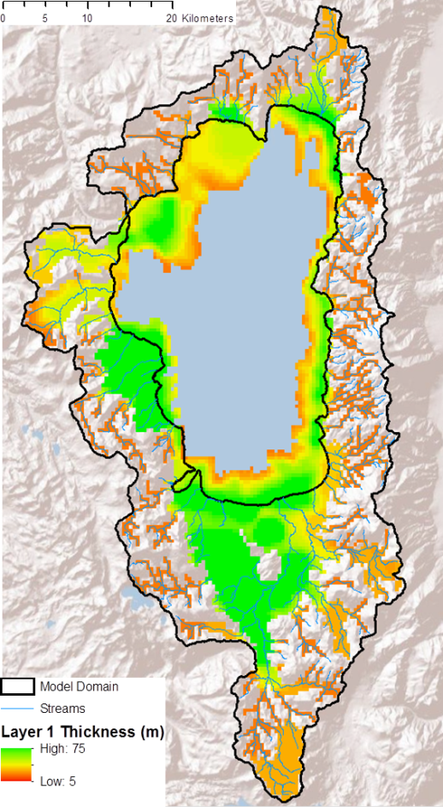
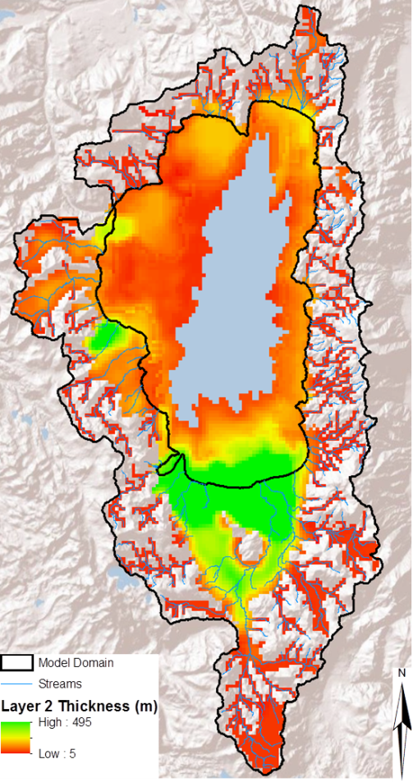
The Lake (LAK7)Package
Lakes are simulated using the MODFLOW Lake Package (Merritt and Kinokow, 2000), revised for MODFLOW-2005, NWT

Slide 2
Lake Connections to Aquifers and Streams
LAK Package simulates interaction of Lakes with MODFLOW and MOC3D
Merritt and Konikow, 2000,WRI 00-4167
Recent modifications
Lake
Aquifer
Lake Grid Cells
Aquifer Grid Cells

Slide 3
Lake Inflow
Separate water budget for each lake.
Inflow to Lake
Streams
Precipitation
Point
Overland runoff
Interflow
Leakage

Slide 4
Lake Outflows
Streams
Point
ET
Leakage

Slide 5
Computing Lake Stage
Precipitation and ET are a function of lake surface area.
Overland runoff and interflow to lakes are independent of lake stage
Stream inflow is routed to lakes with SFR2 in MODFLOW and is independent of lake stage
Additional inflow from factories, etc. are specified in Lake Package input by stress period and are independent of lake stage

Slide 6
Computing Lake Stage
h=f(V)
Q=f(h,A)
A=f(h)
Qsif
Qp
Qohr
Qsif
Qord
Qet
Qfif

Slide 7
Lake Connection to Aquifers
Lake surface
Lake bottom
Conductance terms
b
C_{b}=(K_{b}*A)/b
Lakebed
l
C_{a}=(K_{a}*A)/l
Aquifer
Cell node
Cross sectional area of aquifer

Slide 8
Model Representation
Lake cells
Aquifer cells
Kh
Kv
Cell node
Lakebed

Slide 9
Connection of lakes with streams and MODFLOW
Segment 1
1
2
1
3
2
Segment 2
4
3
5
6
5
4
7
7
6
Lake 1
8
12,500 feet
9
Segment 3
1
2
3
4
5
12,500 feet

Slide 10
Lake/Reservoir Release to SFR
Discharge can be specified
Discharge function of options used for stream in computing stream depth and width– wide rectangular channel, 8-point cross section, log-log equation, or table
Each stream discharging from a lake can have a different option for computing flows out of lake

Slide 11
Simulating Floodplain Dynamics
Lakes can rewet from surface inflow, precipitation, and/or ground-water inflow
Lake bathymetry can be specified using input tables (Stage, volume, and area)
Lakes can be contained within a single active cell
Floodplain
(LAK7)
Active
Channel
(SFR7)
Levee
Unsat.
Flow
(UZF)

Slide 12
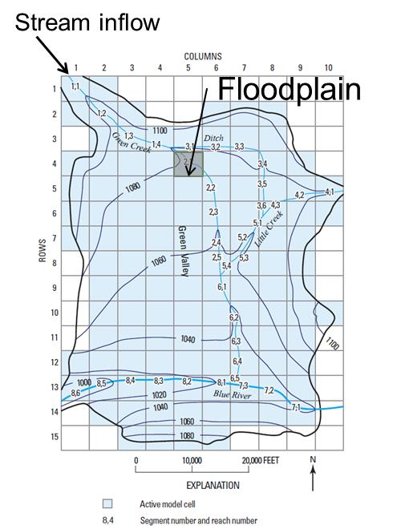
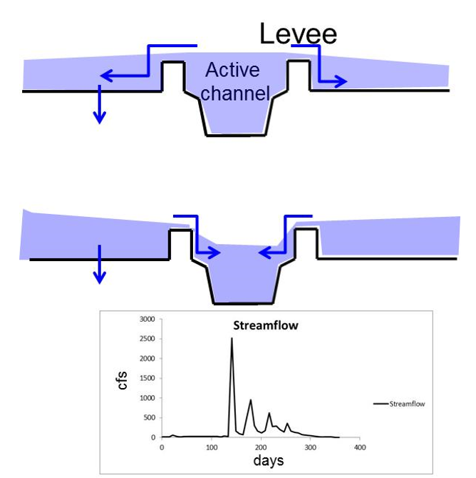
Simulating Floodplain Dynamics

Slide 13
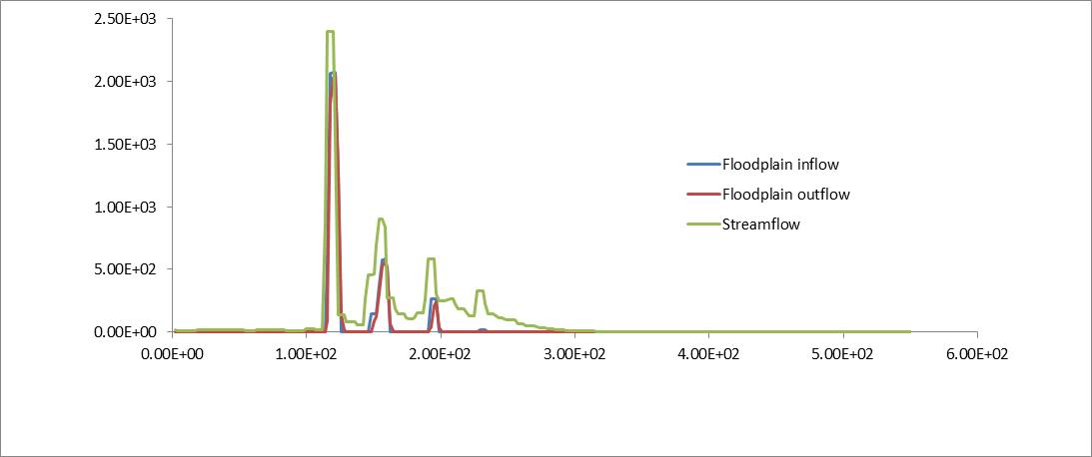
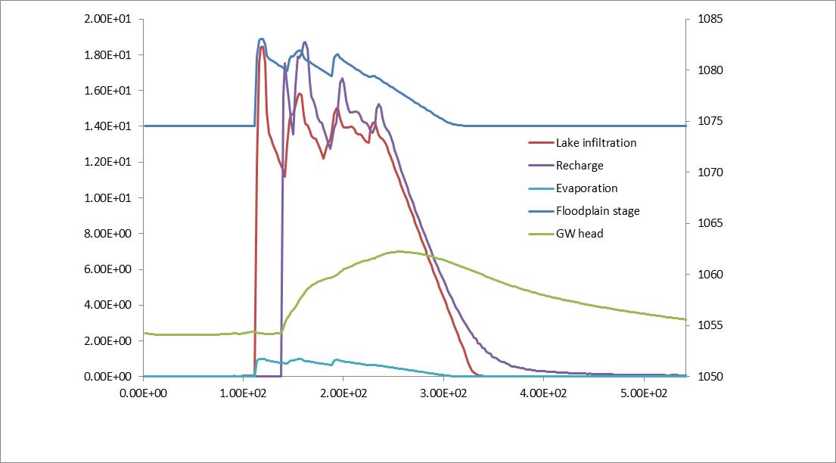
Simulating Floodplain Dynamics

