Slide 1
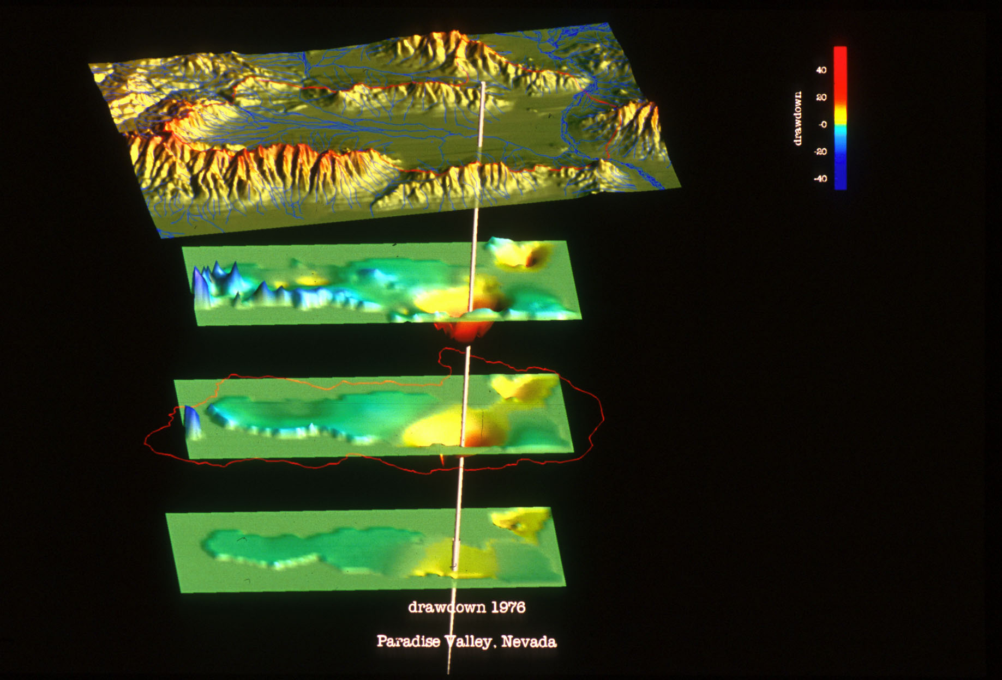
Flow in Channels (SFR)

Slide 2
Channel Flow (SFR)
Prudic et al., 2004 (SFR1)
Niswonger and Prudic, 2005 (SFR2)

Slide 3
Channel Flow (SFR)
SFR simulates streamflow using continuity
Simulating flow and depth is important for estimating SW-GW interactions
Wetting and drying of channels, impacts of capture by wells
Simulate flows where there are no measurements
Inflows and outflows from reservoirs

Slide 4
Channel Flow (SFR)
Steady-flow
Kinematic-wave (transient flow)
Diversions, releases, floodplain
Surface water and groundwater interactions
Wetting/drying/disconnected systems

Slide 5
Steady Flow Routing Option in SFR2
Simplifies routing by assuming only continuity of mass and no changes in storage: sum of flows in equals sum of flows out
Continuity:
*Relationship between flow and depth defined using several user options
Momentum:
S_{f} = S_{o}

Slide 6

Distributed Routing Option for SFR2
Transient Flow—Flood waves are routed using a kinematic-wave approximation of the Saint-Venant equations
Continuity:
$\frac{∂A}{∂t}+$ $\frac{∂Q}{∂x}∓q_{lateral flows}$
Momentum:
S_{f} = S_{o}

Slide 7
Channels are Represented at Sub-grid Level
Streams divided into segments and reaches
Reach is a length of stream within one MODFLOW grid cell that has constant streambed properties.
Segments are groups of reaches that have
Uniform overland flow, precipitation, ET
Tributary inflow
Point inflow or outflow at beginning
Diversions from downstream end

Slide 8
Stream Network and Channel Geometry
Model grid
Inflow
Segment 1
Diversion
Inflow
Segment 3
Segment 5
Canal
Segment 2
Point diversion
Segment 4
Segment
junction
Canal delivery
for irrigation
Segment 6
Segment 7

Slide 9
Channel Flow (SFR)
Joining reaches
Parallel reaches
Flow into and out of each reach calculated during every MODFLOW iteration
Multiple stream reaches simulated for a model cell
Does not simulate multiple model cells for one stream reach
1
2
1
2
GW node
3
Only one cell per reach
1
2
3

Slide 10
Stream Inflows
1
2
3
Pipeline
Start of segment 4
Inflow = pipeline + sum of tributary flows
Reach
Overland runoff
(L³/T)
w= width
L = channel length
Streambed

Slide 11
Stream Outflows
pipeline
Start of segment
End of segment
Diversionary flow
Reach
w= width
L = channel length
Streambed

Slide 12
Computing Stream Depth
Five options 1. Specified depth (same as river package)
2. Depth computed from Manning’s equation assuming a wide rectangular channel 3. Depth computed from Manning’s equation assuming eight point cross section 4. Depth computed from a log-log equation relating depth to flow 5. Depth computed from table

Slide 13
Option 2: Manning’s Equation for Wide Rectangular Channel
Q = (C/n) A R^{2/3} S_{o}^{1/2}
Where
A = area of rectangular channel (width * depth)
R = hydraulic radius = A /wetted perimeter= wd/(2d+w)
R = depth when width>>depth)
C = constant (1.0 for m³/s and 1.486 for ft³/s)
n = Manning’s roughness coefficient, dimensionless
Depth (d) can be computed as (explicit form):
d= [(Q/n)/(CwS₀ ^{1/2})]^{3/5}

Slide 14
Option 3: Eight Point Cross Section
The eight point cross section is divided into three parts.
Vertical walls are assumed at the end of each cross section
Channel
Left bank
Right bank
Part 2
Width
Depth
Wetted perimeter
Wetted perimeter and width also computed from cross section.

Slide 15
Option 3 Continued: Eight Point Cross Section
Area, , and hydraulic radius, , may be complicated (implicit) functions of depth , , and depth is on both sides of the equation (no matter how you apply algebra).
Equation solved by Newton-bisection method:

Slide 16
Option 5: Depth Computed from Table
Table of depth and width versus flow is entered from field rating curve information
Program uses log interpolation except when computed flow is between 0 and the first value in table
Flow | Depth | Width
5 | 0.5 | 10
50 | 1.3 | 15
100 | 1.8 | 20
1000 | 2.6 | 35

Slide 17
Diverting Flow into a Segment
Specified diversion
Diversion rate reduce to available flow
Diversion rate reset to zero when available flow less than specified diversion
Specified fraction of flow in stream
Flow diverted only when available flow exceeds a specified flow rate

Slide 18
Big Challenge: How to Create Stream Network
Creating a stream network is tricky, especially in areas with significant relief
Issues are caused by the model grid scale DEM; causes low lying cells to shift. Can’t use NHD stream network
Solution is to use combination of NHD and ARC tools to create network
Stream network and model grid DEM must be consistent

Slide 19
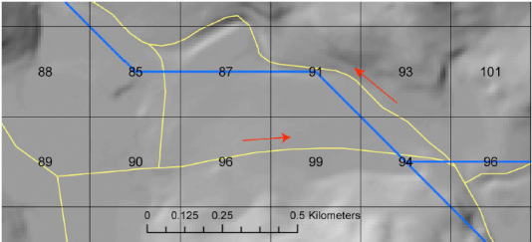
NHD+ Networks not Consistent with Resampled DEM (Model Top)
Circular Flows

Slide 20
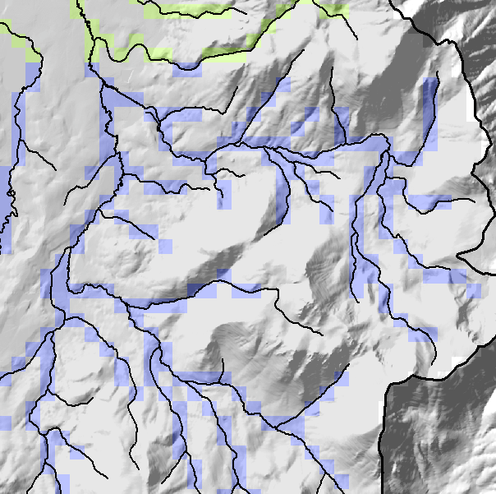
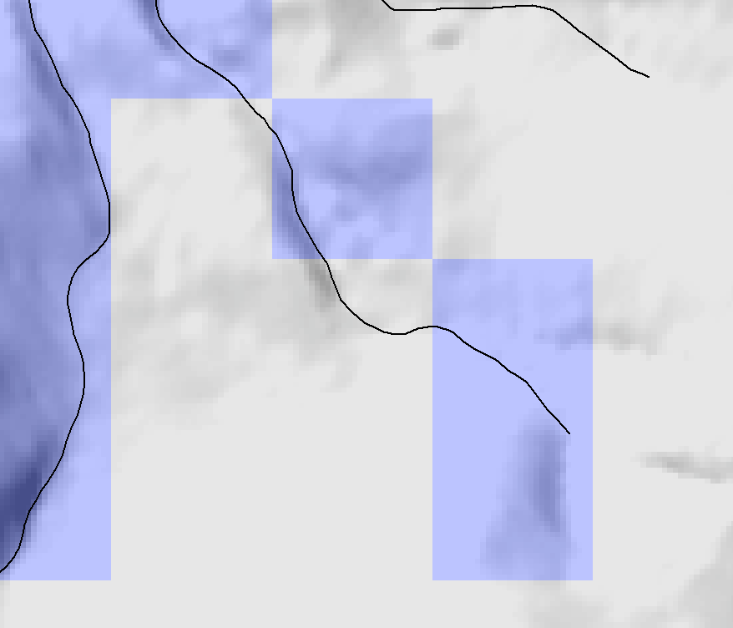
NHD+ Networks not Consistent with Resampled DEM (Model Top)
NHD streams cut across cells above the stream canyon defined by model cells

Slide 21
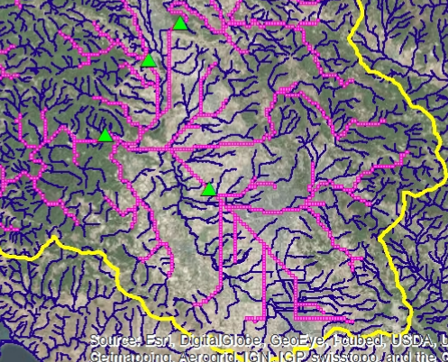
Difficulties Developing Stream Networks
Alternatively, use ArcHydro flow direction (FD) and flow accumulation (FA) tools based on model cell altitudes.
This causes problems in flat areas

Slide 22
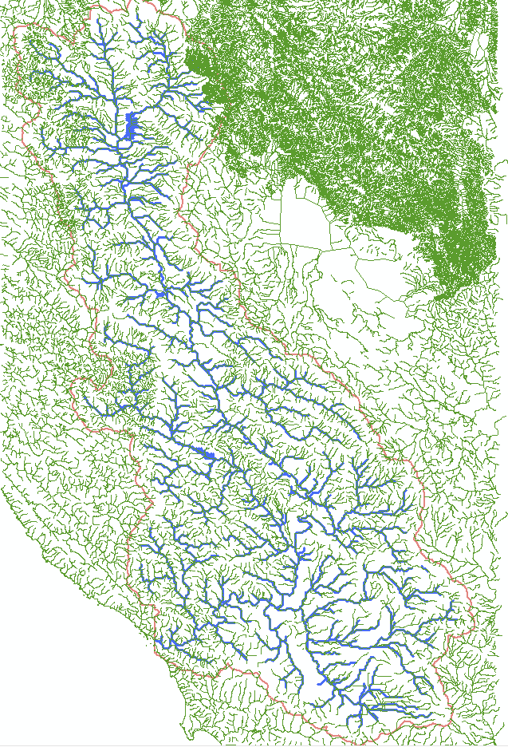
Hybrid NHD/ArcHydro Approach
Sequential process
Buffer model cells around NHD streams (4 cells wide)
Apply DEM (model scale) conditioning (CRT), assure continuous down-sloping paths, lower cells to deal with “holes”
Use conditioned DEM to develop streams using ArcHydro (FD+FA)
Much better!

Slide 23
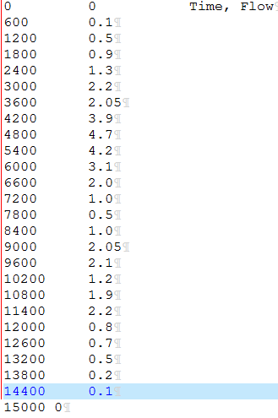
New SFR2 Features
Time series inflow to stream reach (can be any arbitrary time interval)
OPTIONS
Tabfiles 716 13219 #tabfiles, numtab, maxval
END

Slide 24
Streambed Top Altitude Must be Greater than Cell Bottom
Model will stop if this occurs for any stream reach
Stream penetrates into layer 2
Layer 1
Layer 2

Slide 25
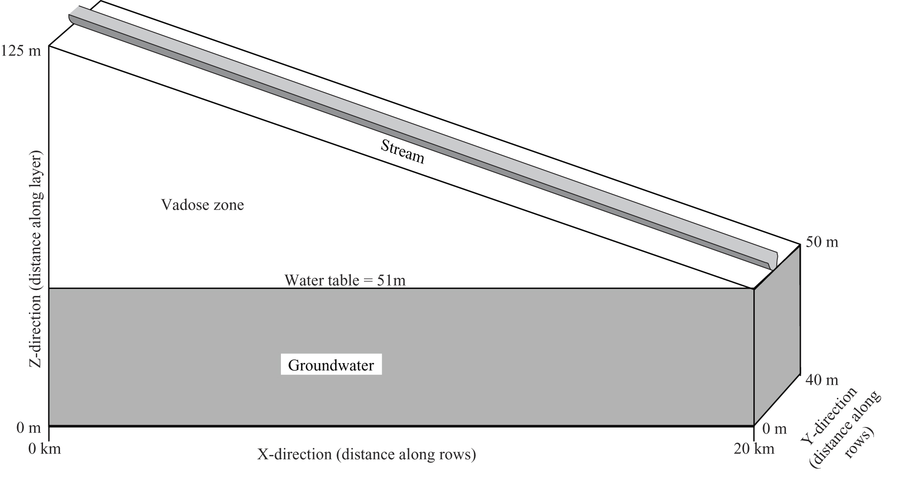
Example of Transient Flow

Slide 26
GAGE Package
Used for writing specific types of output data for streams and lakes.
Like its name suggests, it provides a means of writing output to separate files as a time series like a stream gage.
However, it can provide many different types of output.

