Slide 1
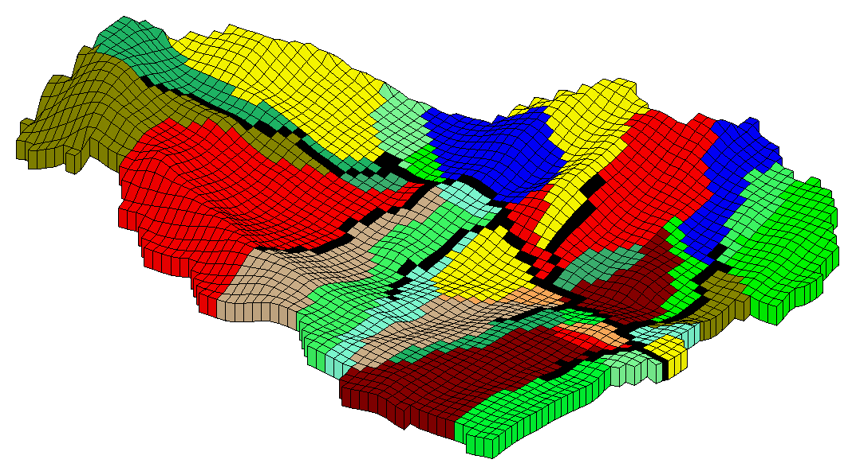
GSFLOW: Integration of PRMS with MODFLOW-2005

Slide 2
Philosophy of Model Development
“The objective of model formulation is to make simplifying assumptions so that the model is not unwieldy but still retains the important characteristics of the physical system.”
- R.E. Smith, 1971
Our addition:
The model must be applicable at the watershed scale.

Slide 3
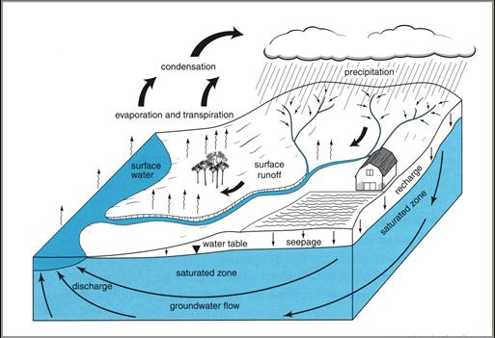
PRMS Questions
Where does water go when it rains?
How long does precipitation reside in the watershed?
What pathway does it take to the stream channel?

Slide 4
GSFLOW Questions:
Where is the water in space and time?
  Where and when does recharge occur?
  Where and when does GW discharge to land surface occur?
  Can we do a better job of identifying components of streamflow?
Which hydrologic process are affected by SW/GW interaction?
  What are the effects of a changing water table on SW processes?
  How does the variably saturated subsurface respond to dynamic surface processes?
  What are the SW/GW interactions in surface water bodies?

Slide 5
GSFLOW Scenarios:
What are the effects of different natural scenarios?
  Droughts
  Floods
  Fires
  Climate change
What are the effects of different management scenarios?
  Conjunctive use
  Urbanization
  Irrigation

Slide 6
Design Goals
Integrate models without modification
Use PRMS and MODFLOW-2005 data files without modification
Have PRMS-only and MODFLOW-only options
Use GIS tools to automate mapping between HRUs, GW cells, and streams

Slide 7
Design Goals
Open source
Modular code
  Extensible for new and existing models
  Selection of alternate algorithms for processes
Isolate integration methods from models

Slide 8
Linking PRMS to MODFLOW
PRMS partitions precipitation between evapotranspiration, surface runoff, infiltration, and storage by balancing daily energy and mass budgets of the land surface, snowpack, and soil zone to rooting depth to each active HRU
MODFLOW receives drainage to the unsaturated zone to each active cell and simulates storage and discharge to the soil zone, streams, and lakes and simulates stream and lake hydrologic processes

Slide 9
The Best of the Models
 | Land Surface | Unsaturated Zone | Saturated Zone | Stream- Flow
PRMS | HRUs distributed in space | Gravity-zone tank model (interflow) | Ground-water tank model | Sum of all individual responses
UZF | Space average recharge (input) | Cells distributed in space (vertical) | Space average discharge (input) | Water surface elevation (input)
MODFLOW | Space average recharge (input) | UZF: Cells distributed in space (vertical) | Cells distributed in space | Water surface elevation (input)
SFR | Gains at nodes (input) | Gains at nodes (input) | Gains or losses at nodes (input) | Segments and reaches distributed in space

Slide 10
GSFLOW
PRMS to SFR Runoff
PRMS to/from UZF
Drainage/Discharge
MODFLOW/SFR Streamflow
Streamflow at
Basin Outlet

Slide 11
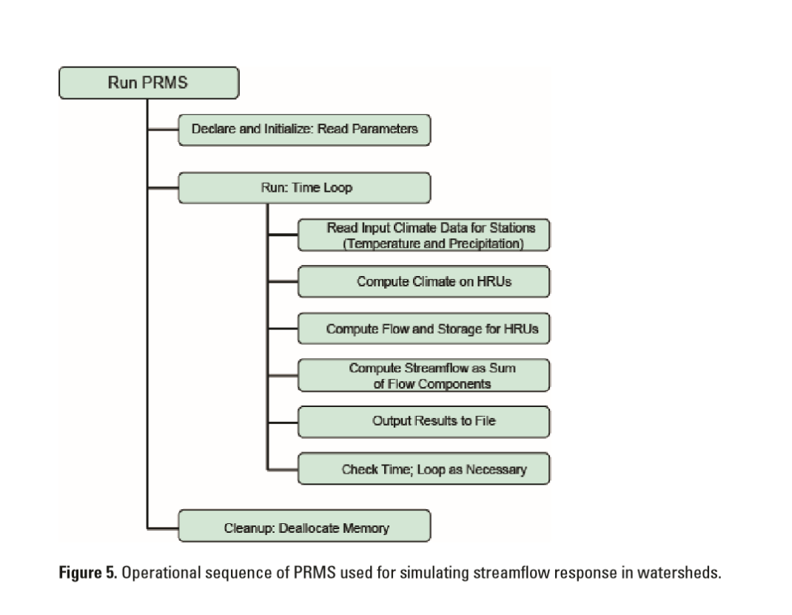

Slide 12
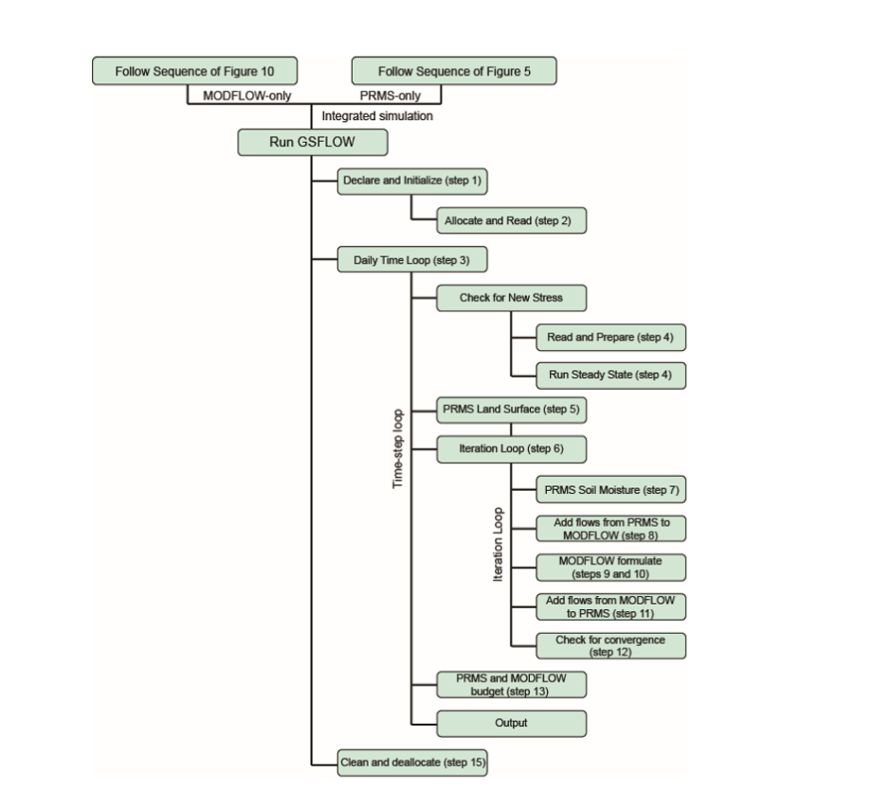

Slide 13
What Does This Mean?
For PRMS users:
  Ground-water is handled in a head dependent and distributed way
  Baseflow can be gaining or losing
  Transbasin ground-water flow (“under gage”) is handled
For MODFLOW users:
  Recharge is highly variable in time and space
  Flow in the variably-saturated zone is simulated laterally and horizontally
  Water surface elevations in streams and lakes is a more rigorous boundary condition

Slide 14
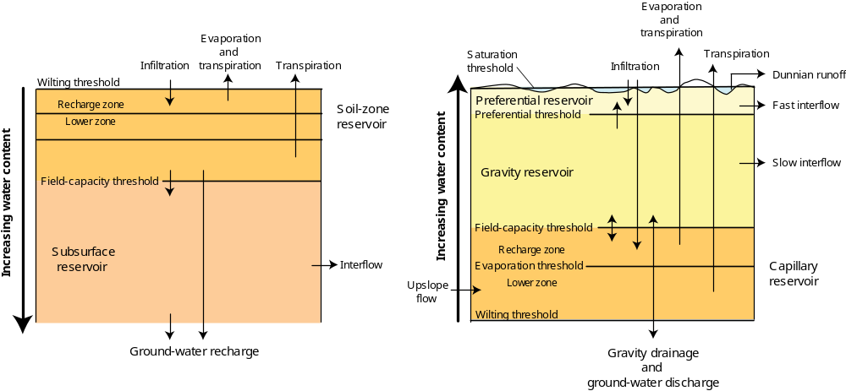
Changes to old PRMS for GSFLOW
Soil Zone
gsflowhelp@usgs.gov
Notes:
Modules ssflow and smbal -> soilzone

Slide 15
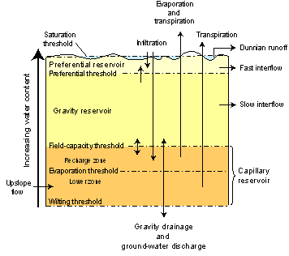
Changes to PRMS for GSFLOW
Soil Zone
One physical space, down to rooting depth
Three Reservoirs
  Capillary (CPR)
    wilting point to FC
    pervious portion
  Gravity (GVR)
    whole HRU
  Preferential Flow (PFR)
    GVR + PFR storage
    Saturation – FC
    whole HRU

Slide 16
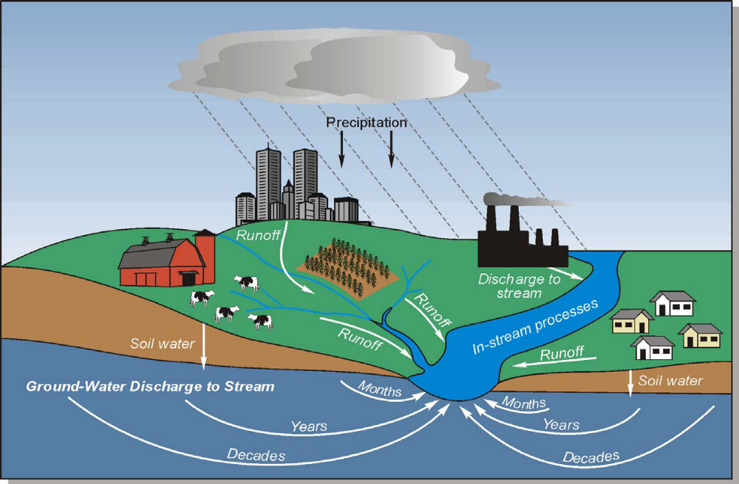



Soil Zone
ET
ET
Preferential flow
Recharge
Dunnian runoff
Recharge
Notes:
This cartoon illustrates flow paths in the hydrologic cycle. The yellow lines represent flows computed by the soilzone module. Flows computed are: soil evapotranspiration, interflow, preferential flow, Dunnian runoff, and recharge.

Slide 17

PRMS Soilzone
Evaporation and
Transpiration
Infiltration
Dunnian Surface Runoff
Preferential-Flow Reservoir
Fast Interflow
Cascading Surface Runoff
and Interflow
Capillary Reservoir
(pervious fraction)
surface depressions and
impervious processes
computed in srunoff module
Impervious
Gravity Reservoir
Slow Interflow
Recharge
Recharge
Notes:
This cartoon illustrates the three soil zone water-holding reservoirs: the capillary, preferential-flow, and gravity reservoirs. The impervious and surface depression reservoirs are shown to illustrate that the capillary reservoir is the pervious fraction of the HRU land surface. Thus, the area of the capillary reservoir is the HRU area minus the sum of the impervious and surface-depression storage areas. Processes for impervious and surface depression reservoirs are computed by the surface runoff module; described in another presentation. The dashed lines represent internal flows and the solid lines flows from or to a reservoir.

Slide 18
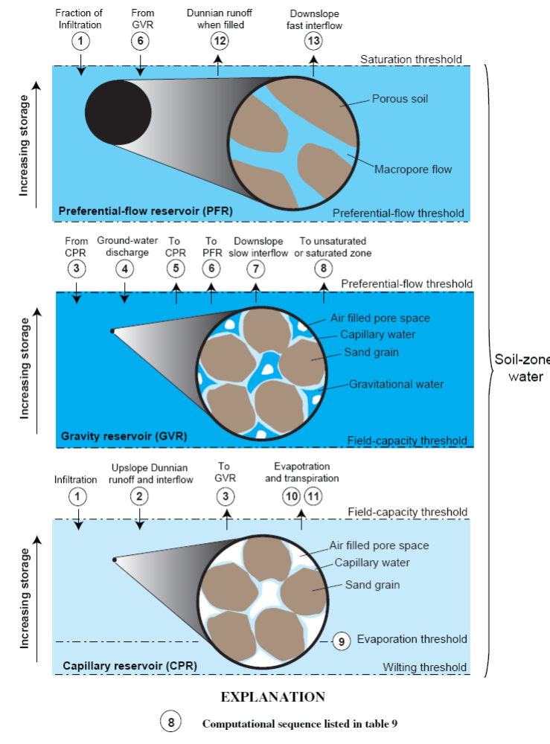
Reservoir Pore space
Preferential Flow Reservoir - PFR
(optional)
Gravity Reservoir - GVR
Capillary Reservoir - CPR
Pore space
Notes:
While computations for the soilzone processes are compartmentalized using the three reservoirs, the soil zone is considered one physical space from the land surface to the rooting depth. Each reservoir represents different pore spaces and water-holding capacities. <click> The capillary reservoir has water that does not flow laterally and is where soil-water evaporation and plant transpiration is computed. <click> The gravity reservoir holds soil water greater than the water-holding capacity of the capillary reservoir. This water can flow laterally as interflow and drain as recharge. <click> The preferential flow reservoir holds macropore soil water that can flow laterally, typically at a greater rate than from the gravity reservoir and does not drain.

Slide 19
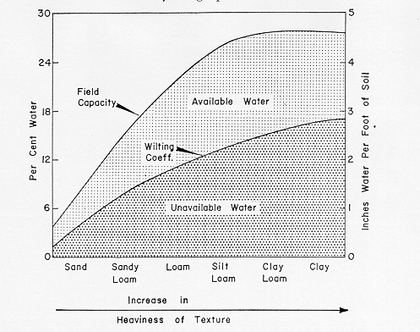
Soil Type and Percent Water
Interflow, gravity drainage,
Dunnian surface runoff
Gravity and Preferential
Flow Reservoirs
Evapotranspiration
Capillary Reservoir
Not in water budget
Notes:
This figure illustrates available water within the soil profile for the continuum of soil characteristics (X‑axis) and percent water-holding capacity (Y‑axis). <click>
Unavailable water, that is water less than the wilting point threshold, is not included in a PRMS reservoir or water budget. The diagram illustrates that as clay content increases the unavailable water increases. This is primarily due to the pore size decreasing, thus more and more soil water is bound to the grains and not available for hydrologic flux computations. <click>
The capillary reservoir can be thought of as the water between field capacity and the wilting threshold. However, the capillary reservoir is defined as the soil water between the land surface and the rooting depth of the dominant plant species, for the pervious fraction of the HRU. One method to estimate the water-holding capacity of the capillary reservoir is as the rooting depth times the permeability of the soil. <click>
Gravity driven lateral flows and drainage are computed from the soil-water content above the water-holding capacity of the capillary reservoir to total soil saturation of the entire HRU. This water content is partitioned into the gravity and preferential-flow reservoirs.

Slide 20
Storage Parameters for Soilzone Reservoirs
Capillary (CPR) – pervious area
  wilting point to field capacity soil
  to rooting depth
  soil_moist_max
  pervious portion
  1 – hru_percent_imperv – dprst_frac_hru
  recharge zone (ET)
  soil_rechr_max
  lower zone (transpiration)
  soil_moist_max - soil_rechr_max
Gravity (GVR) – whole HRU
(1 – pref_flow_den) * sat_threshold
Preferential Flow (PFR) – whole HRU
pref_flow_den * sat_threshold
Notes:
The parameters that define the water-holding capacity for each reservoir are highlighted in red.
The water-holding capacity of the capillary reservoir is specified by soil_moist_max, which occupies the pervious fraction, which is equal to: 1 – hru_percent_imperv – dprst_frac_hru. Each HRU must have at least 0.1% pervious area. The capillary reservoir is partitioned into two zones using parameter soil_rechr_max. Water in the recharge zone can both evaporate and is available for plant transpiration. Water in the lower zone is available for plant transpiration. Infiltration fills the recharge zone prior to being available for the lower zone.
The gravity reservoir receives infiltration in excess of the water-holding capacity of the capillary reservoir and is where gravity drainage (or recharge) to the groundwater reservoir and slow interflow are computed. The water-holding capacity is the portion of sat_threshold minus the water-holding capacity of the preferential-flow reservoir. Computations are based on the full HRU areal extent.
The preferential-flow reservoir receives a portion of infiltration and water in excess of the water-holding capacity of the gravity reservoir. This water is used to compute fast interflow. It has a water-holding capacity that is estimated to account for shallow subsurface storm flow. Computations are based on the entire HRU area extent.
Dunnian runoff is the result of soil-water in excess of the water-holding capacity of the preferential-flow reservoir. If a preferential-flow reservoir is not present, Dunnian runoff occurs when water content in the gravity reservoir exceeds sat_threshold.

Slide 21
T
ET
Precipitation, Snowmelt, cascading Hortonian Runoff
12
12
soil_type
pref_flow_den
Dunnian runoff
14
2
2
1
1
1
8
1
8
Cascading Dunnian Runoff
11
11
3
3
PFR storage
Fast Interflow
Cascading Interflow
Recharge Zone
fastcoef_lin
fastcoef_sq
7
7
sat_threshold
soil_moist_max
4
4
1 – pref_flow_den
13
Lower Zone
13
soil_rechr_max
6
6
Cascading flow
Excess CPR
GVR storage
9
9
5
Slow Interflow
5
Gravity Drainage
See the PRMS Manual (Markstrom and others, 2015)
pages 106 – 112 for description of computation steps
and equations.
slowcoef_lin
slowcoef_sq
10
10
soil2gw_max
ssr2gw_rate
sslr2gw_exp
Recharge
Notes:
This information rich slide is used to illustrate the fourteen computation steps in the soilzone module. Parameters are shown in red text, storage components in purple, and processes in light blue.
The antecedent water content plus inputs is the starting point for the sequence. Inputs are infiltration, unsatisfied potential ET, transpiration state, and snow cover. Infiltration is computed in the surface-runoff module based on throughfall, snowmelt, and cascading Hortonian runoff. Unsatisfied PET is the potential ET as computed by the selected potential ET module minus the sum of canopy evaporation as computed by the interception module; sublimation as computed by the snow computation module, and evaporation from impervious and surface-depression storage as computed by the surface runoff module. Snow cover is computed by the snow computation module and transpiration state is computed by the transpiration module. <click>
The first step is to add a portion, based on the value of parameter pref_flow_den, of infiltration to the preferential-flow reservoir. If the addition of this water plus the antecedent water exceeds the storage capacity, the excess water is the first component of Dunnian surface runoff. <click>
Step 2 adds the remainder of the infiltration to the storage capacity of the recharge zone.
Step 3 adds any cascading Dunnian surface runoff and interflow from upslope HRUs to the storage capacity of the recharge zone.
Step 4 partitions excess water from steps 2 and 3 to the lower zone, up to its storage capacity. <click>
Step 5 partitions excess water from step 4 up to the value of parameter soil2gw_max as the first component of recharge. Typically, the value of soil2gw_max is set to zero unless direct recharge to groundwater is likely, such when karst features exist.
Step 6 adds excess water from step 5 to the antecedent storage of the gravity reservoir, up to its storage capacity. <click>
Step 7 adds excess water from step 6 to the antecedent storage of the preferential-flow reservoir, up to its storage capacity. <click>
Step 8 sets excess water from step 7 as the second component of Dunnian surface runoff. <click>
Step 9 computes slow interflow from the water content of the gravity reservoir and subtracts this water from the storage. <click>
Step 10 computes gravity drainage from the adjusted water content of the gravity reservoir and subtracts this water from the storage. <click>
Step 11 computes fast interflow from the water content of the preferential-flow reservoir and subtracts this water from the storage. <click>
Step 12 sums the first and second components of Dunnian surface runoff.
Step 13 computes cascading fast and slow interflow and Dunnian surface runoff when the cascading flow option is active.
Step 14 computes soil-water evaporation and the first component of plant transpiration from the current water content of the recharge zone of the capillary reservoir and the second component of plant transpiration from the lower zone. The water is then subtracted from the capillary reservoir storage. <click>
<pause>
<click>
See the PRMS manual for a more complete description of the computation order and equations used in soilzone computations.

Slide 22
Evapotranspiration from the Capillary Reservoir – step 14
Function of unsatisfied potential ET, recharge zone and total capillary reservoir water content, growing season, snow cover, soil type (soil_type), and cover type (cov_type)
ET is first computed from the water content of the recharge zone, then additional transpiration is computed from lower zone
Transpiration state computed during growing season [months transp_beg [when sum of maximum temperatures for month transp_beg > transp_tmax to month transp_end] OR [from Julian day spring_frost to fall_frost]
Notes:
Soil ET is determined based on unsatisfied potential ET, water content of the recharge zone and capillary reservoir, transpiration state, snow cover, cover type, and soil type. ET is computed for the recharge zone first. The unsatisfied potential ET available for the lower zone is reduced by recharge zone ET.
Whether or not plant transpiration is computed is determined by transpiration module. There are two modules, transp_tindex and transp_frost. Transp_tindex determines the transpiration period, or growing season, based on an index temperature (parameter transp_tmax) and beginning and ending months (parameters transp_beg and transp_end, respectively). Transp_frost is used to specify the growing season as the days from the last spring frost to the first fall frost (parameters spring_frost and fall_frost, respectively). These modules are described in another training video.
If plant transpiration is inactive and snow covered area is greater than 1 percent, soil ET is set to 0. Additionally, if transpiration is active, snow covered area is greater than 1 percent, and bare ground (cov_type=0), soil ET is set to 0.

Slide 23
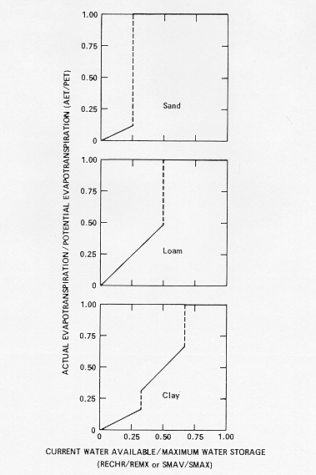
Evapotranspiration from the Capillary Reservoir – step 14
Notes:
These graphs define the algorithms used to compute ET for the three soil types. The x-axis is the fraction of water content of the maximum water content of the recharge zone or capillary reservoir storages. The y-axis is the fraction of unsatisfied ET that is set to actual ET.

Slide 24
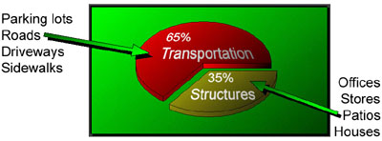
Impervious Considerations
Surfaces that prevent precipitation and snowmelt from infiltrating the soil
  Constructed surfaces
  Compacted soils
  Rock outcrops
http://chesapeake.towson.edu/landscape/impervious/

Slide 25
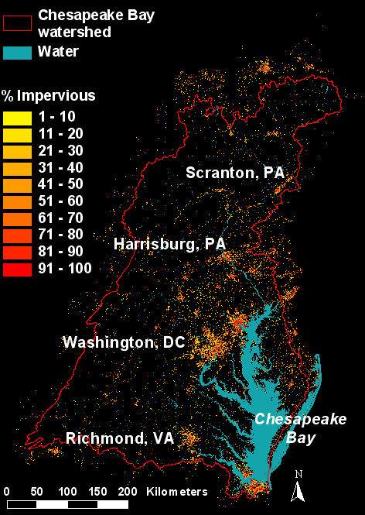
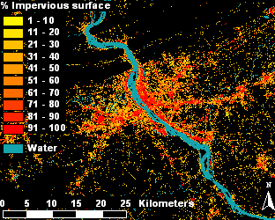
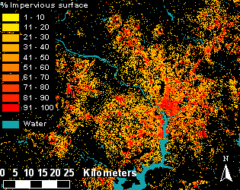
Harrisburg, PA
Washington, DC
http://www.whrc.org/midatlantic/mapping_land_cover/products/impervious_surfaces.htm
Impervious Surface Analysis Tool
http://www.csc.noaa.gov/crs/cwq/isat.html

Slide 26
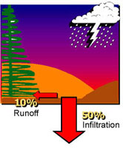
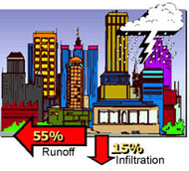
Impervious Considerations
Fate of water
  Stored subject to evaporation
  Storm water leaving the HRU

Slide 27
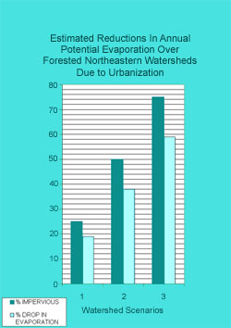
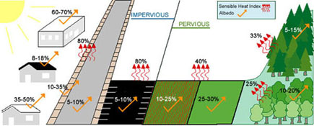
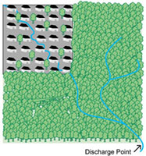
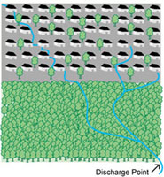
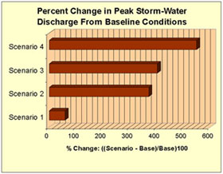
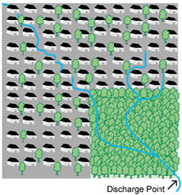
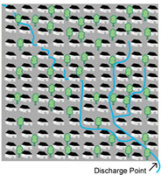
Impervious Considerations
Effects
  Increased surface runoff
Effects
  Reduced soil moisture
  Reduced recharge
  Increased surface runoff
  Reduced evapotranspiration (less vegetation)
  Degrade water quality (non-point pollution)
  Thermal heat islands
1
2
3
4

Slide 28
Impervious Considerations
What is the effective impervious area of each HRU?
  hru_percent_imperv
What is the effective retention storage depth on impervious surfaces?
  imperv_stor_max

Slide 29
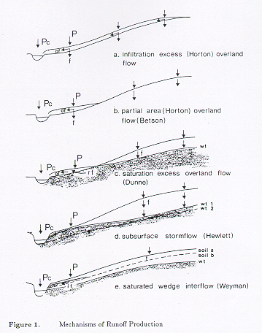
SURFACE RUNOFF MECHANISMS
gsflowhelp@usgs.gov

Slide 30
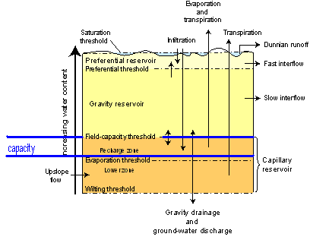
Pervious Hortonian Surface Runoff
Contributing-area concept
Linear (srunoff_cara_casc)
Non-linear (srunoff_smidx_casc)
capacity = soil_moist_max – Cap_{m-1}
  Linear (srunoff_carea_casc)
    ca_pct = CAmin + (CAmax - CAmin)*(Cap_{m-1}/soil_moist_max)
  Non-linear (srunoff_smidx_casc)
sroff = ca_pct*net_precip + ca_pct*ROup
+ snowmelt > capacity
smidx = Cap_{m-1}+ net_precip*0.5
(smidx_exp * smidx)
ca_pct = smidx_coef * 10.
Equation 30

Slide 31
gsflowhelp@usgs.gov

