Slide 1
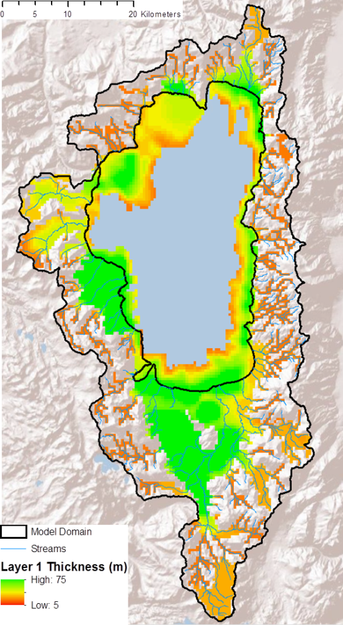
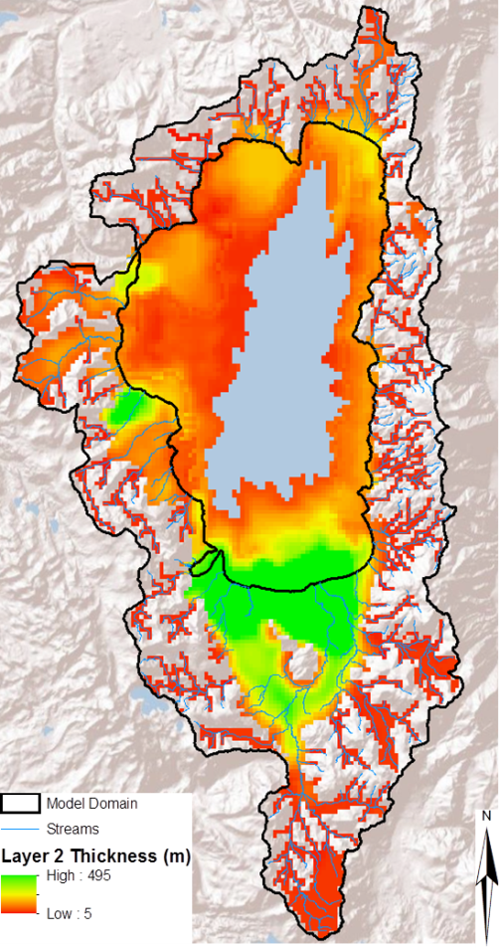
The Lake (LAK7)Package
Lakes are simulated using the MODFLOW Lake Package (Merritt and Kinokow, 2000), revised for MODFLOW-2005, NWT

Slide 2
Lake Connections to Aquifers and Streams
LAK Package simulates interaction of Lakes with MODFLOW and MOC3D
Merritt and Konikow, 2000,WRI 00-4167
Recent modifications
Lake
Aquifer
Lake Grid Cells
Aquifer Grid Cells

Slide 3
Lake Inflow
Separate water budget for each lake.
Inflow to Lake
Streams
Precipitation
Point
Overland runoff
Interflow
Leakage

Slide 4
Lake Outflows
Streams
Point
ET
Leakage

Slide 5
Computing Lake Stage
Precipitation and ET are a function of lake surface area.
Overland runoff and interflow to lakes are independent of lake stage
Stream inflow is routed to lakes with SFR2 in MODFLOW and is independent of lake stage
Additional inflow from factories, etc. are specified in Lake Package input by stress period and are independent of lake stage

Slide 6
Lake Connection to Aquifers
Lake surface
Lake bottom
Conductance terms
b
C_{b}=(K_{b}*A)/b
Lakebed
l
C_{a}=(K_{a}*A)/l
Aquifer
Cell node
Cross sectional area of aquifer

Slide 7
Model Representation
Lake cells
Aquifer cells
Kh
Kv
Cell node
Lakebed

Slide 8
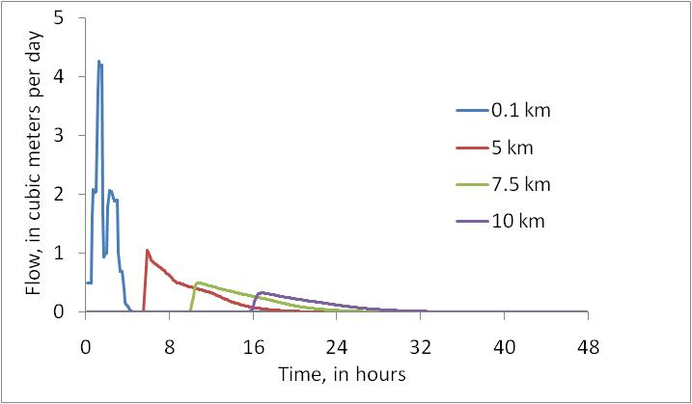
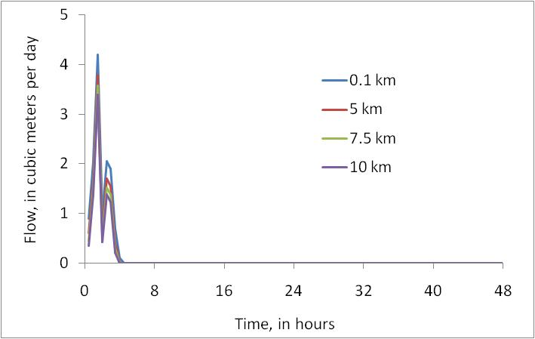
Example of Transient Flow
Transient
Steady

Slide 9
Example of Transient Flow
Transient
Steady

