Slide 1
How MODSIM Iterates
Initialize
Time Step 0
Time Step 1
Iteration 0
Iteration 1
Iteration 2
Iteration 0
Iteration 1
Iteration 2
IterTop
IterTop
IterTop
IterTop
IterTop
IterTop
IterBottom
IterBottom
IterBottom
IterBottom
IterBottom
IterBottom
Solver
Solver
Solver
Solver
Solver
Solver
Converge
Converge
Converge
Converge
Converge
Converge
No
No
No
No
Yes
Yes
OnConverge
OnConverge
Finalize

Slide 2
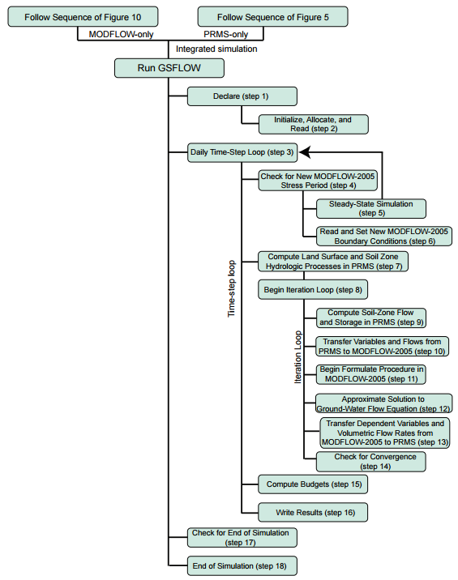

Slide 3
MMF: call function to read control file
MMF: call function to read parameter file
call gsflow_modflow (print stuff and allocate GSFLOW specific arrays)
run PRMS declare
call function to read data file
run PRMS init, MODFLOW AR and RP
call time loop function (call MODFLOW RP for stress period)
begin time step loop
call gsflow_prms
run most PRMS modules
call gsflow_modflow
iteration loop
call gsflow_mudflow
Call Modflow BD
PRMS output (?)
Call gsflow_modflow
Deallocate MODFLOW
Finish (what is this for PRMS and MMF?)
Modsim (read)
Modsim (time loop)
Modsim (iteration loop)
Modsim (output?)
Modsim (finish)

Slide 4
Initialize
MMF: call function to read control file
MMF: call function to read parameter file
call gsflow_modflow (print stuff and allocate GSFLOW specific arrays)
run PRMS declare
call function to read data file
run PRMS init, MODFLOW AR and RP
call time loop function (call MODFLOW RP for stress period)
begin time step loop
call gsflow_prms
run most PRMS modules
call gsflow_modflow
iteration loop
call gsflow_mudflow
Call Modflow BD
PRMS output (?)
Call gsflow_modflow
Deallocate MODFLOW
Finish (what is this for PRMS and MMF?)
Time Step 0
Iteration 0
Iteration 1
Iteration 2
IterTop
IterTop
IterTop
IterBottom
IterBottom
IterBottom
Solver
Solver
Solver
Converge
Converge
Converge
No
No
Yes
OnConverge

Slide 5
