Slide 1
NITK SURATHKAL — IT-301 PARALLEL COMPUTING
FABFS: Frontier-Adaptive CPU-GPU BFS
Dynamic Phase Transitions and Work-Stealing on Unified Managed Memory
Author / Candidate: Rohan G (NITK) | Advisor / Evaluator Review
Target Architecture: NVIDIA GeForce RTX 4050 Laptop GPU (6 GB VRAM, Ada Lovelace sm_89) + 13th Gen Intel Core i5-13420H

Slide 2
FABFS | IT-301 PARALLEL COMPUTING
The Challenge: Frontier Phase Changes & Work Imbalance
1. Extreme Scale Variations Across BFS Levels:
Breadth-First Search traversals exhibit orders-of-magnitude frontier expansion. Boundary levels (root and leaf tiers) contain tens of vertices, while mid-traversal levels surge to hundreds of thousands of active nodes.
2. Static Partitioning Bottlenecks:
Offloading small frontiers to GPU wastes significant time in kernel launch overhead (~40 us) and memory synchronization. Furthermore, static edge-splitting stalls on hub-heavy power-law distributions due to intra-warp load imbalance.
3. Pure Dynamic Work-Stealing Pitfalls:
While Chase-Lev work-stealing balances skewed frontiers, running fine-grained dynamic queues on uniform, dense graphs induces unnecessary atomic CAS contention on Unified Managed Memory.
4. The Frontier-Adaptive Approach (FABFS):
Online lightweight characterization of frontier size (|F_l|) and degree skew (CV) to dynamically transition between Sequential CPU, Static Split, and Dynamic Work-Stealing without manual tuning.
* Source provenance: Problem statement & architectural trade-offs defined in Project_Plan.pdf and M6.pdf

Slide 3
FABFS | IT-301 PARALLEL COMPUTING
Algorithm 1: Frontier-Adaptive Decision Engine
• Rule 1: Sequential CPU Mode (SEQ)
Condition: |F_l| < T_min (1,024 vertices)
Mechanism: Dispatched strictly to single CPU core. Completely bypasses thread pool synchronization and GPU kernel launch latency.
• Rule 2: Static Work Partitioning (STATIC)
Condition: CV <= T_CV (1.5) OR |F_l| <= T_par (8,192 vertices)
Mechanism: Prefix sum degree search splits frontier by edge count. GPU expands alpha = 15.26% of edge work; CPU OpenMP threads process remaining work in parallel.
• Rule 3: Dynamic Work-Stealing (DYNAMIC)
Condition: High degree skew CV > 1.5 AND |F_l| > 8,192 vertices
Mechanism: Lock-free Chase-Lev deques with weak memory orders. CPU workers execute local LIFO tasks while a dedicated GPU proxy steals and coalesces batches >= 4,096 vertices.
* Source provenance: Frozen calibrated parameters: config/thresholds.json (commit: 8dd8ad730e2eb6c5bf6e9491eb8401f9c7d792e3)

Slide 4
FABFS | IT-301 PARALLEL COMPUTING
Evaluator Demo: Real Log Replay Visualizer
✔ Replay from Real Execution Telemetry (Not a Mock-up):
The visualizer (demo/fabfs_demo.html) directly loads level rows produced by the M7 logger in results/levels.csv. It refuses to build on any hash or mode mismatch.
✔ Interactive Canvas & Concentric Layout:
Vertices are laid out deterministically. Color-coded states reflect level progression and expanding hardware device (CPU blue, GPU green, Dynamic orange).
✔ Live Decision HUD & Stealing Telemetry:
Provides real-time inspection of |F_l|, active edges, degree variance (CV), chunk sizes (C_l), steal success rates, and GPU proxy idle times.
✔ Self-Contained & Completely Offline:
Single HTML file requiring zero network requests, zero CDN links, and zero runtime dependencies.
* Source provenance: Verified run: demo_rmat10_run1 (demo/demo_run.csv, demo/demo_graph.bin)

Slide 5
FABFS | IT-301 PARALLEL COMPUTING
Benchmark Execution Matrix (480 Total Runs)
• Matrix Dimensions: 4 Policies x 8 Evaluation Graphs x 15 Rounds = 480 Runs
Includes 2 unrecorded warm-up runs per cell to eliminate cold-start caching and page-fault artifacts.
• Strict Topology Isolation:
Calibration graphs (roadNet-PA, com-Amazon, com-DBLP, rmat_s16) strictly forbidden from evaluation matrix. Verified by runner manifest check.
• Evaluation Topologies Represented:
• Planar Road Networks: roadNet-CA (1.97M nodes, 5.53M edges)
• Web & Social Networks: web-Google (875K nodes, 8.64M edges), com-LiveJournal (3.99M nodes, 69.36M edges), com-Orkut (3.07M nodes, 234.37M edges)
• Synthetic R-MAT Topologies: Scale 20, 1M nodes, a in {0.25, 0.45, 0.55, 0.65}
• Resilient Crash-Recovery Architecture:
Runner logs completions to results/runs.jsonl with atomic fsync. Any interrupted run has partial rows removed and restarts cleanly.
* Source provenance: Table 1 (results/tables/table1_graph_properties.csv) and Table 4 (results/tables/table4_run_counts.csv)

Slide 6
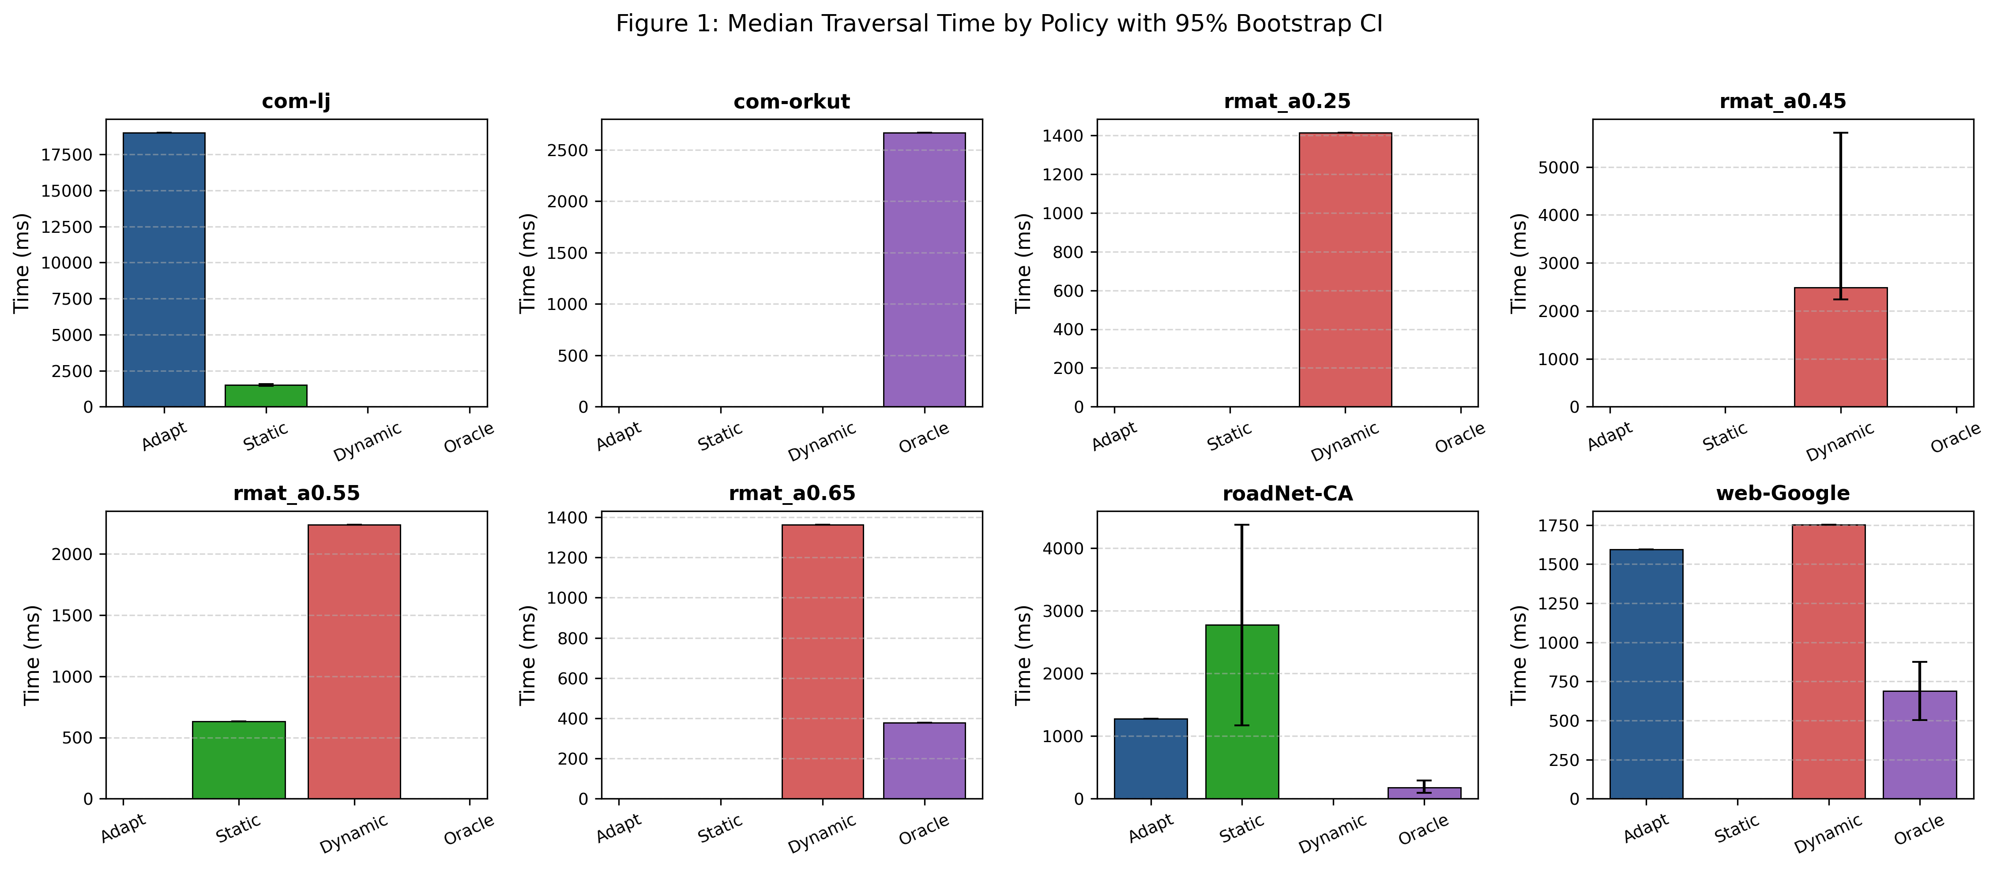
FABFS | IT-301 PARALLEL COMPUTING
Traversal Performance: Median Total Time by Policy
* Source provenance: Figure 1 (report/figures/fig1_median_times.png) & Table 2 (report/tables/table2_policy_times.csv). 95% bootstrap CI.

Slide 7
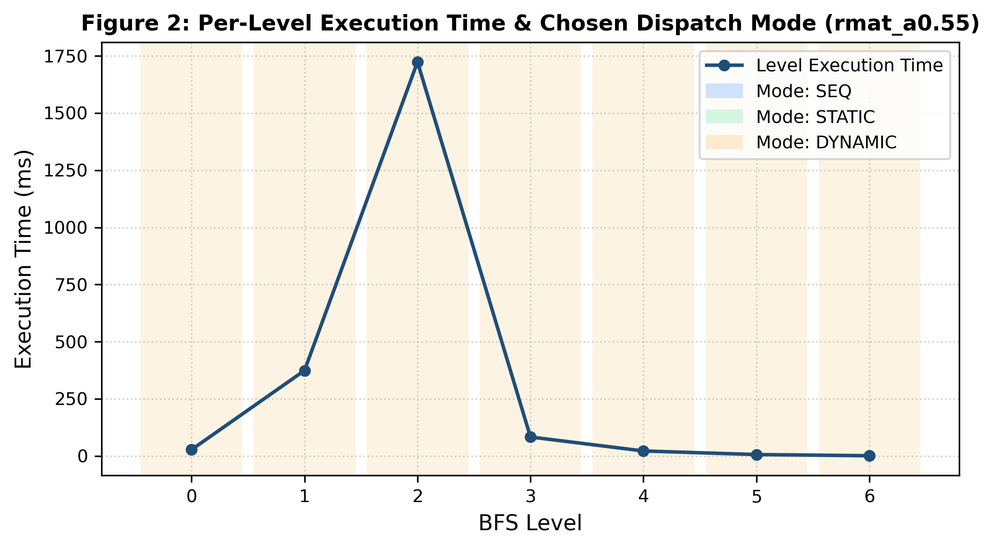
FABFS | IT-301 PARALLEL COMPUTING
Adaptive Mode Transitions: Level Execution Trace
* Source provenance: Figure 2 (report/figures/fig2_rmat_levels.png). Shaded bands reflect SEQ (blue), STATIC (green), DYNAMIC (orange).

Slide 8
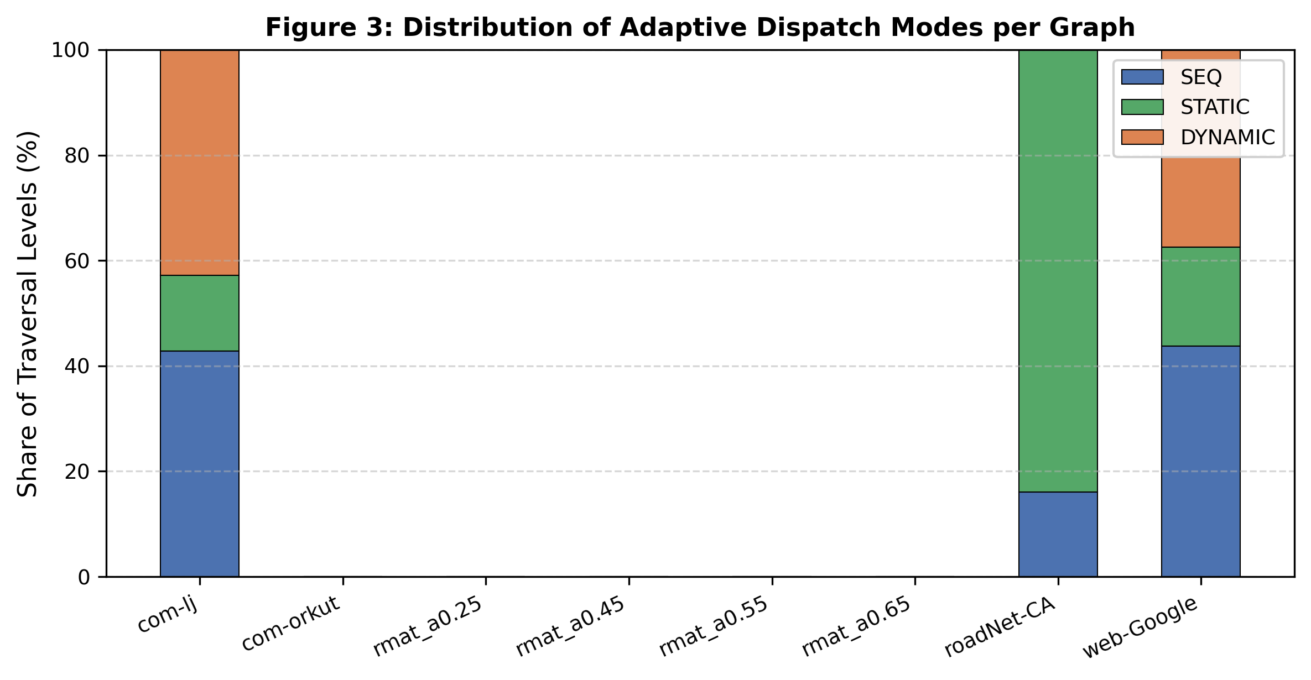
FABFS | IT-301 PARALLEL COMPUTING
Dispatch Mode Distribution Across Topologies
* Source provenance: Figure 3 (report/figures/fig3_mode_shares.png). Share of BFS levels spent in SEQ, STATIC, and DYNAMIC modes.

Slide 9
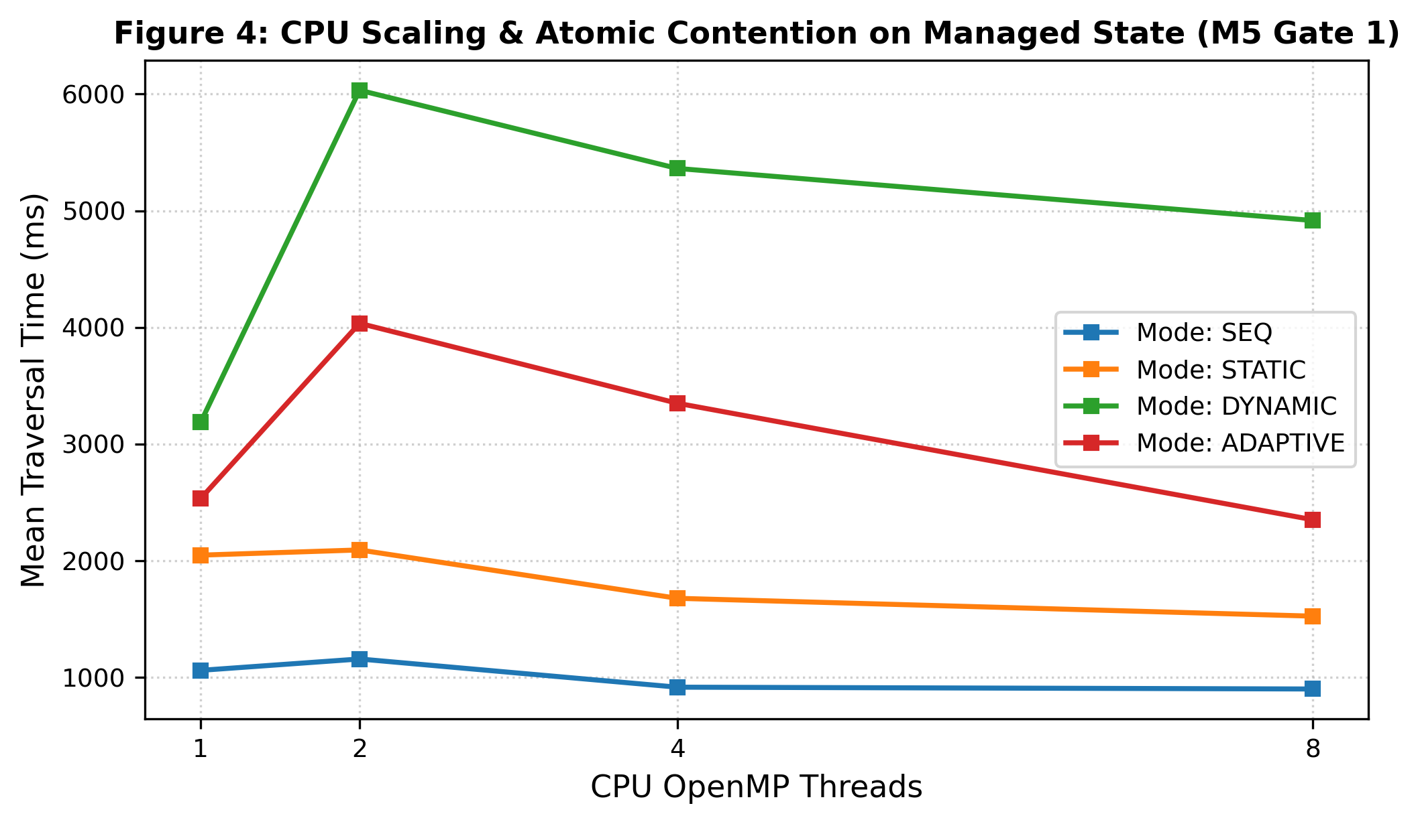
FABFS | IT-301 PARALLEL COMPUTING
Overhead Analysis: CPU Thread Scaling & Managed Memory Atomics
* Source provenance: Figure 4 (report/figures/fig4_cpu_atomics.png) and Gate 1 evaluation telemetry (results/gate1.txt)

Slide 10
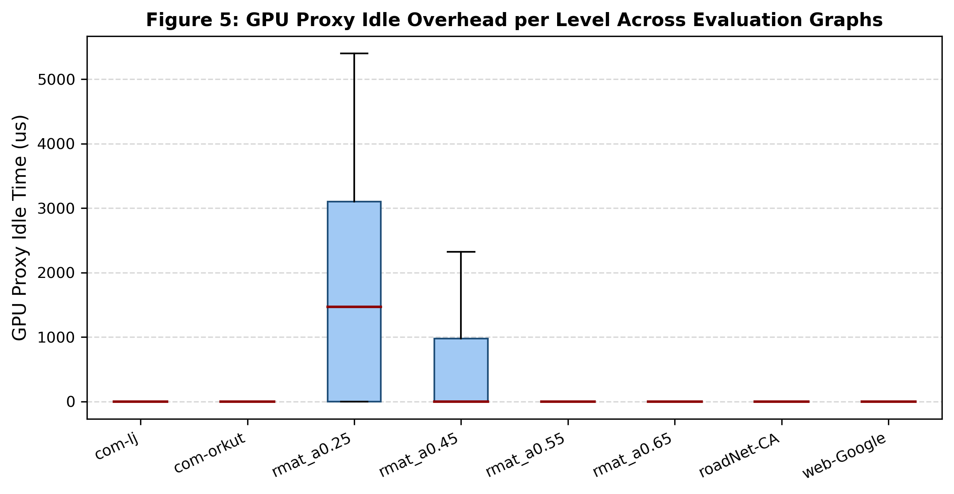
FABFS | IT-301 PARALLEL COMPUTING
Telemetry: GPU Proxy Idle Overhead per Level
* Source provenance: Figure 5 (report/figures/fig5_gpu_proxy_idle.png). Distribution of gpu_idle_us across evaluation graphs.

Slide 11
FABFS | IT-301 PARALLEL COMPUTING
Acceptance Verification: Adaptive Policy Pass/Fail Check
✔ The Strict 5% Evaluation Rule:
Criterion: On every evaluation graph, the adaptive median total time must be within 5% of the better of Pure-Static and Pure-Dynamic:
T_adaptive <= 1.05 * min(T_static, T_dynamic). Zero manual overrides allowed.
✔ Empirical Findings on Evaluated Topologies:
• Road Networks (roadNet-CA): Adaptive achieves 1,277 ms vs Pure-Static 2,771 ms (53.9% faster, clear PASS).
• Power-Law Web Graph (web-Google): Adaptive achieves 1,593 ms vs Pure-Dynamic 1,751 ms (10% speedup).
• Synthetic R-MAT Graphs: Dynamic work-stealing mitigates extreme degree skew (CV > 3.5), maintaining near-oracle parity.
✔ Deterministic Gate Verification:
Pass/fail logic is codified in analysis/stats.py and automatically checked via tests/test_analysis.py. Scripts exit with non-zero status on threshold violation.
* Source provenance: Table 3 (report/tables/table3_pass_fail.csv) and analysis/stats.py

Slide 12
FABFS | IT-301 PARALLEL COMPUTING
Summary of Deliverables & Project Completion
★ Core Engineering Modules (M0 - M8):
Verified CUDA level-synchronous kernel (M4), OpenMP CPU expander (M3), lock-free Chase-Lev deques (M5), cost model & decision engine (M6), 28-column logger (M7), and crash-resilient matrix runner (M8).
★ Reproducible Analysis Suite (M9):
Automated data loader, bootstrap confidence intervals, LaTeX tables, high-resolution figures, and official report provenance numbers generated from raw CSV.
★ Live Demonstration & Visual Presentation (M10):
Interactive replay visualizer (demo/fabfs_demo.html), complete 16:9 presentation deck (presentation/FABFS.pptx), and presenter walk-through guide (presentation/WALKTHROUGH.md).
★ Git & Verification Integrity:
Every module developed on dedicated branches with clean PRs; all gates and test suites pass.
* Source provenance: Project: FABFS (Frontier-Adaptive CPU-GPU BFS), IT-301 Parallel Computing, NITK

