Slide 1
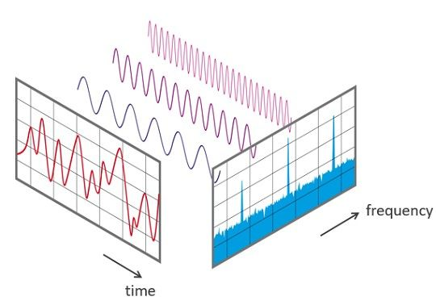
How-to Implement a DFT on a Real-Time System
Rainer Nitsche – 02/2024
Discrete Fourier Transform – DFT

Slide 2
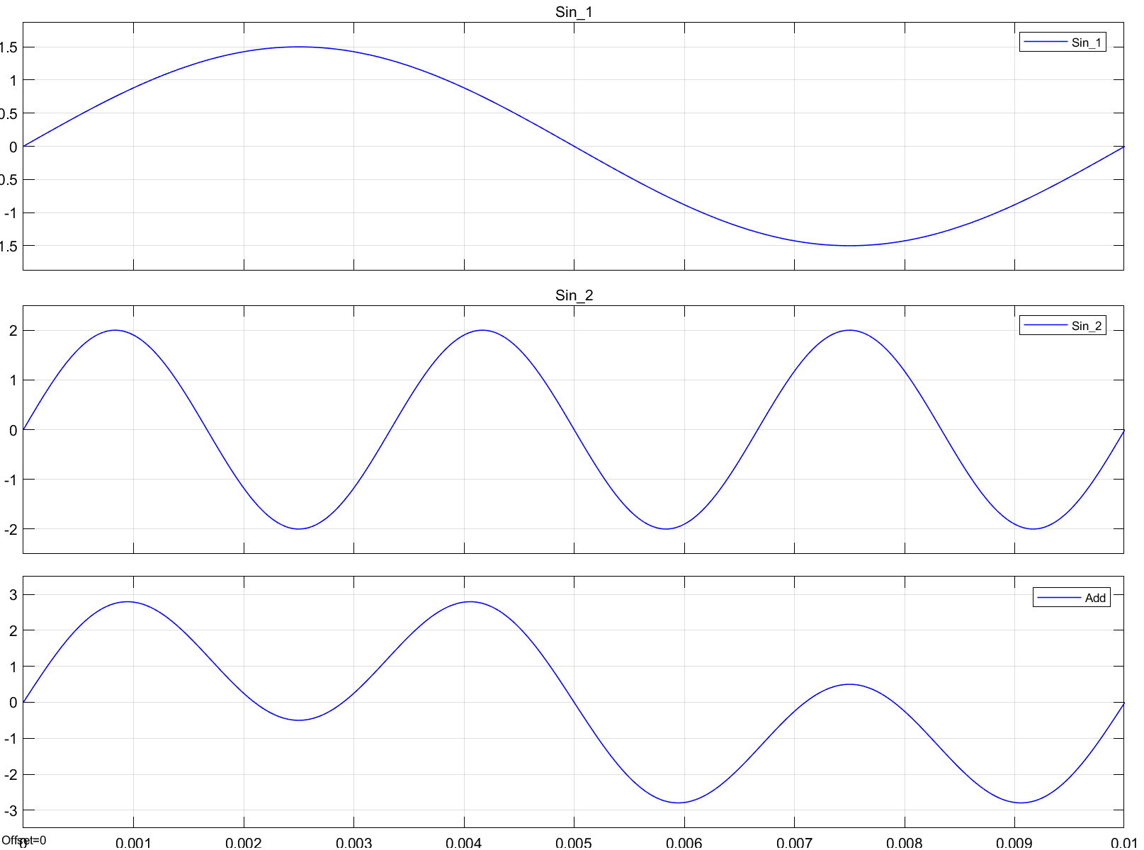
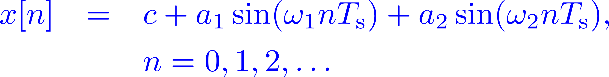
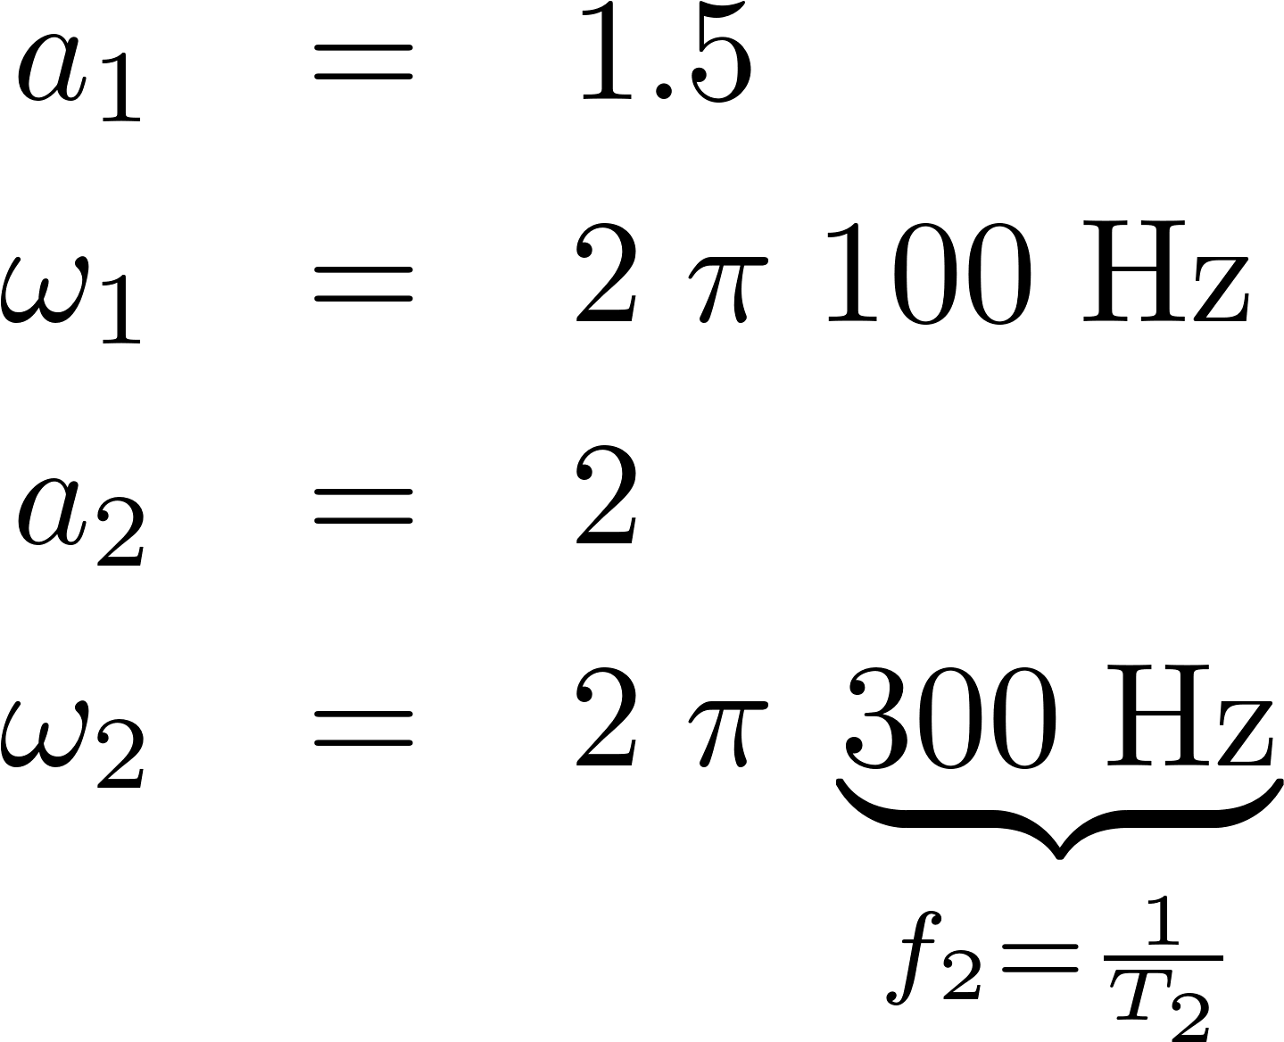
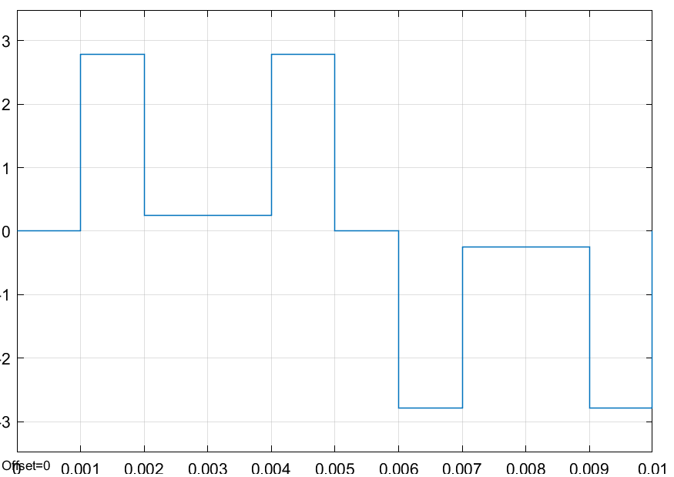

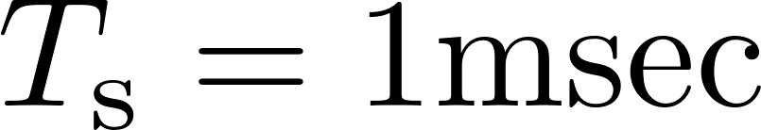
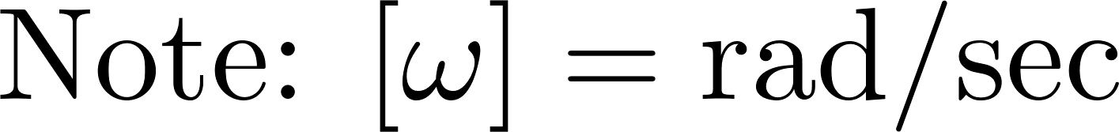
FFT in Real-Time | Objectives
Analyzing a time domain signal in the frequency domain ⇝ Fourier Transform
The fast Fourier transform (FFT) is an efficient method to numerically compute a discrete Fourier transform (DFT)
Example
Parameters:
Time ->

Slide 3
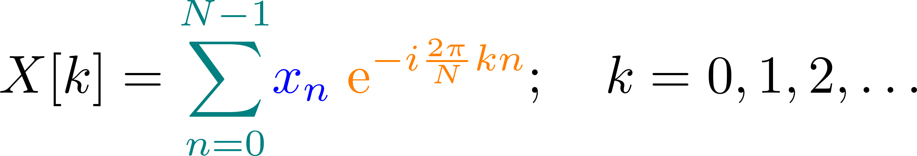
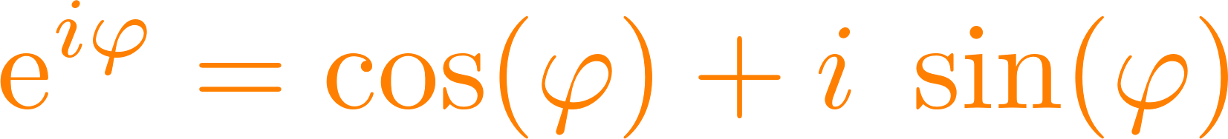
FFT in Real-Time | Discrete Fourier Transform (DFT)
Notes:
https://www.overleaf.com/learn/latex/Using_colors_in_LaTeX

Slide 4
FFT in Real-Time
Link to video: Steve Brunton / Matlab
Simulink Implementation
Plotting resutls from simulation and data capture…
How to chose:
Sample Time Ts
Number of samples for FFT : 2^N
Bid Width (Frequenzauflösung)
Nyquist Frequency
Leackage effect

