Slide 1
COVID-19 in INDIA defined using EDA and Prediction
Presented By:
RAUNAK PODDAR(2K21/ISY/20)
KARAN YADAV (2K21/ISY/11)

Slide 2
Introduction
This project is study about COVID-19 cases in India to analyze and visualize the spread of COVID-19 in INDIA.
The Corona Virus Disease (COVID-19) has been reportedly originated from China at the end of 2019.
On 30th January,2020, the first case was registered in India.
The COVID-19 pandemic has allowed the scientist, researchers, students to study research and analyze this pandemic.
Machine Learning, Deep Learning and Data Analysis field has also contributed to analyze and predict the pandemic and helped to make strategies and contain the disease.
For the analysis, we have used the concept Exploratory Data Analysis (EDA).
For prediction we have used models like Prophet Model and ARIMA.

Slide 3
Literature Survey
From the literature survey in related to the topic, we have found out the research paper have followed:
NLP driven techniques, unsupervised learning, modelling and forecasting, ANN,
MATLAB, MLP, ANFIS, SCIKET Learn, polynomial regression.
For the analysis and prediction, we have used EDA, Prophet Model and ARIMA.
The EDA has been a great tool for visualizing data.
Other than the above models or methods, Prophet Model and ARIMA can also be used for the prediction.

Slide 4
Methodology
Dataset: The number of confirmed, recovered and death cases for world data is collected from Hopkins John. Retrieved from:
https://github.com/CSSEGISandData/COVID-19/tree/master/csse_covid_19_data/csse_covid_19_time_series.
The dataset for India has been collected form https://www.kaggle.com/imdevskp/covid19-corona-virus-india-dataset
We have used EDA for analysis of the data.
For prediction we have used models like Prophet Model and ARIMA.

Slide 5
Analyzation
Age/Gender Group Analysis: As per the dataset, we can observe the most affected age group is >40, which is against the trend which says the most affected people are old/elder ones.
Only >28% people are affected from the disease. In gender group analysis we have found only 12.3% are male and 6.3% are female and more than 80% data of gender parameter is missing in the dataset.
Figure 1 show that age group of the people who have affected by COVID-19 cases. The pie chart gives a result as 24.9% people are from age group of 20-29, 21.1% people are from the age group of 30-39 and 16.2% people are from age group of 40-49.
Figure 2 show that gender ratio of the person who have affected by COVID-19 cases respectively.

Slide 6
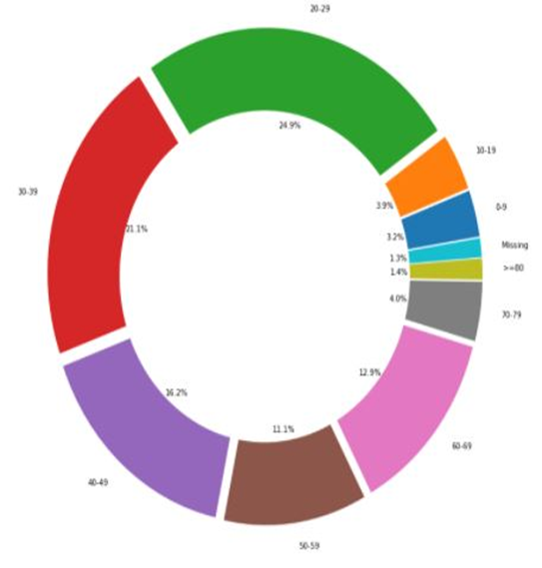
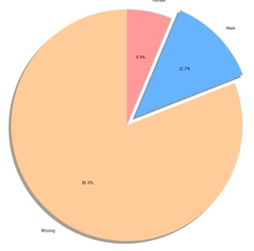
Analyzation Contd…
Fig:2 Gender Group Analysis
Fig:1 Age Group Analysis

Slide 7
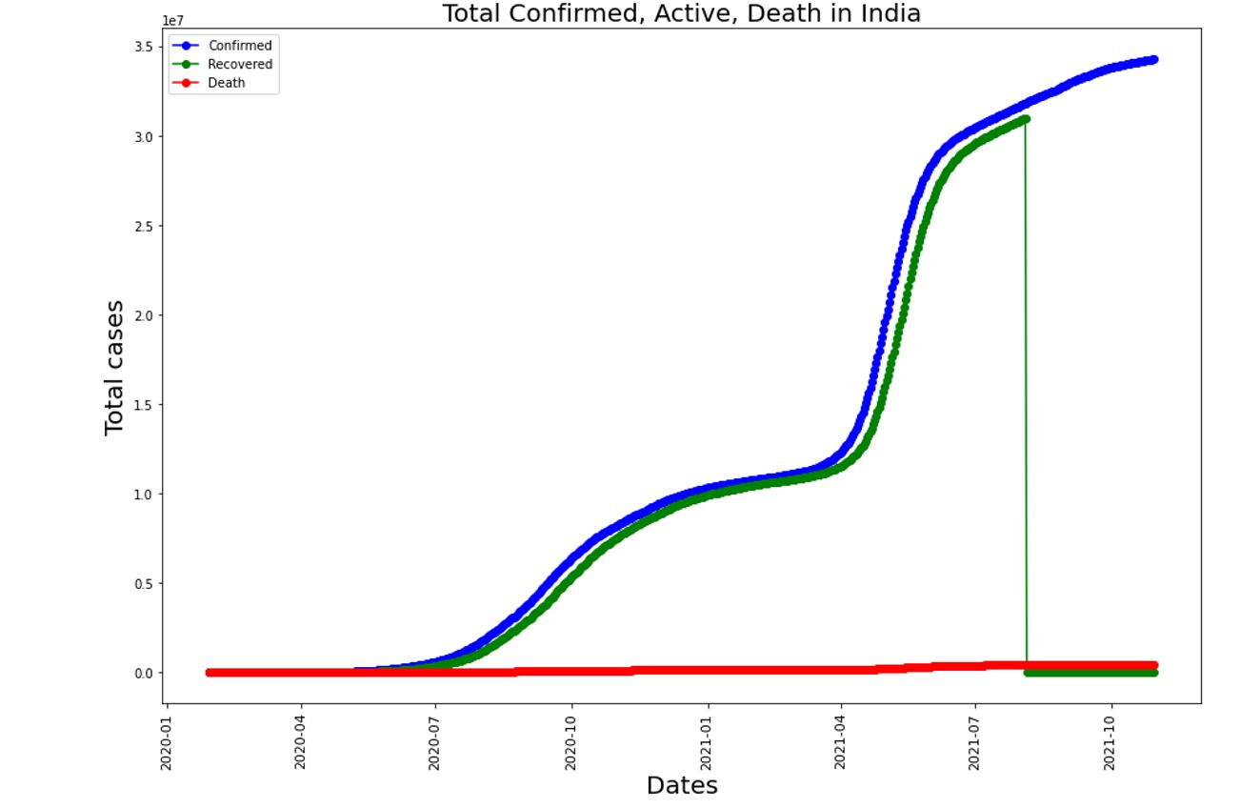
Analyzation Contd…
The Spike of Cases in India: We have seen the maximum spike of recovered cases as per the dataset on 11/08/2021. We also have compared cases with other countries.
Figure 3, clearly described the rise of the recovered cases, death cases and confirmed cases in India.
Fig: 3 Spike of cases

Slide 8
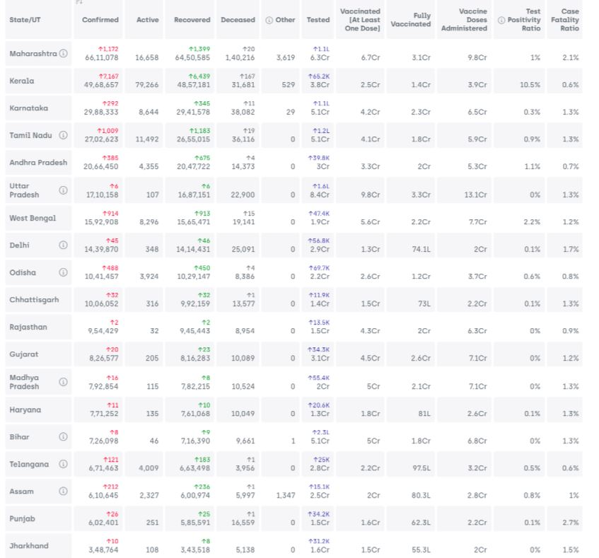
Analyzation Contd…
State wise Insights: The complete report of state in a single table can be shown.
Gives a detailed report of the number of cases with parameters as death rate percentage and cure rate percentage.
The chart plot also gives a visual analyzation of top 15 highly infected cities that have a greater number of cases.
Figure 4 shows the detailed insight of the states our country, the parameters are confirmed, death, cured and active cases and also death and cured rate.
Fig: 4 Detailed Insights of the States in India

Slide 9
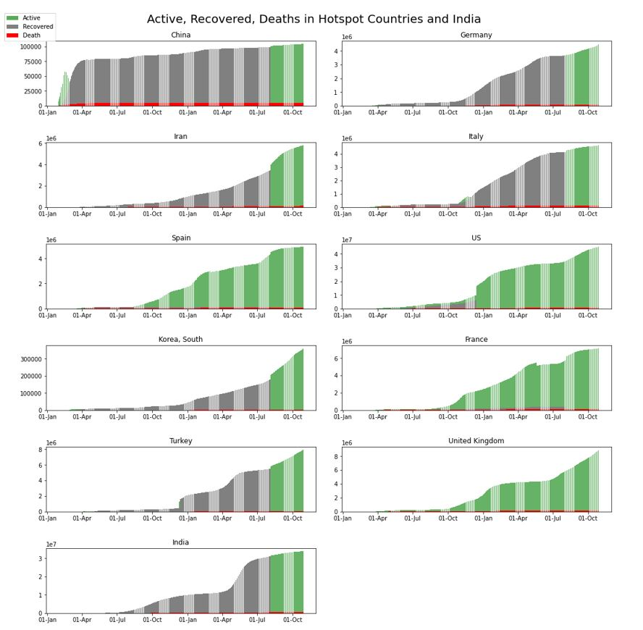
Analyzation Contd…
Fig: Detailed Insights of the top hotspot countries

Slide 10
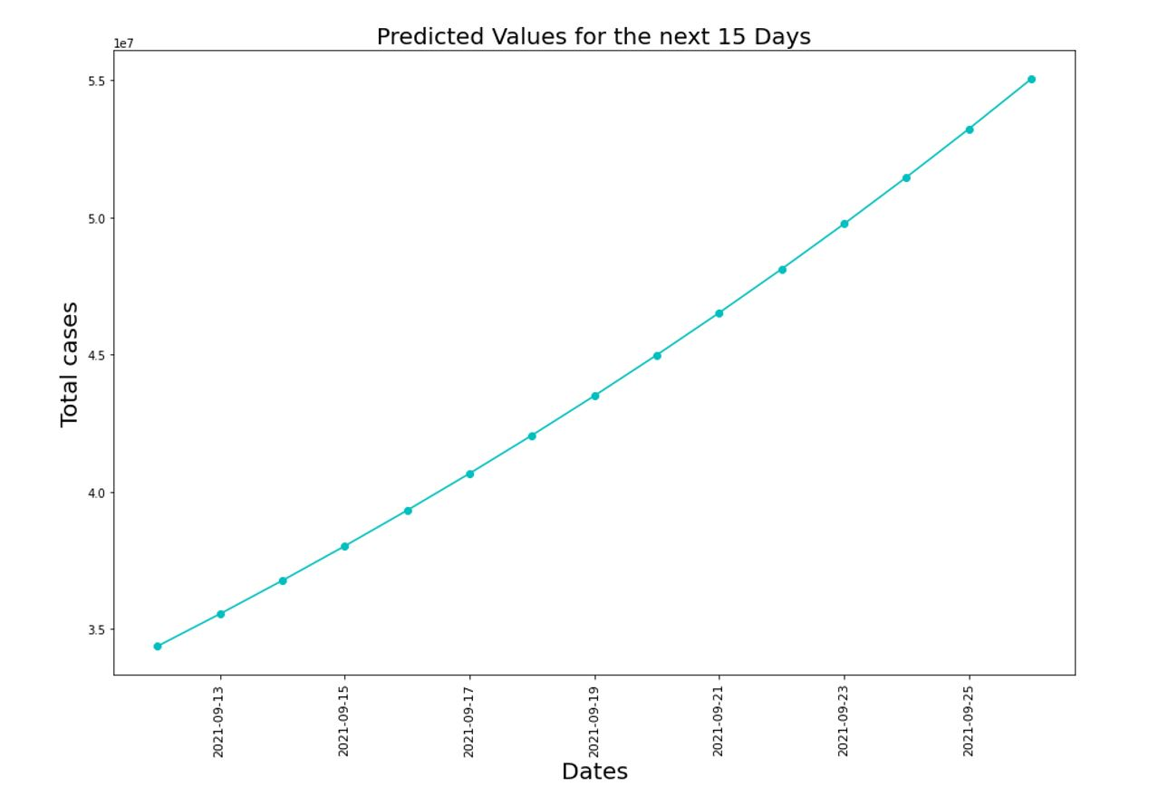
Prediction
Prediction using growth factor:
We are calculating the growth factor for continuous 15 days.
Taking the confirmed cases, we are calculating the average growth factor which is 1.0342139453392285.
Fig: 5: Line Plot Chart for Predicted Value

Slide 11
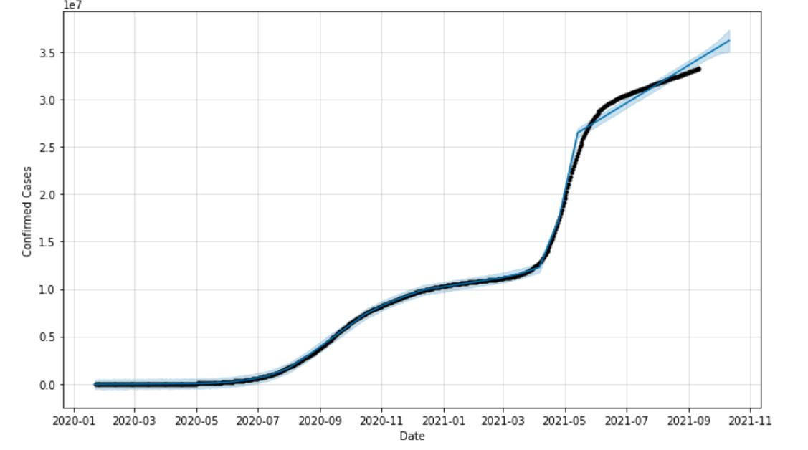
Prediction Contd…
Prediction using Prophet Model:
Prophet model is an open-source time series forecasting tool/library designed by Facebook for making forecasts for univariate time series datasets.
Figure 6 show that Prediction using Prophet Model of growth rate of disease. Here the X- axis denotes the dates and the Y- axis denotes the total number of confirmed cases.
Fig: 6 Prediction using Prophet Model

Slide 12
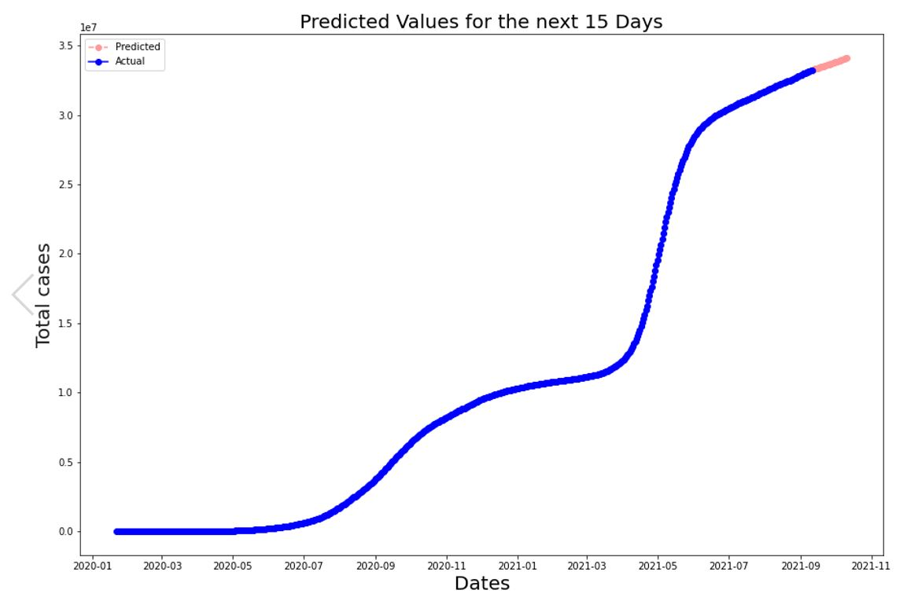
Prediction Contd…
Prediction using ARIMA:
Auto Regressive Integrated Moving Average also known as ARIMA
It is a class of prototype that describes us about the given time series which is established on its own old values,
i.e., its own lags and the lagged forecast errors, so that equation can be used to predict destiny rate.
Figure 7 show that the Prediction of growth rate using ARIMA Model.
Fig: 7 Prediction using ARIMA Model

Slide 13
Conclusion
The COVID-19, originated from China, caused from SARS-COV-2 is a global pandemic disease.
Time series model have helped us to predict and visualize the growth of number of cases. From the figure 1 and figure 2, it has been observed that not only the aged people but it has affected the more on the age group of 20-50 years by the COVID-19 cases and maximum cases happened to male candidate.
From figure 3 and figure 4 we got an insight of the rise of cases in our country
With proper real-time data, the prophet model and the ARIMA model will help us to do the time series forecasting prediction with minimal errors comparison to other models.

Slide 14
Reference
[1] Anhvinh Doanvo et al., “Machine Learning Maps Research Needs in COVID-19 Literature”, https://doi.org/10.1016/j.patter.2020.100123 (references)
[2] Junaid Farooq and Mohammad Abid Bazaz, “A deep learning algorithm for modeling and forecasting of COVID-19 in five worst affected states of India”, Alexandria Engineering Journal Volume 60, Issue 1, February 2021, Pages 587-596 https://doi.org/10.1016/j.aej.2020.09.037 (references)
[3] Panel Raj Dandekar, Chris Rackauckas and George Barbastathis, “A Machine Learning-Aided Global Diagnostic and Comparative Tool to Assess Effect of Quarantine Control in COVID-19 Spread,” in Patterns Volume 1, Issue 9, 11 December 2020, 100145, https://doi.org/10.1016/j.patter.2020.100145
[4] Junaid Farooq and Mohammad Abid Bazaz, “A novel adaptive deep learning model of Covid-19 with focus on mortality reduction strategies,” Chaos, Solitons & Fractals Volume 138, September 2020, 110148, https://doi.org/10.1016/j.chaos.2020.110148
[5] Sina F. Ardabili et al., “COVID-19 Outbreak Prediction with Machine Learning”, March 2020 DOI: 10.20944/preprints202004.0311.v1,
https://www.researchgate.net/publication/340782507_COVID-19_Outbreak_Prediction_with_Machine_Learning (references).
[6] Tarik Alafif et al., “Machine and Deep Learning Towards COVID-19 Diagnosis and Treatment: Survey, Challenges, and Future Directions,” October 2020 DOI: 10.13140/RG.2.2.20805.47848/1, August1987, https://www.researchgate.net/publication/344660073_Machine_and_Deep_Learning_Towards_COVID-19_Diagnosis_and_Treatment_Survey_Challenges_and_Future_Directions.

Slide 15
Reference Contd…
[7] Akib Mohi Ud Din Khanday et al., “Machine learning based approaches for detecting COVID-19 using clinical text data,” Published: 30 June 2020 International Journal of Information Technology volume 12, pages731–739(2020), https://link.springer.com/article/10.1007/s41870-020-00495-9
[8] R. Sujath, Jyotir Moy Chatterjee & Aboul Ella Hassanien, “A machine learning forecasting model for COVID-19 pandemic in India, ” Published: 30 May 2020, Stochastic Environmental Research and Risk Assessment volume 34, pages959–972(2020), https://link.springer.com/article/10.1007/s00477-020-01827-8
[9] Siddique Latif et al., “Leveraging Data Science to Combat COVID-19: A Comprehensive Review,” Published in: IEEE Transactions on Artificial Intelligence ( Volume: 1, Issue: 1, Aug. 2020) Page(s): 85 – 103 Date of Publication: 02 September 2020 Electronic ISSN: 2691-4581 DOI: 10.1109/TAI.2020.3020521 Publisher: IEEE
[10] Narinder Singh Punn, Sanjay Kumar Sonbhadra and Sonali Agarwal, “COVID-19 Epidemic Analysis using Machine Learning and Deep LearningAlgorithms,” doi:https://doi.org/10.1101/2020.04.08.20057679.
[11] Hopkins John. Retrieved from https://github.com/CSSEGISandData/COVID-19/tree/master/csse_covid_19_data/csse_covid_19_time_series
[12] Retrieved from https://www.mohfw.gov.in/

