Slide 1
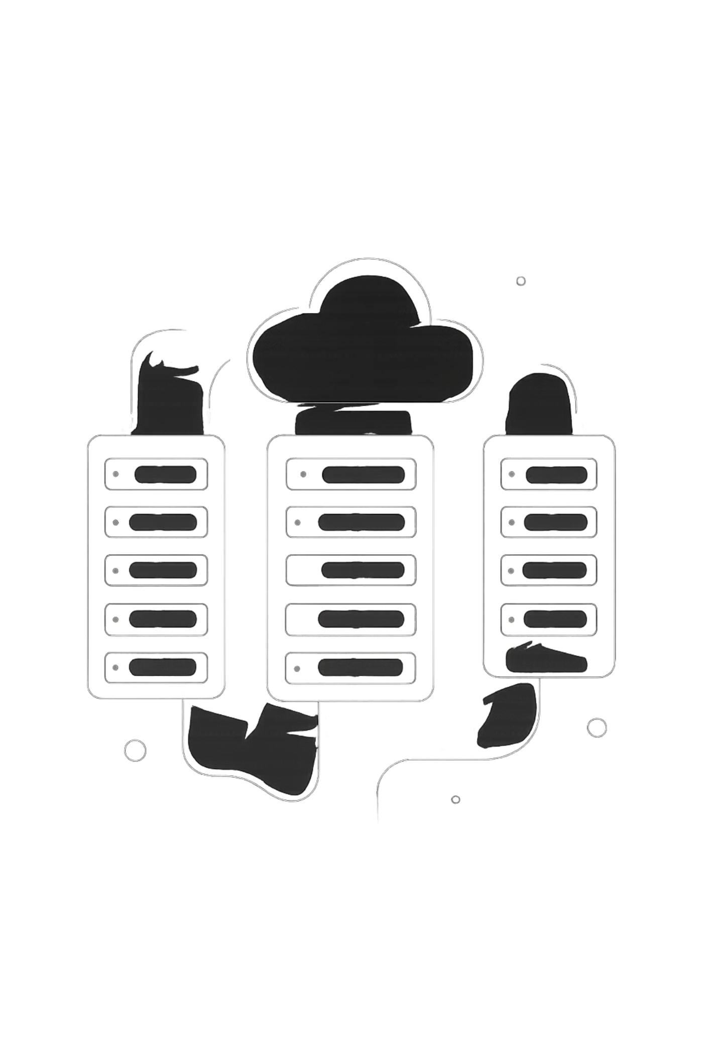
Infrastructure & Terraform Architecture Review
Highly-Available, Private VPC Deployment of the Patient Management System
Technical review of network architecture, security controls, and IaC patterns — covering Terraform-managed production infrastructure only.

Slide 2
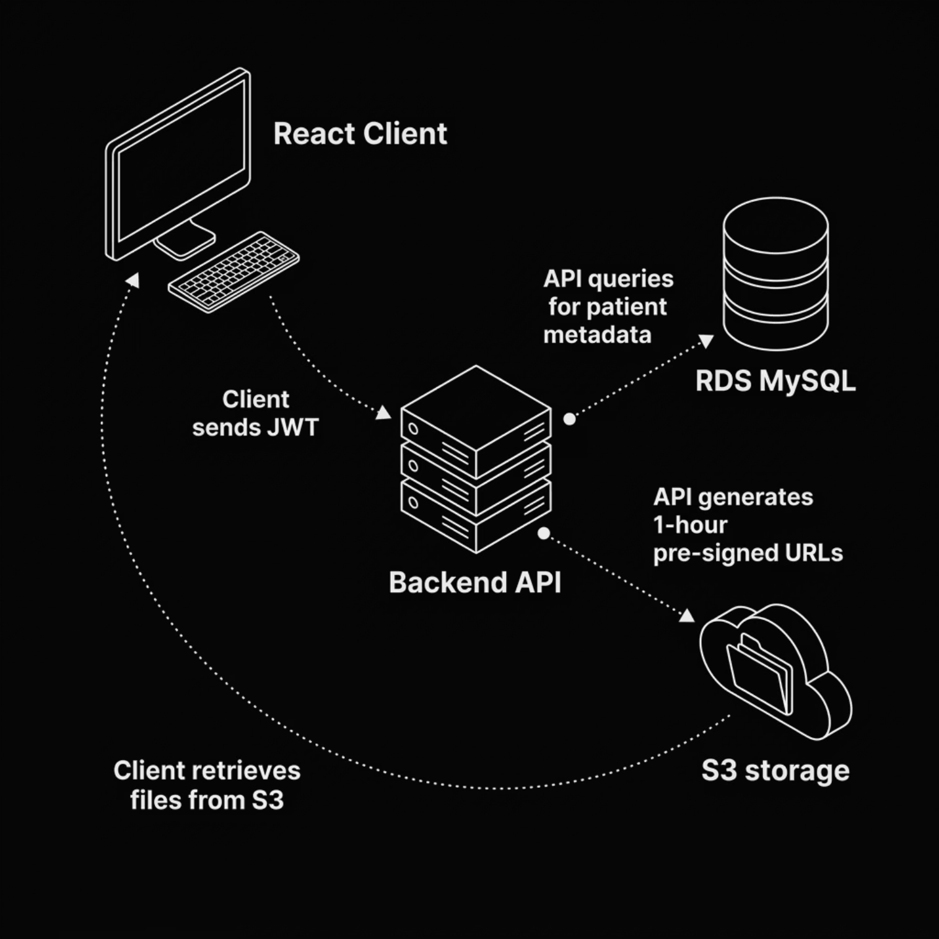
APPLICATION CONTEXT
Application Context & Data Flows
System Components
FastAPI + Gunicorn backend tracks patient metadata
S3 stores diagnostic files — never served directly
1-hour pre-signed URLs enforce time-limited access
JWT auth gates all API interactions

Slide 3
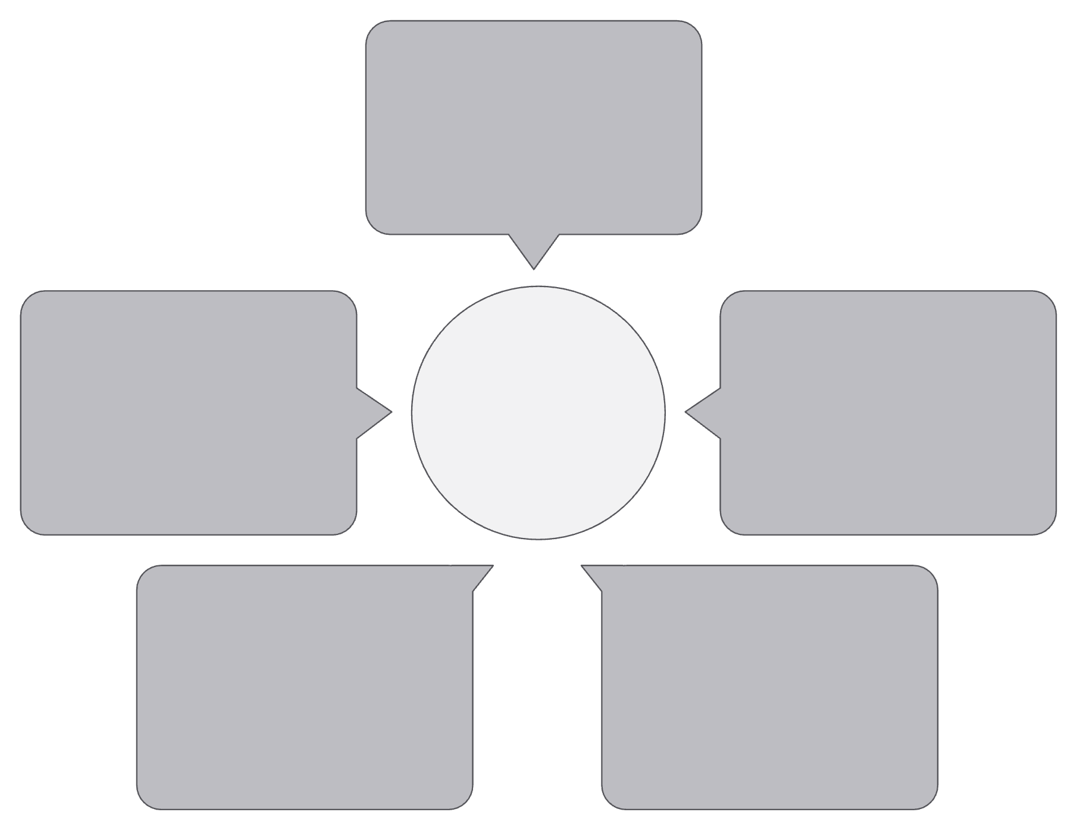
PRODUCTION TOPOLOGY
Production Target AWS Architecture
Route53 DNS
lavenbloom.xyz & api.lavenbloom.xyz
RDS MySQL & Secrets Manager
Production AWS Architecture
CloudFront CDN
Serves React from private S3
Managed DB and secrets
Auto Scaling Group
Application Load Balancer
Nodes in private subnets (2 AZs)
Routes API traffic to ASG
Dual-AZ, multi-tier deployment with managed services and zero public-facing compute.
Route53: lavenbloom.xyz → CloudFront; api.lavenbloom.xyz → ALB
CloudFront: Serves static assets from private S3 via Origin Access Control
ALB: Routes to ASG nodes in private subnets — no public IPs
RDS MySQL: Managed, multi-AZ, encrypted via KMS

Slide 5
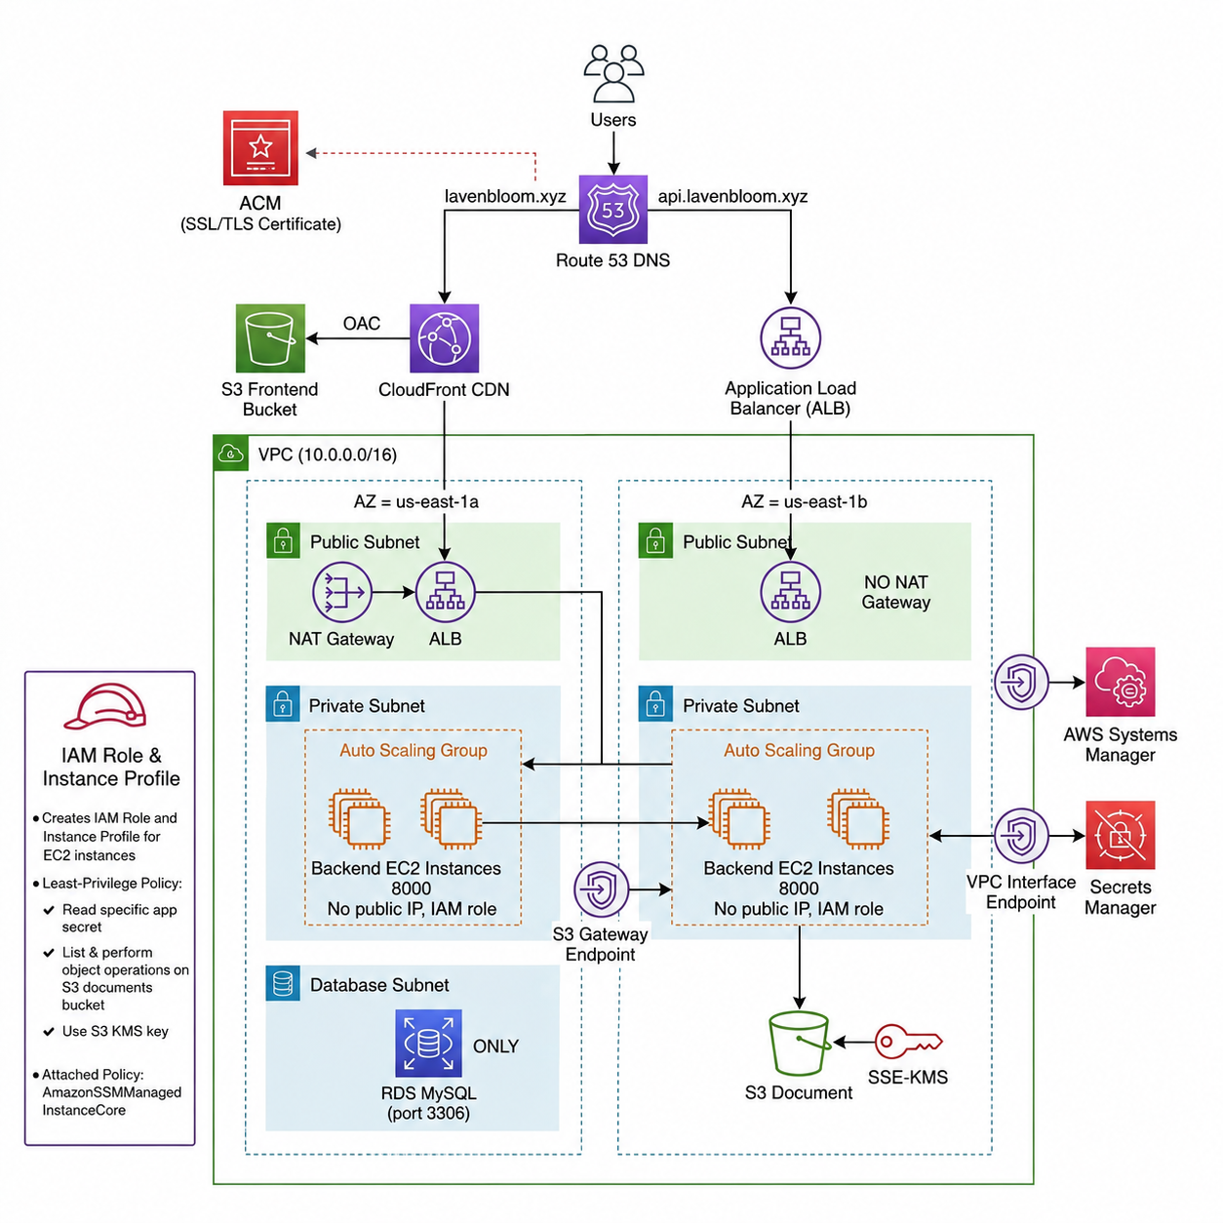

Slide 6

NETWORK DESIGN
VPC Segmentation, High Availability & Routing
VPC: 10.0.0.0/16 — Dual-AZ Design
VPC Endpoints (Private)
Interface Endpoints: SSM, Secrets Manager — private AWS API access
Gateway Endpoint: S3 — no NAT traversal for bucket traffic
Subnet Type
CIDR
Route Target
AZs
Public
/24
Internet Gateway
a, b
Database subnets have zero internet route — RDS is fully isolated
Private (App)
/24
NAT Gateway
a, b
Database
/24
Local VPC
a, b
NAT Gateway in public subnet enables outbound internet for ASG nodes. Database subnets have no route to the internet.

Slide 7
TERRAFORM DESIGN
Terraform Codebase: Modular Design
Module Directory Structure
Module Composition
Each module exposes typed input variables and explicit outputs
Root main.tf wires module outputs as downstream inputs
Reusable across environments — no hard-coded values
Single-module changes isolated; no cross-module side effects
terraform/
├── modules/
│ ├── vpc/
│ ├── kms/
│ ├── s3/
│ ├── rds/
│ ├── security-groups/
│ ├── iam/
│ ├── secrets/
│ ├── launch-template/
│ ├── asg/
│ ├── frontend/
│ └── dns/
├── main.tf
└── variables.tf

Slide 8
TERRAFORM PATTERNS
Terraform Design Patterns & IaC Concepts
Dynamic Data Sources
Dependency Management
Ubuntu AMI via aws_ami filter; Route53 zone via aws_route53_zone lookup — no hard-coded IDs.
Implicit via resource references; explicit depends_on for non-reference ordering (e.g., endpoints before ASG).
State-Driven Provisioning
Dynamic Resource References
Terraform state tracks real-world resource drift. terraform plan surfaces changes before apply.
Module outputs resolved at runtime — subnet IDs, security group ARNs wired without static values.

Slide 9

PROVISIONING WORKFLOW
Infrastructure Orchestration & Dependency Resolution
Phase 2 Security & Storage
Phase 3 Secrets & Compute
Security groups, KMS, S3, RDS instance.
Secrets Manager, launch template, ASG.
Phase 1 Networking
Phase 4 Routing & DNS
VPC, subnets, IGW, NAT, VPC endpoints.
ALB, CloudFront, Route53 records.
Dependency graph dictates strict ordering — networking resources must exist before compute or storage can reference them.
Phase 1 — Networking: VPC, subnets, IGW, NAT Gateway, VPC Endpoints
Phase 2 — Security & Storage: Security Groups, KMS, S3, RDS
Phase 3 — Secrets & Compute: Secrets Manager, Launch Template, ASG
Phase 4 — Routing & DNS: ALB, CloudFront, Route53 records

Slide 10
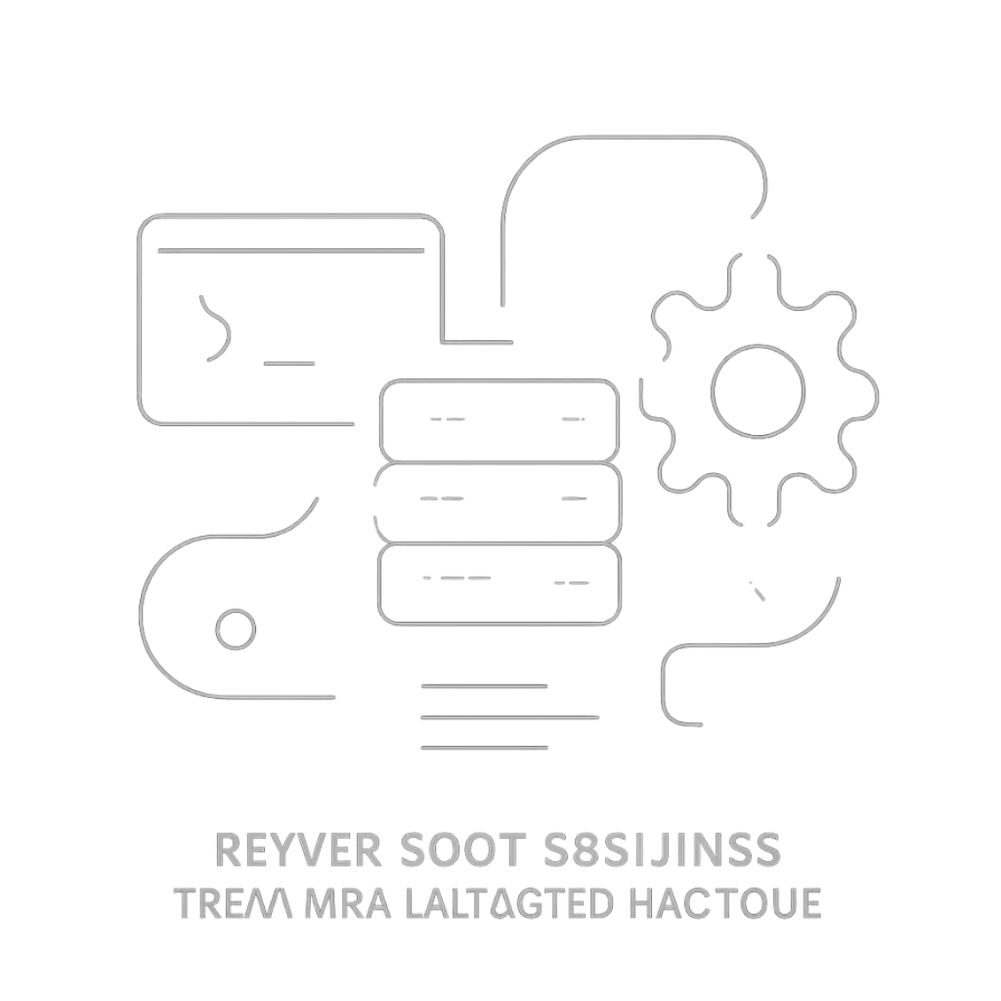

COMPUTE LAYER
Compute Automation: Launch Templates & User Data
Launch Template Configuration
Private subnet placement — no public IP assigned
Security groups attached at launch
IMDSv2 enforced; instance metadata locked down
User-Data Bootstrap Sequence
System updates via apt upgrade
Clone repo at tag v1.0.0 (immutable deploy)
Create virtualenv; install dependencies
Start Gunicorn bound to 0.0.0.0:8000
ASG health checks auto-replace unhealthy nodes — zero-touch recovery

Slide 11
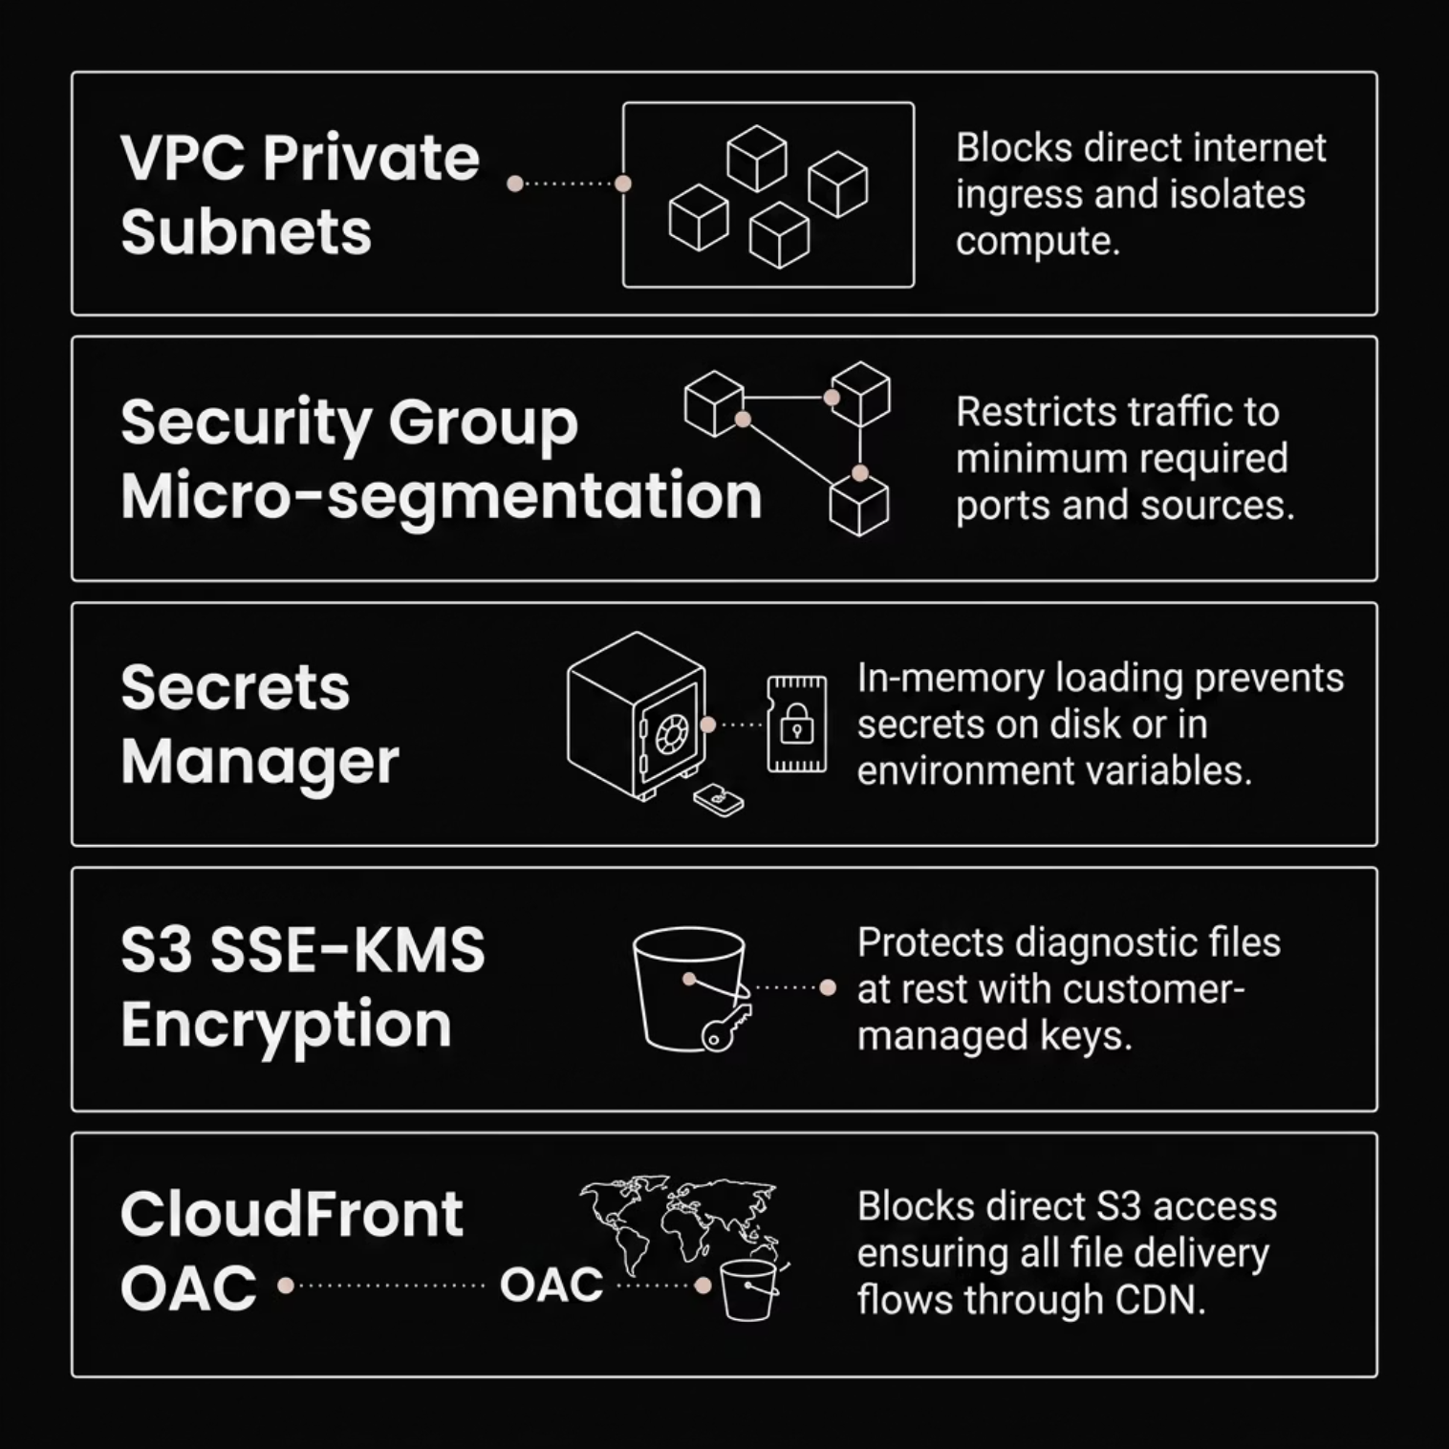
SECURITY ARCHITECTURE
Security Engineering & Threat Mitigation
Defense-in-Depth Layers
Network isolation: Private subnets block all direct ingress
Micro-segmentation: Security groups restrict to minimum required ports
Secrets hygiene: Loaded in-memory at runtime — never on disk
Data encryption: S3 SSE-KMS with customer-managed key
Origin protection: CloudFront OAC prevents direct S3 access

Slide 12
OUTCOMES & ROADMAP
Infrastructure Outcomes & Future Roadmap
✓ Achieved
→ Roadmap
High availability — dual-AZ, ASG auto-healing, multi-AZ RDS
IaC scaling — modular Terraform, repeatable provisioning
Automated bootstrapping — zero-touch node recovery via user-data
Private-by-default — VPC endpoints, no public compute exposure
S3 Remote State with DynamoDB locking for team collaboration
Multi-environment workspaces — staging, production isolation
CI/CD pipelines — terraform plan on PR, apply on merge
CloudWatch monitoring — ASG, ALB, RDS metrics and alarms

