Slide 1
Methods Extended SIR: Considering different Sources of Immunity
Rebecca Nishide
Partner: Katherine La
Physics 128L, Winter 2021

Slide 2

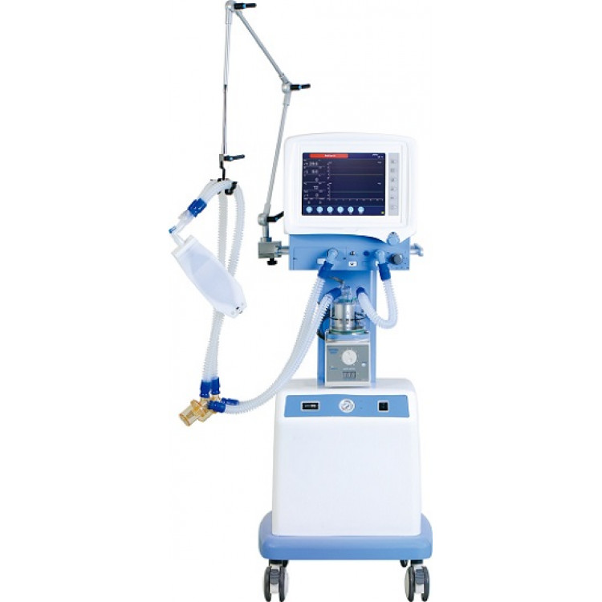

What makes an individual not susceptible?
Basic SIR far-off from real life
Concepts
Images from iStock, Science News fo rStudents, Allied Scientific Pro
Notes:
https://www.sciencenewsforstudents.org/article/what-are-antibodies-explainer
https://alliedscientificpro.com/shop/product/respiratory-ventilator-icu-s1100-24417

Slide 3
Extension
Population of N people
Susceptible (S)
Exposure resulting in infection
Deceased (D)
Infected (I)
Death
Recovery
Loss of antibodies
Vaccination
Recovered, temporarily immune (R)
Immune by vaccination (H)
Vaccination
N = S + I + R + D + H
Concepts
Notes:
BLACK BOX
ANAMOLOUS
LONG TERM
PARALLEL
OPTIMIZATION
Sensor testing important
We can think of sensor as black box for my seminar
Anomalous behavior
Long term behavior
Large systems useful for physical findings
How sensors work in parallel
Super well optimized

Slide 4
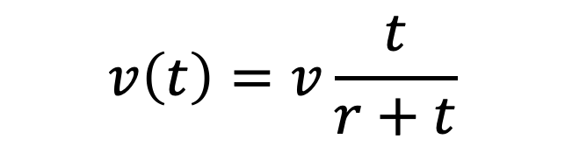
Introducing new parameters
v | Upper limit for number of vaccines given per day
r | Number of days since first vaccine it takes to reach half of capacity
lag | Number of days from start of epidemic to administration of first vaccine
d | Percent of infected people who pass away
w | Number of days after infection that a person loses temporary immunity
A | Percent of population that will not be effectively vaccinated
$$v\left(t\right)=v\frac{t}{r+t}$$
Vaccination administration ramps up exponentially to simulate real life
Technical
Notes:
BLACK BOX
ANAMOLOUS
LONG TERM
PARALLEL
OPTIMIZATION
Sensor testing important
We can think of sensor as black box for my seminar
Anomalous behavior
Long term behavior
Large systems useful for physical findings
How sensors work in parallel
Super well optimized

Slide 5
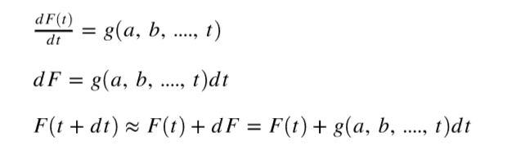
Solving Differentials
Simple iterative approach
Tested against radioactive decay differential equation
Systematic unit testing shows slight dependence on timestep dt only at large values, e.g. dt > 0.1
Technical
Notes:
BLACK BOX
ANAMOLOUS
LONG TERM
PARALLEL
OPTIMIZATION
Sensor testing important
We can think of sensor as black box for my seminar
Anomalous behavior
Long term behavior
Large systems useful for physical findings
How sensors work in parallel
Super well optimized

Slide 6
How to Incorporate real data?
Using Neher Lab CA dataset
Some initial conditions are clear...
Death rate can be calculated as average: d = 0.0016
Population of CA: N = 39.5 million
I₀ = 53
Value of k requires more in depth analysis.
Initial Conditions
Notes:
BLACK BOX
ANAMOLOUS
LONG TERM
PARALLEL
OPTIMIZATION
Sensor testing important
We can think of sensor as black box for my seminar
Anomalous behavior
Long term behavior
Large systems useful for physical findings
How sensors work in parallel
Super well optimized

Slide 7

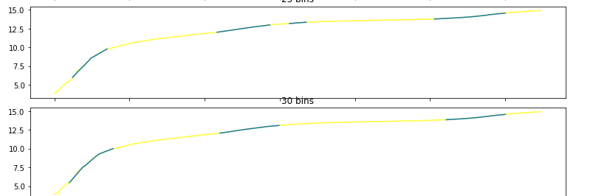
Try 1: Slicing into bins
Log of cases over time sliced into bins
Each bin fit to line, slope is k of that bin.
Algorithm automates:
rejects some bins
Gives chi-square
Tries different bin sizes
Consistently gives k values that are too low, and break SIR model.
Initial Conditions
Notes:
BLACK BOX
ANAMOLOUS
LONG TERM
PARALLEL
OPTIMIZATION
Sensor testing important
We can think of sensor as black box for my seminar
Anomalous behavior
Long term behavior
Large systems useful for physical findings
How sensors work in parallel
Super well optimized

Slide 8
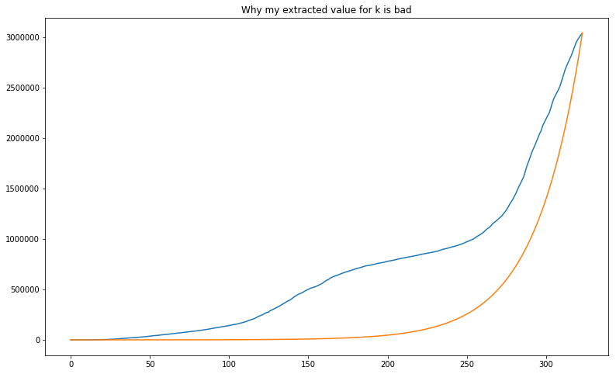
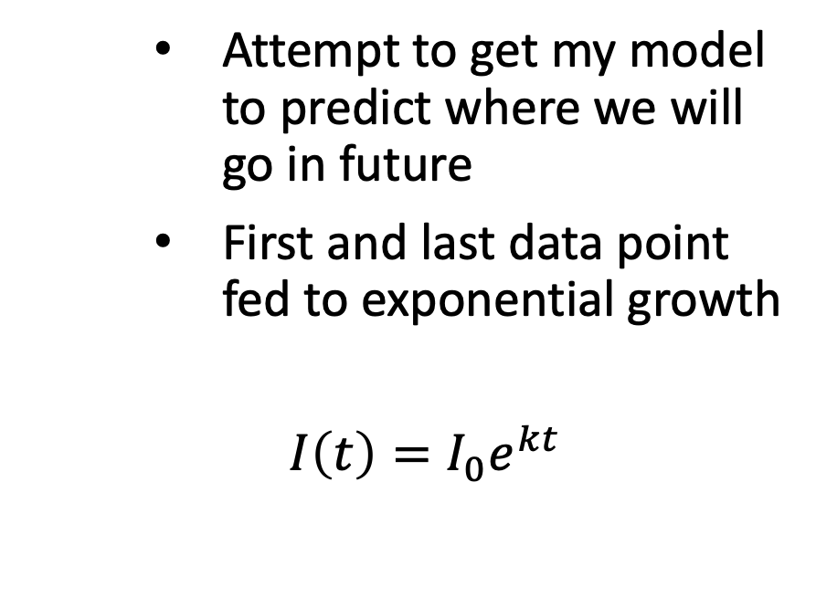
Try 2: First and Last point approx.
Attempt to get my model to predict where we will go in future
First and last data point fed to exponential growth
$I\left(t\right)=I_{0}e^{kt}$
k values still too low. This is clearly a bad approximation
Initial Conditions
Notes:
BLACK BOX
ANAMOLOUS
LONG TERM
PARALLEL
OPTIMIZATION
Sensor testing important
We can think of sensor as black box for my seminar
Anomalous behavior
Long term behavior
Large systems useful for physical findings
How sensors work in parallel
Super well optimized

Slide 9
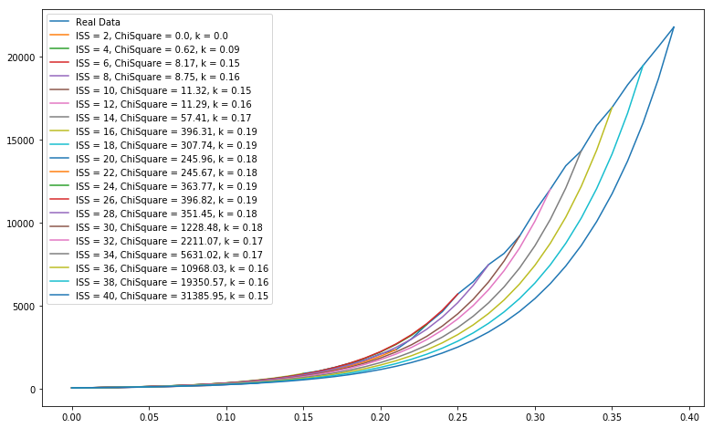
Try 3: Initial Steady State (ISS)
Checking goodness of fit between real data and I(t)
ISS = 14 days
K = 0.17
This is a good method for finding k.
Initial Conditions

Slide 10
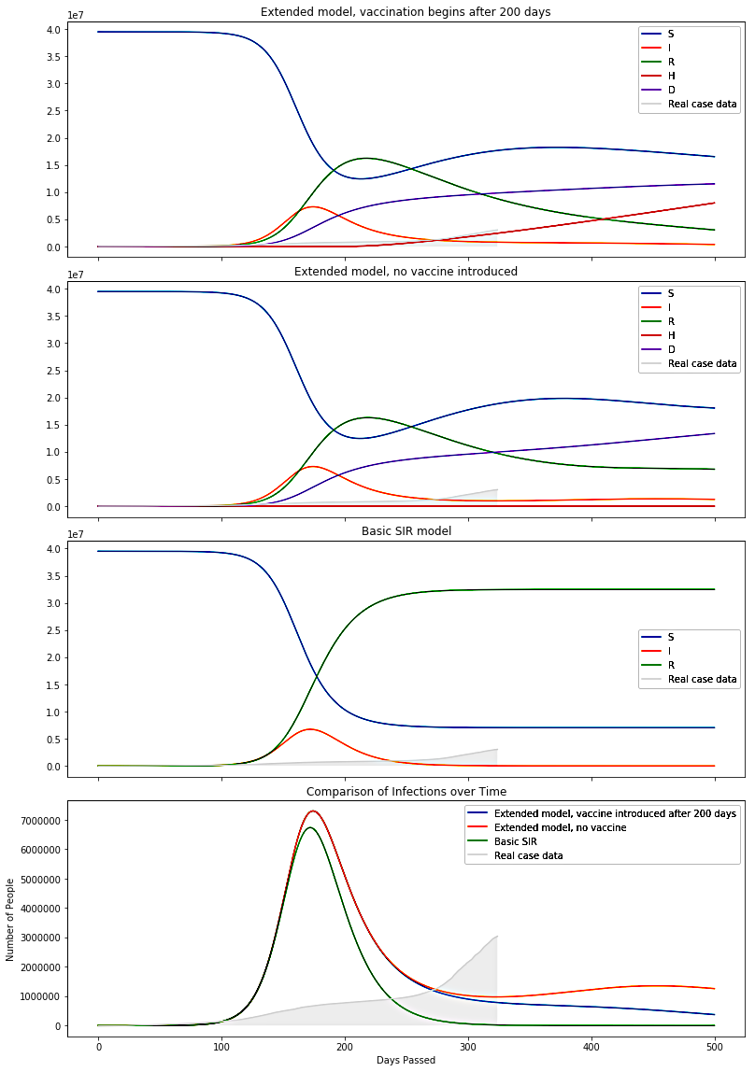
How does death rate and temporary immunity change the model?
Infections is wider
S reaches local minimum and grows again
Dead population is high ☹
Final Product
Notes:
https://www.sciencenewsforstudents.org/article/what-are-antibodies-explainer
https://alliedscientificpro.com/shop/product/respiratory-ventilator-icu-s1100-24417

Slide 11
Adding in Vaccinations
Vaccination forces infections to go to zero
SIRHD useful tool to build off as we get more info
SIRHD
I
Final Product
Notes:
https://www.sciencenewsforstudents.org/article/what-are-antibodies-explainer
https://alljiedscientificpro.com/shop/product/respiratory-ventilator-icu-s1100-24417

Slide 12
Acknowledgements
Katherine La: partner
Ari Kaplan: TA
Xiao Luo: Professor
Thank you for listening!
Methods
Notes:
BLACK BOX
ANAMOLOUS
LONG TERM
PARALLEL
OPTIMIZATION
Sensor testing important
We can think of sensor as black box for my seminar
Anomalous behavior
Long term behavior
Large systems useful for physical findings
How sensors work in parallel
Super well optimized

Slide 13
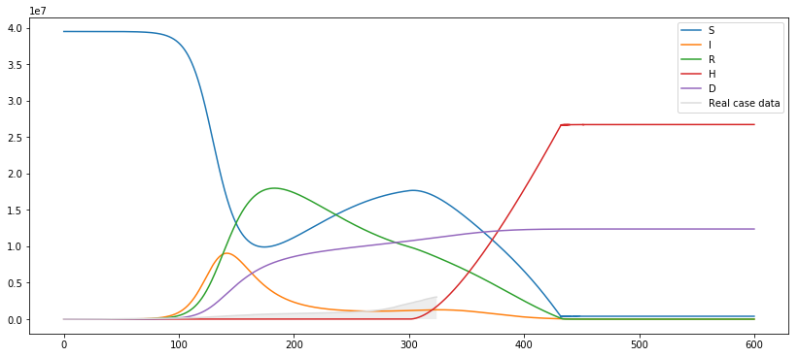
SIRHD plot
Backup Slides
Notes:
https://www.sciencenewsforstudents.org/article/what-are-antibodies-explainer
https://alljiedscientificpro.com/shop/product/respiratory-ventilator-icu-s1100-24417

Slide 14
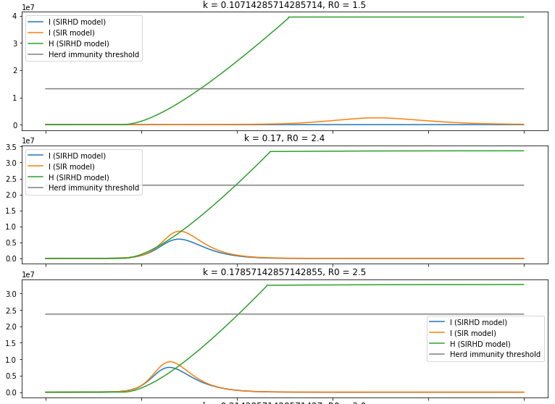
Varied k constants lag = 8, v = N*0.01 r = 50 A =0.01
Backup Slides

Slide 15
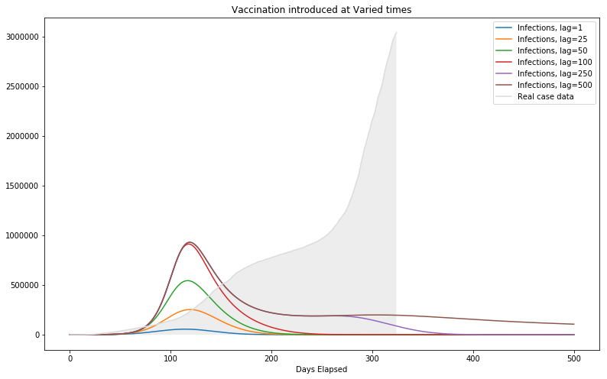
Varied lag constants A = 0.01 v = N*0.01 r = 50 k = 0.17
Backup Slides

Slide 16
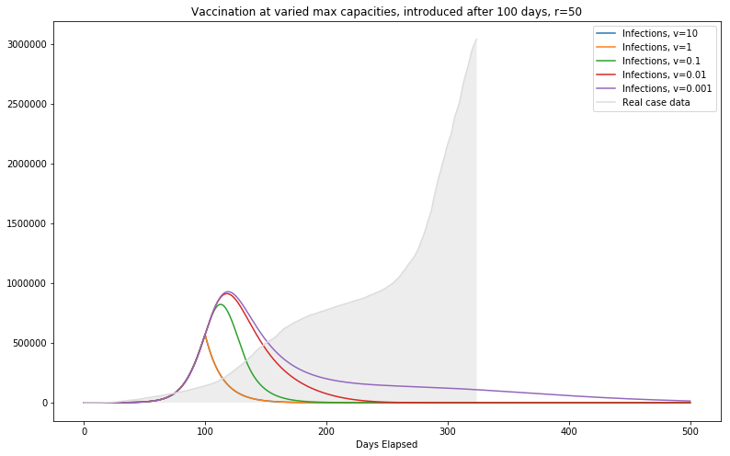
Varied v constants A = 0.01 lag = 100 r = 50 k = 0.17
Backup Slides

Slide 17
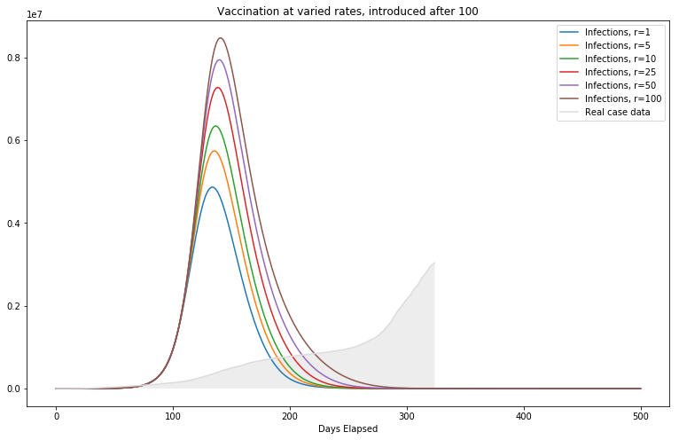
Varied r constants A = 0.01 lag = 100 v = 0.01*N k = 0.17
Backup Slides

