Slide 1
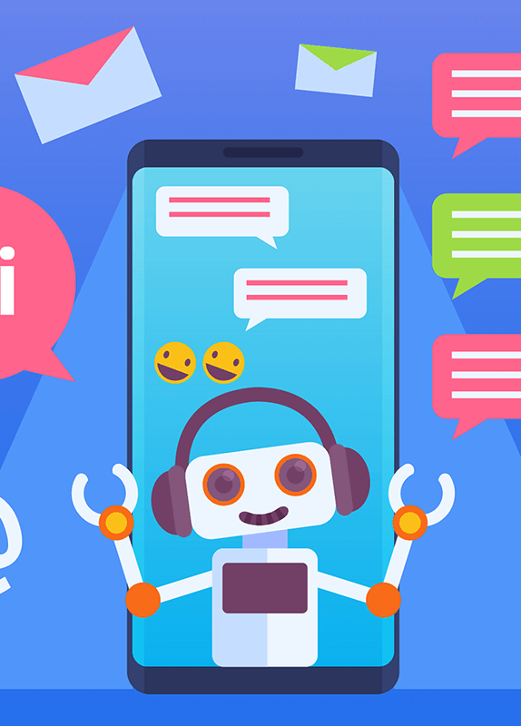
INSURANCE BOT
TEAM #9:
NANDINI.D
NIVEDHA.S
RAJASRI.N
MENTOR: Dr.S.P.MANIKANDAN
Notes:
`

Slide 2
PROBLEM STATEMENT:
Design an Insurance voice Bot to sell insurance products.
Pick up an insurance company. Identify the insurance products. Market the insurance products with the necessary details.

Slide 3
AUTO INSURANCE
Vehicle insurance is insurance for cars, trucks, motorcycles, and other road vehicles.
Its primary use is to provide financial protection against physical damage or bodily injury resulting from traffic collisions and against liability that could also arise from incidents in a vehicle.

Slide 4
AI IN INSURANCE
Today, chatbots or virtual assistants, are the most visible form of AI applications in the financial services space. With the evolution of natural language processing (NLP), chatbots are capable of answering queries, responding to voice commands and making recommendations.

Slide 5
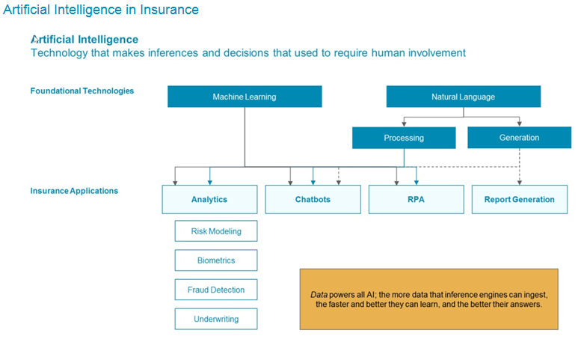

Slide 6
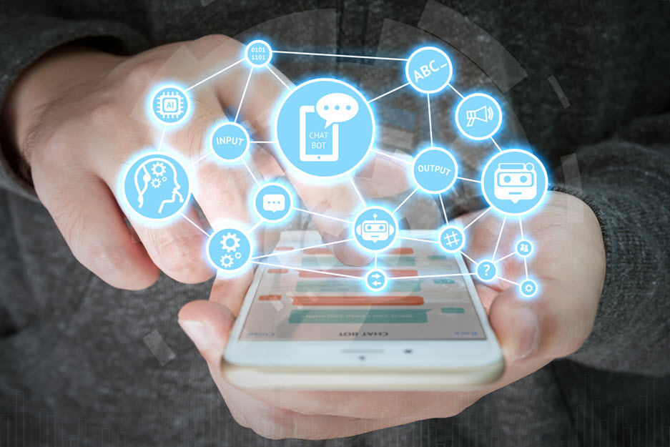
WORKING ENVIRONMENT

Slide 7
ANACONDA. - The data science platform
TENSORFLOW - An open source machine learning framework
JUPYTER - Web based computing notebook environment
PYTHON – The language used

Slide 8
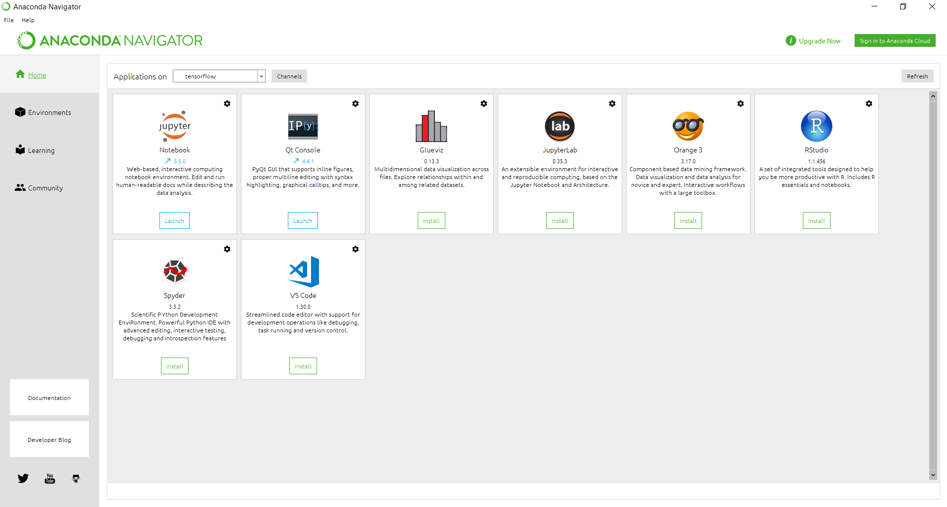
ANACONDA. - The data science platform

Slide 9
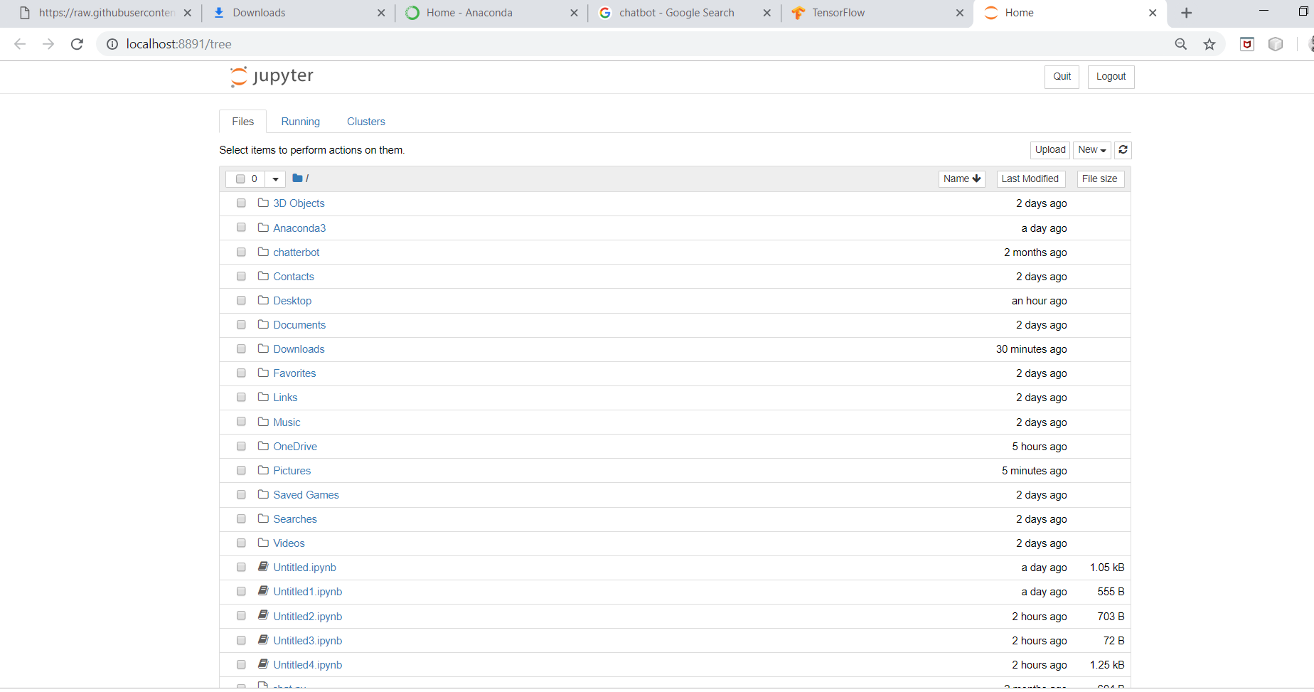
JUPYTER - Web based computing notebook environment

Slide 10
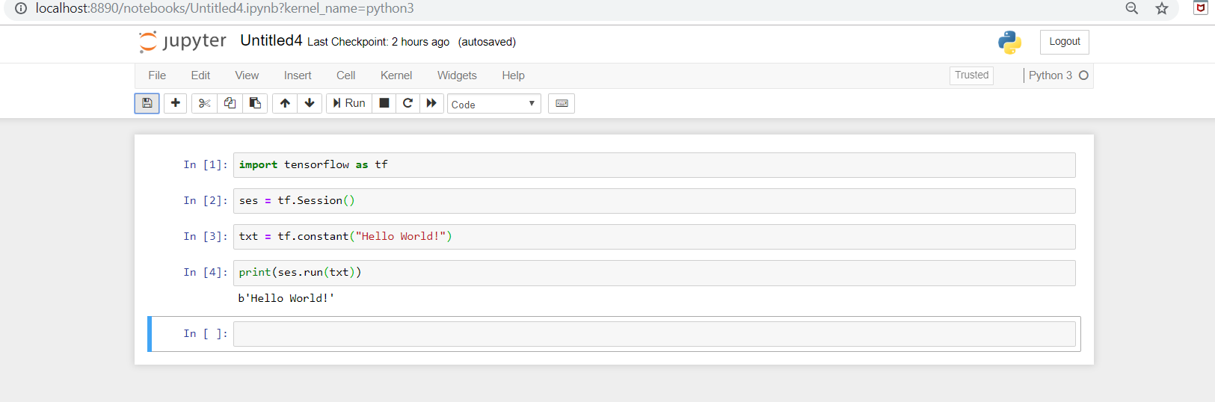
PYTHON Platform

Slide 11
What our insurance bot does?
Basically it starts with formal greetings.Then based on client’s query it either replies or asks question to get more clarification.
Then it provides a form to fill up by the clients.
In case of query that bot cannot answer, it directs them to a physical agent.

Slide 12
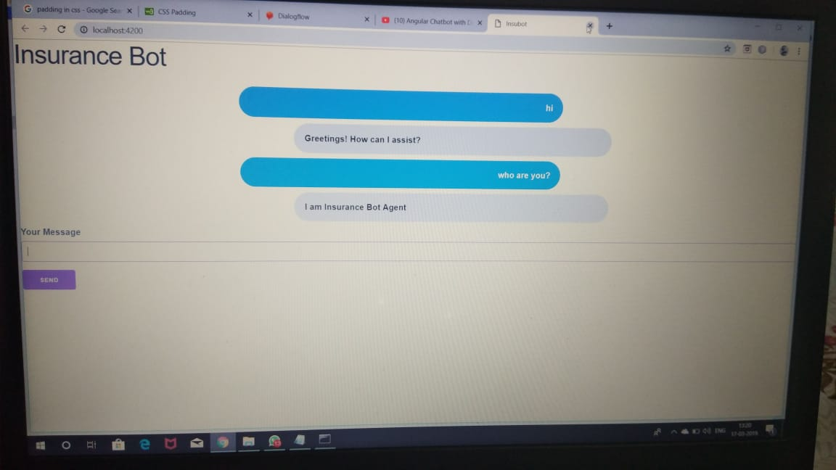
Sample Image of the bot.

Slide 13
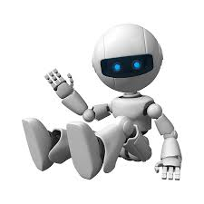
Thank You!!

