Slide 1
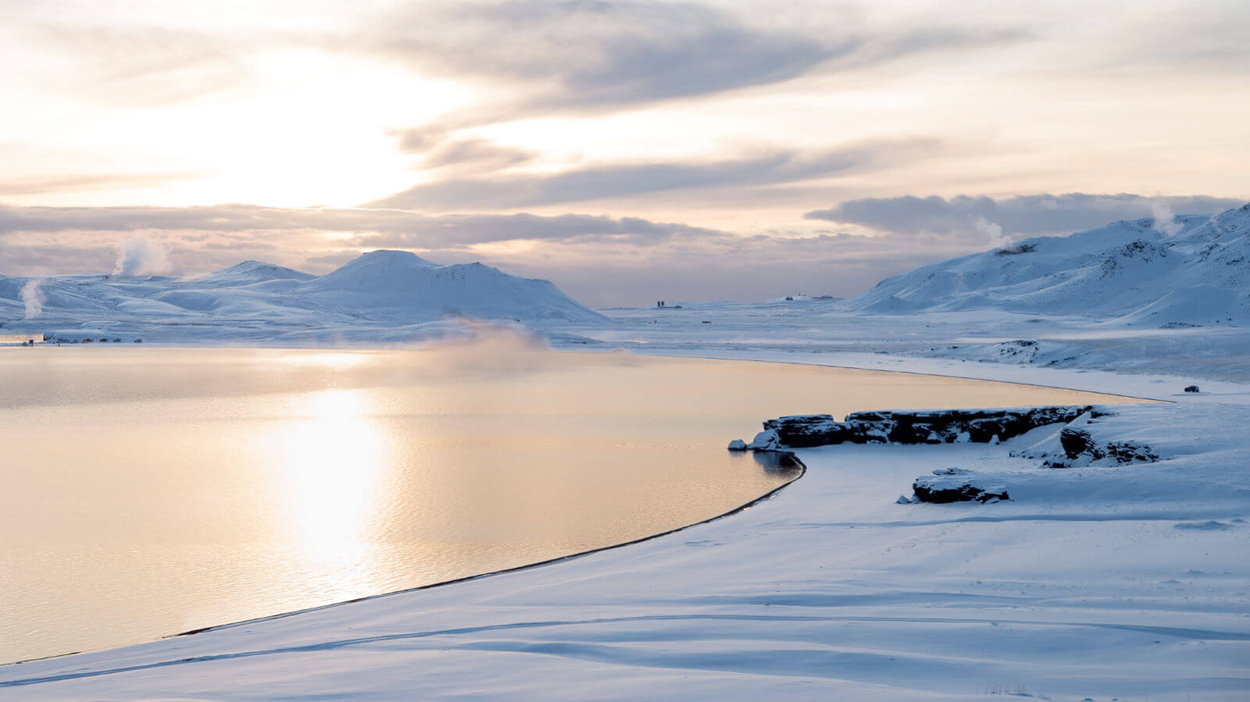
Iceland 02.23 – 03.02

Slide 2
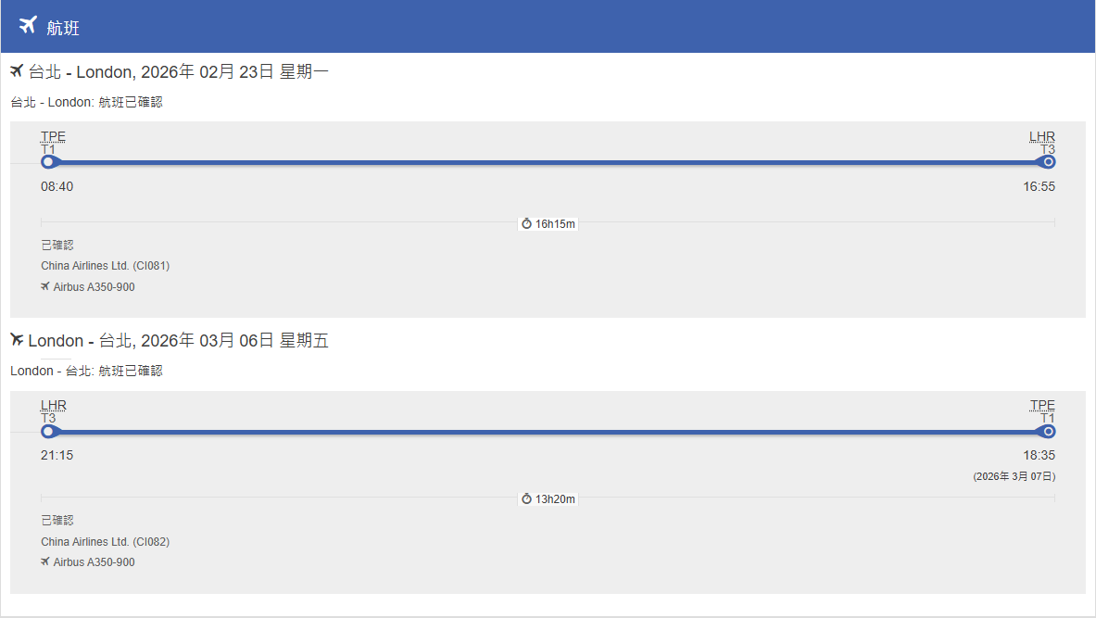
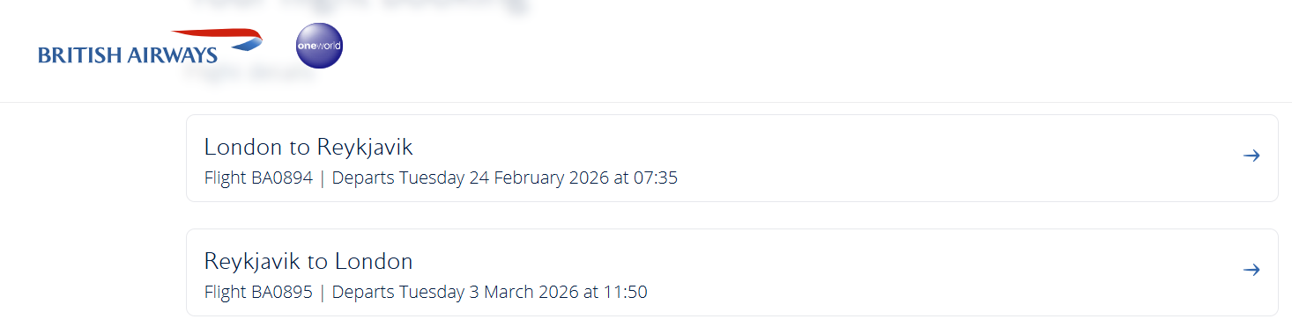
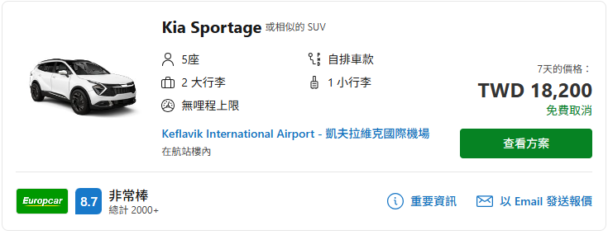
Information
#F3OKUO
Flight
02/23 TPE-LHR 08:40 – 16:55
02/24 LHR-KEF 07:35 – 10:55
03/03 KEF-LHR 11:50 – 15:00
03/06 LHR-TPE 21:15 – 18:35+1
Car Rental
#YWSN44

Slide 3
Information
Hotel
02/23: Crowne Plaza London Heathrow T4 by IHG
02/24: Hótel Kria
02/25: Hótel Hamar
02/26: Hótel Hamar
02/27: Hótel Jökulsarlon - Glacier Lagoon Hotel
02/28: Hótel Jökulsarlon - Glacier Lagoon Hotel
03/01: Hotel Reykjavík Saga
03/02: Courtyard by Marriott Keflavik
03/03: Page8, Page Hotels
03/04: Page8, Page Hotels
03/05: Page8, Page Hotels
03/06: Airbus A350-900
03/07: ShaoPeeWoo

Slide 4
Day 1-2
02/23
TPE [08:40] – LHR [16:55]
Crowne Plaza London Heathrow T4 by IHG
02/24
LHR [07:35] – KEF [10:55]
KEF – Costco Iceland (39min)
Costco Iceland - Tommi‘s Burger Joint - 66°North (10mins)
66°North - Hótel Kría (1hr 41min)

Slide 5
Day 3-4
02/25 [Golden Circle]
Hótel Kría – Víkurfjara Black Sand Beach – Friðheimar [12:00] (1hr 58min)
Friðheimar - Strokkur Geyser (18min)
Strokkur Geyser - Gullfoss (10 min)
Gullfoss – Þingvellir (46 min)
Þingvellir - Hótel Hamar (1hr 6 min)
02/26
Hótel Hamar – Snæfellsnes (46min)
Snæfellsnes - Ytri Tunga (20min)
Ytri Tunga - Búðakirkja (19min)
Búðakirkja - Ingjaldshólskirkja (29min)
Ingjaldshólskirkja - Borgarnes (1hr 34min)
Borgarnes - Hótel Hamar (7min)

Slide 6
Day 5-6
02/27
Hótel Hamar – Bónus (53min)
Bónus – Seljalandsfoss (1hr 37min)
Seljalandsfoss – Fjaðrárgljúfur (1hr 34min)
Fjaðrárgljúfur - Hótel Jökulsarlon (1hr 47 min)
02/28 [Glacier Hiking]
Hótel Jökulsarlon – Skaftafell Blue Ice Cave & Glacier Hike (51min)
Skaftafell Blue Ice Cave & Glacier Hike – Pakkhus Restaurant (1hr 41min)
Pakkhus Restaurant - Hótel Jökulsarlon (55min)

Slide 7
Day 7-8
03/01
Hótel Jökulsarlon – Mia's Country Van - Local Fish & Chips – Skógafoss (2hr 54min)
Skógafoss - Svarta Kaffið - Hotel Reykjavík Saga (1hr 44min)
03/02
Hotel Reykjavík Saga – Sky Lagoon (15min)
  Hallgrimskirkja – Harpa – Sun Voyager Reykjavík Iceland - Bæjarins Beztu Pylsur
Courtyard by Marriott Keflavik

Slide 8
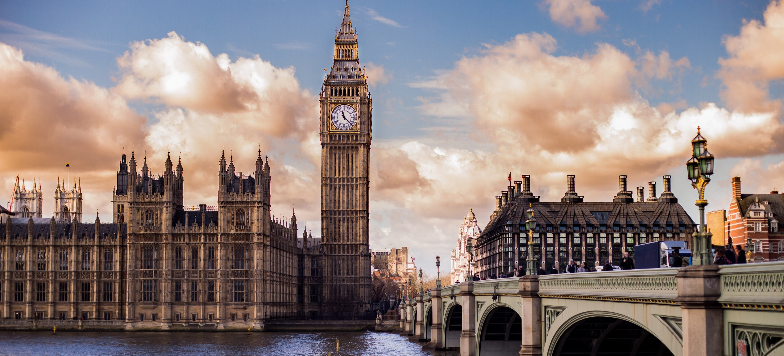
London 03.03 – 03.05

Slide 9
Day 9-10
03/03
Courtyard by Marriott Keflavik - KEF
KEF [11:50] – LHR [15:00]
LHR – Page8, Page Hotels (1hr 15min)
CORE by Clare Smyth***
Restaurant St. Barts*
03/04
Page8, Page Hotels - University of Oxford (1hr 30min)
University of Oxford - Bicester Village Outlet (35min)
Bicester Village Outlet - Page8, Page Hotels (1hr 30min)

Slide 10
Day 11-12
03/05
Page8, Page Hotels
  Trafalgar Square – Big Ben - London Eye - Westminster Abbey - Buckingham Palace - The British Museum
03/06
LHR [21:15] – TPE [18:35+1]

