Slide 1
R Meetup April 2017 - Package Workshop
Sarah Pollicott, Sarah Johnston & Rob Noble-Eddy
Notes:
Template version: 11/20/2012, for PowerPoint 2007 & 2010

Slide 2
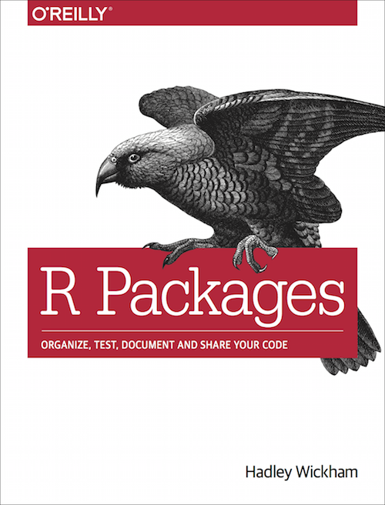
We’ll cover the basics of creating your own package today – for more thorough coverage see Hadley Wickham’s ‘R Packages’ book
Available online for free
http://r-pkgs.had.co.nz/
Or on Amazon
https://www.amazon.co.uk/R-Packages-Hadley-Wickham/dp/1491910593
Or for a quicker guide, the ‘Not So Standard Devations’ blog by Hilary Parker
https://hilaryparker.com/2014/04/29/writing-an-r-package-from-scratch/

Slide 3



We’re borrowing problem 3 from ProjectEuler.net to illustrate how to build an R package
Let’s start with 24 as a simpler example…
The factors of 24 are 1, 2, 3, 4, 6, 8, 12, 24
We can group these as pairs of factors that produce 24 : 1 x 24, 2 x 12, 3 x 8, 4 x 6
Prime number- a number that is divisible only by itself and 1
Therefore the largest prime factor of 24 is 3
Rather than just solve the Project Euler problem, our aim is to produce an R package that will find the largest prime factor of any number

Slide 4
The plan…
Introduction to R Packages
Why write an R package?
Package structure
roxygen2 based documentation
Unit testing
RStudio Add Ins
Handy hints & next steps

Slide 5



Three reason why you should consider structuring your code as an R package
Packages make sharing easier
For a new user packages are a much easier to understand than a page of code
Every R user knows how packages work – installation, documentation, etc.
Packages are how code is shared in the wider R community, via the CRAN or GitHub
Packages force the use of a particular structure
This removes the element of choice!
Forces the use of functions, which are a good model for reusable R code
The package structure encourages the creator to consider documentation and testing
3. There are lots of tools available to help making a package easier
devtools for package development
roxygen2 for documentation
testthat for unit testing

Slide 6
An R package consists of code and other files laid out in a specific format. We only need worry about a subset of the package structure
Covered today
File | Notes
DESCRIPTION | Package metadata – who, why, what
NAMESPACE | Auto generated - what does this package expose and what does it need
Folder | Files | Notes
/R | R code | All your R code – must be written as functions. No subfolders.
/man | Documentation | Function documentation, generally generated by ROxygen
/tests | Unit tests | Generally using the testthat framework
/inst | Installed files | Location of Shiny Add-in files
/vignettes | Vignettes | Long form documentation – big picture rather than functions
/data | Data | Any data that is distributed with your package
/src | Compiled code | Generally C++ to supplement R code (Rcpp package)
/demo | Demos | Generally replaced by vignettes
/exec | Executable files
/po | Translations
/tools | Auxiliary files
Not covered today

Slide 7
/R contains all the code. Functions are the building blocks of all packages, and there are some rules to follow…
The need for functions means you might need to refactor your existing code – but it’s a pretty sensible model to choose when writing reusable code in R
Packages should just create functions (or other objects) – they should not run any code directly or use source()
Dependencies on other packages should be handled using ROxygen – an R package should never use library() or require() calls
You should choose coding standards and then be consistent
Coding style, for example Google’s style https://google.github.io/styleguide/Rguide.xml
Sensible names for functions and files, grouping functions in files in a logical way
Don’t take this too seriously – it’s much better to have a go than to worry about getting it perfect first time!
DEMO 1+2

Slide 8
Functions are the main way a user interacts with any package you build
DEMO 3
The user interacts with your package through the functions your make available (and documentation, vignettes, etc.)
No hard and fast rules, but generally accepted best practice is for functions to …
be self contained and perform one task
be short
have intuitive names
You can choose which functions to ‘export’ to the user, and which remain internal. I’ve chosen the following structure for our prime factor package
Input/Output
Exported
Internal
24
getFactors(x)
c(1,2,3,4,6,8,12,24)
24
getPrimeFactors(x)
isPrime(x)
c(2,3)
24
getLargestPrimeFactor(x)
3
Notes:
On the flip side, it’s not a good idea to create complicated code with too many functions calling one another, as this can be hard to debug

Slide 9
Every package should have documentation, but this doesn’t need to be a burden
R help files live in .Rd files the /man folder. You can write .Rd files following the required formatting, but if we’re honest, how often would you come back to do that?
ROxygen2 allows you to write your documentation in-line with your code using specially formatted comments. It then creates the .Rd files for you.
This approach has a number of advantages
Code and documentation live side by side – if you update your code, you’re more likely to update the documentation too
ROxygen2 can inspect your code and write some of the documentation for you
It’s best practise to write comments describing how functions work, the inputs & outputs. Doing so in ROxygen2 format involves very little extra work!
DEMO 4, 4a

Slide 10
Example of ROxygen documentation
Roxygen provides a very rich feature set for documentation – some of the most useful are
Functions includes descriptions, parameters and outputs, including examples (note, these are run by default, so must work!) - see https://cran.r-project.org/web/packages/roxygen2/vignettes/rd.html
Formatting including internal links to functions and external links to websites – see https://cran.r-project.org/web/packages/roxygen2/vignettes/formatting.html
Inheritance where many functions are similar, the @inherit source_function syntax saves you repeating yourself
Export functions from your package
Dependencies - document other packages that your package needs to work
Create documentation files using devtools::document()

Slide 11
Questions?

Slide 12
The plan…
Introduction to R Packages
Unit testing
Introduction to unit testing
Practical examples with testthat
RStudio Add Ins
Handy hints & next steps

Slide 13
There are several benefits to using an automated testing framework instead of only manual/informal tests
Efficiency
You don’t have to manually keep track of what you need to look out for every time you make a change.
Once tests are written, testing is simply a matter of running a piece of code.
The expected behaviour of the code is explicitly written out in unit tests.
Unlike comments, when the behaviour documented in a test is no longer applicable, it will be apparent in the tests.
Documentation
Code Quality
Automated testing typically forces you to write modular code.
Unit testing at a more granular level using modular code makes it easier to debug, since the issues are more isolated.

Slide 14
There are two packages that are particularly useful for testing when developing an R package: ‘testthat’ and ‘covr’
This is used for creating a suite of automated unit tests.
If you’re using devtools (highly recommended), it has built-in functions that set up and run testthat test suites for your package.
testthat
covr
The covr package provides a way to measure how much of your code is being exercised by your tests, which may help you identify areas where you may need to have more testing

Slide 15
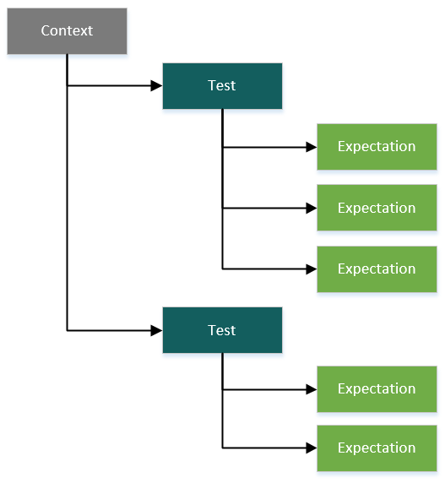
The testthat package uses a hierarchical structure for its test files
A single test file will have one context.

Slide 16
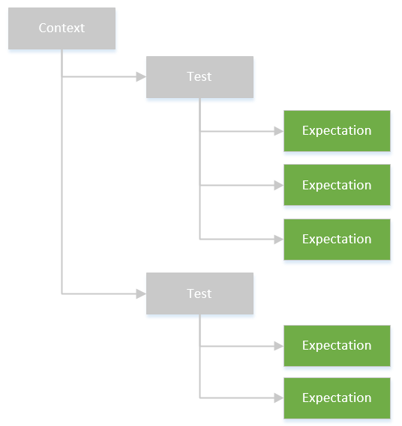
An ‘expectation’ looks at whether or not a specific outcome is as you expect using various expectation functions, which start with ‘expect_’
For example:
expect_equal(sum(2, 2), 4)
expect_error(sum(“cat”,”dog”))

Slide 17
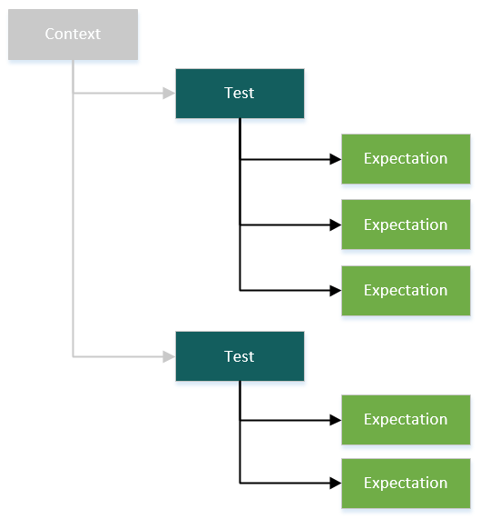
A test should look at a single piece of functionality by including multiple expectations of its outcomes.
For example:
test_that("sum errors on bad input",{
expect_error(sum("cat","dog"))
expect_error(sum(as.factor(2),as.factor(3)))
})

Slide 18
A context is a group of related tests. The test suite results are organised by context.
For example:
context("Sums")
test_that("sum produces accurate sums",{
expect_equal(sum(2,2),4)
expect_equal(sum(-1,1),0)
expect_equal(sum(.25,-1), -.75)
})
test_that("sum errors on bad input",{
expect_error(sum("cat","dog"))
expect_error(sum(as.factor(2),as.factor(3)))
})

Slide 19
An example of a single context for our package
library(primeFactors)
context("Get factors")
test_that("getFactors returns the correct number of factors",{
expect_length(getFactors(1),1)
expect_length(getFactors(2),2)
expect_length(getFactors(12),6)
})
test_that("getFactors returns the correct factors",{
expect_equal(sort(getFactors(10)),c(1,2,5,10))
expect_equal(sort(getFactors(1)), c(1))
expect_equal(sort(getFactors(2)), c(1,2))
})
test_that("getFactors errors at bad input",{
expect_error(getFactors("hello"))
expect_error(getFactors(as.factor(1)))
})

Slide 20
An example of a single context for our package
Load in your package
library(primeFactors)
context("Get factors")
test_that("getFactors returns the correct number of factors",{
expect_length(getFactors(1),1)
expect_length(getFactors(2),2)
expect_length(getFactors(12),6)
})
test_that("getFactors returns the correct factors",{
expect_equal(sort(getFactors(10)),c(1,2,5,10))
expect_equal(sort(getFactors(1)), c(1))
expect_equal(sort(getFactors(2)), c(1,2))
})
test_that("getFactors errors at bad input",{
expect_error(getFactors("hello"))
expect_error(getFactors(as.factor(1)))
})

Slide 21
An example of a single context for our package
Load in your package
library(primeFactors)
context("Get factors")
test_that("getFactors returns the correct number of factors",{
expect_length(getFactors(1),1)
expect_length(getFactors(2),2)
expect_length(getFactors(12),6)
})
test_that("getFactors returns the correct factors",{
expect_equal(sort(getFactors(10)),c(1,2,5,10))
expect_equal(sort(getFactors(1)), c(1))
expect_equal(sort(getFactors(2)), c(1,2))
})
test_that("getFactors errors at bad input",{
expect_error(getFactors("hello"))
expect_error(getFactors(as.factor(1)))
})
Define context

Slide 22
An example of a single context for our package
Load in your package
library(primeFactors)
context("Get factors")
test_that("getFactors returns the correct number of factors",{
expect_length(getFactors(1),1)
expect_length(getFactors(2),2)
expect_length(getFactors(12),6)
})
test_that("getFactors returns the correct factors",{
expect_equal(sort(getFactors(10)),c(1,2,5,10))
expect_equal(sort(getFactors(1)), c(1))
expect_equal(sort(getFactors(2)), c(1,2))
})
test_that("getFactors errors at bad input",{
expect_error(getFactors("hello"))
expect_error(getFactors(as.factor(1)))
})
Define context
Test description should complete the sentence ‘Test that...’

Slide 23
An example of a single context for our package
Load in your package
library(primeFactors)
context("Get factors")
test_that("getFactors returns the correct number of factors",{
expect_length(getFactors(1),1)
expect_length(getFactors(2),2)
expect_length(getFactors(12),6)
})
test_that("getFactors returns the correct factors",{
expect_equal(sort(getFactors(10)),c(1,2,5,10))
expect_equal(sort(getFactors(1)), c(1))
expect_equal(sort(getFactors(2)), c(1,2))
})
test_that("getFactors errors at bad input",{
expect_error(getFactors("hello"))
expect_error(getFactors(as.factor(1)))
})
Define context
Test description should complete the sentence ‘Test that...’
Multiple expectations for different scenarios

Slide 24
The devtools package makes it easy to set up and run the tests within your package
devtools::use_testthat()
Running this command once in your package root will set up everything you need to run testthat tests within your package
Creates tests/testthat directory
Edits the DESCRIPTION file to suggest testthat
Creates a testthat.R file for running the tests in an R CMD check
devtools::test()
Run this any time you modify your code or your tests
You can also press Ctrl/Cmd + Shift + T
Note that all test files need to be stored in tests/testthat and have ‘test’ at the beginning of the file name.

Slide 25
The testthat output is organised by context and shows the results of each of the expectations within that context
Get factors: 12..34..
A full stop indicates that the outcome was as expected
A numeric value indicates a failure, with the specific number corresponding to a detailed note of that failure, which follows below
A ‘W’ indicates that a warning was produced which is also included in the testthat output

Slide 26
Output
> devtools::test()
Loading primeFactors
Testing primeFactors
Get factors: 12..34..
getLargestPrimeFactor: .....
getPrimeFactors: .....
isPrime: ..........W.
Warnings ------------------------------------------------------------------
1. isPrime errors on bad input (@test_isPrime.R#21) - ‘<=’ not meaningful for factors
Failed --------------------------------------------------------------------
1. Failure: getFactors returns the correct number of factors (@test_getFactors.R#5)
getFactors(1) has length 4, not length 1.
2. Failure: getFactors returns the correct number of factors (@test_getFactors.R#6)
getFactors(2) has length 6, not length 2.
3. Failure: getFactors returns the correct factors (@test_getFactors.R#12)
sort(getFactors(1)) not equal to c(1).
Lengths differ: 4 vs 1
4. Failure: getFactors returns the correct factors (@test_getFactors.R#13)
sort(getFactors(2)) not equal to c(1, 2).
Lengths differ: 6 vs 2
DONE ======================================================================

Slide 27
The results shown for each expectation by context
> devtools::test()
Loading primeFactors
Testing primeFactors
Get factors: 12..34..
getLargestPrimeFactor: .....
getPrimeFactors: .....
isPrime: ..........W.
Warnings ------------------------------------------------------------------
1. isPrime errors on bad input (@test_isPrime.R#21) - ‘<=’ not meaningful for factors
Failed --------------------------------------------------------------------
1. Failure: getFactors returns the correct number of factors (@test_getFactors.R#5)
getFactors(1) has length 4, not length 1.
2. Failure: getFactors returns the correct number of factors (@test_getFactors.R#6)
getFactors(2) has length 6, not length 2.
3. Failure: getFactors returns the correct factors (@test_getFactors.R#12)
sort(getFactors(1)) not equal to c(1).
Lengths differ: 4 vs 1
4. Failure: getFactors returns the correct factors (@test_getFactors.R#13)
sort(getFactors(2)) not equal to c(1, 2).
Lengths differ: 6 vs 2
DONE ======================================================================

Slide 28
Successful expectations are indicated with a full stop
> devtools::test()
Loading primeFactors
Testing primeFactors
Get factors: 12..34..
getLargestPrimeFactor: .....
getPrimeFactors: .....
isPrime: ..........W.
Warnings ------------------------------------------------------------------
1. isPrime errors on bad input (@test_isPrime.R#21) - ‘<=’ not meaningful for factors
Failed --------------------------------------------------------------------
1. Failure: getFactors returns the correct number of factors (@test_getFactors.R#5)
getFactors(1) has length 4, not length 1.
2. Failure: getFactors returns the correct number of factors (@test_getFactors.R#6)
getFactors(2) has length 6, not length 2.
3. Failure: getFactors returns the correct factors (@test_getFactors.R#12)
sort(getFactors(1)) not equal to c(1).
Lengths differ: 4 vs 1
4. Failure: getFactors returns the correct factors (@test_getFactors.R#13)
sort(getFactors(2)) not equal to c(1, 2).
Lengths differ: 6 vs 2
DONE ======================================================================

Slide 29
Failed expectations are described below the results.
> devtools::test()
Loading primeFactors
Testing primeFactors
Get factors: 12..34..
getLargestPrimeFactor: .....
getPrimeFactors: .....
isPrime: ..........W.
Warnings ------------------------------------------------------------------
1. isPrime errors on bad input (@test_isPrime.R#21) - ‘<=’ not meaningful for factors
Failed --------------------------------------------------------------------
1. Failure: getFactors returns the correct number of factors (@test_getFactors.R#5)
getFactors(1) has length 4, not length 1.
2. Failure: getFactors returns the correct number of factors (@test_getFactors.R#6)
getFactors(2) has length 6, not length 2.
3. Failure: getFactors returns the correct factors (@test_getFactors.R#12)
sort(getFactors(1)) not equal to c(1).
Lengths differ: 4 vs 1
4. Failure: getFactors returns the correct factors (@test_getFactors.R#13)
sort(getFactors(2)) not equal to c(1, 2).
Lengths differ: 6 vs 2
DONE ======================================================================

Slide 30
Failed expectations are described below the results.
> devtools::test()
Loading primeFactors
Testing primeFactors
Get factors: 12..34..
getLargestPrimeFactor: .....
getPrimeFactors: .....
isPrime: ..........W.
Warnings ------------------------------------------------------------------
1. isPrime errors on bad input (@test_isPrime.R#21) - ‘<=’ not meaningful for factors
Failed --------------------------------------------------------------------
1. Failure: getFactors returns the correct number of factors (@test_getFactors.R#5)
getFactors(1) has length 4, not length 1.
2. Failure: getFactors returns the correct number of factors (@test_getFactors.R#6)
getFactors(2) has length 6, not length 2.
3. Failure: getFactors returns the correct factors (@test_getFactors.R#12)
sort(getFactors(1)) not equal to c(1).
Lengths differ: 4 vs 1
4. Failure: getFactors returns the correct factors (@test_getFactors.R#13)
sort(getFactors(2)) not equal to c(1, 2).
Lengths differ: 6 vs 2
DONE ======================================================================
These tests highlighted that our getFactors function did not handle certain situations properly.

Slide 31
Tests and contexts can have more code in them than simply the test_that and expect_ functions
test_that("floor_date works for different units", {
base <- as.POSIXct("2009-08-03 12:01:59.23", tz = "UTC")
floor_base <- function(unit) floor_date(base, unit)
as_time <- function(x) as.POSIXct(x, tz = "UTC")
expect_equal(floor_base("second"), as_time("2009-08-03 12:01:59"))
expect_equal(floor_base("minute"), as_time("2009-08-03 12:01:00"))
expect_equal(floor_base("hour"), as_time("2009-08-03 12:00:00"))
expect_equal(floor_base("day"), as_time("2009-08-03 00:00:00"))
expect_equal(floor_base("week"), as_time("2009-08-02 00:00:00"))
expect_equal(floor_base("month"), as_time("2009-08-01 00:00:00"))
expect_equal(floor_base("year"), as_time("2009-01-01 00:00:00"))
})
There isn’t automatic set-up and teardown functionality in testthat, so this is a way to create variables and functions important to running the tests.
It may be necessary to explicitly clean-up after your tests are run.
Code example from: http://r-pkgs.had.co.nz/tests.html

Slide 32
The quality of the tests themselves is still the most important part of writing unit tests
Writing unit tests before the actual function is essentially a way to explicitly state your success criteria before you start.
A good practice is to try to think of the ways you might break your code and to test for those fringe examples in addition to the obvious scenarios.
It’s also possible to measure how much of your code is being exercised by the tests, which can help point out places where you might need more testing
In R, the covr package is a convenient way to do this.

Slide 33
Hadley Wickham has some useful resources on using testthat, which go into more detail and have some helpful tips both in general and for creating packages
Chapter on tests in his R Packages book:
http://r-pkgs.had.co.nz/tests.html
Journal article on getting started with testthat:
https://journal.r-project.org/archive/2011-1/RJournal_2011-1_Wickham.pdf

Slide 34
Questions?

Slide 35
The plan…
Introduction to R Packages
Unit testing
RStudio Add Ins
Handy hints & next steps

Slide 36
Demo R Studio Shiny Gadget Add-in

Slide 37
RStudio Add-Ins
These allow the user to execute R functions interactively within the Rstudio IDE
Keyboard Shortcuts
Addins menu
Example:
https://rstudio.github.io/rstudioaddins/demo/demo-subset.gif
Add-ins can also be developed as Shiny Applications as a Shiny Gadget
Shiny Gadgets are similar to regular Shiny Applications
Some extra packages need to be installed: miniUI, rstudioapi (and must have latest version of Shiny)
We have included a very simple Shiny Gadget with our example package

Slide 38
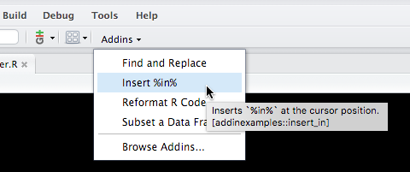
Once you have installed a R package that contains addins, they’ll be immediately available within your Rstudio
The Addins drop down box will display up to 15 Add-ins
You can view all your Add-ins with the ‘Browse Add-ins..’ menu button
It is quite straightforward to develop your own Add-ins and include in your packages
There are 2 main types of Add-in:
Text macros
Shiny Gadgets

Slide 39
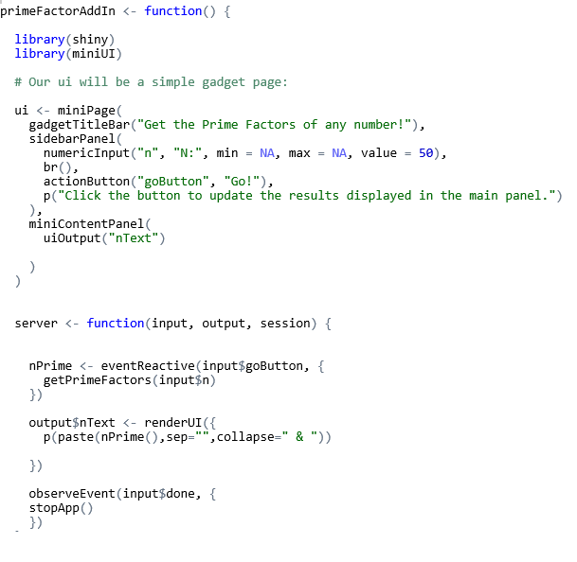
To create your own Rstudio Add-ins you need to:
Create an R package
Create some R functions
Create a Shiny Gadget

Slide 40
To create your own Rstudio Add-ins you need to:
Create a file at ../inst/rstudio/addins.dcf
This should be created at the same level as the R package folders i.e. ../R
Include the following information in your registration file:
Name: The name of the add-in.
Description: A description of the add-in.
Binding: The R function this add-in is associated with.
Interactive: Whether this add-in is interactive (e.g. runs a Shiny application).
Rstudio will automatically discover and register your add-ins when the package is installed
You can register multiple add-ins in the same package by just inserting a blank line between each add-in information in the registration file
If creating an add-in with Shiny Gadgets then you need to add the following packages as imports in the package DESCRIPTION file:
Imports:
shiny (>= 0.13),
miniUI (>= 0.1.1),
rstudioapi (>= 0.5)

Slide 41
Questions?

Slide 42
The plan…
Introduction to R Packages
Unit testing
RStudio Add Ins
Handy hints & next steps
Notes:
Most of this is beyond the scope of being covered in the next 10 minutes

Slide 43
The DESCRIPTION and NAMESPACE files are both required before sharing a package more widely…
DESCRIPTION – package metadata
Contains who, what, why
License details
Requirements/dependencies/suggested packages
NAMESPACE
Namespaces in R control which objects are available in an environment – for example, if you load plyr and dplyr, which version of arrange() do you get?
For packages, the NAMESPACE file controls what functions are exported to the user
The NAMESPACE file also handles any dependencies on other packages
Generally, if you document everything you need in roxygen2 comments, the NAMESPACE file is created for you
DEMO 5

Slide 44
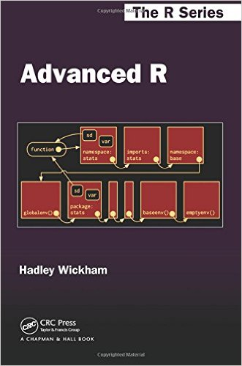
Before you make your package available more widely, it’s worth considering running some performance testing
I’ve learned the hard way that not all R packages scale well
Code that works well on iris may not work well on a 60Gb dataset!
Profvis can help understand code performance and scaling
Profvis has been built in to Rstudio since last year, or can be used standalone
It shows what R spent time working on, and therefore, which parts of your code you should concentrate
To find the largest prime factor, the package first finds all factors, then checks each for primality – which part is slowest?
Fortunately, Hadley can help us again – see ‘Advanced R’ http://adv-r.had.co.nz/ for tips of performance enhancement including using Rcpp
DEMO 8

Slide 45


The benefits of version control : git + GitHub
Version control is a good idea for every project, but is particularly useful when developing a package
Collaboration within your team – handles many developers working at the same time
Collaboration with strangers – easy for anyone to report bugs or even become a contributor to your project
GitHub functionality like README, wiki, git pages make it easy to provide the extra documentation you need
Version control for releases
It’s also a decent halfway house for releasing your code publicly
Although not as visible as the CRAN, there are no restrictions
Users can install directly from GitHub using the package devtools install_github command
DEMO 6

Slide 46
To the CRAN!
Submitting your package to the CRAN (https://cran.r-project.org/) is the best way to make it discoverable by other R users
However, the CRAN has additional rules and requirements
Much of what we talked about so far are recommendations, but your package will work without them. For the CRAN, many of these become requirements
Specific requirements on versioning, NAMESPACE and DESCRIPTION files
Requires an acceptable LICENSE file
Need to worry about compatibility on Windows, Linux & MAC
devtools to the rescue!
The R CMD checks can be run in devtools – this recreates the CRAN submission process as far as possible
DEMO 7

Slide 47
Approaches to sharing packages…
CRAN
Devtools (for package source, prior to building)
install_git, install_github, install_bitbucket, install_local, install_url, install_svn
As a tar.gz file
Create built package via devtools::build()
Share .tar.gz file
Anyone can install via install.packages(path_to_file, repos = NULL, type="source") or through the Rstudio interface

Slide 48
Useful commands and links
devtools
See devtools cheat sheet at https://www.rstudio.com/wp-content/uploads/2015/03/devtools-cheatsheet.pdf
testthat
testing chapter ‘R Packages’ of http://r-pkgs.had.co.nz/tests.html
roxygen2
Vignettes at https://cran.r-project.org/web/packages/roxygen2/vignettes/roxygen2.html
GitHub of material
https://github.com/rnobleeddy/buildAnRPackage

Slide 49
Questions?

