Slide 1
Zenith
Presented By Team 15 :
Arvind Anand
Rahul Manoj
Harshit Singh
Akash Vijayasarathy

Slide 2
Language Specification:
Name: Zenith
File Extension: .zth
Program Paradigm: Imperative
Tools Used: ANTLR , PyCharm, VSCode

Slide 3
Features:
Data Types: Supports strings, integers,float, double and booleans.
Identifiers and Numbers: Allows identifiers and numeric values.
Arithmetic Operators: Includes +, -, *, /. (precedence is also addressed)
Assignment Operator: Represented by "=".
Boolean Operators: Supports <=, >=, >, <, ==, not, and, or.
Ternary Operator: Syntax: (condition) ? a : b.
Comments: Supports single-line and multiline comments.
Loops: Supports for, while, and enhanced for loops.
Conditional Constructs: Includes if ,elseif, else.
Display Function: Uses print(“message”) for display.
Type Casting: Supports type casting between float and integers.
Dynamic Declaration:Supports dynamic declaration using ternary expressions.

Slide 4
GRAMMAR

Slide 5
// -- declaration
declaration
: 'int' VARIABLE_IDENTIFIER (ASSIGNMENT_OPERATOR num_expr)? # integerDeclaration
| 'int' VARIABLE_IDENTIFIER (ASSIGNMENT_OPERATOR ternary_expr)? # integerDeclaration
| 'boolean' VARIABLE_IDENTIFIER (ASSIGNMENT_OPERATOR bool_expr)? # booleanDeclaration
| 'boolean' VARIABLE_IDENTIFIER (ASSIGNMENT_OPERATOR ternary_expr)? # booleanDeclaration
| 'string' VARIABLE_IDENTIFIER (ASSIGNMENT_OPERATOR VALID_STRING)? # stringDeclaration
| 'string' VARIABLE_IDENTIFIER (ASSIGNMENT_OPERATOR ternary_expr)? # stringDeclaration
| 'float' VARIABLE_IDENTIFIER (ASSIGNMENT_OPERATOR num_expr)? # floatDeclaration
| 'float' VARIABLE_IDENTIFIER (ASSIGNMENT_OPERATOR ternary_expr)? # floatDeclaration
| 'double' VARIABLE_IDENTIFIER (ASSIGNMENT_OPERATOR num_expr)? # doubleDeclaration
| 'double' VARIABLE_IDENTIFIER (ASSIGNMENT_OPERATOR ternary_expr)? # doubleDeclaration
| '{}' # emptyDeclaration
;
grammar ZenithGrammar;
//Program Structure and Blocks
// --program
program
: 'start' block 'end'
;
// --block
block
: '{' atomic_block+ '}'
| '{' '}'
;
// -- atomic block
atomic_block
: command+
| declaration+
;

Slide 6
//Commands and Expressions
// --commands
command
: (if_expr|while_expr|for_enhanced|for_loop|print|assignment_expr)
;
// --assignments
assignment_expr
: VARIABLE_IDENTIFIER ASSIGNMENT_OPERATOR num_expr # integerAssignment
| VARIABLE_IDENTIFIER ASSIGNMENT_OPERATOR bool_expr # booleanAssignment
| VARIABLE_IDENTIFIER ASSIGNMENT_OPERATOR ternary_expr # ternaryAssignment
;
// --expressions
exprs
: num_expr
| bool_expr
;
// --boolean expressions
bool_expr
: VARIABLE_IDENTIFIER ASSIGNMENT_OPERATOR bool_expr
| bool_computation_expr
;
// --bool computation
bool_computation_expr
: bool_computation_expr op=(AND|OR|IS_EQUL_TO|NOT_EQUL_TO) bool_computation_expr
| comp_expr
| bool_bracket_expr
;
bool_bracket_expr
: '(' bool_expr ')'
| BOOLEAN
| VARIABLE_IDENTIFIER
;
// --comparison expressions
comp_expr
: num_expr op=(GREATER_THAN|LESS_THAN|MORE_THAN_OR_EQUL|LESS_THAN_OR_EQUL|IS_EQUL_TO|NOT_EQUL_TO) num_expr # numberComparisonExpression
;

Slide 7
// Conditional and Looping Constructs
// --conditional expression
cond_expr
: '(' bool_expr ')'
;
// --if expression
if_expr
: 'if' cond_expr block (else_if_expr)* (else_expr)?
;
// --else if (condition) expression
else_if_expr
: 'elseIf' cond_expr block
;
// --else expression
else_expr
: 'else' block
;
// --arithmetic expressions
num_expr
: VARIABLE_IDENTIFIER ASSIGNMENT_OPERATOR num_expr
| add_sub_expr
;
// --add and sub expressions
add_sub_expr
: add_sub_expr (ADD|SUB) term_expr
| term_expr
;
// --term expressions
term_expr
: term_expr (MUL|DIV) bracket_expr
| bracket_expr
;
// --bracket expressions
bracket_expr
: '(' num_expr ')'
| SUB? DIGITS
| SUB? DECIMAL_VALUE
| SUB? VARIABLE_IDENTIFIER
;

Slide 8
ternary_expr
: cond_expr '?' exprs ':' exprs
| cond_expr '?' BOOLEAN ':' BOOLEAN
| cond_expr '?' VALID_STRING ':' VALID_STRING
;
// all types of values
value
: DIGITS
| BOOLEAN
| VARIABLE_IDENTIFIER
| num_expr
| bool_expr
| VALID_STRING
;
// --print statement
print
: 'print' '(' print_parameters ')'
| 'print' '(' (print_parameters ',')+ print_parameters ')'
;
// -- print parameters
print_parameters
: value
;
// --numbers > 0.
DIGITS
: [1-9] [0-9]*
| '0'
;
// --primitive types
primitive_type
: 'num'
| 'boolean'
| 'float'
| 'double'
| 'string'
;
// Looping expressions
// --while(condition) expression
while_expr
: 'while' cond_expr block
;
// --for enhanced
for_enhanced
: 'for' VARIABLE_IDENTIFIER 'in' 'range' '(' rangeVal '..' rangeVal ')' block
;
rangeVal
: VARIABLE_IDENTIFIER
| DIGITS
;
// --for normal
for_loop
: 'for' '(' VARIABLE_IDENTIFIER '$=' DIGITS ';' bool_expr ';' variable_change_part ')' block
;
variable_change_part : increment_expression
| decrement_expression
|VARIABLE_IDENTIFIER ASSIGNMENT_OPERATOR num_expr;
decrement_expression : VARIABLE_IDENTIFIER '--'
| '--' VARIABLE_IDENTIFIER;
increment_expression : VARIABLE_IDENTIFIER '++'
| '++' VARIABLE_IDENTIFIER;

Slide 9
// all types of values
value
: DIGITS
| BOOLEAN
| VARIABLE_IDENTIFIER
| num_expr
| bool_expr
| VALID_STRING
;
// --print statement
print
: 'print' '(' print_parameters ')'
| 'print' '(' (print_parameters ',')+ print_parameters ')'
;
// -- print parameters
print_parameters
: value
;
// --numbers > 0.
DIGITS
: [1-9] [0-9]*
| '0'
;
// --primitive types
primitive_type
: 'num'
| 'boolean'
| 'float'
| 'double'
| 'string'
;
// --Boolean value as true or false.
BOOLEAN
: 'true'
| 'false'
;
// --operators
ADD : '+';
SUB : '-';
MUL : '*';
DIV : '/';
AND : 'and';
OR : 'or';
LESS_THAN : '<';
GREATER_THAN : '>';
LESS_THAN_OR_EQUL : '<=';
MORE_THAN_OR_EQUL : '>=';
NOT_EQUL_TO : 'not';
IS_EQUL_TO : '==';
// --lower case and upper case letters.
VARIABLE_IDENTIFIER
: [a-zA-Z_] [a-zA-Z_0-9]*
;
// --valid Strings
VALID_STRING
: '"'[a-zA-Z0-9_]+'"'
| EMPTY_STRING
;
// --decimal values
DECIMAL_VALUE
: DIGITS '.' (DIGITS)
| DIGITS '.0'
;
// --assignment operator
ASSIGNMENT_OPERATOR : '=';
// --defining whitespaces
WHITE_SPACES : [ \t\r\n]+ -> skip; // skip spaces, tabs and newline
// --empty string
EMPTY_STRING: '""';
// --comment syntax
Comment : ('#' ~[\r\n]* | '/#' .*? '#/') -> skip;

Slide 10
Program Flow
File Input
Tokens
Parse Tree
OUTPUT
Runtime
Intermediate Code

Slide 11
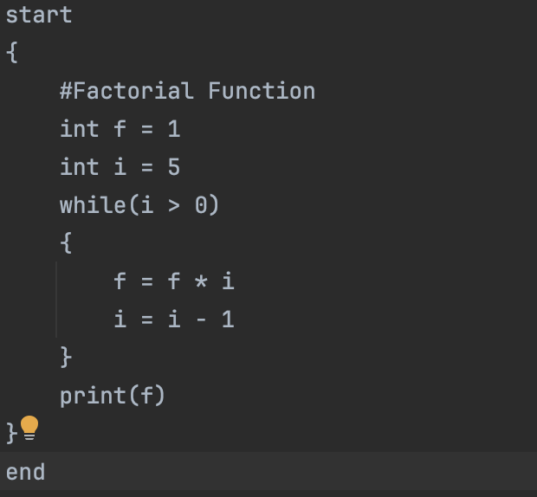
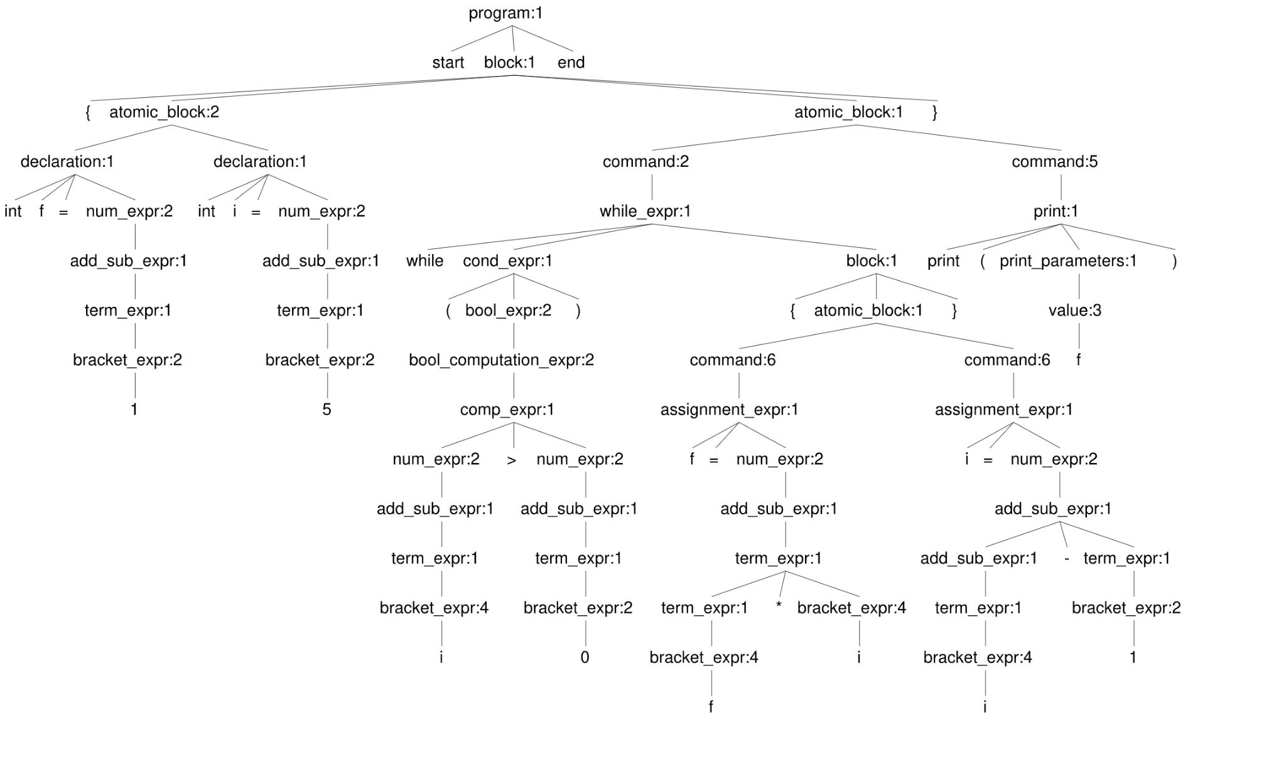
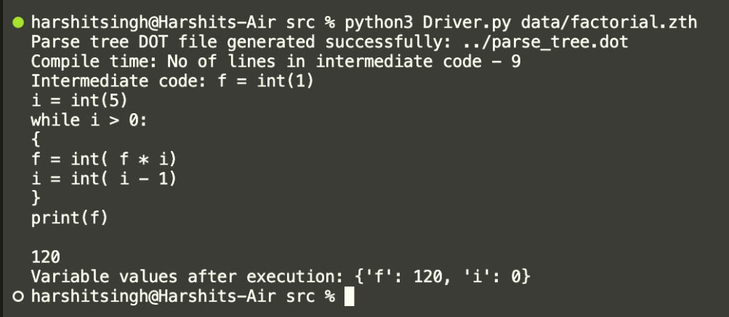
Factorial

Slide 12
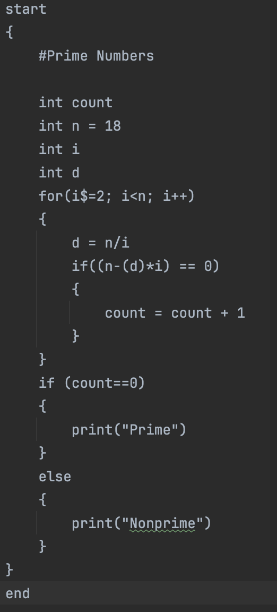
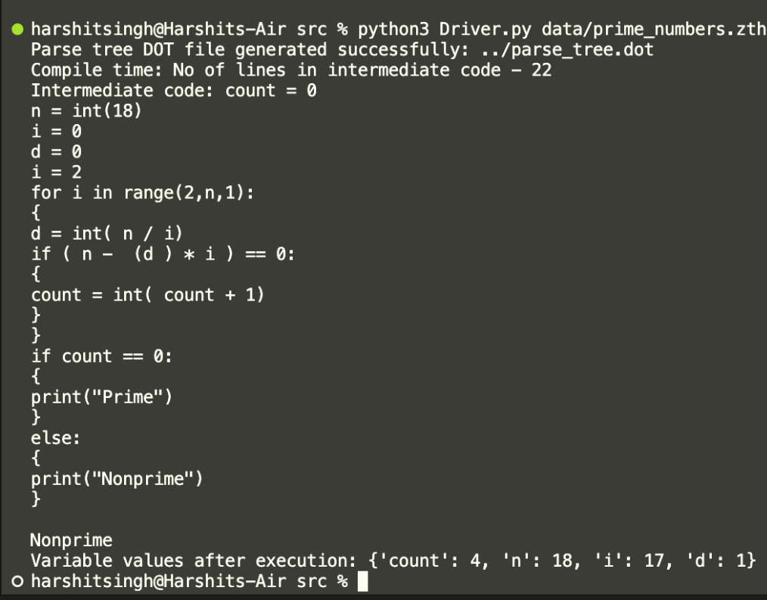
Prime Numbers

Slide 13
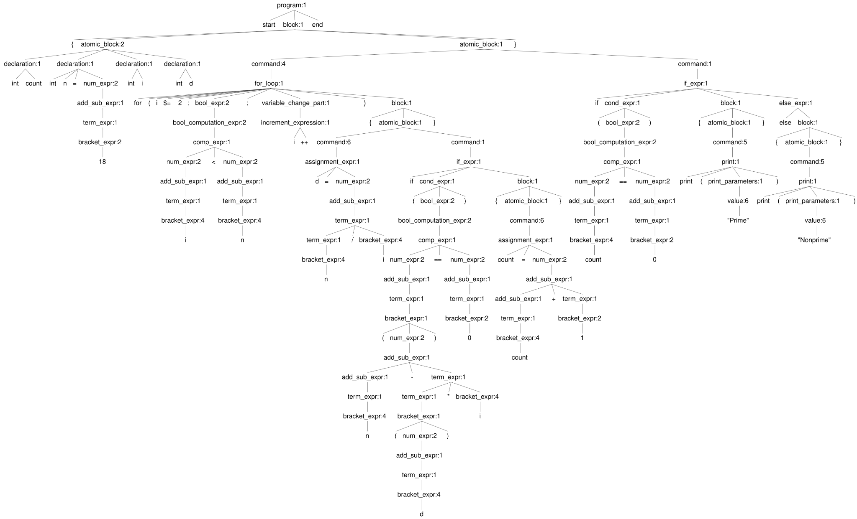
Prime Numbers

Slide 14
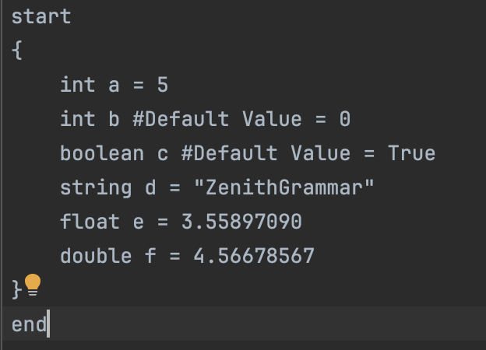
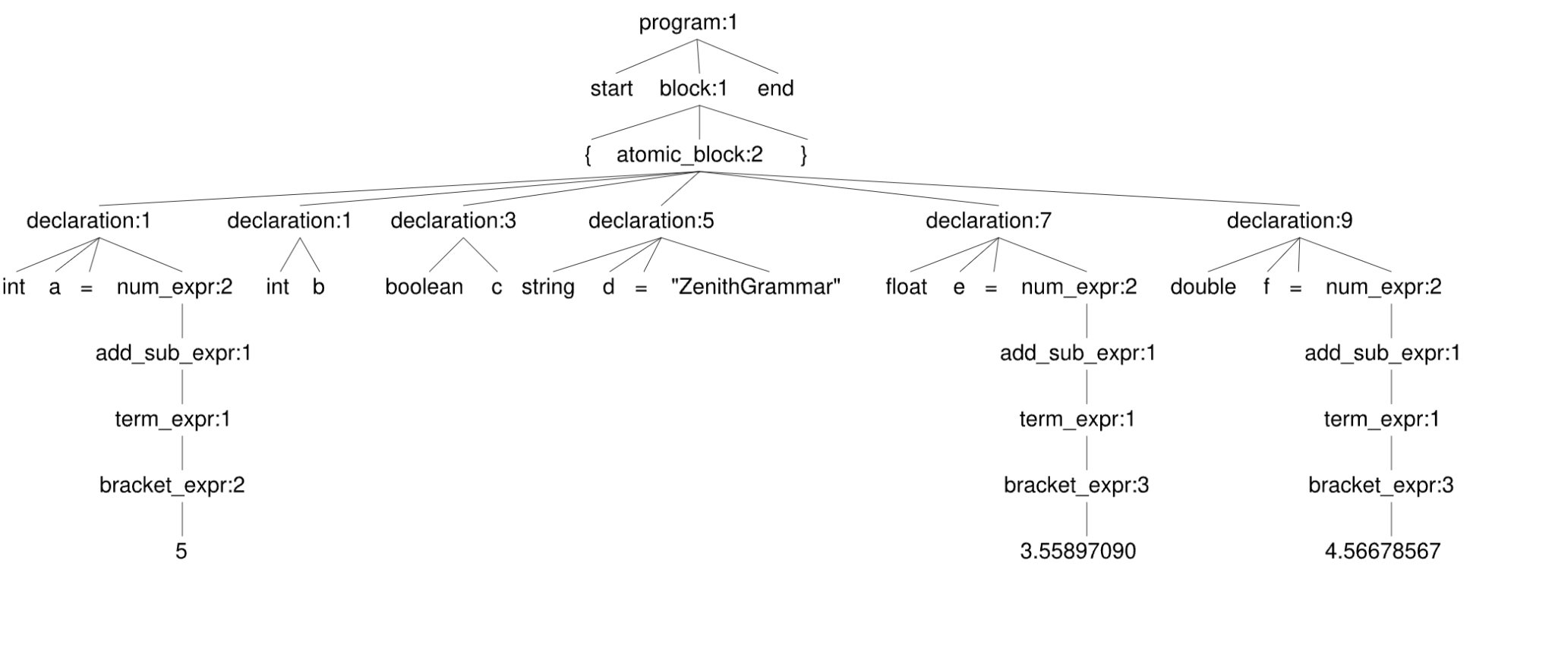
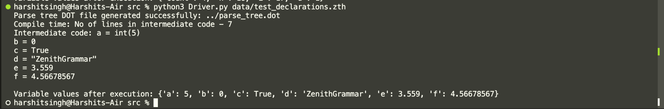
Declaration

Slide 15
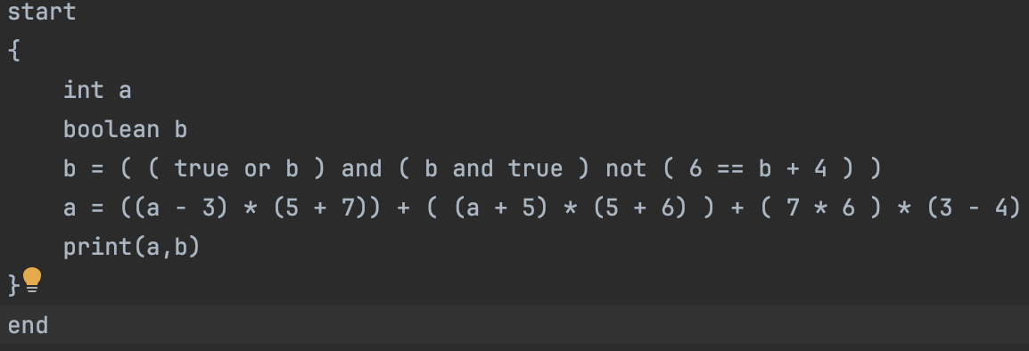
Expression

Slide 16
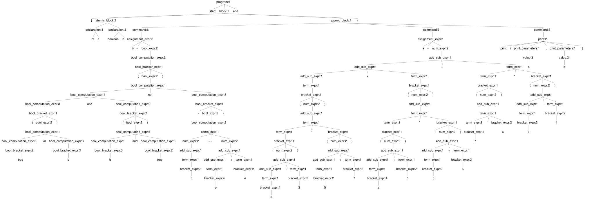
Expression

Slide 17
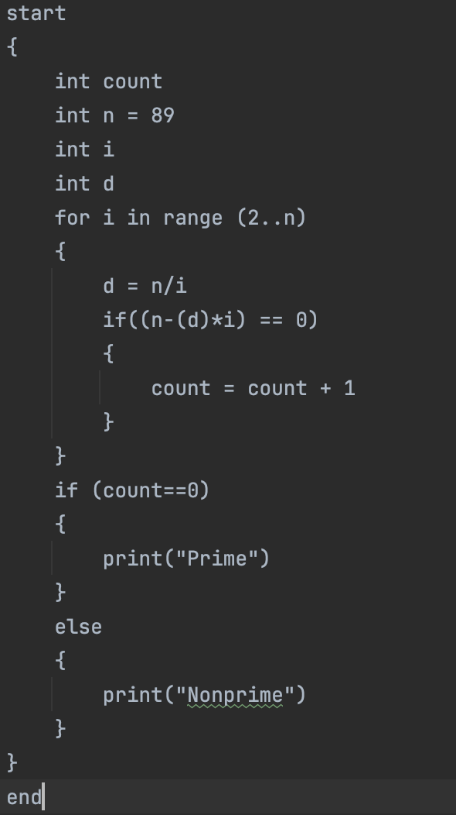
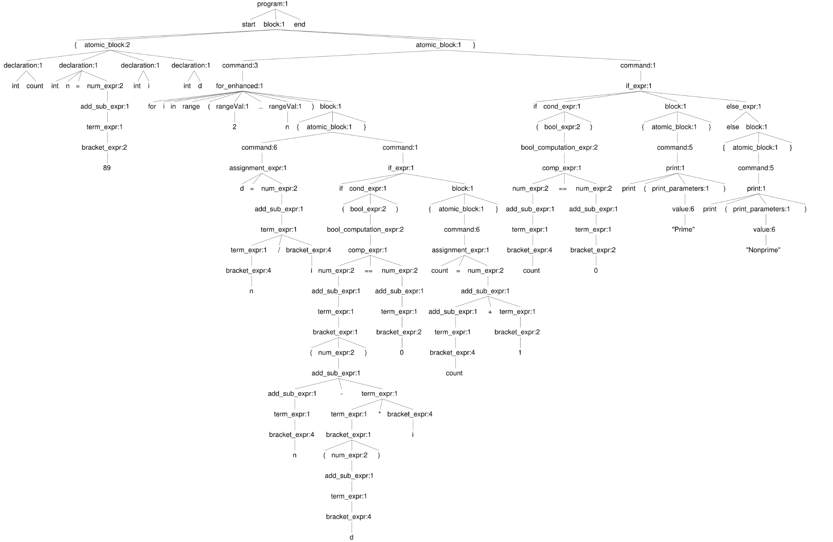
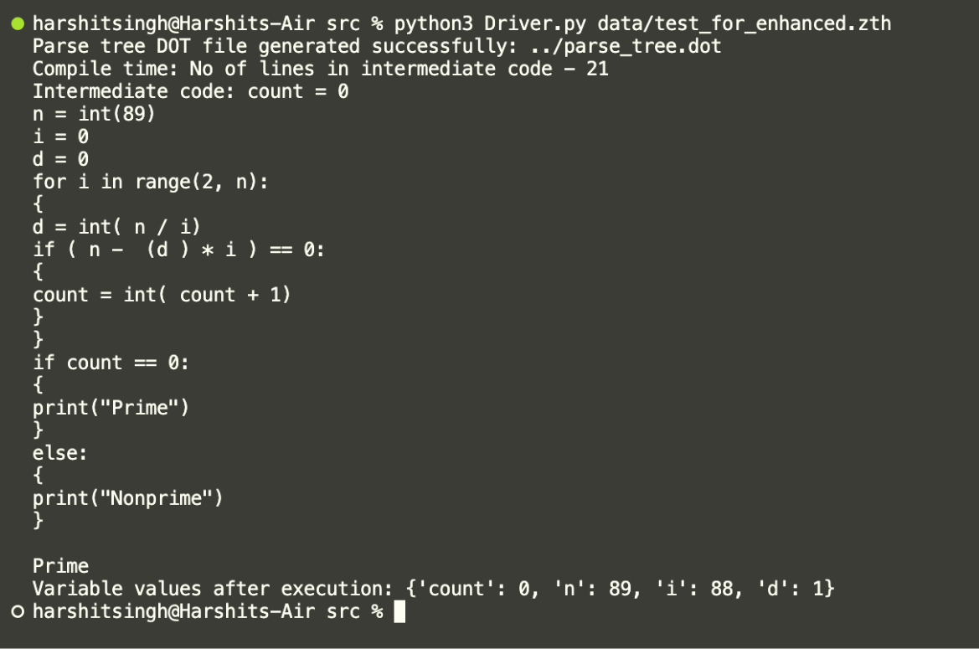
For Enhanced

Slide 18
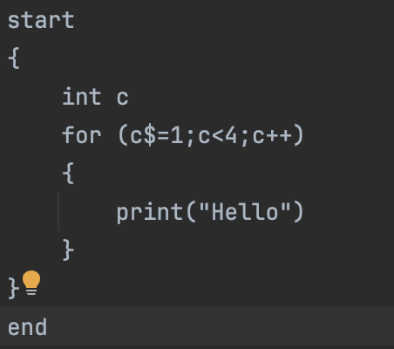
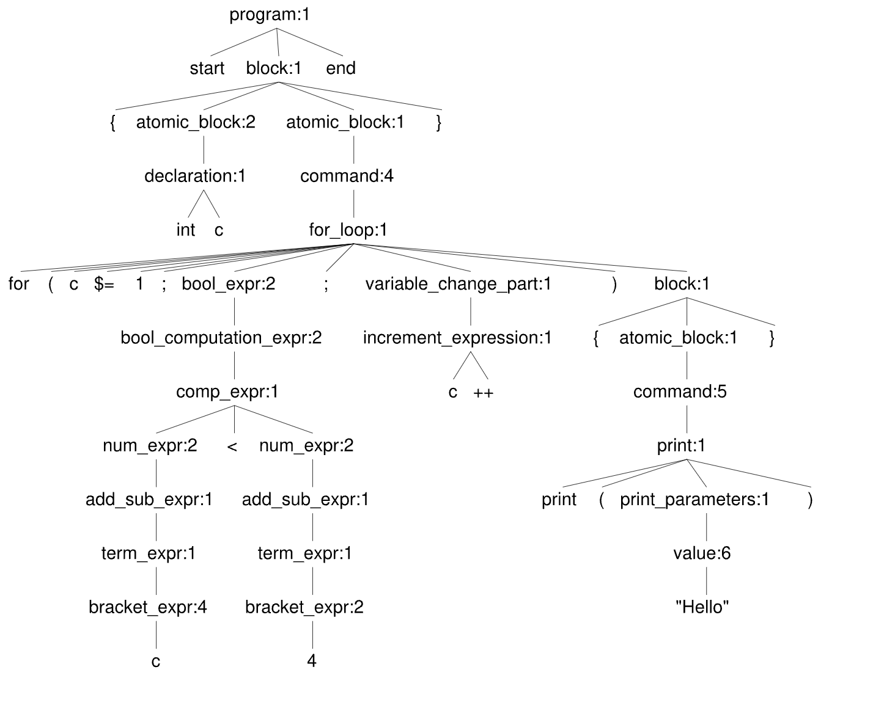
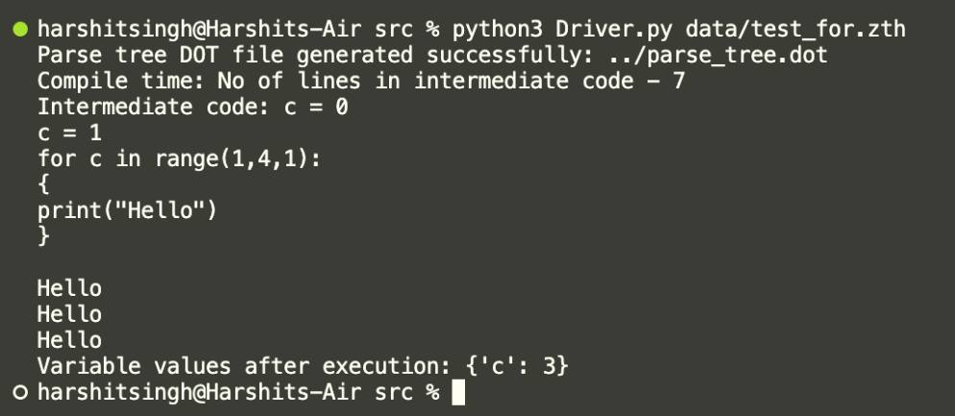
For

Slide 19
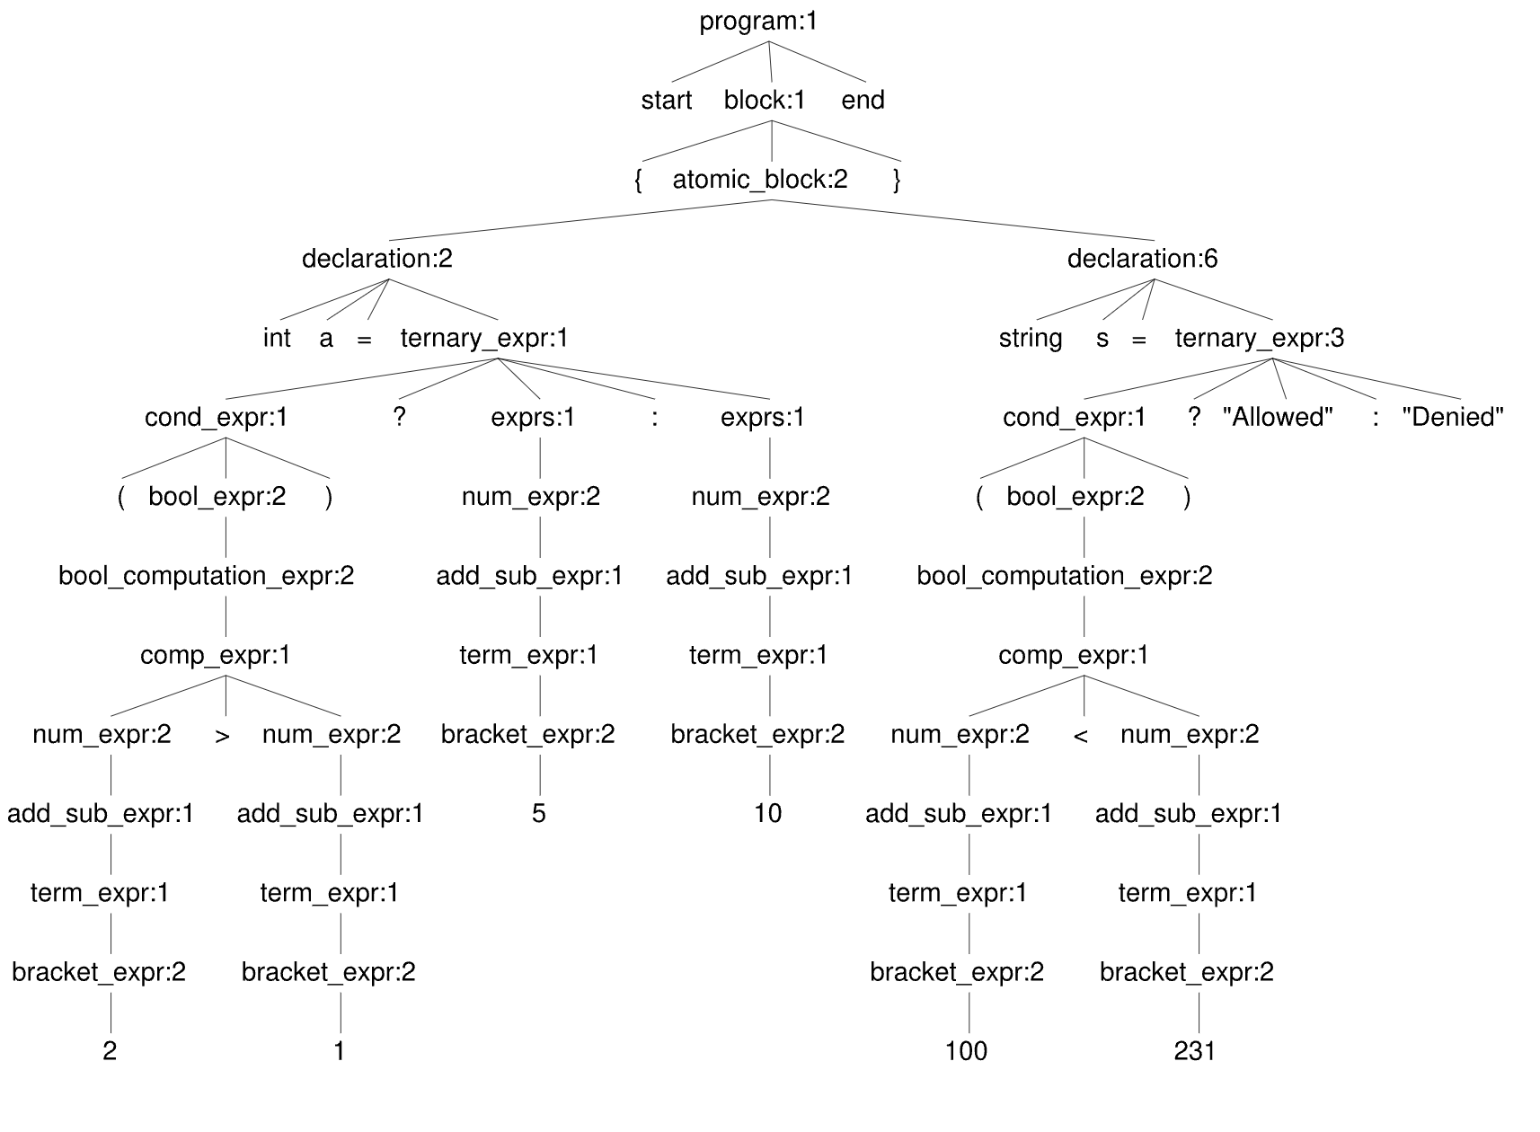
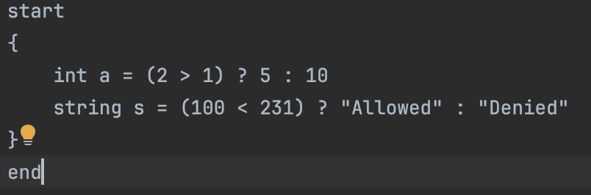
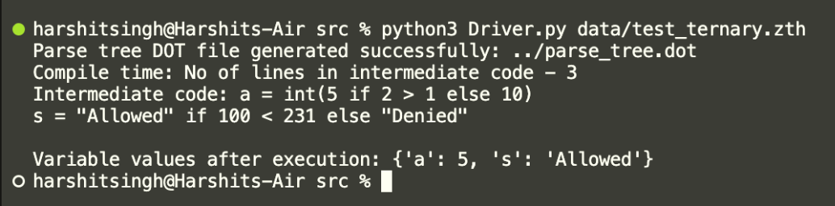
Ternary

Slide 20
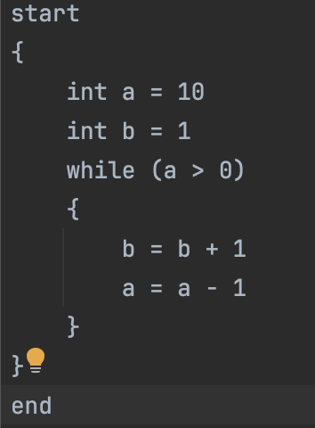
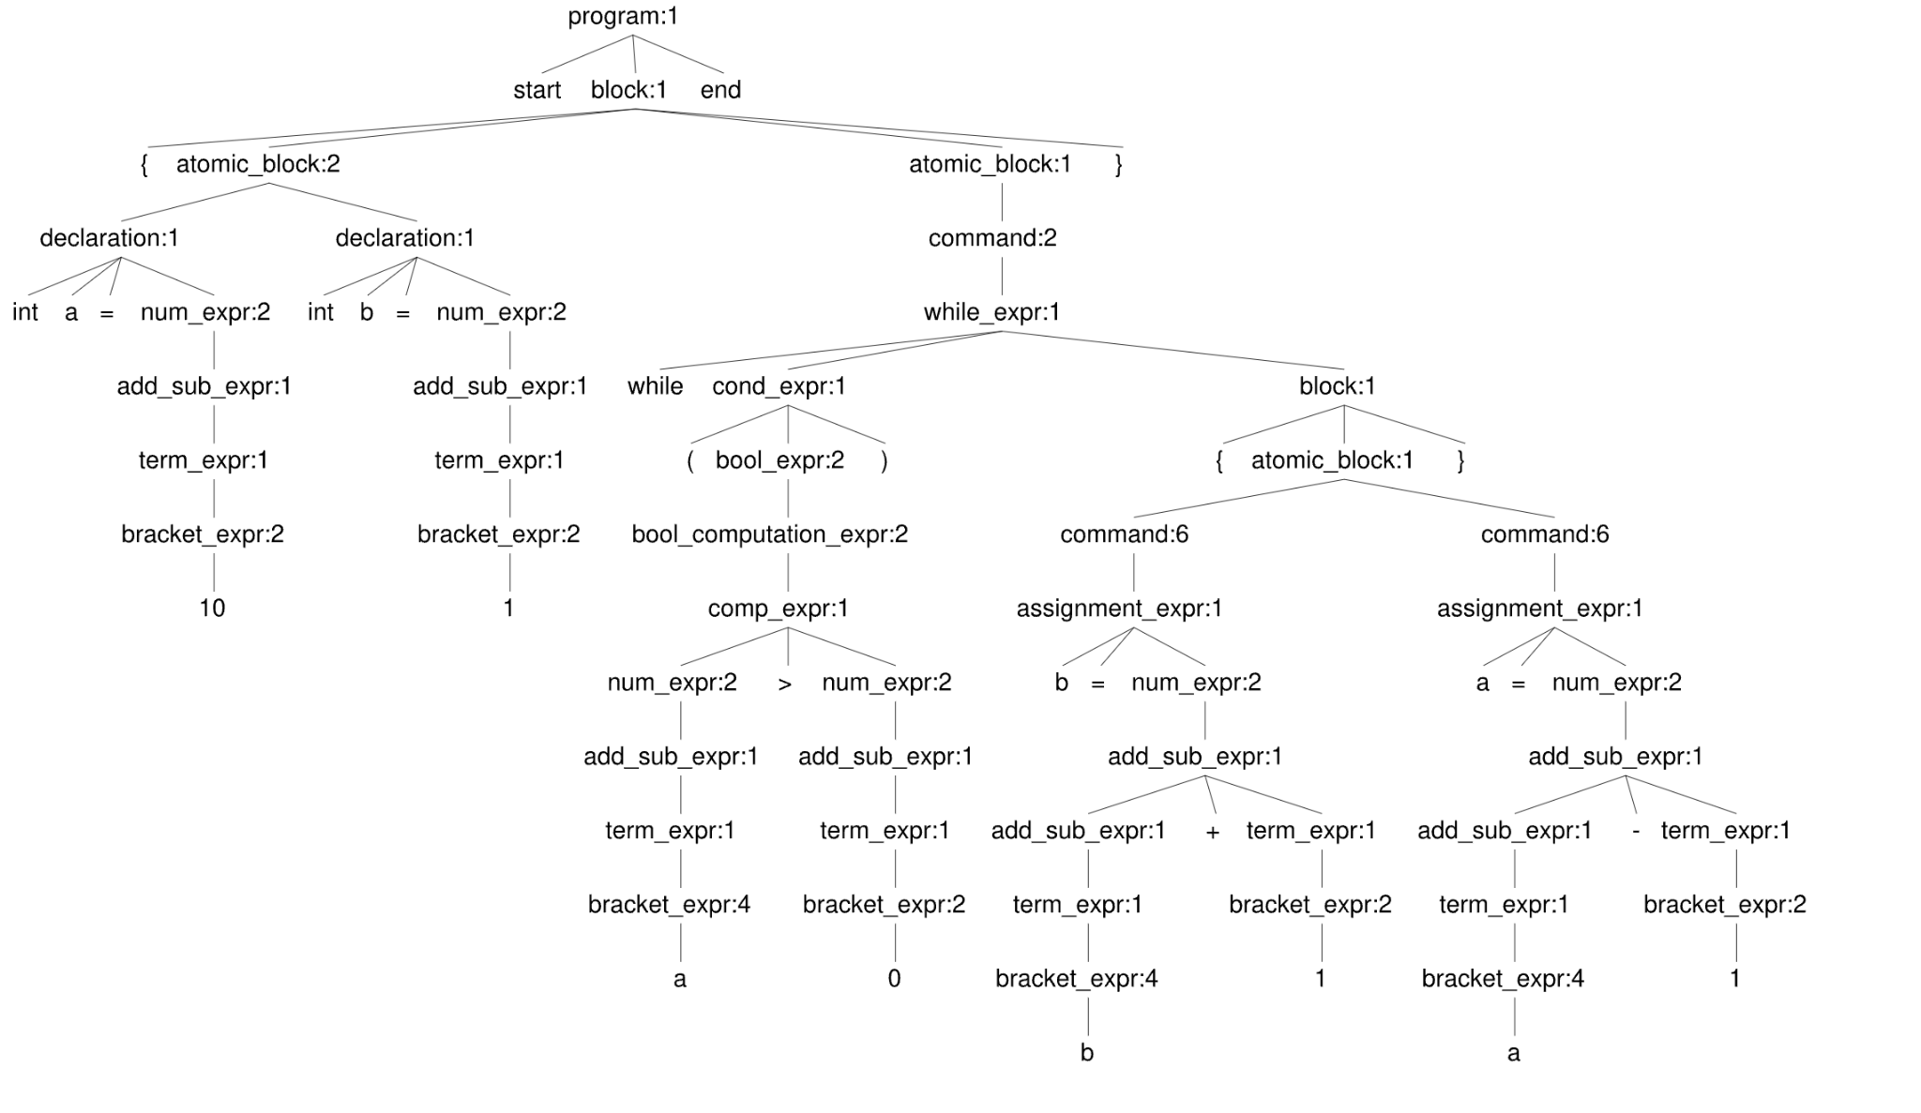
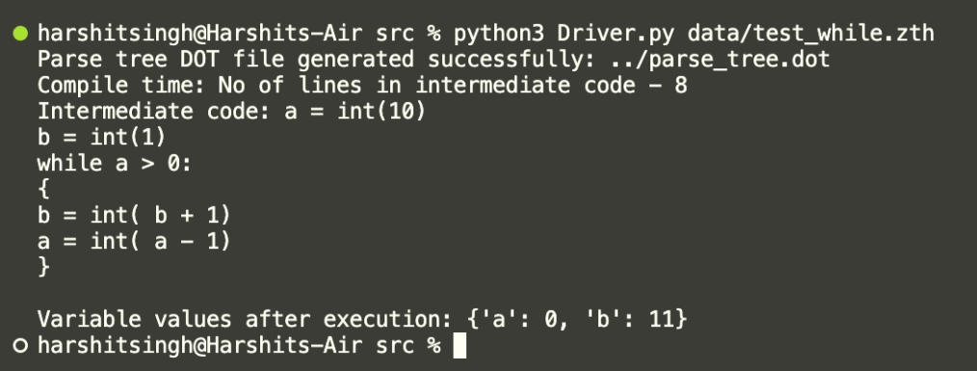
While

Slide 21
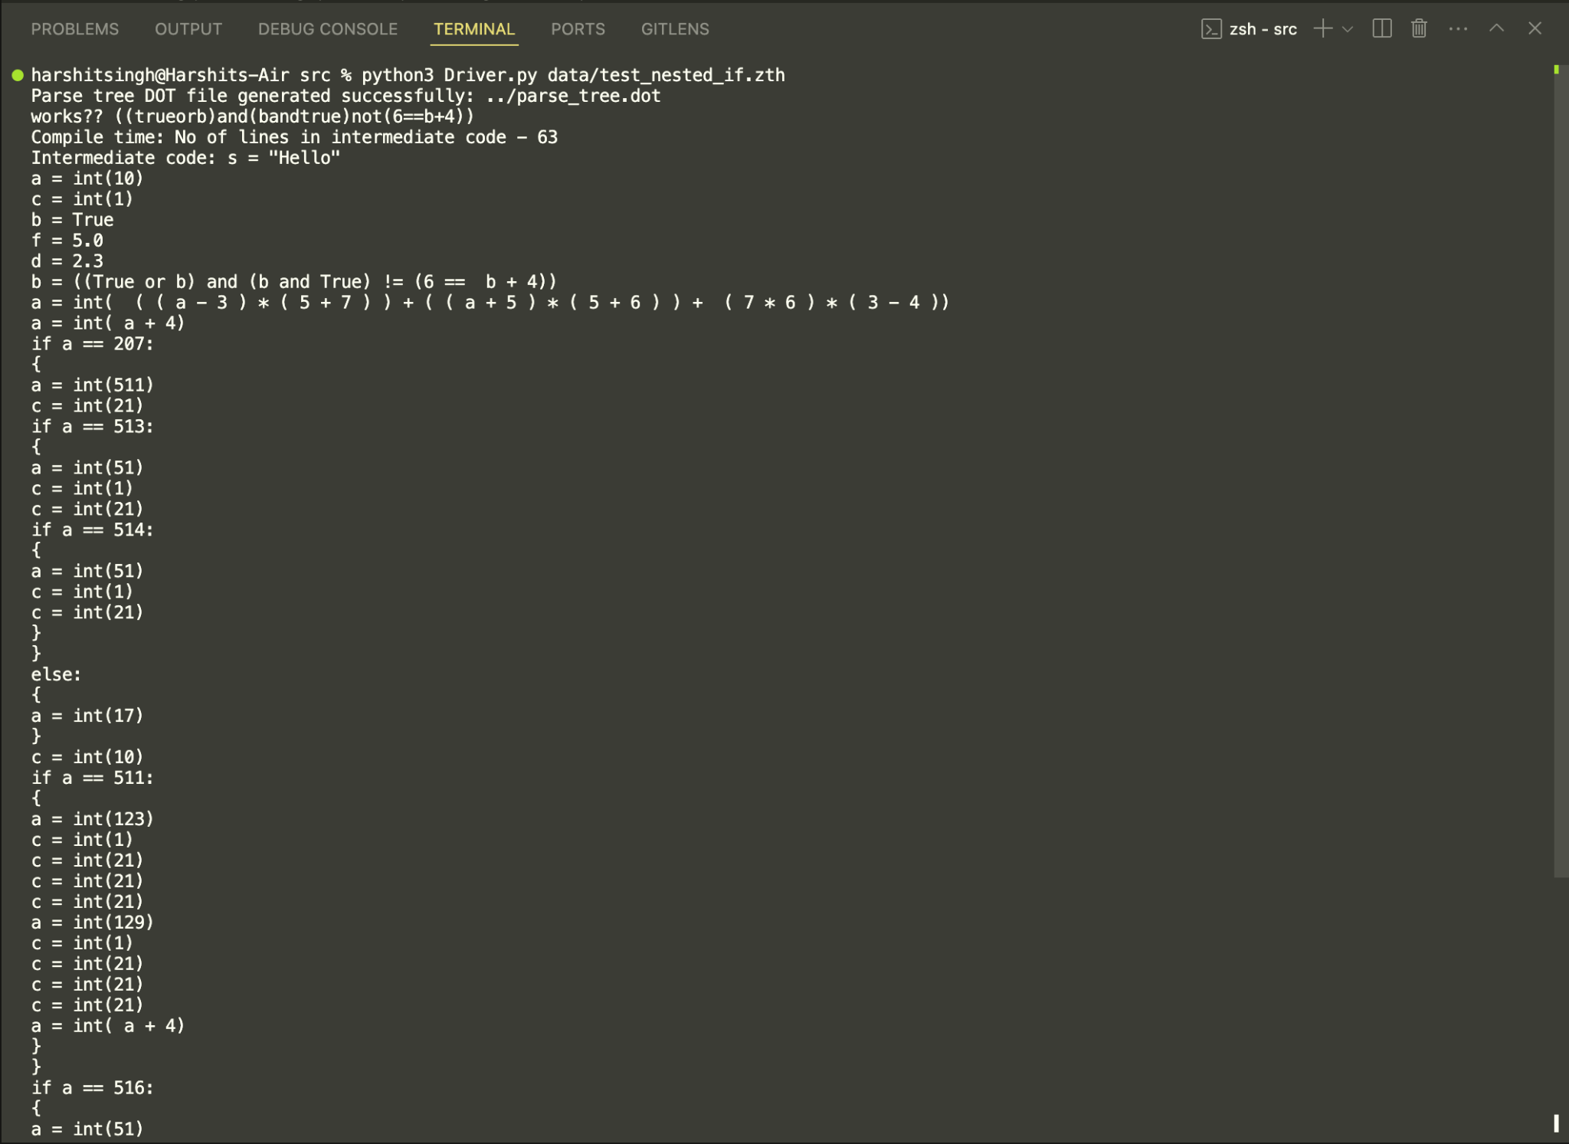
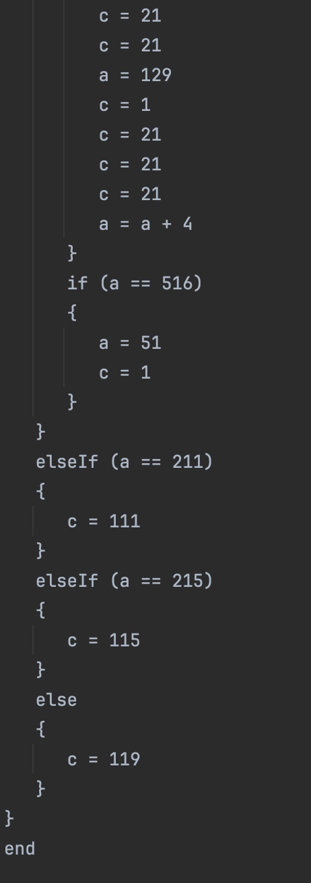
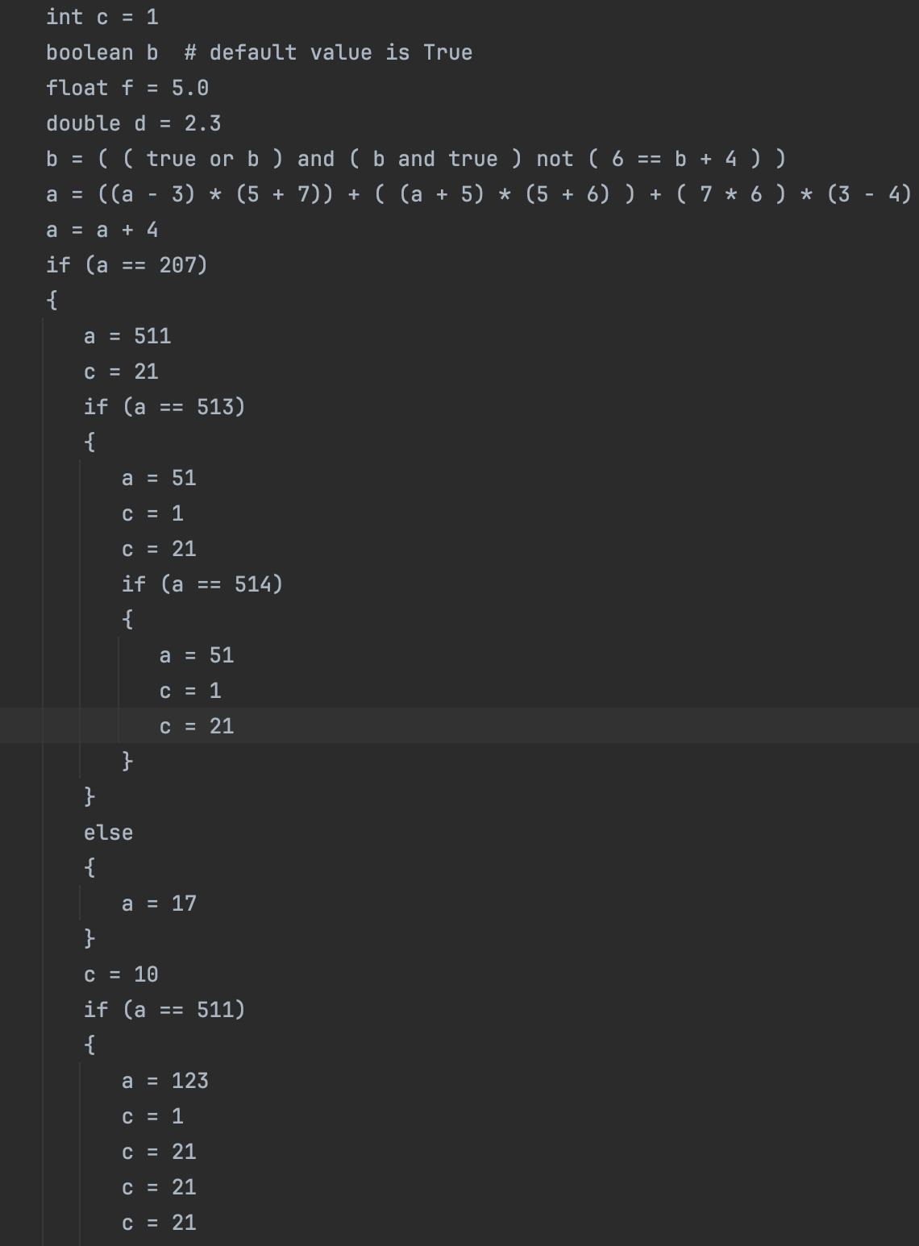
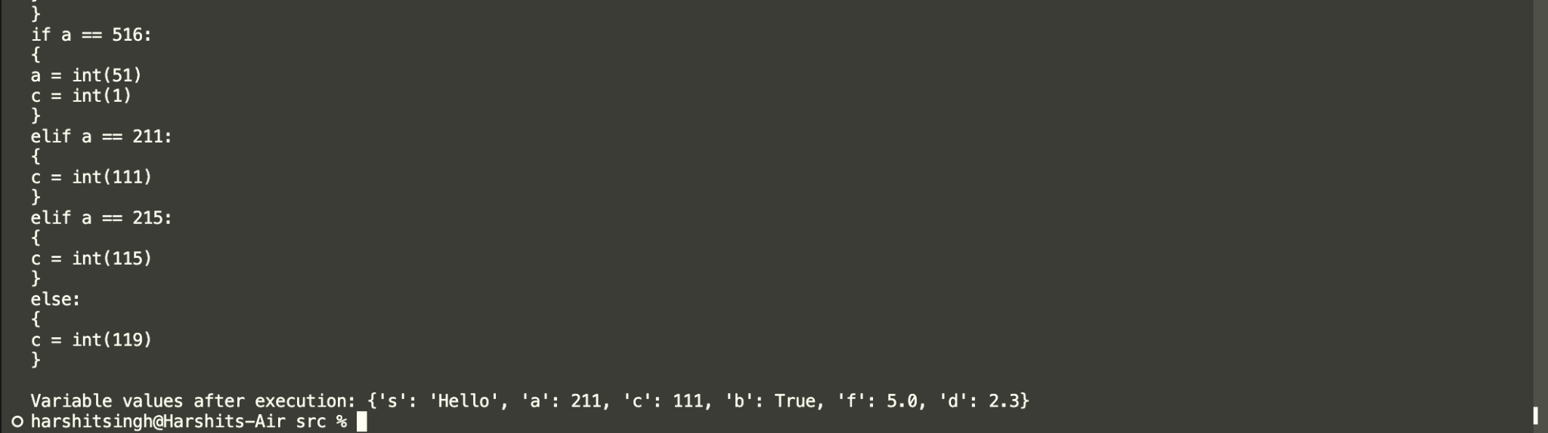
Nested If

