Slide 1
MG + MIS of 3D-HCCC
Reyhaneh Norouziani

Slide 2
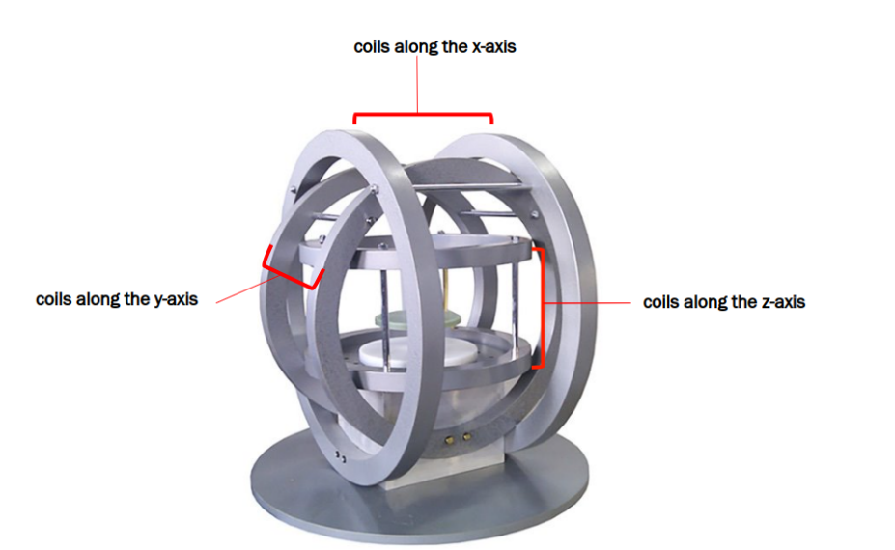
Introduction
Calculate the current required for each of the 3 pairs of coils of a three-axis Helmholtz coil system to achieve the target magnetic force and torque at the center.

Slide 3
Level 1 | Level 2
Hardware Hiding Modules
Behavior-Hiding Module | Input Format Module Output Format Module Output Verification Module Magnetic Core Module coilT module Helmholtz Module
Software Decision Module | Vector Module
? (I assume it can be merged with the Helmholtz module since it only needs to print the value of I for three pairs of coils)

Slide 4
Hardware Hiding Modules
Secrets: The data structure and algorithm used to implement the virtual hardware.
Services: Serves as a virtual hardware used by the rest of the system. This module provides the interface between the hardware and the software. So, the system can use it to display outputs or to accept inputs.
Implemented By: OS

Slide 5
Magnetic Core Module
Secrets: The physical constants and algorithm used to implement the magnetic equations
Services: Define the magnetic equations needed in the program
Implemented By: 3D-HCCC

Slide 6
coilT module
Secrets: The data structure of a pair of Coils
Services: Provides comprehensive data on the coil pair's configuration, using the detailed coil parameters defined in the input parameters module.
Implemented By: 3D-HCCC

Slide 7
Helmholtz Module
Secrets: The algorithms that integrate data and calculations from the Coil and Magnetic modules Calculate the required currents.
Services: Define the current calculator equation using the Magnetic Core and coilT modules
Implemented By: 3D-HCCC

Slide 8
Vector Module
Secrets: The algorithms for performing a wide range of vector operations
Services: Provides functions executing various vector operations.
Implemented By: NumPy

Slide 9
Vector Module
Output Verification Module
Helmholtz Module
Magnetic Core Module
coilT module
Output Format Module
Input Format Module
Hardware Hiding Modules
9/15

Slide 10
Input Format Module
Uses: Hardware Hiding Modules
State Variables: -
Environment Variable: command line input
Name | In | Out | Exceptions
load_params | string | - | -
verify_param | - | - | ValueError

Slide 11
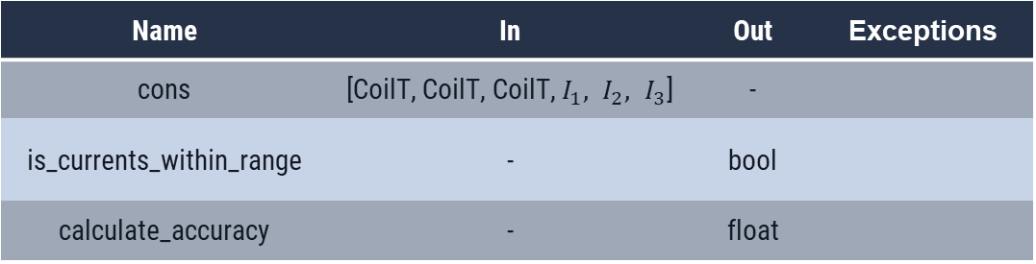
Output Verification Module
Uses: Coil, Magnetic Core
State Variables: -
Environment Variable: -
Name | In | Out | Exceptions
cons | [CoilT, CoilT, CoilT, $I_{1}, I_{2}, I_{3}$] | -
is_currents_within_range | - | bool
calculate_accuracy | - | float

Slide 12
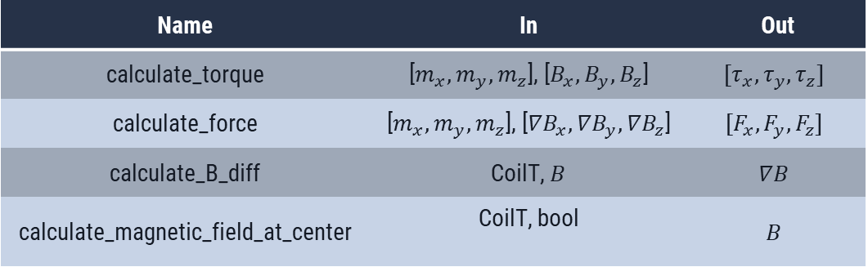
Magnetic Core Module
Uses: Vector Module
State Variables: Magnetic Physical constants
Environment Variable: -
Name | In | Out
calculate_torque | [$m_{x},m_{y},m_{z}$], [$B_{x},B_{y},B_{z}$] | $$[τ_{x},τ_{y},τ_{z}]$$
calculate_force | [$m_{x},m_{y},m_{z}$], [${∇B}_{x},{∇B}_{y},{∇B}_{z}$] | $$[F_{x},F_{y},F_{z}]$$
calculate_B_diff | CoilT, $B$ | $$∇B$$
calculate_magnetic_field_at_center | CoilT, bool | $$B$$

Slide 13
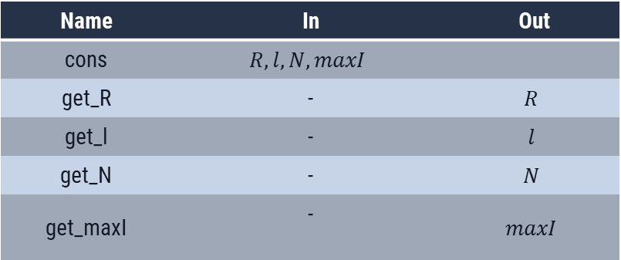
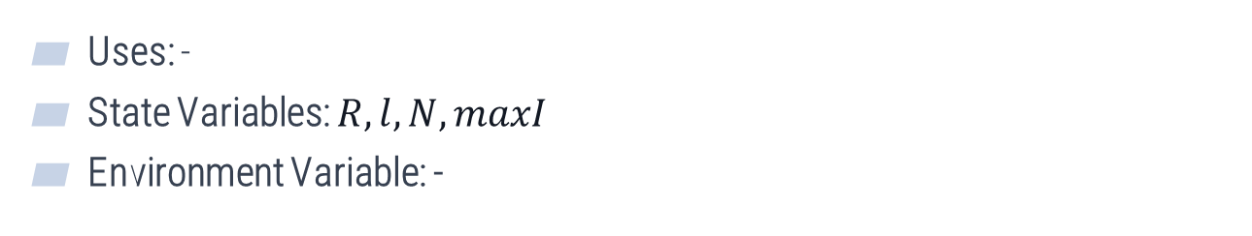
coilT module
Uses: -
State Variables: $R,l, N,maxI$
Environment Variable: -
Name | In | Out
cons | $$R,l, N,maxI$$
get_R | - | $$R$$
get_l | - | $$l$$
get_N | - | $$N$$
get_maxI | - | $$maxI$$

Slide 14
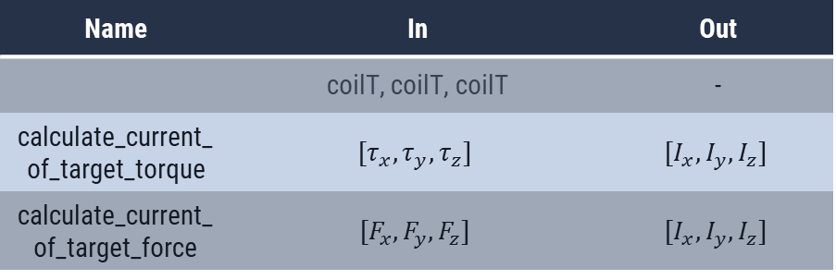
Helmholtz Module
Uses: Vector, coil, magnetic, Output Format Module, Output Verification Module
State Variables: 3 x coilT
Environment Variable: -
Name | In | Out
 | coilT, coilT, coilT | -
calculate_current_of_target_torque | $$[τ_{x},τ_{y},τ_{z}]$$ | $$[I_{x},I_{y},I_{z}]$$
calculate_current_of_target_force | $$[F_{x},F_{y},F_{z}]$$ | $$[I_{x},I_{y},I_{z}]$$

Slide 15
THANK You!
Any questions?

