Slide 1
MG + MIS of 3D-HCCC
Reyhaneh Norouziani

Slide 2
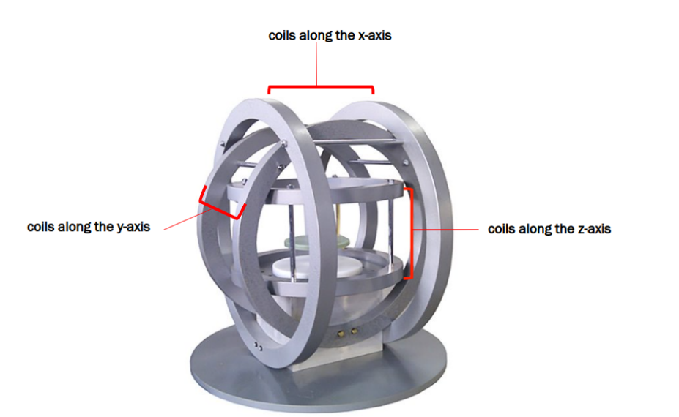
Introduction
Calculate the current required for each of the 3 pairs of coils of a three-axis Helmholtz coil system to achieve the target magnetic force and torque at the center.

Slide 3
Level 1 | Level 2
Hardware Hiding Modules
Behavior-Hiding Module | Control Module Input Format Module Output Format Module Output Verification Module Magnetic Core Module CoilT Module
Software Decision Module | Vector Module

Slide 4
Hardware Hiding Modules
Secrets: The data structure and algorithm used to implement the virtual hardware.
Services: Serves as a virtual hardware used by the rest of the system. This module provides the interface between the hardware and the software. So, the system can use it to display outputs or to accept inputs.
Implemented By: OS

Slide 5
Magnetic Core Module
Secrets: The physical constants and algorithm used to implement the magnetic equations to calculate the required currents
Services: Define the current calculator equations.
Implemented By: 3D-HCCC

Slide 6
CoilT Module
Secrets: The data structure of a pair of Coils
Services: Provides comprehensive data on the coil pair's configuration, using the detailed coil parameters defined in the input parameters module.
Implemented By: 3D-HCCC

Slide 7
Control Module
Secrets: The algorithm for coordinating the running of the program
Services: Provide the main program
Implemented By: 3D-HCCC

Slide 8
Vector Module
Secrets: The algorithms for performing a wide range of vector operations
Services: Provides functions executing various vector operations.
Implemented By: NumPy

Slide 9
Control Module
Input Format Module
Output Verification Module
Output Format Module
Magnetic Core Module
CoilT module
Vector Module
Hardware Hiding Modules
9/15

Slide 10
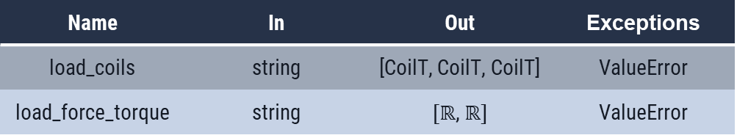
Input Format Module
Uses: Hardware Hiding Modules
State Variables: -
Environment Variable: file, command line input
Name | In | Out | Exceptions
load_coils | string | [CoilT, CoilT, CoilT] | ValueError
load_force_torque | string | $[ℝ$, $ℝ]$ | ValueError

Slide 11
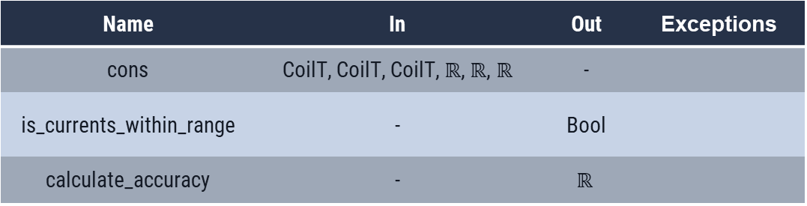
Output Verification Module
Uses: Coil, Magnetic Core
State Variables: -
Environment Variable: -
Name | In | Out | Exceptions
cons | CoilT, CoilT, CoilT,$ℝ$, $ℝ$, $ℝ$ | -
is_currents_within_range | - | Bool
calculate_accuracy | - | $$ℝ$$

Slide 12
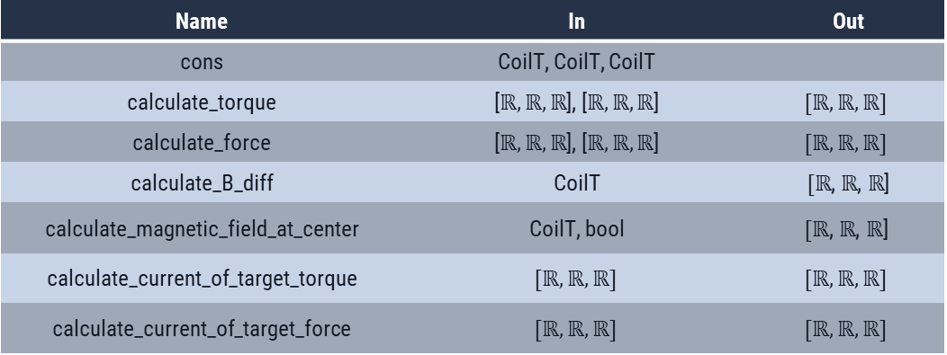
Magnetic Core Module
Uses: Vector Module, CoilT Module
State Variables: 3 × CoilT
Environment Variable: -
Name | In | Out
cons | CoilT, CoilT, CoilT
calculate_torque | [$ℝ,ℝ,ℝ$], [$ℝ,ℝ,ℝ$] | $$[ℝ,ℝ,ℝ]$$
calculate_force | [$ℝ,ℝ,ℝ$], [$ℝ,ℝ,ℝ$] | $$[ℝ,ℝ,ℝ]$$
calculate_B_diff | CoilT | $[ℝ$, $ℝ$, $ℝ$]
calculate_magnetic_field_at_center | CoilT, bool | $$[ℝ\text{, }ℝ\text{,} ℝ\text{]}$$
calculate_current_of_target_torque | $$[ℝ,ℝ,ℝ]$$ | $$[ℝ,ℝ,ℝ]$$
calculate_current_of_target_force | $$[ℝ,ℝ,ℝ]$$ | $$[ℝ,ℝ,ℝ]$$

Slide 13
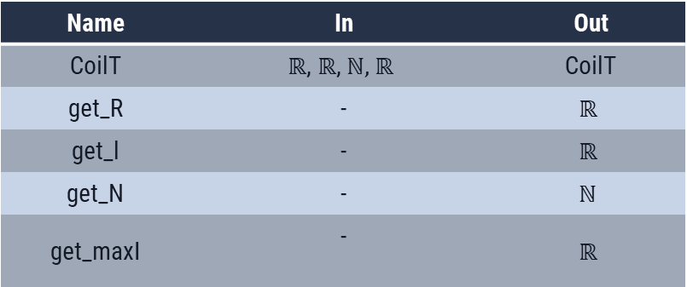
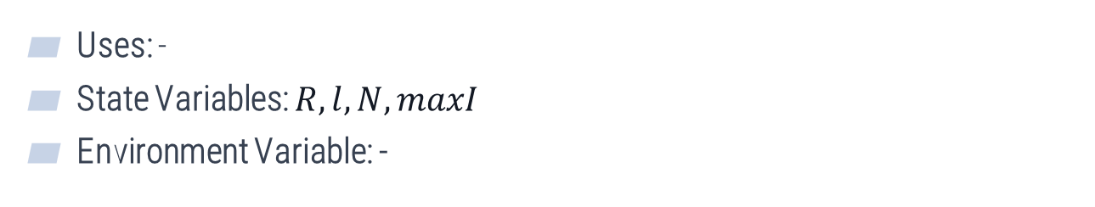
CoilT module
Uses: -
State Variables: $R,l, N,maxI$
Environment Variable: -
Name | In | Out
CoilT | $$ℝ\text{, }ℝ\text{,} \text{ℕ}\text{, }ℝ$$ | CoilT
get_R | - | $$ℝ$$
get_l | - | $$ℝ$$
get_N | - | $$\text{ℕ}$$
get_maxI | - | $$ℝ$$

Slide 14
Control Module
Uses: Input Module, Output Format Module, Output Verification Module, Magnetic Core Module
State Variables: -
Environment Variable: -
Name | In | Out
main | - | -

Slide 15
THANK You!
Any questions?

