Slide 1
Three-axis Helmholtz Coil System Current Calculator for Target Magnetic Field
Reyhaneh Norouziani

Slide 2
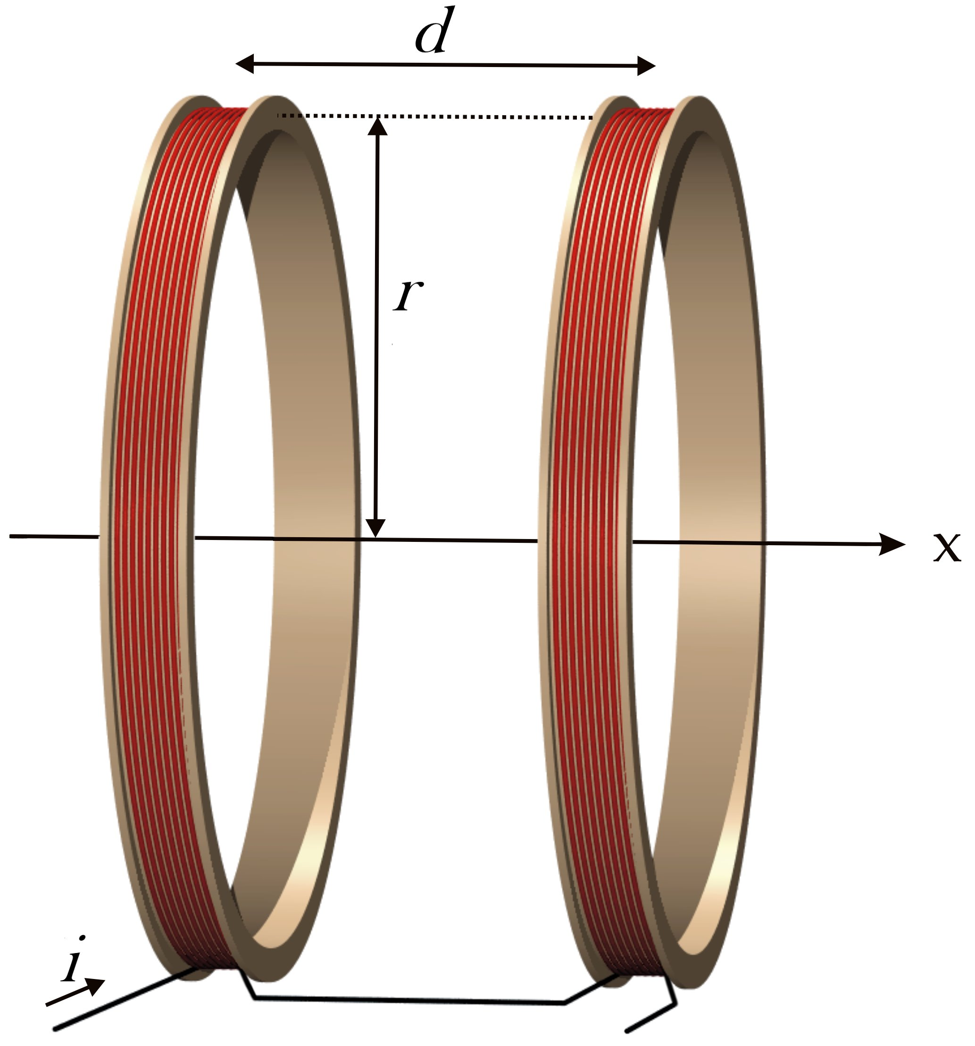
Helmholtz coil system
A pair of two electromagnetic coaxial circular coils of radius r separated by a distance equal to the radius of the coil
A nearly uniform magnetic field at the center
Small magnetic fields with high uniformity
If the electric current be equal but in the opposite direction, it is known as Maxwell coil, which creates a region of magnetic field gradient
Notes:
A Helmholtz coil is a device for producing a region of nearly uniform magnetic field, named after the German physicist Hermann von Helmholtz. It consists of two electromagnets on the same axis, carrying an equal electric current in the same direction. Besides creating magnetic fields, Helmholtz coils are also used in scientific apparatus to cancel external magnetic fields, such as the Earth's magnetic field.
When the pair of two electromagnetics of a Helmholtz coil carry an equal electric current in the opposite direction, it is known as anti-Helmholtz coil, which creates a region of nearly uniform magnetic field gradient, and is used for creating magnetic traps for atomic physics experiments.

Slide 3
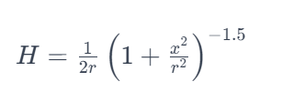
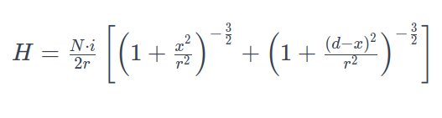

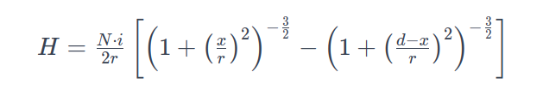
Model
H of One Coil:
Total H of in Helmholtz coils:
Total H of in Maxwel coils:
H Magnetic field strength
N Number of turns in the coil
I Current flowing through the coils
r Radius of the coils
x Position along the coil's axis where the magnetic field is calculating
d Separation between the coils
3/9

Slide 4

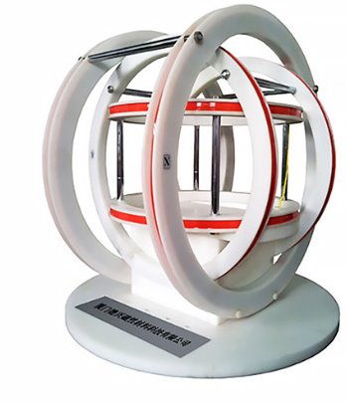
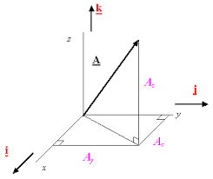
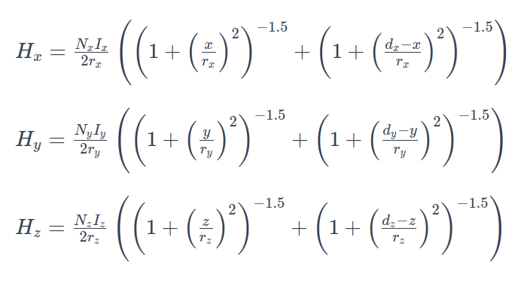
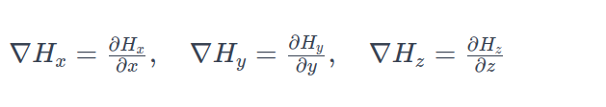
Model
The gradient of the magnetic field for Maxwel coil can be found by taking the spatial derivatives of these field components:
4/9

Slide 5
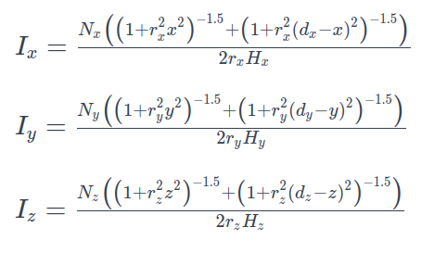
Model
5/9

Slide 6
Input & Output
Inputs:
The characteristics of the 3D Helmholtz coil system:
The diameter of each pair of coils
The distance between each pair of coils
The number of turns in each coil
The desired magnetic field
• The type of magnetic field( magnetic field with a gradient or uniform magnetic field)
Outputs:
The needed electric current of each coil to produce the desired magnetic field strength.

Slide 7
Goal Statements
GS1: Calculate the current required for the x-axis coil to achieve the target magnetic field strength along the x-axis.
GS2: Calculate the current required for the y-axis coil to achieve the target magnetic field strength along the y-axis.
GS3: Calculate the current required for the z-axis coil to achieve the target magnetic field strength along the z-axis.
GS4: Offer the functionality to switch between a Maxwell Coil and Helmholtz Coil configurations
7/9

Slide 8
Assumptions:
A1: The system is assumed to be powered by a direct current (DC) source, ensuring that the generated magnetic field is steady.
A2: It is assumed there are no significant external magnetic fields present that could interfere with the magnetic field generated by the Helmholtz coil system. This ensures that the magnetic field within the operational area is solely due to the coils themselves.
A3: We assume that the desired target magnetic field is to be generated within the center of the Helmholtz coil
A4: We assume that the desired target magnetic field is within the generatable range of the Helmholtz coil system, based on its design, power supply capabilities, and coil configurations.

Slide 9
Thank you for your attention!
9/9

