Slide 1
MG + MIS of 3D-HCCC
Reyhaneh Norouziani

Slide 2
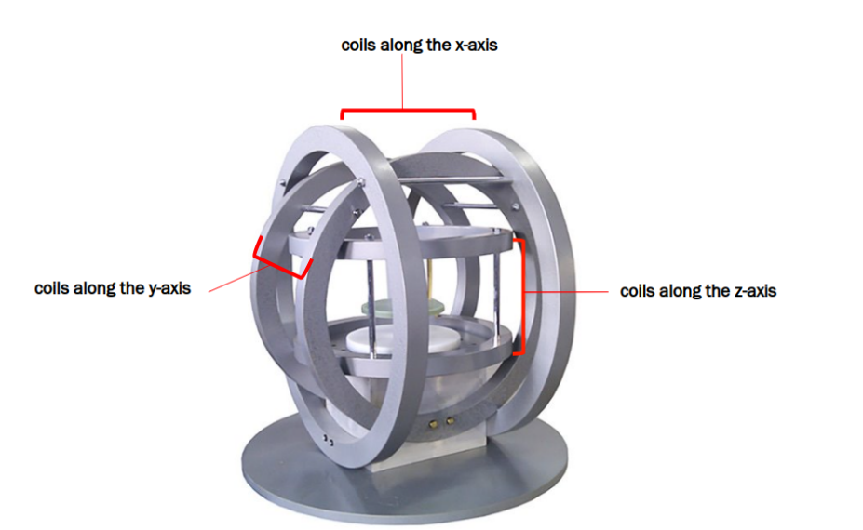
Introduction
Calculate the current required for each of the 3 pairs of coils of a three-axis Helmholtz coil system to achieve the target magnetic force and torque at the center.

Slide 3
Level 1 | Level 2
Hardware Hiding Modules
Behavior-Hiding Module | Control Module Input Format Module Output Format Module Output Verification Module Magnetic Core Module CoilT Module
Software Decision Module | Vector Module

Slide 4
CoilT Module
Secrets: The data structure of a pair of Coils
Services: Provides comprehensive data on the coil pair's configuration, using the detailed coil parameters defined in the input parameters module.
Implemented By: 3D-HCCC

Slide 5
Magnetic Core Module
Secrets: The physical constants and algorithm used to implement the magnetic equations to calculate the required currents
Services: Define the current calculator equations.
Implemented By: 3D-HCCC

Slide 6
Vector Module
Secrets: The algorithms for performing a wide range of vector operations
Services: Provides functions executing various vector operations.
Implemented By: NumPy

Slide 7
Control Module
Secrets: The algorithm for coordinating the running of the program
Services: Provide the main program
Implemented By: 3D-HCCC

Slide 8
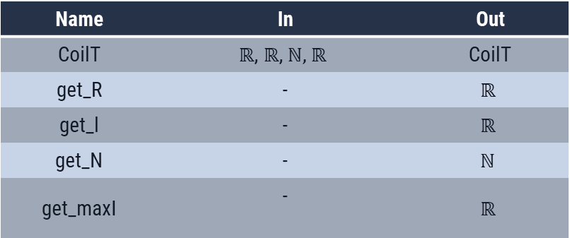
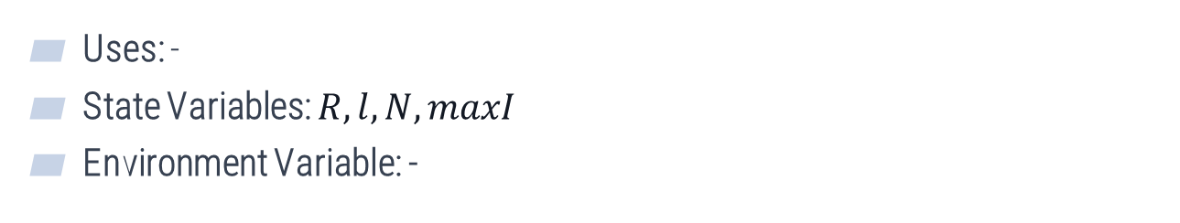
CoilT module
Uses: -
State Variables: $R,l, N,maxI$
Environment Variable: -
Name | In | Out
CoilT | $$ℝ\text{, }ℝ\text{,} \text{ℕ}\text{, }ℝ$$ | CoilT
get_R | - | $$ℝ$$
get_l | - | $$ℝ$$
get_N | - | $$\text{ℕ}$$
get_maxI | - | $$ℝ$$

Slide 9
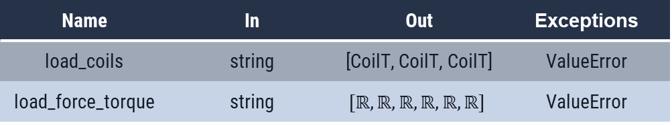
Input Format Module
Uses: Hardware Hiding Modules
State Variables: -
Environment Variable: file, command line input
Name | In | Out | Exceptions
load_coils | string | [CoilT, CoilT, CoilT] | ValueError
load_force_torque | string | $$[ℝ,ℝ,ℝ,ℝ,ℝ,ℝ]$$ | ValueError

Slide 10
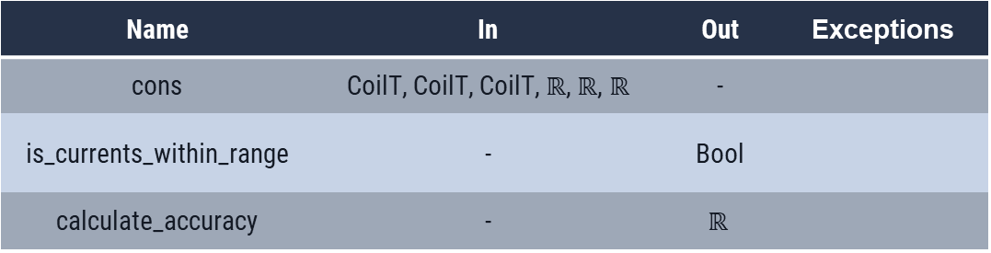
Output Verification Module
Uses: CoilT, Magnetic Core
State Variables: -
Environment Variable: -
Name | In | Out | Exceptions
cons | CoilT, CoilT, CoilT,$ℝ$, $ℝ$, $ℝ$ | -
is_currents_within_range | - | Bool
calculate_accuracy | - | $$ℝ$$

Slide 11
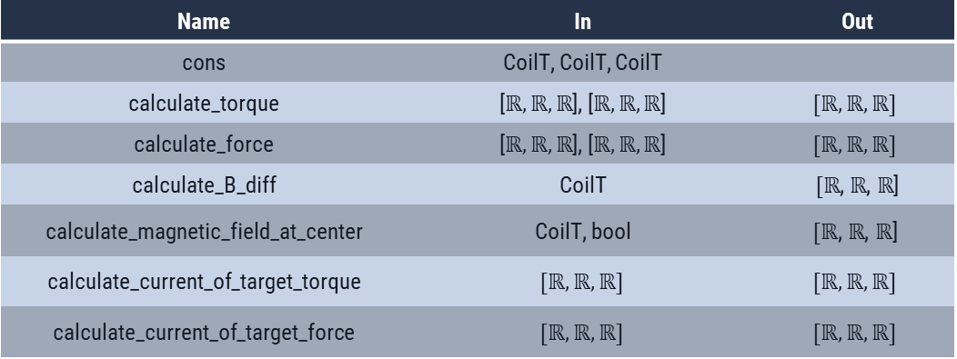
Magnetic Core Module
Uses: Vector Module, CoilT Module
State Variables: 3 × CoilT
Environment Variable: -
Name | In | Out
cons | CoilT, CoilT, CoilT
calculate_torque | [$ℝ,ℝ,ℝ$], [$ℝ,ℝ,ℝ$] | $$[ℝ,ℝ,ℝ]$$
calculate_force | [$ℝ,ℝ,ℝ$], [$ℝ,ℝ,ℝ$] | $$[ℝ,ℝ,ℝ]$$
calculate_B_diff | CoilT | $[ℝ$, $ℝ$, $ℝ$]
calculate_magnetic_field_at_center | CoilT, bool | $$[ℝ\text{, }ℝ\text{,} ℝ\text{]}$$
calculate_current_of_target_torque | $$[ℝ,ℝ,ℝ]$$ | $$[ℝ,ℝ,ℝ]$$
calculate_current_of_target_force | $$[ℝ,ℝ,ℝ]$$ | $$[ℝ,ℝ,ℝ]$$

Slide 12
Control Module
Uses: Input Module, Output Format Module, Output Verification Module, Magnetic Core Module
State Variables: -
Environment Variable: -
Name | In | Out
main | - | -

Slide 13
Control Module
Input Format Module
Output Verification Module
Output Format Module
Magnetic Core Module
CoilT module
Vector Module
Hardware Hiding Modules
13/14

Slide 14
THANK You!
Any questions?

