Slide 1
introduction to r
basic concepts

Slide 3
pre-requisites
R is a programming language and software environment for statistical analysis, graphics representation and reporting. R was created by Ross Ihaka and Robert Gentleman at the University of Auckland, New Zealand, and is currently developed by the R Development Core Team.
The core of R is an interpreted computer language which allows branching and looping as well as modular programming using functions. R allows integration with the procedures written in the C, C++, .Net, Python or FORTRAN languages for efficiency.
R is freely available under the GNU General Public License, and pre-compiled binary versions are provided for various operating systems like Linux, Windows and Mac.
R is free software distributed under a GNU-style copy left, and an official part of the GNU project called GNU S.

Slide 7

who uses r ?

Slide 8
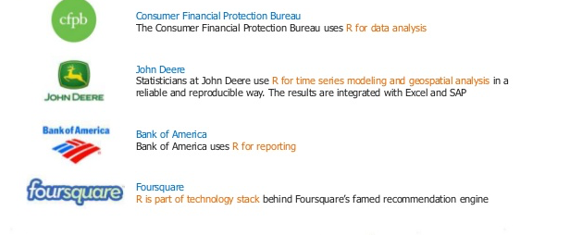
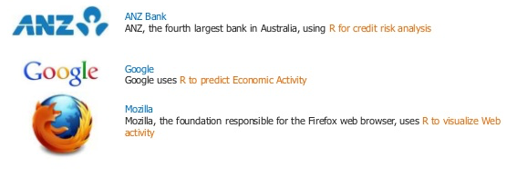
who uses r ?

Slide 9

corporate clients of r

Slide 10

case studies
R has become one of the most popular language for statistics, visualization and analytics in the last decade. Many companies like Facebook, Google, Ford Motor Company and millions of people Worldwide from different fields are using R language.
Facebook uses R for the analysis of status updates. All the charts used for analysis are created using ggplot2 package. Graphical powers of R is also used in Facebook’s social network graph. They also uses R to predict colleague interaction
Believe it or not, R is even used in journalism. Infact, the New York Times uses R for data visualization. It’s true, R is indeed gaining popularity because of its flexibility and it’s powerful data analysis and visualization. It is praised by established media and at the same time it has become an essential tool for companies in various sectors.

Slide 11
case studies
Google uses R to predict economic activity. It has used R to fit autoregressive models to retail sales, automotive sales, home sales, and passenger arrival data. Also it uses R to make online marketing more effective. They also use R for statistical analysis and visualization, to ensure that its advertisers are always getting the best for their marketing investment.
Other than social networking sites many banks are also using R. For example ANZ bank, thefourth largest bank in Australia has used R to fit models for mortgage loss because of the flexibility of R to adapt to new modelling situations and generate predictions, summaries, etc
Another important use of R is to produce elegant and flexible reports. Knitr package in R gives dynamic and automated reports which saves time and effort. Even in the case of big data which is often time consuming to deal with, Knitr generates reports automatically. It tries to give beautiful output by default and it is fully customizable to incorporate with different types of demand.

Slide 12
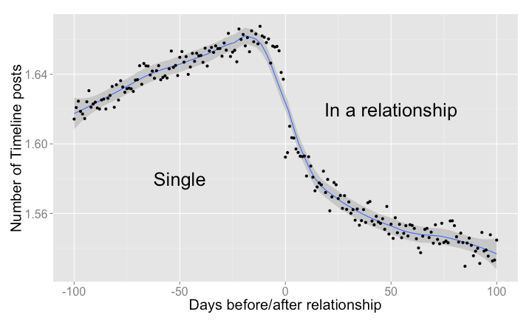
Facebook for data analytics
Relationships start with a period of courtship: on Facebook, messages are exchanged, profiles are visited, posts are shared on each other's timelines. The following graph shows the average number of timeline posts exchanged between two people who are about to become a couple. We studied the group of people who changed their status from "Single" to "In a relationship" and also stated an anniversary date as the start of their relationship. During the 100 days before the relationship starts, we observe a slow but steady increase in the number of timeline posts shared between the future couple. When the relationship starts ("day 0"), posts begin to decrease. We observe a peak of 1.67 posts per day 12 days before the relationship begins, and a lowest point of 1.53 posts per day 85 days into the relationship. Presumably, couples decide to spend more time together, courtship is off, and online interactions give way to more interactions in the physical world..

Slide 13
the s language
about s
S is a language and computational environment designed specifically for carrying out “statistical” computations.
It was designed by statisticians so that they could easily develop and deploy new statistical methodology. It brings good ideas on numerical methods, graphics and language design together in a single useful package.
The S language was developed at Bell Laboratories by John Chambers and his collaborators Rick Becker, Allan Wilks and Duncan Temple Lang over the years from 1975 to 1998.

Slide 14
the r language
about r
R is a computer language (and associated computational environment) for carrying out statistical computations.
It appears similar to the S language developed at Bell Laboratories, but the similarity was retrofitted on top of quite different looking piece of software.
R was created by Robert Gentleman and Ross Ihaka at the University of Auckland as a testbed for trying out some ideas in statistical computing.
It has now evolved into a fully featured tool for carrying out statistical (and other) computations.

Slide 15
the r project
The R Project is an international collaboration of researchers in statistical computing
There are roughly 20 members of the “R Core Team” who maintain and enhance R.
Releases of the R environment are made through the CRAN (comprehensive R archive network) twice per year. The software is released under a “free software” license, which makes it possible for anyone to download and use it.
There are over 3500 extension packages that have been contributed to CRAN.

Slide 16

original r developers

Slide 17
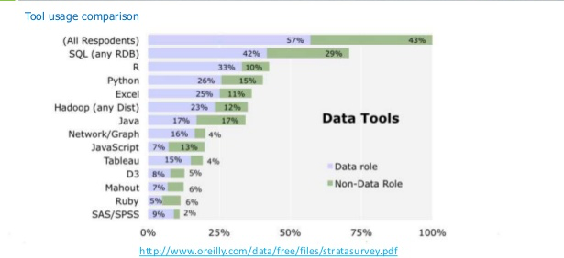
tool usage comparison
comparing R

Slide 18
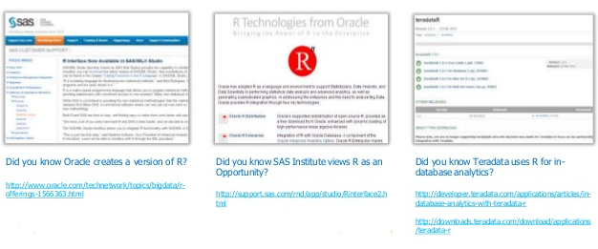
r products

Slide 19
R is world’s most widely used statistics programming language. It's the # 1 choice of data scientists and supported by a vibrant and talented community of contributors.
The following are the important features of R −
• R is a well-developed, simple and effective programming language which includes conditionals, loops, user defined recursive functions and input and output facilities.
• R has an effective data handling and storage facility,
• R provides a suite of operators for calculations on arrays, lists, vectors and matrices.
• R provides a large, coherent and integrated collection of tools for data analysis.
• R provides graphical facilities for data analysis and display either directly at the computer or printing at the papers.
Notes:
Before proceeding with this tutorial, you should have a basic understanding of Computer Programming terminologies. A basic understanding of any of the programming languages will help you in understanding the R programming concepts and move fast on the learning track.
check if environment is set correctly and run these commands
install.packages(“plotrix")

Slide 20
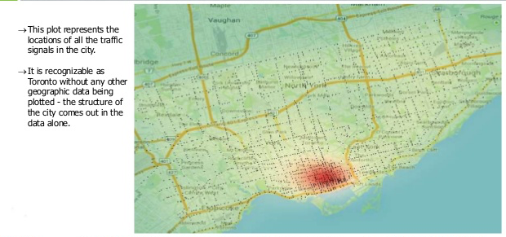
data visualisation in r

Slide 21
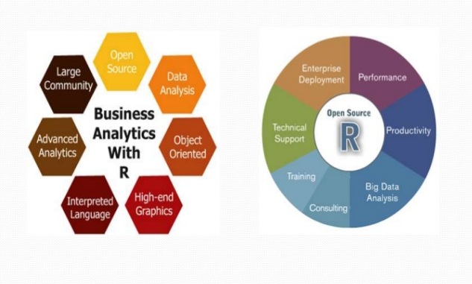
why study r?

Slide 22



use cases
Use-case 1:
Use-case 2:
Use-case 3:

Slide 23
r environment

Slide 24

r command prompt, script file and comments
Command prompt : $ R
> myString <- "Hello, World!"
> print ( myString)
R Script File : test.R
# My first program in R Programming
myString <- "Hello, World!"
print ( myString)
Run in command prompt : $ Rscript test.R
Comments :
R does not support multi-line comments but you can perform a trick which is something as follows −
if(FALSE) {
"This is a demo for multi-line comments and it should be put inside either a single OR double quote"
}
Notes:
R Command Prompt
Once you have R environment setup, then it’s easy to start your R command prompt by just typing the following command at your command prompt −
$ R
This will launch R interpreter and you will get a prompt > where you can start typing your program as follows −
> myString <- "Hello, World!"
> print ( myString)
[1] "Hello, World!"
Here first statement defines a string variable myString, where we assign a string "Hello, World!" and then next statement print() is being used to print the value stored in variable myString.
R Script File
Usually, you will do your programming by writing your programs in script files and then you execute those scripts at your command prompt with the help of R interpreter called Rscript. So let's start with writing following code in a text file called test.R as under −
# My first program in R Programming
myString <- "Hello, World!"
print ( myString)
Save the above code in a file test.R and execute it at Linux command prompt as given below. Even if you are using Windows or other system, syntax will remain same.
$ Rscript test.R
When we run the above program, it produces the following result.
[1] "Hello, World!"
Comments
Comments are like helping text in your R program and they are ignored by the interpreter while executing your actual program. Single comment is written using # in the beginning of the statement as follows −
# My first program in R Programming
R does not support multi-line comments but you can perform a trick which is something as follows −
if(FALSE) {
"This is a demo for multi-line comments and it should be put inside either a single
OR double quote"
}
myString <- "Hello, World!"
print ( myString)
Though above comments will be executed by R interpreter, they will not interfere with your actual program. You should put such comments inside, either single or double quote.

Slide 25
using R as calculator

Slide 26
variables
Variable Name | Validity | Reason
var_name2. | valid | Has letters, numbers, dot and underscore
var_name% | Invalid | Has the character '%'. Only dot(.) and underscore allowed.
2var_name | invalid | Starts with a number
.var_name , var.name | valid | Can start with a dot(.) but the dot(.)should not be followed by a number.
.2var_name | invalid | The starting dot is followed by a number making it invalid.
_var_name | invalid | Starts with _ which is not valid
Naming Rules
Variable Assignment
Free Memory Space

Slide 27
data types
In contrast to other programming languages like C and java in R, the variables are not declared as some data type. The variables are assigned with R-Objects and the data type of the R-object becomes the data type of the variable. There are many types of R-objects. The frequently used ones are −
• Vectors
• Lists
• Matrices
• Arrays
• Factors
• Data Frames
The simplest of these objects is the vector object and there are six data types of these atomic vectors, also termed as six classes of vectors. The other R-Objects are built upon the atomic vectors.

Slide 28
data types
Data Type | Example | Verify | Result
Logical | TRUE, FALSE | v <- TRUE print(class(v)) | [1] "logical"
Numeric | 12.3, 5, 999 | v <- 23.5 print(class(v)) | [1] "numeric"
Integer | 2L, 34L, 0L | v <- 2L print(class(v)) | [1] "integer"
Complex | 3 + 2i | v <- 2+5i print(class(v)) | [1] "complex"
Character | a' , '"good", "TRUE", '23.4' | v <- "TRUE" print(class(v)) | [1] "character"
Raw | "Hello" is stored as 48 65 6c 6c 6f | v <- charToRaw("Hello") print(class(v)) | [1] "raw"

Slide 29
dates in r

Slide 30
input output in r

Slide 31
operators in r
introduction to data structures
We have the following types of operators in R programming :
Arithmetic Operators
Relational Operators
Logical Operators
Assignment Operators
Miscellaneous Operators

Slide 32
arithmetic operators
Operator | Description | Example
+ | Adds two vectors | v <- c( 2,5.5,6) t <- c(8, 3, 4) print(v+t) it produces the following result − [1] 10.0 8.5 10.0
− | Subtracts second vector from the first | v <- c( 2,5.5,6) t <- c(8, 3, 4) print(v-t) it produces the following result − [1] -6.0 2.5 2.0
* | Multiplies both vectors | v <- c( 2,5.5,6) t <- c(8, 3, 4) print(v*t) it produces the following result − [1] 16.0 16.5 24.0
/ | Divide the first vector with the second | v <- c( 2,5.5,6) t <- c(8, 3, 4) print(v/t) When we execute the above code, it produces the following result − [1] 0.250000 1.833333 1.500000
%% | Give the remainder of the first vector with the second | v <- c( 2,5.5,6) t <- c(8, 3, 4) print(v%%t) it produces the following result − [1] 2.0 2.5 2.0
%/% | The result of division of first vector with second (quotient) | v <- c( 2,5.5,6) t <- c(8, 3, 4) print(v%/%t) it produces the following result − [1] 0 1 1
^ | The first vector raised to the exponent of second vector | v <- c( 2,5.5,6) t <- c(8, 3, 4) print(v^t) it produces the following result − [1] 256.000 166.375 1296.000

Slide 33
relational operators
Operator | Description | Example
> | Checks if each element of the first vector is greater than the corresponding element of the second vector. | v <- c(2,5.5,6,9) t <- c(8,2.5,14,9) print(v>t) it produces the following result − [1] FALSE TRUE FALSE FALSE
< | Checks if each element of the first vector is less than the corresponding element of the second vector. | v <- c(2,5.5,6,9) t <- c(8,2.5,14,9) print(v < t) it produces the following result − [1] TRUE FALSE TRUE FALSE
== | Checks if each element of the first vector is equal to the corresponding element of the second vector. | v <- c(2,5.5,6,9) t <- c(8,2.5,14,9) print(v == t) it produces the following result − [1] FALSE FALSE FALSE TRUE

Slide 34
<= | Checks if each element of the first vector is less than or equal to the corresponding element of the second vector. | v <- c(2,5.5,6,9) t <- c(8,2.5,14,9) print(v<=t) it produces the following result − [1] TRUE FALSE TRUE TRUE
>= | Checks if each element of the first vector is greater than or equal to the corresponding element of the second vector. | v <- c(2,5.5,6,9) t <- c(8,2.5,14,9) print(v>=t) it produces the following result − [1] FALSE TRUE FALSE TRUE
!= | Checks if each element of the first vector is unequal to the corresponding element of the second vector. | v <- c(2,5.5,6,9) t <- c(8,2.5,14,9) print(v!=t) it produces the following result − [1] TRUE TRUE TRUE FALSE

Slide 36
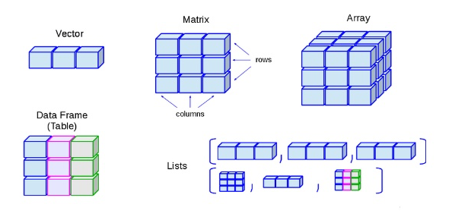
data structures in r

Slide 37
vectors in r
introduction to data structures
Ways to declare vectors
Addition of Vectors
If two vectors are not of same length
Pick a particular element from the vector

Slide 38
Miscellaneous types in Vectors

Slide 39
data frames in r
A data frame is a table or a two-dimensional array-like structure in which each column contains values of one variable and each row contains one set of values from each column.
Following are the characteristics of a data frame.
• The column names should be non-empty.
• The row names should be unique.
• The data stored in a data frame can be of numeric, factor or character type.
• Each column should contain same number of data items.

Slide 40
lists in r
Lists are the R objects which contain elements of different types like − numbers, strings, vectors and another list inside it. A list can also contain a matrix or a function as its elements. List is created using list() function.
Initialise
Naming a List
Access a List
Add items to the List
Modify items in a List
Delete

Slide 41
Matrix in R
Matrices are the R objects in which the elements are arranged in a two-dimensional rectangular layout. They contain elements of the same atomic types.
A Matrix is created using the matrix() function.
Initialise
Accessing specific element
Modifying a Matrix

Slide 42
loops in r
decision making in r
Sr.No. | Loop Type & Description
1 | repeat loop Executes a sequence of statements multiple times and abbreviates the code that manages the loop variable.
2 | while loop Repeats a statement or group of statements while a given condition is true. It tests the condition before executing the loop body.
3 | for loop Like a while statement, except that it tests the condition at the end of the loop body.

Slide 43
4 | break statement Terminates the loop statement and transfers execution to the statement immediately following the loop.
5 | Next statement The next statement simulates the behavior of R switch.

Slide 44
functions in r

Slide 46
assignment 1
questions
Build a simple calculator
assignment 2
Factorial of a number

Slide 47
Installing packages in r

Slide 48
Linking R and html

Slide 49
Read csv files in r
In R, we can read data from files stored outside the R environment. We can also write data into files which will be stored and accessed by the operating system. R can read and write into various file formats like csv, excel, xml etc.
Set Working Directory
Reading a CSV File
Basic computations using the CSV File
Write to a CSV File

Slide 50
Read XLSX files in r
Microsoft Excel is the most widely used spreadsheet program which stores data in the .xls or .xlsx format. R can read directly from these files using some excel specific packages. We’ll learn how to input and read an xlsx file using R.

Slide 53
Plots in R
Pie Charts
Bar Charts
Box Plot
Histogram
Line Charts
Scatter Plots

Slide 54
Pie charts in r
In R the pie chart is created using the pie() function which takes positive numbers as a vector input. The additional parameters are used to control labels, color, title etc.
Syntax
The basic syntax for creating a pie-chart using the R is −
pie(x, labels, radius, main, col, clockwise)
Following is the description of the parameters used −
• x is a vector containing the numeric values used in the pie chart.
• labels is used to give description to the slices.
• radius indicates the radius of the circle of the pie chart.(value between −1 and +1).
• main indicates the title of the chart.
• col indicates the color palette.
• clockwise is a logical value indicating if the slices are drawn clockwise or anti clockwise.

Slide 55
Bar charts in r
A bar chart represents data in rectangular bars with length of the bar proportional to the value of the variable. R uses the function barplot() to create bar charts. R can draw both vertical and horizontal bars in the bar chart. In bar chart each of the bars can be given different colors.
Syntax
The basic syntax to create a bar-chart in R is −
barplot(H, xlab, ylab, main, names.arg, col)
Following is the description of the parameters used −
• H is a vector or matrix containing numeric values used in bar chart.
• xlab is the label for x axis.
• ylab is the label for y axis.
• main is the title of the bar chart.
• names.arg is a vector of names appearing under each bar.
• col is used to give colors to the bars in the graph.

Slide 56
Boxplot in r
Boxplots are a measure of how well distributed is the data in a data set. It is useful in comparing the distribution of data across data sets by drawing boxplots for each of them.
Boxplots are created in R by using the boxplot() function
Syntax
The basic syntax to create a boxplot in R is −
boxplot(x, data, notch, varwidth, names, main)
Following is the description of the parameters used −
• x is a vector or a formula.
• data is the data frame.
• notch is a logical value. Set as TRUE to draw a notch.
• varwidth is a logical value. Set as true to draw width of the box proportionate to the sample size.
• names are the group labels which will be printed under each boxplot.
• main is used to give a title to the graph.

Slide 57
HISTOGRam in r
A histogram represents the frequencies of values of a variable bucketed into ranges. Each bar in histogram represents the height of the number of values present in that range.
R creates histogram using hist() function.
Syntax
The basic syntax for creating a histogram using R is
hist(v,main,xlab,xlim,ylim,breaks,col,border)
Following is the description of the parameters used −
• v is a vector containing numeric values used in histogram.
• main indicates title of the chart.
• col is used to set color of the bars.
• border is used to set border color of each bar.
• xlab is used to give description of x-axis.
• xlim is used to specify the range of values on the x-axis.
• ylim is used to specify the range of values on the y-axis.
• breaks is used to mention the width of each bar.

Slide 58
Line charts in r
A line chart is a graph that connects a series of points by drawing line segments between them.Line charts are usually used in identifying the trends in data.
The plot() function in R is used to create the line graph.
Syntax
The basic syntax to create a line chart in R is −
plot(v,type,col,xlab,ylab)
Following is the description of the parameters used −
• v is a vector containing the numeric values.
• type takes the value "p" to draw only the points, "l" to draw only the lines and "o" to draw both points and lines.
• xlab is the label for x axis.
• ylab is the label for y axis.
• main is the Title of the chart.
• col is used to give colors to both the points and lines

Slide 59
Scatterplots in r
Scatterplots show many points plotted in the Cartesian plane. Each point represents the values of two variables. One variable is chosen in the horizontal axis and another in the vertical axis.
The simple scatterplot is created using the plot() function.
Syntax
The basic syntax for creating scatterplot in R is −
plot(x, y, main, xlab, ylab, xlim, ylim, axes)
Following is the description of the parameters used −
• x is the data set whose values are the horizontal coordinates.
• y is the data set whose values are the vertical coordinates.
• main is the tile of the graph.
• xlab is the label in the horizontal axis.
• ylab is the label in the vertical axis.
• xlim is the limits of the values of x used for plotting.
• ylim is the limits of the values of y used for plotting.
• axes indicates whether both axes should be drawn on the plot.

Slide 60
STATISTICS in R
Mean, Median Mode
Linear Regression
Multiple Regression
Logistic Regression
Normal Distribution
Binomial Distribution, … etc

Slide 61
Mean, median, mode
Mean
It is calculated by taking the sum of the values and dividing with the number of values in a data series.
The function mean() is used to calculate this in R.
Median
The middle most value in a data series is called the median. The median() function is used in R to calculate this value.
Mode
The mode is the value that has highest number of occurrences in a set of data. Unike mean and median, mode can have both numeric and character data. R does not have a standard in-built function to calculate mode. So we create a user function to calculate mode of a data set in R.

Slide 62
Linear regression
Regression analysis is a very widely used statistical tool to establish a relationship model between two variables. One of these variable is called predictor variable whose value is gathered through experiments. The other variable is called response variable whose value is derived from the predictor variable.
In Linear Regression these two variables are related through an equation, where exponent (power) of both these variables is 1. Mathematically a linear relationship represents a straight line when plotted as a graph. A non-linear relationship where the exponent of any variable is not equal to 1 creates a curve.
The general mathematical equation for a linear regression is −
y = ax + b
Following is the description of the parameters used −
• y is the response variable.
• x is the predictor variable.
• a and b are constants which are called the coefficients.

Slide 63
Steps to Establish a Regression
A simple example of regression is predicting weight of a person when his height is known. To do this we need to have the relationship between height and weight of a person.
The steps to create the relationship is −
• Carry out the experiment of gathering a sample of observed values of height and corresponding weight.
• Create a relationship model using the lm() functions in R.
• Find the coefficients from the model created and create the mathematical equation using these
• Get a summary of the relationship model to know the average error in prediction. Also called residuals.
• To predict the weight of new persons, use the predict() function in R. lm() Function
This function creates the relationship model between the predictor and the response variable.
Syntax
The basic syntax for lm() function in linear regression is −
lm(formula,data)
Following is the description of the parameters used −
• formula is a symbol presenting the relation between x and y.
• data is the vector on which the formula will be applied.

Slide 64
Multiple regression
Multiple regression is an extension of linear regression into relationship between more than two variables. In simple linear relation we have one predictor and one response variable, but in multiple regression we have more than one predictor variable and one response variable.
The general mathematical equation for multiple regression is −
y = a + b1x1 + b2x2 +...bnxn
Following is the description of the parameters used −
• y is the response variable.
• a, b1, b2...bn are the coefficients.
• x1, x2, ...xn are the predictor variables.
We create the regression model using the lm() function in R. The model determines the value of the coefficients using the input data. Next we can predict the value of the response variable for a given set of predictor variables using these coefficients.
lm() Function
This function creates the relationship model between the predictor and the response variable.
Syntax
The basic syntax for lm() function in multiple regression is −
lm(y ~ x1+x2+x3...,data)
Following is the description of the parameters used −
• formula is a symbol presenting the relation between the response variable and predictor variables.
• data is the vector on which the formula will be applied.

Slide 65
Logistic regression
The Logistic Regression is a regression model in which the response variable (dependent variable) has categorical values such as True/False or 0/1. It actually measures the probability of a binary response as the value of response variable based on the mathematical equation relating it with the predictor variables.
The general mathematical equation for logistic regression is −
y = 1/(1+e^-(a+b1x1+b2x2+b3x3+...))
Following is the description of the parameters used −
• y is the response variable.
• x is the predictor variable.
• a and b are the coefficients which are numeric constants.
The function used to create the regression model is the glm() function.
Syntax
The basic syntax for glm() function in logistic regression is −
glm(formula,data,family)
Following is the description of the parameters used −
• formula is the symbol presenting the relationship between the variables.
• data is the data set giving the values of these variables.
• family is R object to specify the details of the model. It's value is binomial for logistic regression.

Slide 66
Normal distribution
In a random collection of data from independent sources, it is generally observed that the distribution of data is normal. Which means, on plotting a graph with the value of the variable in the horizontal axis and the count of the values in the vertical axis we get a bell shape curve. The center of the curve represents the mean of the data set.
dnorm() - This function gives height of the probability distribution at each point for a given mean and standard deviation
pnorm() - This function gives the probability of a normally distributed random number to be less that the value of a given number. It is also called "Cumulative Distribution Function".
qnorm() - This function takes the probability value and gives a number whose cumulative value matches the probability value.
rnorm() - This function is used to generate random numbers whose distribution is normal. It takes the sample size as input and generates that many random numbers.

Slide 67
Binomial distribution
The binomial distribution model deals with finding the probability of success of an event which has only two possible outcomes in a series of experiments. For example, tossing of a coin always gives a head or a tail. The probability of finding exactly 3 heads in tossing a coin repeatedly for 10 times is estimated during the binomial distribution.
dbinom() - This function gives the probability density distribution at each point.
pbinorm() - This function gives the cumulative probability of an event. It is a single value representing the probability.
qbinorm() - This function takes the probability value and gives a number whose cumulative value matches the probability value.
rbinorm() - This function generates required number of random values of given probability from a given sample.

