Slide 1
introduction to r
basic concepts

Slide 3
pre-requisites
R is a programming language and software environment for statistical analysis, graphics representation and reporting. R was created by Ross Ihaka and Robert Gentleman at the University of Auckland, New Zealand, and is currently developed by the R Development Core Team.
The core of R is an interpreted computer language which allows branching and looping as well as modular programming using functions. R allows integration with the procedures written in the C, C++, .Net, Python or FORTRAN languages for efficiency.
R is freely available under the GNU General Public License, and pre-compiled binary versions are provided for various operating systems like Linux, Windows and Mac.
R is free software distributed under a GNU-style copy left, and an official part of the GNU project called GNU S.

Slide 7
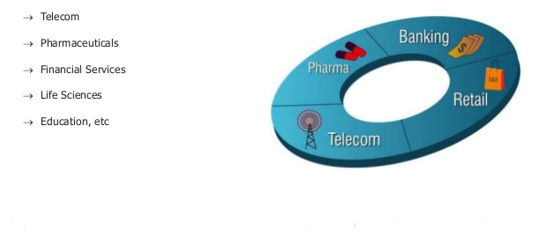
who uses r ?

Slide 8
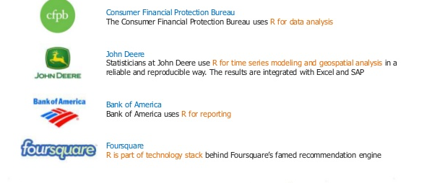
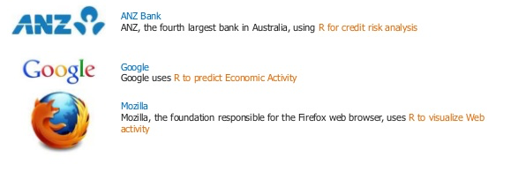
who uses r ?

Slide 9

corporate clients of r

Slide 10

case studies
R has become one of the most popular language for statistics, visualization and analytics in the last decade. Many companies like Facebook, Google, Ford Motor Company and millions of people Worldwide from different fields are using R language.
Facebook uses R for the analysis of status updates. All the charts used for analysis are created using ggplot2 package. Graphical powers of R is also used in Facebook’s social network graph. They also uses R to predict colleague interaction
Believe it or not, R is even used in journalism. Infact, the New York Times uses R for data visualization. It’s true, R is indeed gaining popularity because of its flexibility and it’s powerful data analysis and visualization. It is praised by established media and at the same time it has become an essential tool for companies in various sectors.

Slide 11
case studies
Google uses R to predict economic activity. It has used R to fit autoregressive models to retail sales, automotive sales, home sales, and passenger arrival data. Also it uses R to make online marketing more effective. They also use R for statistical analysis and visualization, to ensure that its advertisers are always getting the best for their marketing investment.
Other than social networking sites many banks are also using R. For example ANZ bank, thefourth largest bank in Australia has used R to fit models for mortgage loss because of the flexibility of R to adapt to new modelling situations and generate predictions, summaries, etc
Another important use of R is to produce elegant and flexible reports. Knitr package in R gives dynamic and automated reports which saves time and effort. Even in the case of big data which is often time consuming to deal with, Knitr generates reports automatically. It tries to give beautiful output by default and it is fully customizable to incorporate with different types of demand.

Slide 12
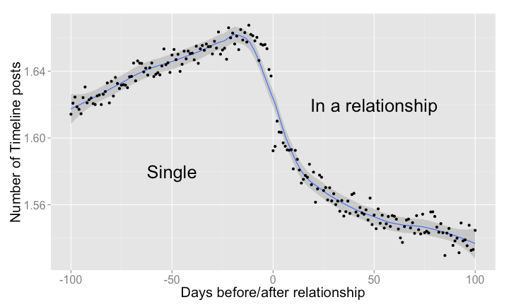
Facebook for data analytics
Relationships start with a period of courtship: on Facebook, messages are exchanged, profiles are visited, posts are shared on each other's timelines. The following graph shows the average number of timeline posts exchanged between two people who are about to become a couple. We studied the group of people who changed their status from "Single" to "In a relationship" and also stated an anniversary date as the start of their relationship. During the 100 days before the relationship starts, we observe a slow but steady increase in the number of timeline posts shared between the future couple. When the relationship starts ("day 0"), posts begin to decrease. We observe a peak of 1.67 posts per day 12 days before the relationship begins, and a lowest point of 1.53 posts per day 85 days into the relationship. Presumably, couples decide to spend more time together, courtship is off, and online interactions give way to more interactions in the physical world..

Slide 13
the s language
about s
S is a language and computational environment designed specifically for carrying out “statistical” computations.
It was designed by statisticians so that they could easily develop and deploy new statistical methodology. It brings good ideas on numerical methods, graphics and language design together in a single useful package.
The S language was developed at Bell Laboratories by John Chambers and his collaborators Rick Becker, Allan Wilks and Duncan Temple Lang over the years from 1975 to 1998.

Slide 14
the r language
about r
R is a computer language (and associated computational environment) for carrying out statistical computations.
It appears similar to the S language developed at Bell Laboratories, but the similarity was retrofitted on top of quite different looking piece of software.
R was created by Robert Gentleman and Ross Ihaka at the University of Auckland as a testbed for trying out some ideas in statistical computing.
It has now evolved into a fully featured tool for carrying out statistical (and other) computations.

Slide 15
the r project
The R Project is an international collaboration of researchers in statistical computing
There are roughly 20 members of the “R Core Team” who maintain and enhance R.
Releases of the R environment are made through the CRAN (comprehensive R archive network) twice per year. The software is released under a “free software” license, which makes it possible for anyone to download and use it.
There are over 3500 extension packages that have been contributed to CRAN.

Slide 16
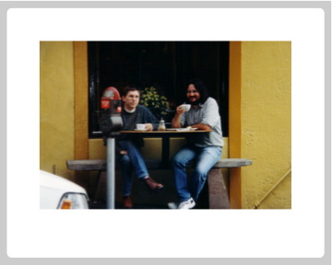
original r developers

Slide 17
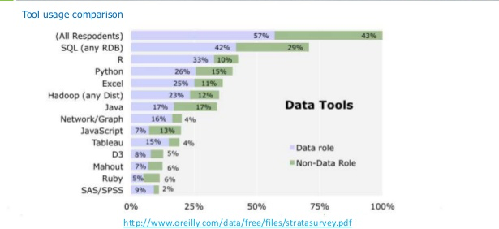
tool usage comparison
comparing R

Slide 18
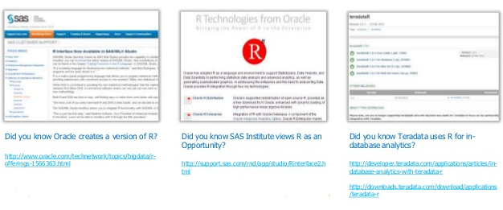
r products

Slide 19
R is world’s most widely used statistics programming language. It's the # 1 choice of data scientists and supported by a vibrant and talented community of contributors.
The following are the important features of R −
• R is a well-developed, simple and effective programming language which includes conditionals, loops, user defined recursive functions and input and output facilities.
• R has an effective data handling and storage facility,
• R provides a suite of operators for calculations on arrays, lists, vectors and matrices.
• R provides a large, coherent and integrated collection of tools for data analysis.
• R provides graphical facilities for data analysis and display either directly at the computer or printing at the papers.
Notes:
Before proceeding with this tutorial, you should have a basic understanding of Computer Programming terminologies. A basic understanding of any of the programming languages will help you in understanding the R programming concepts and move fast on the learning track.
check if environment is set correctly and run these commands
install.packages(“plotrix")

Slide 20
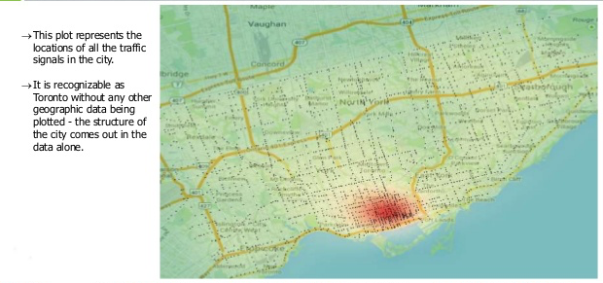
data visualisation in r

Slide 21
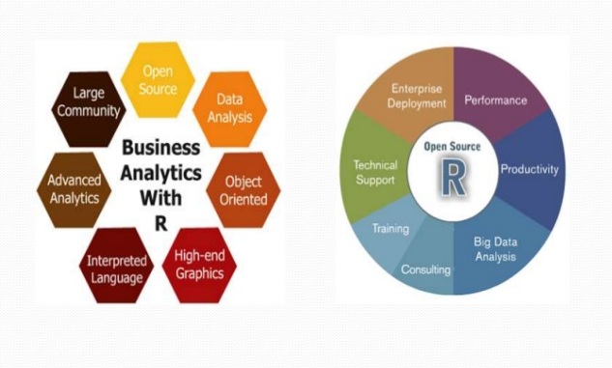
why study r?

Slide 22



use cases
Use-case 1:
Use-case 2:
Use-case 3:

