Slide 1
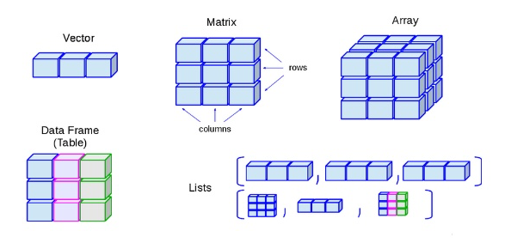
data structures in r

Slide 2
vectors in r
introduction to data structures
Ways to declare vectors
Addition of Vectors
If two vectors are not of same length
Pick a particular element from the vector

Slide 3
Miscellaneous types in Vectors

Slide 4
data frames in r
A data frame is a table or a two-dimensional array-like structure in which each column contains values of one variable and each row contains one set of values from each column.
Following are the characteristics of a data frame.
• The column names should be non-empty.
• The row names should be unique.
• The data stored in a data frame can be of numeric, factor or character type.
• Each column should contain same number of data items.

Slide 5
lists in r
Lists are the R objects which contain elements of different types like − numbers, strings, vectors and another list inside it. A list can also contain a matrix or a function as its elements. List is created using list() function.
Initialise
Naming a List
Access a List
Add items to the List
Modify items in a List
Delete

Slide 6
Matrix in R
Matrices are the R objects in which the elements are arranged in a two-dimensional rectangular layout. They contain elements of the same atomic types.
A Matrix is created using the matrix() function.
Initialise
Accessing specific element
Modifying a Matrix

