Slide 1
Implementation of Micram DAC4 AWG for Twin Pulse Output
Dr. Robert Sheehan, Chief Technical Officer, School of Physics
27 – 6 – 2025

Slide 2
Twin Pulse Implementation
I was asked to configure the Micram DAC4 AWG to output the following pulse pattern in which T_{w} ≈ 100 (ps) and T_{d} ≥ 100 (ps)
Pulse height V ≈ 400 mV, but this can always be amplified
Possible to obtain pattern with T_{w} ≈ 110 (ps) and Td ≥ 110 (ps)
T_{w}
T_{w}
T_{d}

Slide 3
Twin Pulse Implementation
An instability in the AWG output arises for clock input between 25 (GHz) and 29 (GHz)
Very high jitter observed in the output for clock input between 25 (GHz) and 29 (GHz), only one single pulse output visible also
I don’t know the cause, and don’t have time to investigate
System seems to re-stabilise for F_{clck} ≥ 29 (GHz)
T_{w}
T_{w}
T_{d}

Slide 4
Twin Pulse Implementation
Twin pulse can be implemented using Micram MATLAB code
Idea is that you specify the number of symbols in the pulse N_{w}≥ 5
Specify that number of symbols that make the delay N_{d}≥ 5
No output possible for N_{w} < 5
Use MATLAB to compute the number of symbols in the buffer N_{b} = 256 – 2 N_{w} – N_{d}
Signal Generator Input (Clock) specifies the actual output frequency
There’s an odd relationship between Clock Input and Operating output, something like F_{out} ≈ 0.133 F_{clock}

Slide 5
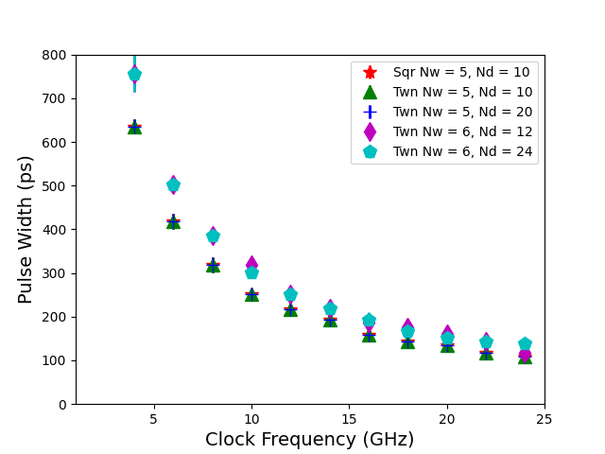
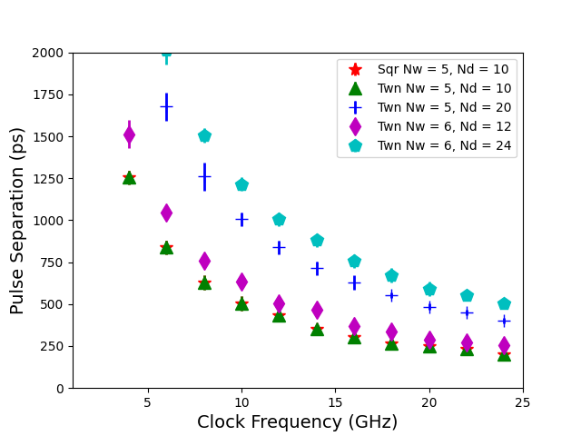
Twin Pulse Implementation
T_{w}
T_{w}
T_{d}
Measured Pulse Width
Measured Pulse Separation
T_{w} controlled by F_{clck} and N_{w}
T_{d} specified by choice of N_{d}

Slide 6
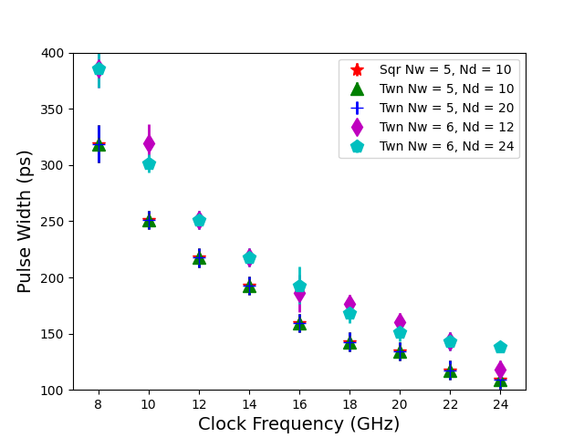
Twin Pulse Implementation
T_{w}
T_{w}
T_{d}
Measured Pulse Width
Measured Pulse Width (Zoomed In)
T_{w} controlled by F_{clck} and N_{w}
T_{w}^{min} ≥ 109.3 ± 8.3 (ps)

Slide 7
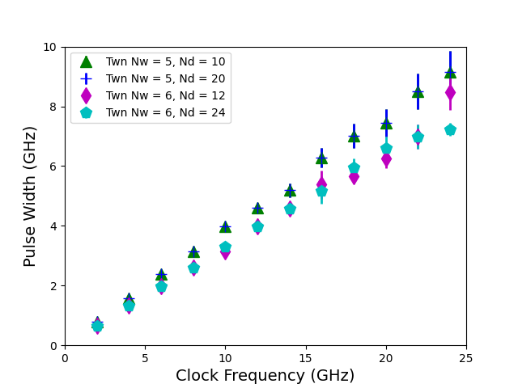
Twin Pulse Implementation
T_{w}
T_{w}
T_{d}
Linear relationship exists between T_{w}[GHz] and F_{clck}[GHz]
Measured Pulse Width
T_{w} controlled by F_{clck} and N_{w}
T_{w}[GHz] = (2 / N_{w}) F_{clck} [GHz]
T_{w}[ps] = 1000/T_{w}[GHz]

Slide 8
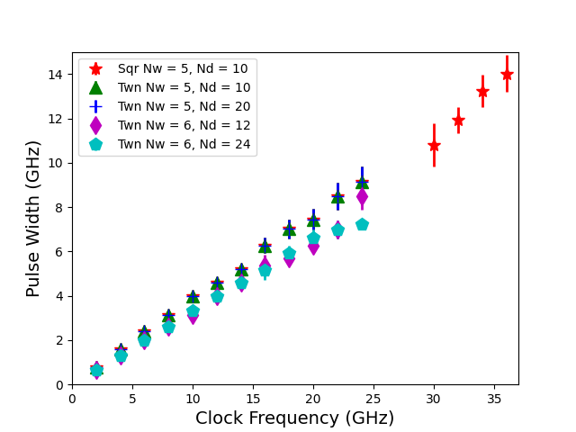
Twin Pulse Implementation
T_{w}
T_{w}
T_{d}
Linear relationship exists between T_{w}[GHz] and F_{clck}[GHz]
Measured Pulse Width
T_{w} controlled by F_{clck} and N_{w}
T_{w}[GHz] = (2 / N_{w}) F_{clck} [GHz]
T_{w}[ps] = 1000/T_{w}[GHz]

Slide 9
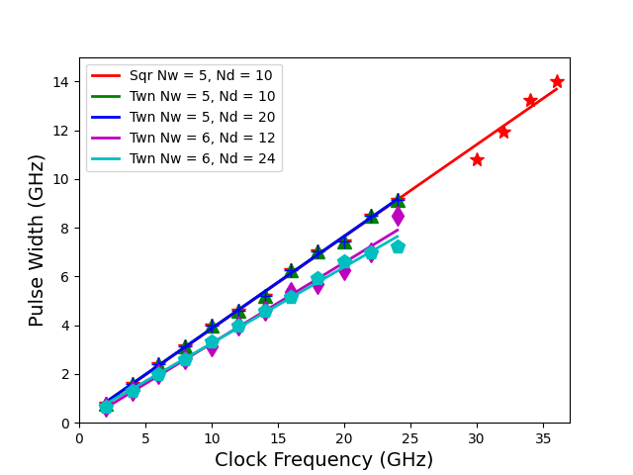
Twin Pulse Implementation
T_{w}
T_{w}
T_{d}
Linear relationship exists between T_{w}[GHz] and F_{clck}[GHz]
Measured Pulse Width
T_{w} controlled by F_{clck} and N_{w}
T_{w}[GHz] = (2 / N_{w}) F_{clck} [GHz]
T_{w}[ps] = 1000/T_{w}[GHz]

Slide 10
Square Pulse Implementation
I implemented a square wave pulse output to examine the instability observed between 25 (GHz) and 29 (GHz)
The instability persisted in the same frequency range
I was able to show that it is possible to obtain pulses with T_{w} < 100 (ps)
Measurements show that square wave pulse widths are equal to the twin pulse widths, which is what you’d expect
T_{w}
T_{w}
T_{w}
T_{w}
T_{d}
T_{d}
T_{d}

Slide 11
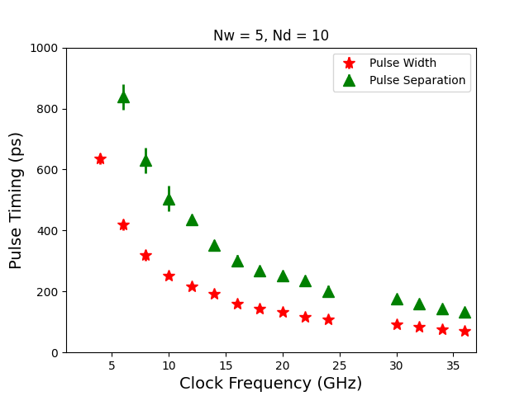
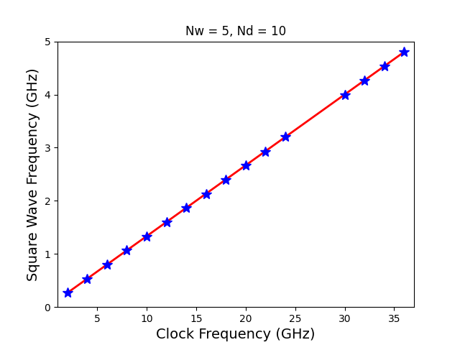
Square Pulse Implementation
T_{w}
T_{w}
T_{w}
T_{w}
T_{d}
T_{d}
T_{d}
Measured Sq Wave Pulse Times
Relationship between Sq Wave Freq and Clock Input
T_{w}^{min} ≥ 71.3 ± 4.2 (ps)
F_{out} = 0.133 F_{clck}

Slide 12
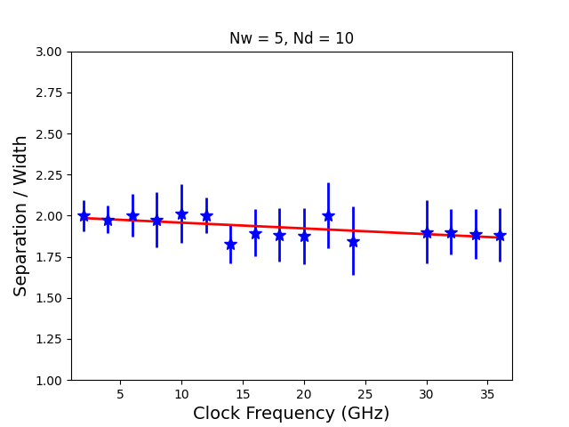
Square Pulse Implementation
T_{w}
T_{w}
T_{w}
T_{w}
T_{d}
T_{d}
T_{d}
Measured Sq Wave Pulse Times
Data showing that T_{d} = 2 T_{w} as required
T_{w}^{min} ≥ 71.3 ± 4.2 (ps)
T_{d} / T_{w} = 1.992 – 0.004 F_{clck}

Slide 13
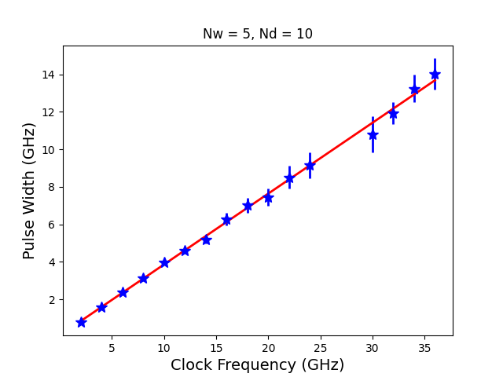
Square Pulse Implementation
T_{w}
T_{w}
T_{w}
T_{w}
T_{d}
T_{d}
T_{d}
Linear relationship exists between T_{w}[GHz] and F_{clck}[GHz]
Measured Sq Wave Pulse Times
T_{w}[GHz] = (2/N_{w}) F_{clck} [GHz]
T_{w}[ps] = 1000/T_{w}[GHz]
T_{w}^{min} ≥ 71.3 ± 4.2 (ps)

Slide 14
Conclusions
Using Micram DAC4 AWG it’s possible to obtain the desired twin-pulse output
It’s possible to control the pulse width and the pulse separation
Pulse width is controlled by the input clock
Output is stable for all frequencies outside the range 25 (GHz) to 29 (GHz)
Pulse widths down to 110 (ps) and less than 100 (ps) possible.
Timing measurements are limited by the resolution of the real-time scope ≈ 10 (ps)

