Slide 1


ESA Operation Test
Dr. Robert Sheehan

Slide 2
ESA Operation Test
The Experiment
Combine two laser signals of known wavelength
I used single frequency DFB laser and Tunable Laser
Measure the beat frequency of the combined signal
I used HS-PD and Rohde-Schwarz ESA
DFB
HSPD
ESA
2*2
TLS
OSA

Slide 3
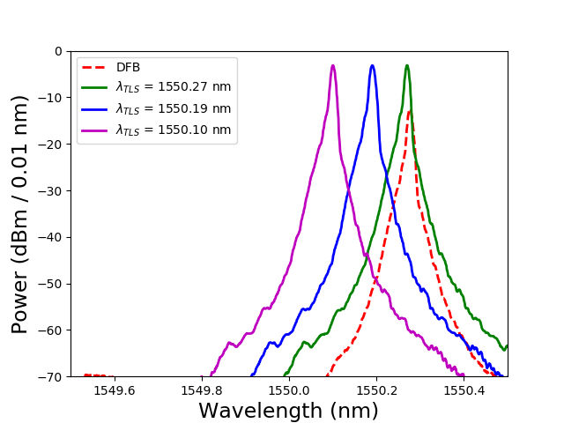
ESA Operation Test: Input Signals
Measurement of individual optical spectra

Slide 4
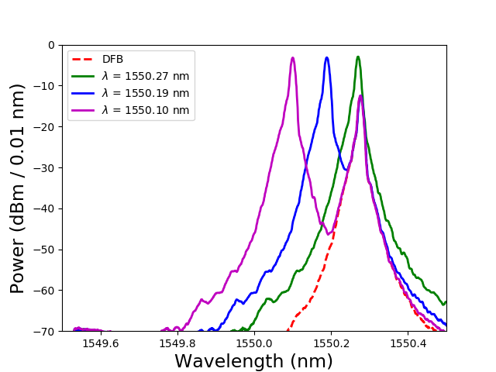
ESA Operation Test: Input Signals
Measurement of coupled optical spectra

Slide 5
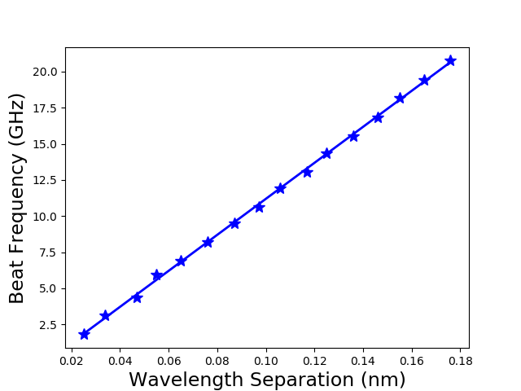
ESA Operation Test: Measured Beat Frequencies
Measurement of beat frequency versus wavelength separation Slope of linear fit matches theoretical prediction to within 0.24%
Δν = 124.57 Δλ – 0.0062 R² = 0.9995
Δλ / λ = Δν / ν => Δν / Δλ = c / λ²
Sub for c and λ to get Δν / Δλ = 300 um THz / (1.55 um)² = 124.87 GHz / nm

Slide 6
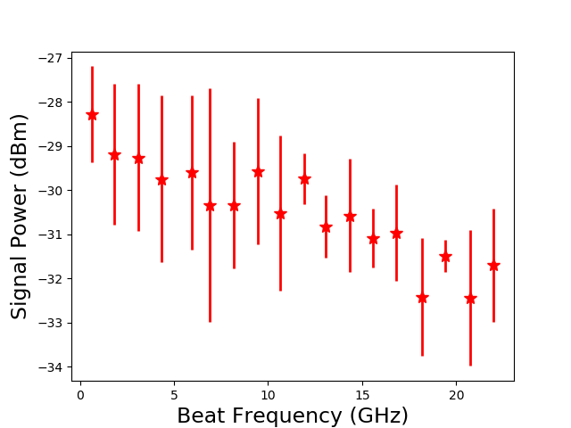
ESA Operation Test: DC Block Freq. Resp.
Can use the measured signal power to estimate the frequency response of the DC block attached to ESA input.
Not sure how accurate this is, but it does give a guide. Signal power varies quite a lot. Each data point is the result of 120 sweeps in 60 second interval.

