Slide 1
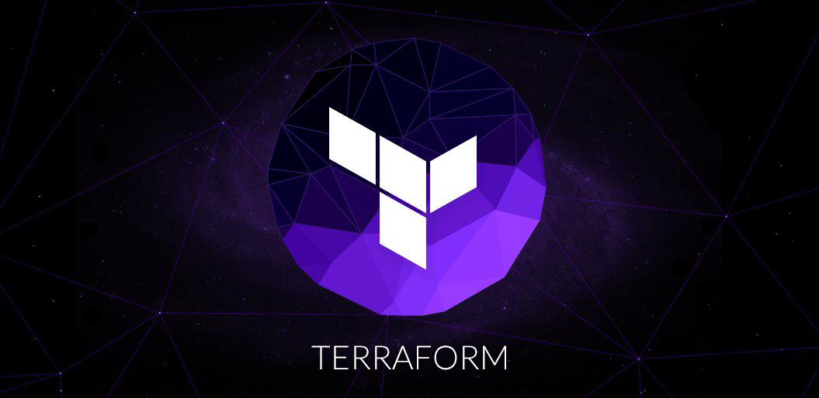
Lets get started

Slide 2

What are we going to see in this session?
What is IAAS & IAC ?
Introduction to Terraform
Why Terraform?
Terraform Vs other tools
Common use cases of Terraform
How Terraform works?
Architecture of Terraform
Terraform Core & Plugins
Infrastructure Prerequisite
Open AWS account
Create IAM admin user
Account final setup
Terraform Installation

Slide 3
What is IAAS & IAC ?
IAAS
IAAS is Infrastructure as service.
Where you can get Infrastructure on-demand. These type of services are provided by [AWS, GCP, Azure & Digital Ocean]
IAC
IAC is Infrastructure as code.
Through code you can pass set of instructions which is needed to provision and configure your infrastructure.
Terraform
Using Terraform you can write your own code to setup your infrastructure.
Hence basically its fit into IAC.

Slide 4
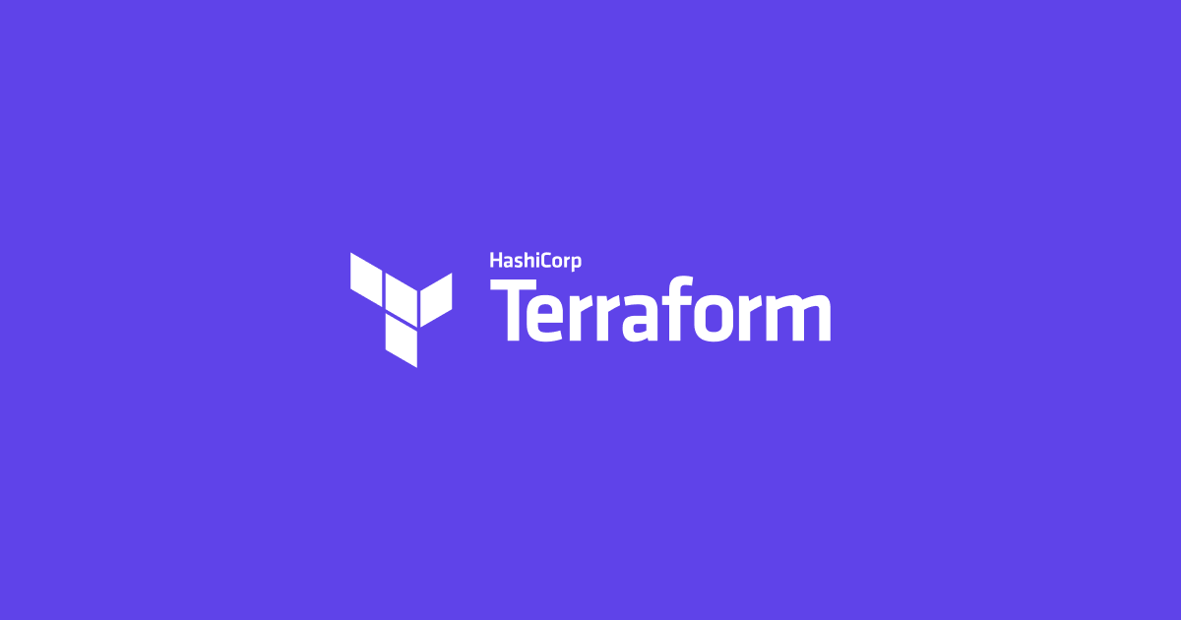
Introduction to Terraform
Terraform is an open-source Infrastructure as a code software tool developed by Hashicorp.
It helps users to define and provision datacentre infrastructure using language known as Hashicorp Configuration Language (HCL)

Slide 5
Why Terraform ?
Automation
Helps you to automate your infrastructure rather then doing things manually.
Managing State
Helps to keep your infrastructure in certain state.
Auditable
By seeing the code, you can understand what is your infrastructure made of.
Also you can keep your infrastructure change history in version control system like Git.
Flexible
Easy to manage multiple cloud providers such as [AWS, AZURE, GCP, Digital Ocean] and private infrastructure such as [VMware]
Easy to use
Easy to install and use.
Codes written are human readable.
Open source
Free to deploy and use.

Slide 6

Terraform Vs Other orchestration tools
Chef, Puppet & Ansible | Cloud Formation, Heat | Python Boto | Custom solutions
Configuration management tools are used to install and manage software on the machine that already exist | Cloud formation & heat are native solutions provided by there own cloud providers which helps to code the infrastructure into a configuration file. | Libraries like Boto are used to provide native access to cloud providers and services by using their API’s. | Many organizations starts to setup their own infrastructure solutions either through simple scripts or web-based interfaces.
Terraform is predominantly used to automate the infrastructure itself. | Terraform does the same, you can code the infrastructure setup into configuration file and implement. | Terraform is very flexible and uses plugin-based model to support providers. | Difficulty here is when infrastructure grows it might become tedious to mange your custom solutions.
Terraform is not an Configuration management tool, and it allows and existing tools to focus on there strengths. | Major difference here is Terraform is cloud-agnostic. It can work with multiple public & private providers. | Major difference here is libraries might give only low-level programmatic access through APIs but Terraform gives high-level access. | Terraform is designed to tackle these kind of challenges. It provides simple solution to mange your Infrastructure.

Slide 7
Common use cases of Terraform
Multi-Tier Applications:
The very common patter is 2-tire architecture [Pool of Web servers along with DB Servers] Additional tires may get added based on requirement. Terraform is very useful to handle in setting up this kind of Infrastructures.
Disposable Environment :
Its very easy to setup a test environment when and where required and its not going to be complex anymore.
Multi-Cloud Deployment :
Its often attractive to spread infrastructure across multiple clouds to increase FT. This is vey much possible through Terraforms.

Slide 8

How Terraform Works?
Terraform is built on a plugin-based architecture.
This helps developers to extend Terraform by writing new plugins or compiling modified versions of existing plugins.
Terraform is logically split into two main parts [Terraform Core & Terraform Plugins]
Terraform Core :
Terraform Core uses remote procedure calls (RPC) to communicate with Terraform Plugins.
Terraform Core is written in Go programming language. The code is open source and you can find it Github
Terraform Plugins :
Terraform Plugins are also written in Go programming language.
Plugins are used in configuration files.
Plugins consists of 2 things [Providers & Provisioners]

Slide 9
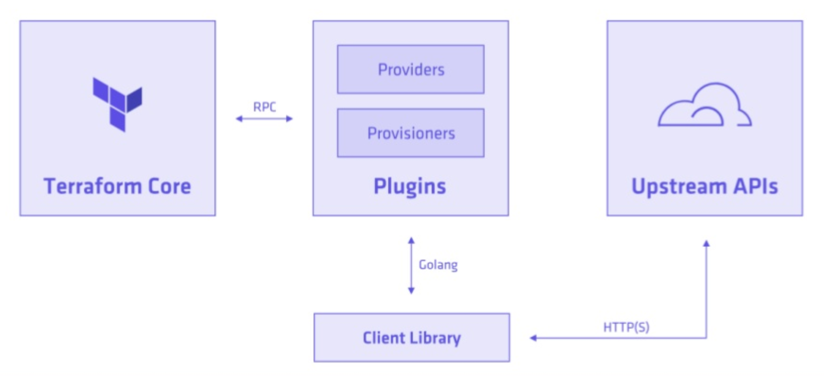
Architecture of Terraform

Slide 10
Infrastructure Prerequisite
We just need one AWS account for practise.
One Linux machines from where you can keep your codes and apply.

Slide 11
Open AWS account
As mentioned earlier we are going to see terraform with AWS in coming sessions. Hence to practice on your own you might need an AWS account.
Most of you all know, AWS provides certain service for free on first year of your subscription so anyone can open new account with AWS and start exploring it. AWS Link
With this free account you can start spinning up some basic configuration VMs [Which is called Free tire EC2 instances] in AWS.
Do note : Things might cost you when you are intend to use AWS free platform.
using any others services such as S3, RDS etc..
Spinning up high resource machines apart from free tire.

Slide 12
Create your IAM admin user
Navigate to IAM in AWS console.
Create an user called terraform [We are going to perform all automation activities through this IAM account from Terraform]
Select create individual IAM users
username = terraform
Enable programmatic access [Because we are going to access this user only through program not for login]
Create new group = terraform-administrator
Provide admin access to created group.
Add user terraform to group terraform-administrator.
Once user is created – You will get [Access key ID & Secret key]
You can also download the keys as CSV file.

Slide 13
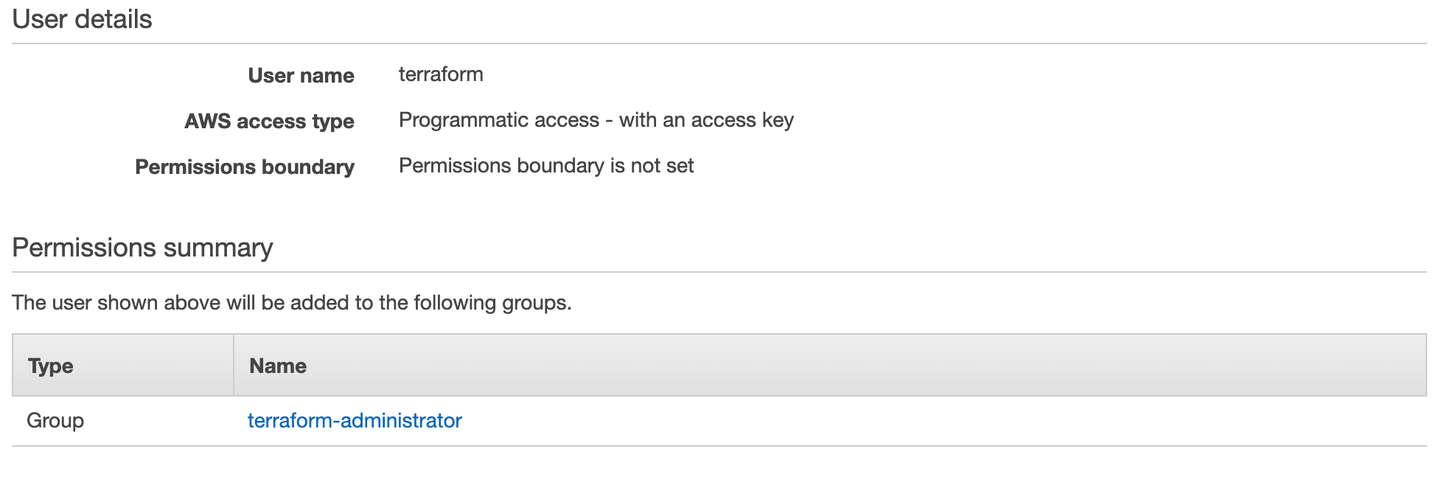
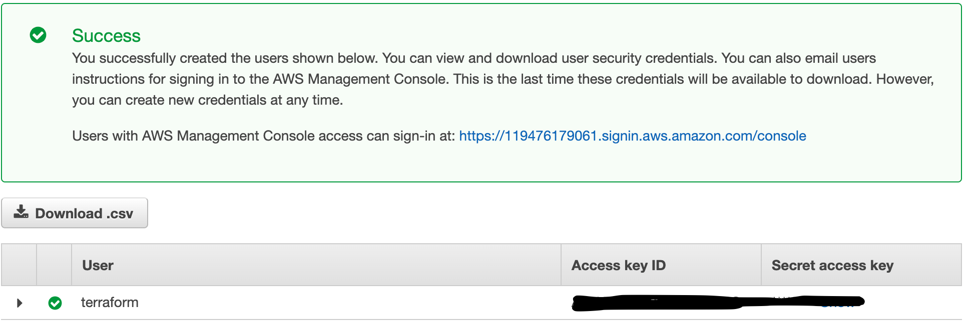
Account final setup
User & Group creation :
Secret access Keys
Excel file :

Slide 14
Terraform Installation
Find installation steps in Readme file

Slide 15
End of this topic !
Any questions?

