Slide 1
Secure Data Hiding in Image Using Steganography
CAPSTONE PROJECT
Presented By: Vinit Kumar Shukla ( PG Scholar)
Student Name : Vinit Kumar Shukla
College Name : SJC INSTITUTE OF TECHNOLOGY, Chickballapur- 562101, Karnataka, Department: Computer Science and Engineering

Slide 2
OUTLINE
Problem Statement
Technology used
Wow factor
End users
Result
Conclusion
Git-hub Link
Future scope

Slide 3
Problem Statement
Sensitive information shared over open communication channels is vulnerable to interception and unauthorized access.
The project combines encryption and decryption with image steganography to create a secure and concealed communication channel.
Encrypted data is embedded within digital images, ensuring confidentiality and minimizing detectability.
A reliable decryption process guarantees secure retrieval of hidden information.
This approach enhances overall cybersecurity by reducing the risk of detection and unauthorized access.

Slide 4
Technology used
Programming Language: Python: Core programming language for both GUI and CUI implementations. IDE: IDLE (Integrated Development and Learning Environment) Version Control: GitHub Libraries:
Tkinter: GUI for encoding and decoding messages into images.
OpenCV (cv2): Image processing (loading and saving images).
NumPy: Handling pixel data efficiently.
Pillow (PIL): Image format conversion and manipulation.
Stenography: Securing the hidden message.

Slide 5
Technology used Continue…
The project includes two versions:
GUI Version:
Embed and extract secret messages in images via a graphical interface.
Passcode-protected decryption.
CUI Version:
Console-based encryption and decryption.
Ensures image integrity and checks capacity before encoding.

Slide 6
Wow factors
Passcode-Protected Message Retrieval:
Unlike basic steganography, your project adds a security layer with passcode authentication, ensuring only authorized users can extract hidden messages.
GUI and CUI Versions:
Offers both a user-friendly GUI (Tkinter) and a command-line interface, making the tool versatile and accessible to different types of users.
Capacity Checking Mechanism:
Before encoding, the system checks the image’s capacity to hold the message, preventing file corruption and ensuring reliable steganography.

Slide 7
Wow factors Continue…
Image Integrity Preservation:
Uses OpenCV and Pillow to convert images without losing quality, ensuring that the hidden message doesn’t affect the visible properties of the image.
Encryption:
Integrating the cryptography library allows for an extra layer of encryption before hiding the message, adding double security — hidden and encrypted.
Custom Error Handling & Notifications:
Clear and actionable error messages for file format mismatches, insufficient space, or incorrect passcodes, enhancing the user experience.
Educational & Practical Impact:
As part of a cyber security internship, the project not only demonstrates technical skill but also addresses real-world needs for secure communication.

Slide 8
End users
Individuals
Businesses/Enterprises
Government Agencies
Defence Research and Development Organisation (DRDO)
National Technical Research Organisation (NTRO)
Centre for Artificial Intelligence and Robotics (CAIR)
Indian Army Cyber Group
Research and Analysis Wing (RAW)
Cybersecurity Professionals
Educational Institutions

Slide 9
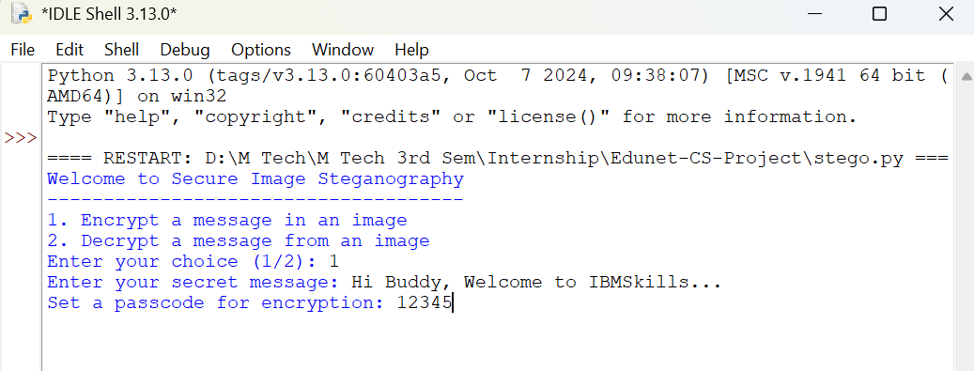
Results (cUI Based)
Output_CUI_Based_1

Slide 10
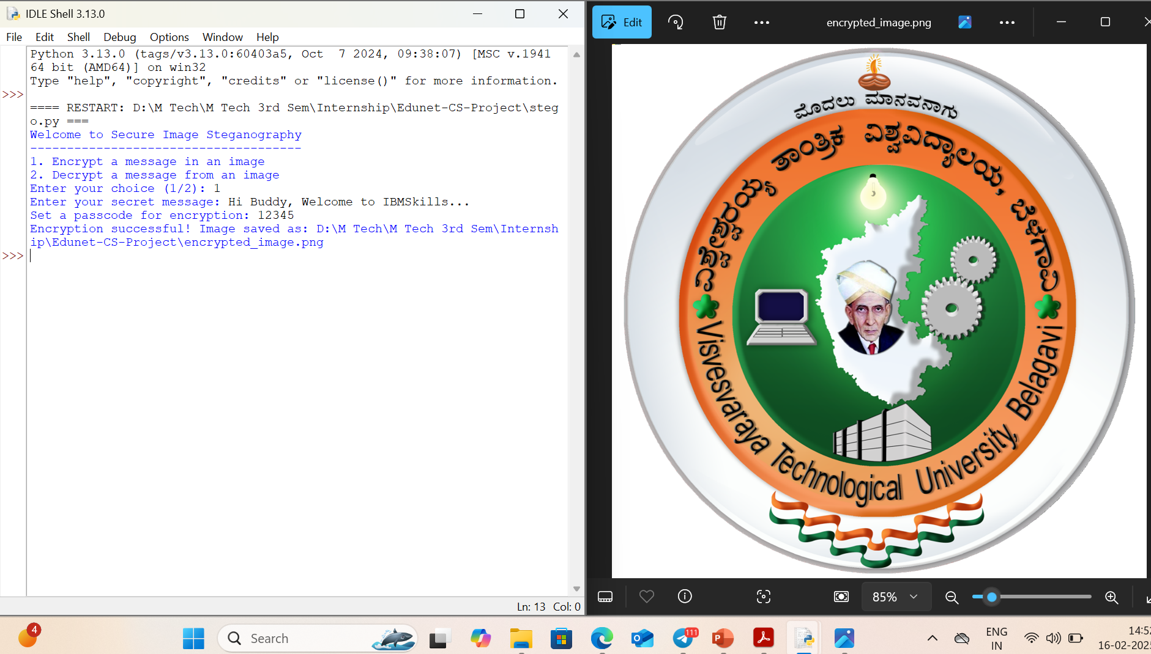
Output_CUI_Based_2

Slide 11
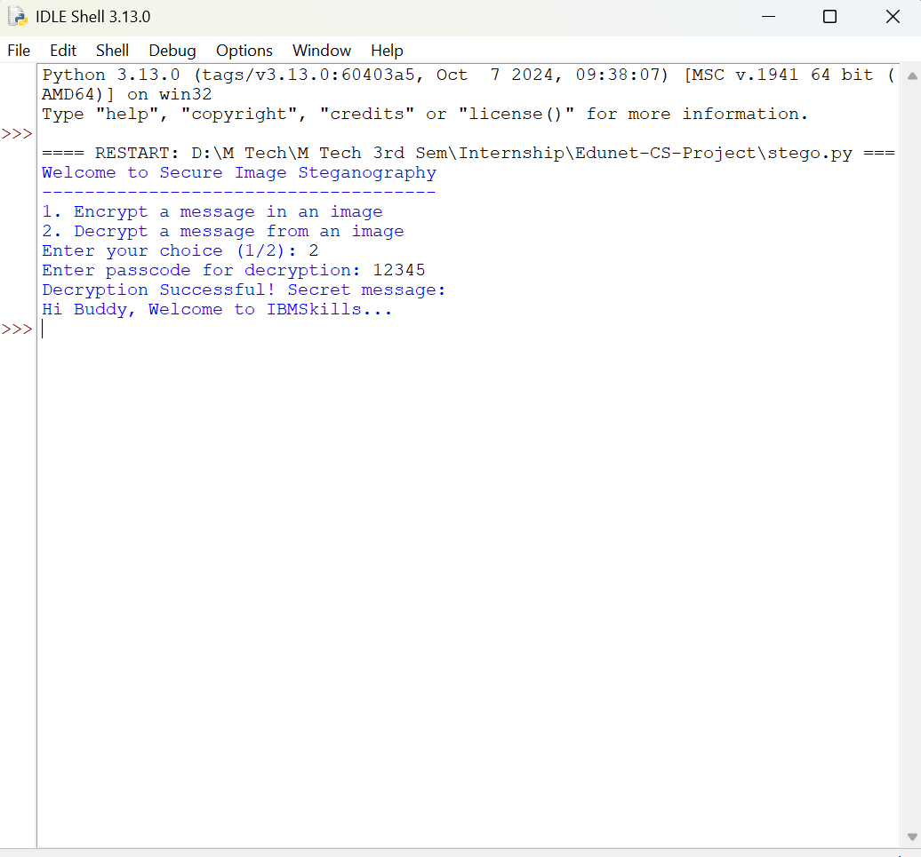
Output_CUI_Based_3

Slide 12
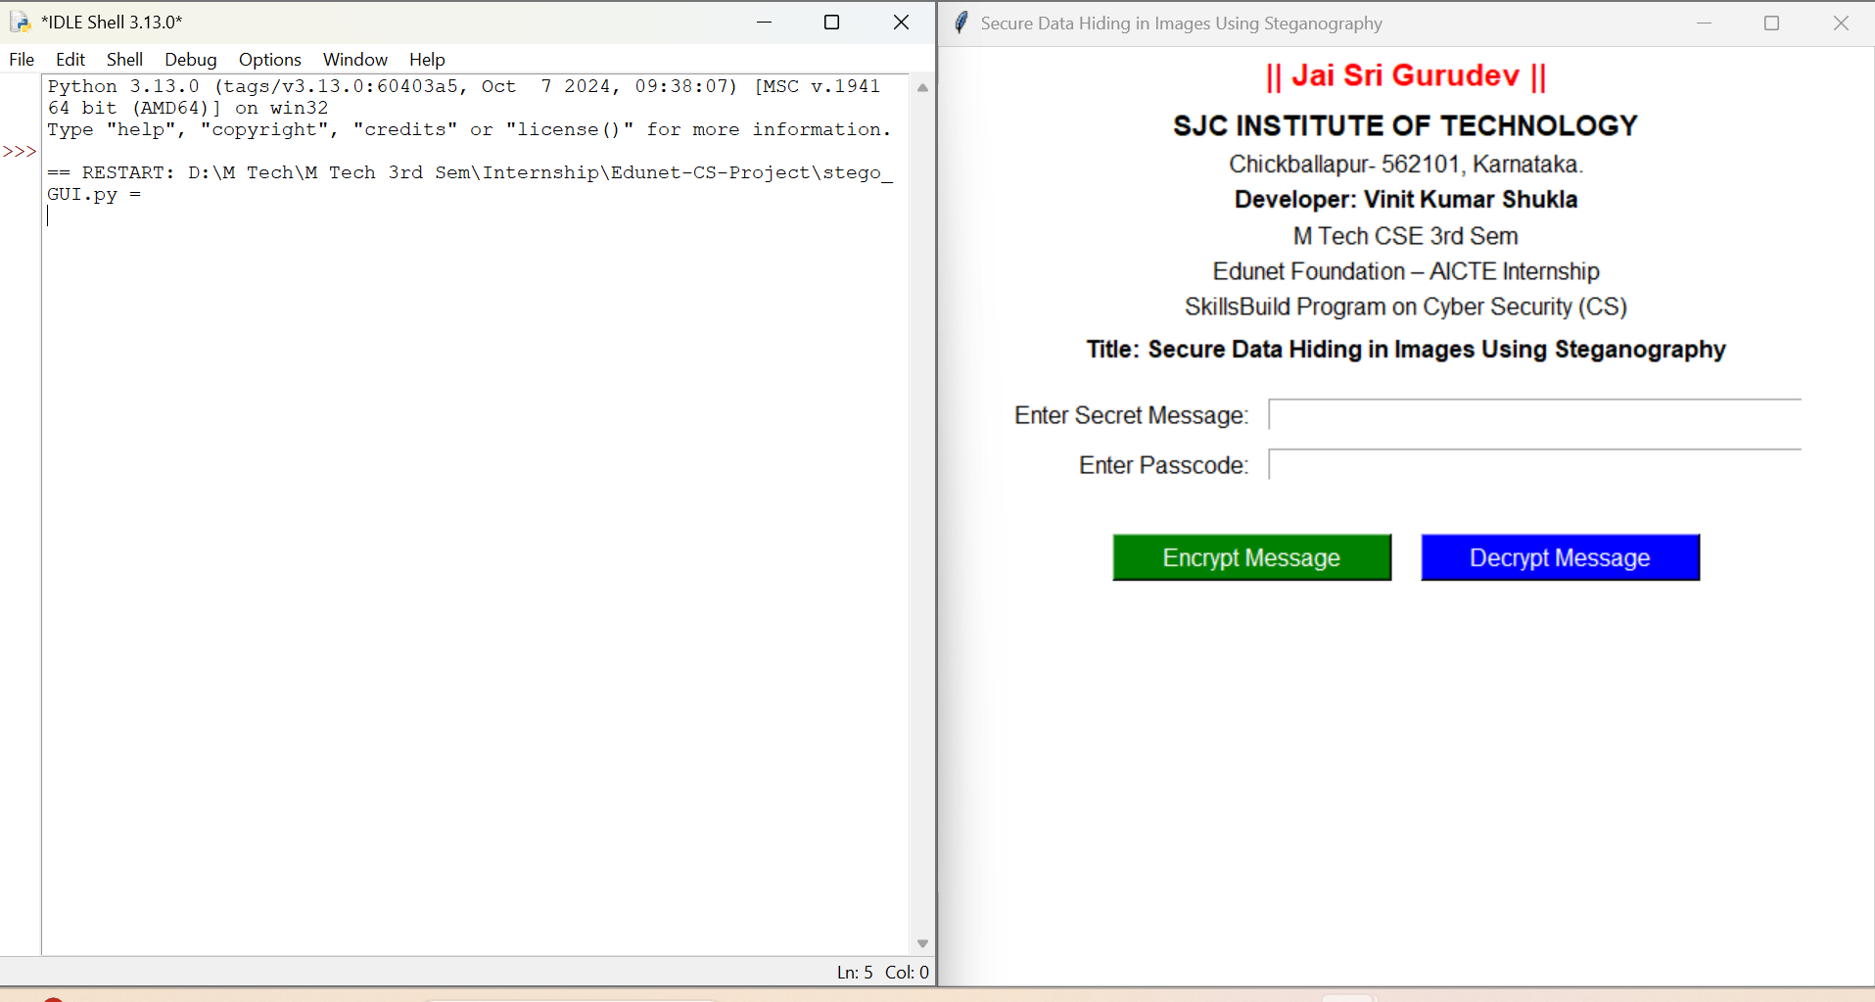
Output_GUI_Based_1
RESULT (GUI Based)

Slide 13
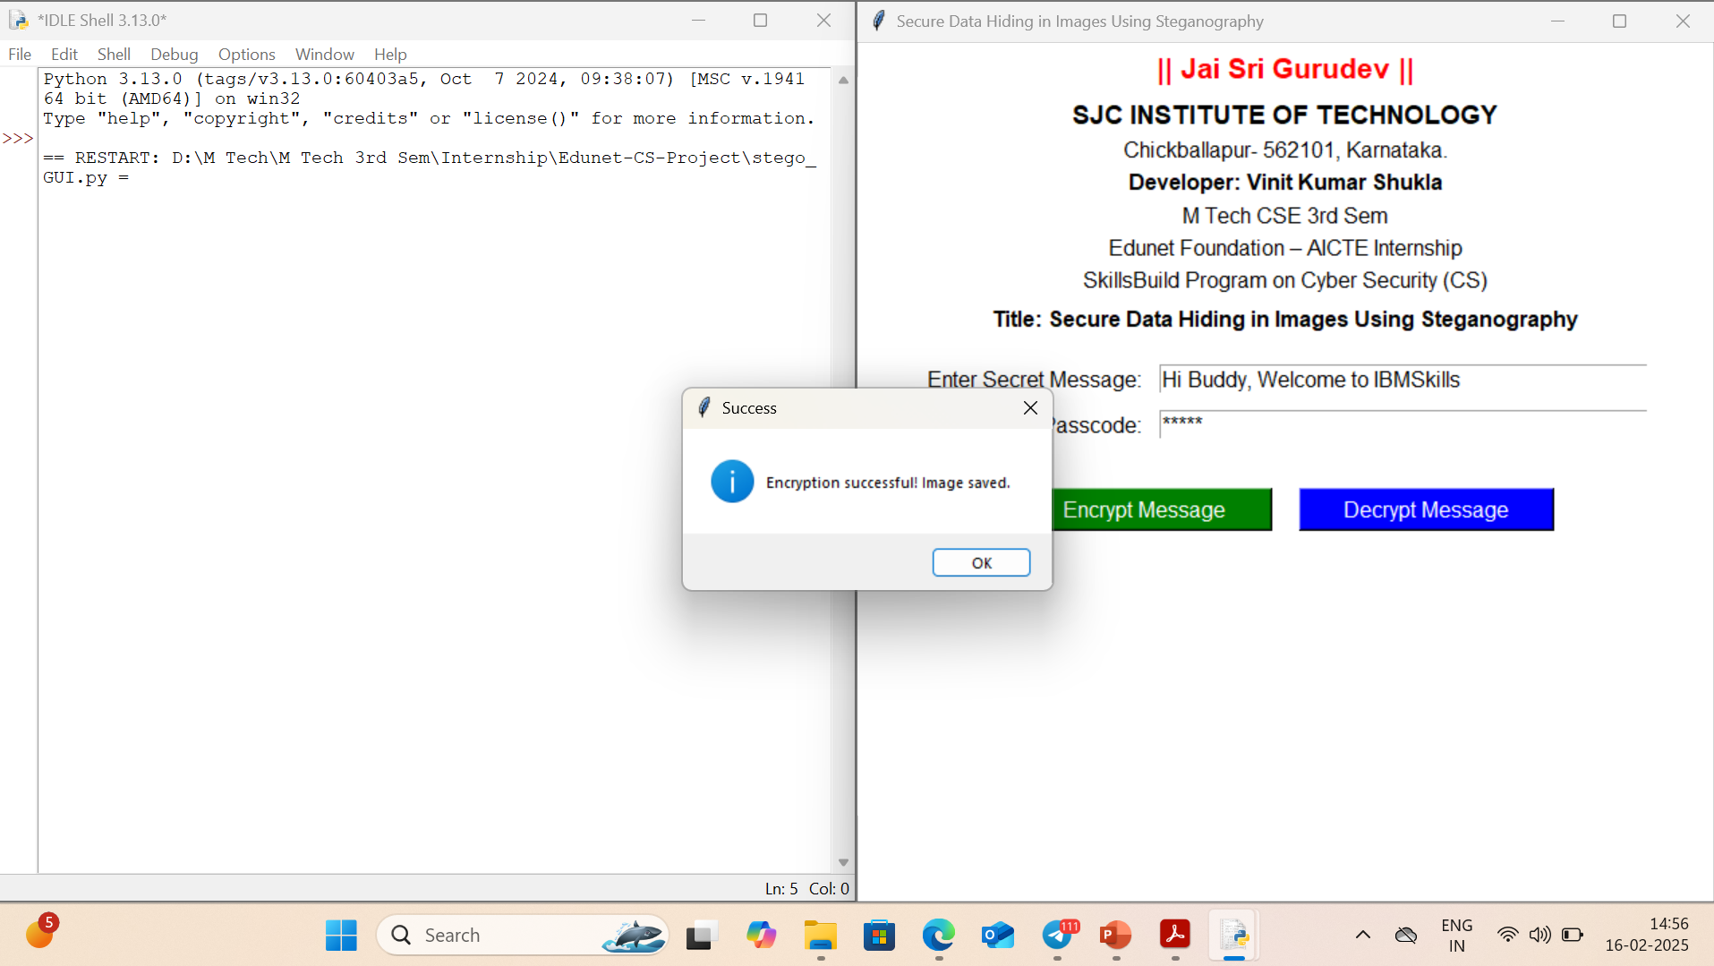
Output_CUI_Based_2

Slide 14
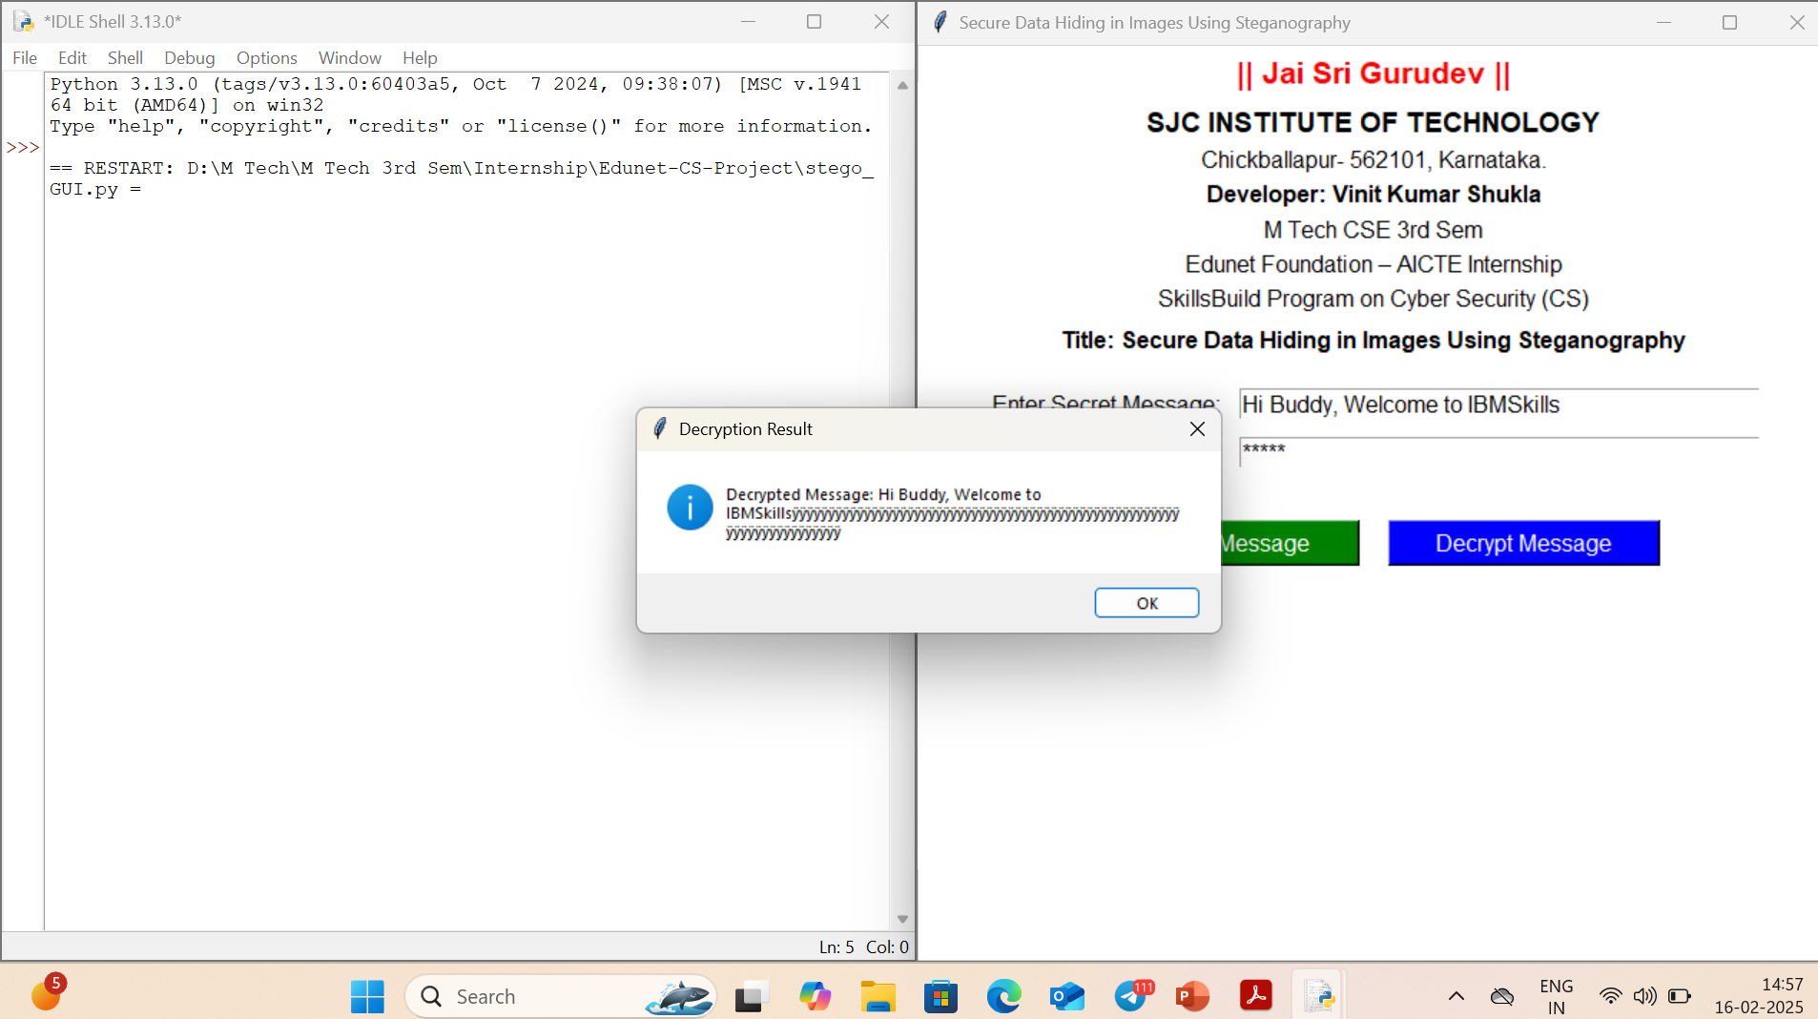
Output_CUI_Based_3

Slide 15
Conclusion
The project "Secure Data Hiding in Images Using Steganography" effectively addresses the vulnerability of sensitive information shared over open communication channels. By combining encryption and decryption with image steganography, it creates a secure and concealed communication channel. Encrypted data is seamlessly embedded within digital images, ensuring confidentiality and minimizing detectability. A reliable decryption process guarantees the safe retrieval of hidden information, thereby reducing the risk of interception and unauthorized access. This innovative approach significantly enhances overall cybersecurity, offering a practical and efficient solution for secure information exchange.

Slide 16
GitHub Link
https://github.com/rnvinit/Edunet_IBMSkills_Internship_Project.git

Slide 17
Future scope
The future scope of this project includes integrating advanced encryption techniques like quantum-safe encryption for enhanced security, along with AI-powered steganalysis resistance to avoid detection. It can be extended to support cross-platform steganography, embedding data in audio, video, and documents. Cloud-based secure communication and real-time steganographic messaging apps could enable instant and covert exchanges. Additionally, blockchain integration would ensure authenticity and traceability, while forensic and defense applications would strengthen covert communication channels for sensitive information.

Slide 18
THANK YOU

