Slide 1
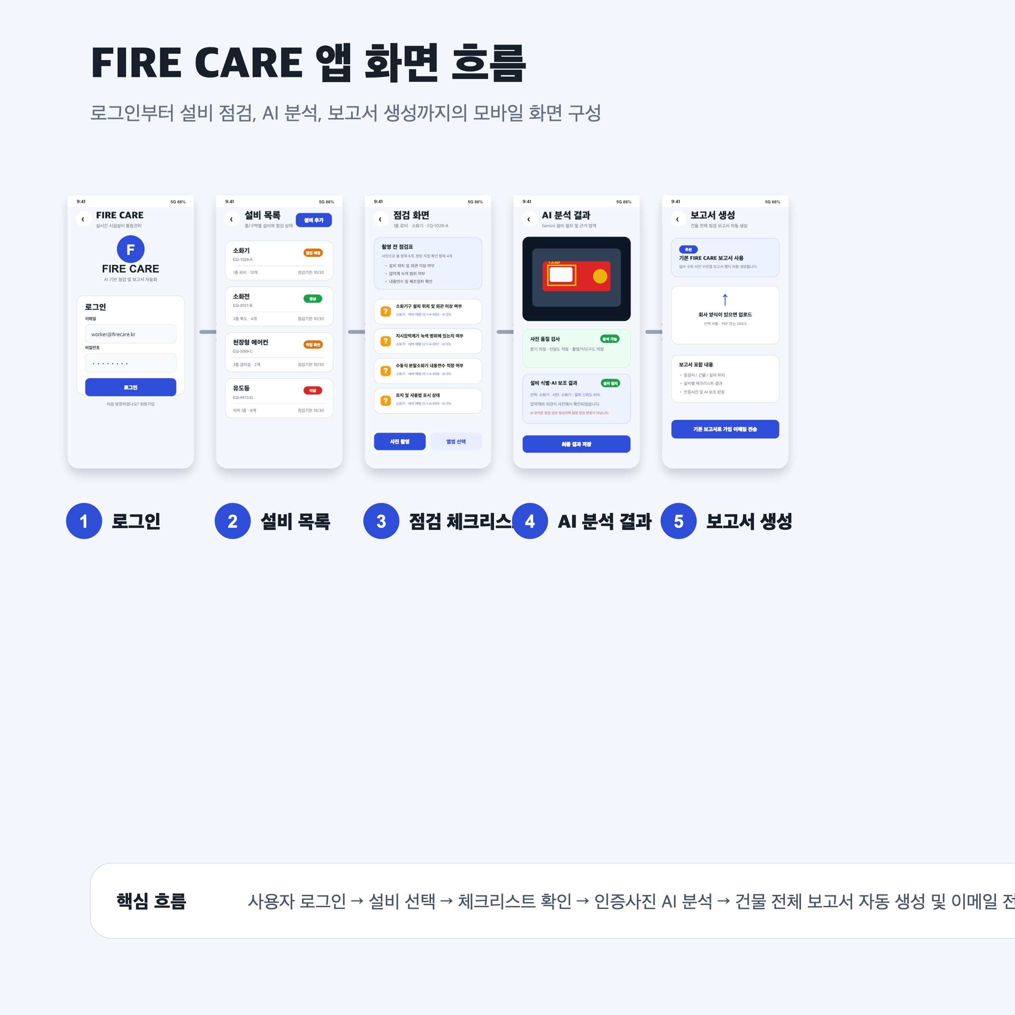
Notes:
Source: https://github.com/rnwjdgus03/fire-care/blob/main/ppt-assets/fire-care-app-flow-onepage.svg.png

