Slide 1
V-LEARNING
Flores, renz jayvie
Culbengan, josh Adrian
Ilustre, Anthony david
Gacusan, juel rei

Slide 2

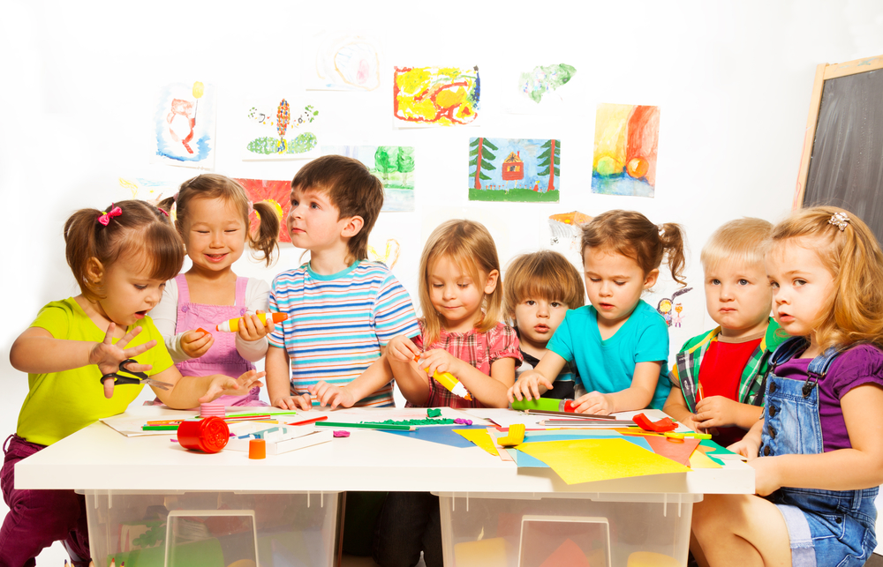
TARGET USERS:
The target of the virtual reality project would be preschool kids with ages 3-5 years old.

Slide 3
SCOPE OF THE PROJECT:
The project will serve as an entertainment and educational medium for preschool age kids.
The project aims to enhance real-life experience.
The project will allow kids to foster their imagination.
It will be consisted of the following basic concepts:
Shapes
Letters
Colors
Numbers
Preschool Science Activities

Slide 4
EXISTING PROJECT
Virtual & Augmented Reality in Pre-school Education (CLASS VR)
The focus of the project is about learning through experience. Young students benefit from immersive 360 environments. VR and AR is used to enhance and complement the real-world exploration and play that builds a solid foundation in the pre-school years.

Slide 5
USABILITY KIT: (What to use for design)
Pencil and Paper
Ideas will be sketched in papers. It’s fast, cheap, and helps express ideas that may take hours in software. This is especially important because moving from sketches to hi-fidelity can cost much more in 3D than in 2D.
Software
The software that will be used to design will be Unity or Unreal Engine. Cinema 4D and Maya are also widely used, but mostly for complex animations and renderings.

Slide 6
THANK YOU! WE ARE NOW READY OFR YOUR COMMENTS , QUESTIONS AND SUGGESTIONS

