Slide 1
CLASS SCHEDULE
DESIGN TEAM
GROUP 5 Bryan Sanchez Devak Mehta Renzo Salazar Cueva

Slide 2
RENZO
TABLES

Slide 3
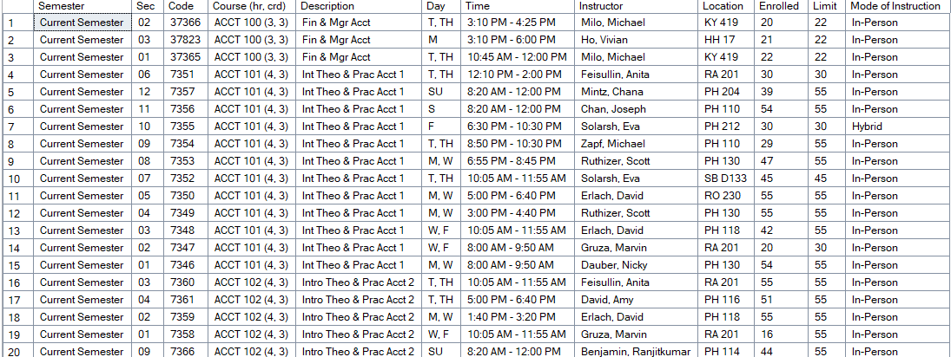
QueensClassSchedule

Slide 4
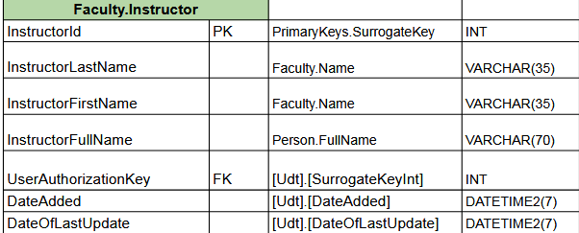
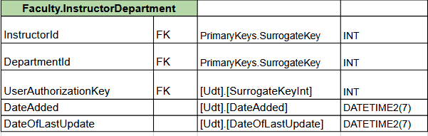
Faculty
Instructor
Original database just had the Instructor as ‘LastName, FirstName’ format.
Split first name and last name, and a computed field for Full Name
InstructorDepartment
Since an instructor could appear in many multiple departments, we created a bridge table.

Slide 5
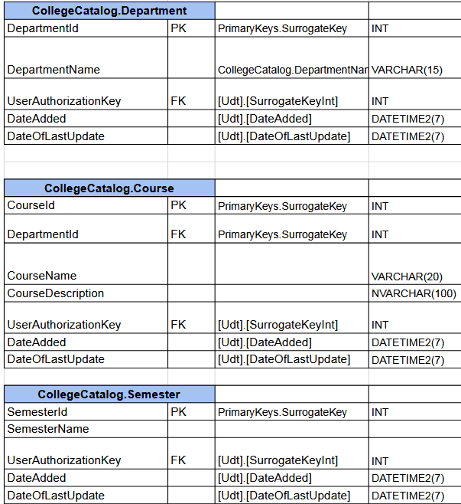
Department
Department
Department codes were shown as “ACCT 100 (3,3)” in the original table.
Departments could just be retrieved from the first values before the space.
Course
The actual course name is just the “ACCT 100” part.
Description was the course description, so renamed and added to the Course table.
Since each course belongs to one department, it became a foreign key.
Semester
Semester needs to be separated as the same course could be taught in different semesters.

Slide 6
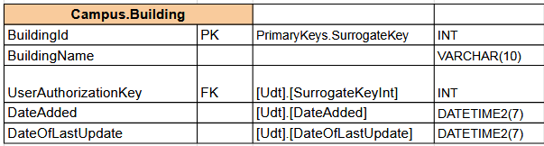
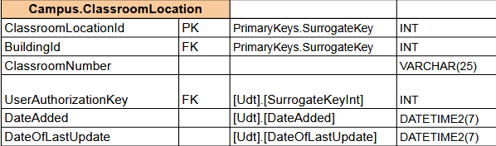
Campus
Building
Original field was just a field called Location and showed “KY 419”.
The first letters represent the building, so that is what gets stored in the BuildingName field.
ClassroomLocation
The ClassroomNumber is the number field of Location.
Used BuildingId to link each room number to the actual building.

Slide 7
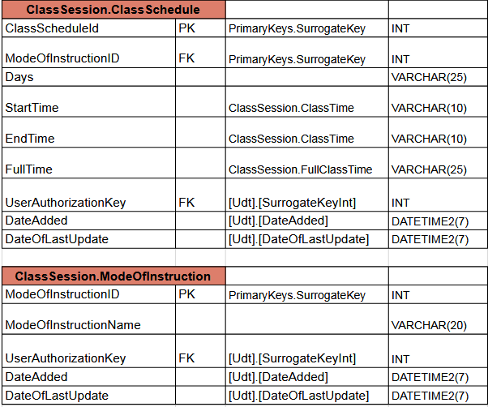
Class
ClassSchedule
Same courses have different schedules, and modes so we created into its own table.
Day and Time were used from the original table.
Time was separated into StartTime and EndTime, while FullTime is just a computed field.
ModeOfInstruction
Looking at the field “Mode of Instruction”, the same 4 values kept getting repeated so it was separated to its own table.

Slide 8
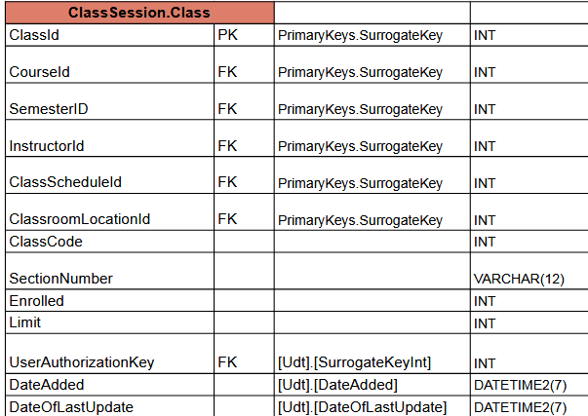
Class - Continued
Class
This is the table in the center that links all the other tables we created to see what an actual class looks like such as who is teaching it, what course is it, what time, where is it location, and what semester does this class appear in.
Looking at values in the original table, some were empty, along with their times, so we just decided to make them TBD as one might see when register for a class.
Enroll and Limit are class specific so they were added to this table.
SectionNumber separates the same course being taught in the same semester.

Slide 9
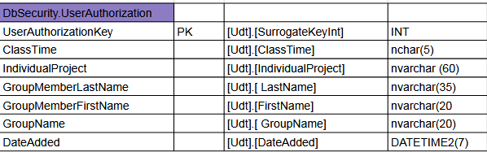
DbSecurity
This table is for auditing members of our group, and was required to be added.
Can be used for linking a student, when they are modifying or adding data in tables we made.

Slide 10
BRYAN
DIAGRAMS

Slide 11
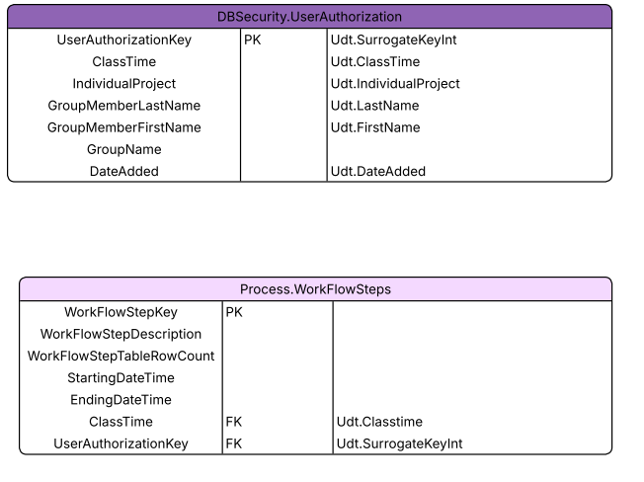
WorkSteps
The classes aren’t apart of the data but are used for recording the steps of users.
The user authorization is keeping track of each member and the general information
Workflow steps table is used to record the specific steps that are taken while building the new database

Slide 12
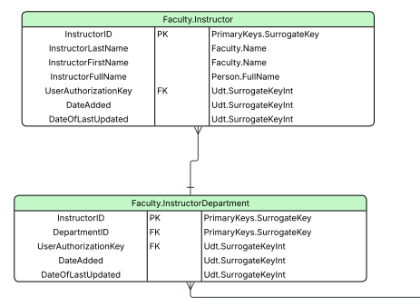
Faculty
Faculty is showing all the columns and which houses the instructor table and their department
The diagram would show the Schema it is under, which are the UDTs

Slide 13
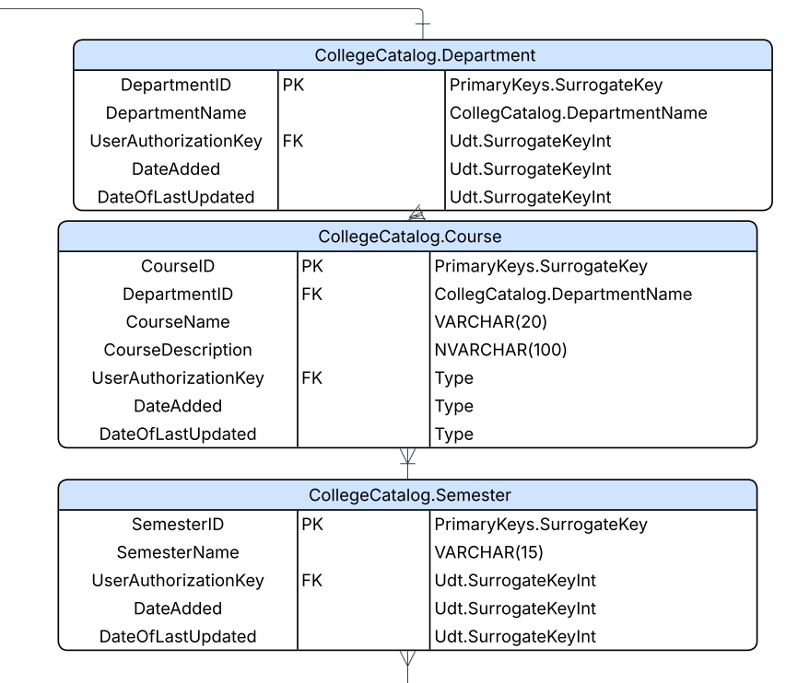
College Catalog

Slide 14
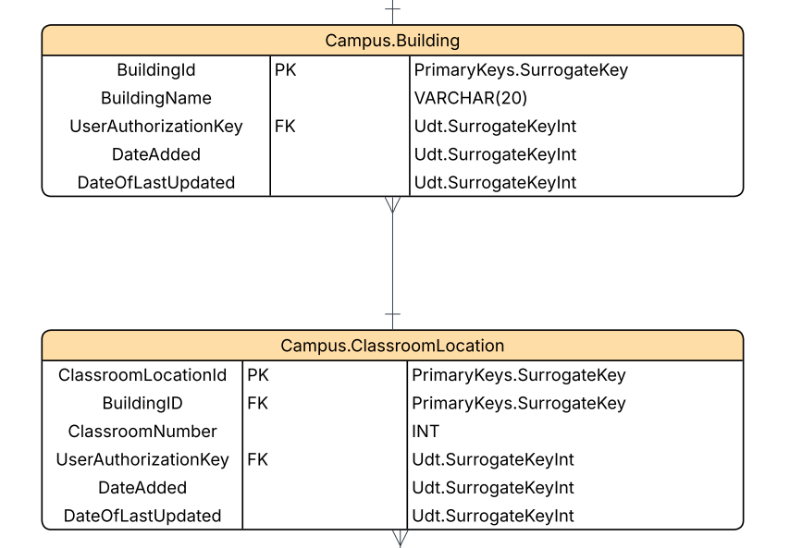
Campus

Slide 15
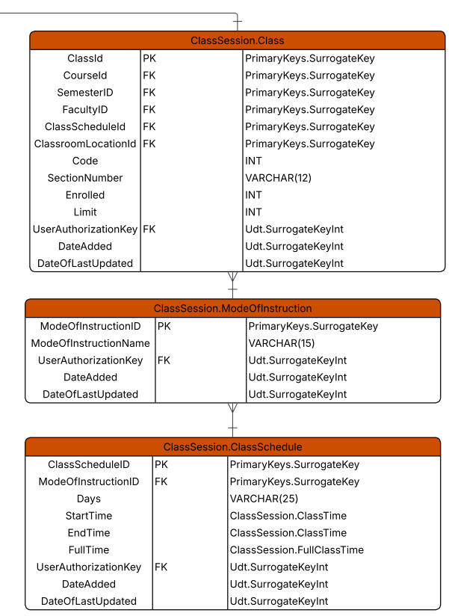
Class Session

Slide 16
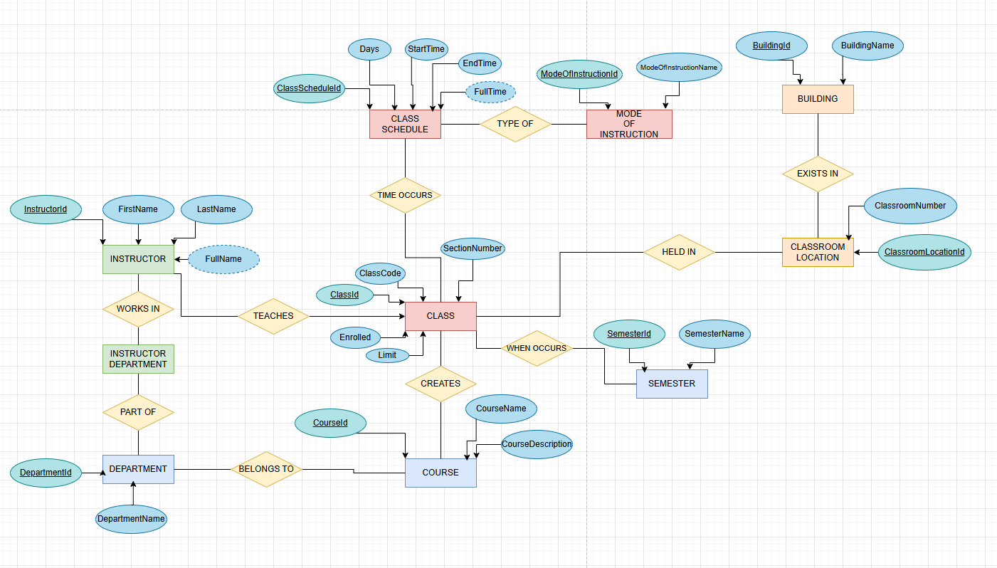
ERD

Slide 17
DEVAK
UDTs

Slide 18
PrimaryKeys.SurrogateKey
PrimaryKeys.Surrogate is the UDT created for any primary keys that are needed in the database
The usage for this is SurrogateKey which is shown in a snip of the table diagram. All of the primary keys will use this and will have the following constraints:
PK, NOT NULL
IDENTITY(1,1)
These constraints will ensure that the primary key cannot be null and that it can be updated on it’s own. Meaning that if we add another row of data, the primary key (if the previous was 12) will be 13 without explicitly saying it

Slide 19
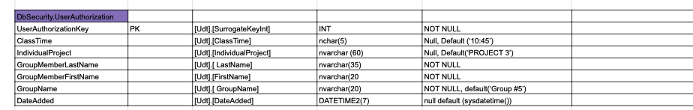
UserAuthorizationKey Udt.SurrogateKeyInt
SurrogateKeyInt is a UDT created to represent all surrogate keys used throughout the database.
This UDT is primarily used for primary keys and foreign keys, such as UserAuthorizationKey, to ensure a consistent integer-based identity strategy.
Using a shared surrogate key UDT allows relationships between tables to be enforced reliably while keeping business data independent from identifiers.
Constraints
Integer data type
NOT NULL when used as a foreign key
Defaults
No default value (must reference an existing key)

Slide 20
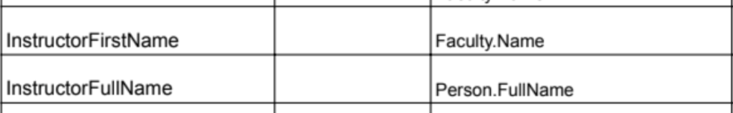
Faculty . Name and Person.FullName
Name and Person Full name are both UDTS to distinguish the data types involving names.
The reason for 2 different ones is one belongs to Faculty (Hence Faculty . Name), meaning that this will only reference the table and the data will always belong to an instructor or worker
Person.Full name is referring to a broad usage for any other person which we can say student, TA, etc.
Faculty . Name has constraints : - CONSTRAINTS - Letters only, starts with
Capital Letter (LIKE '[A-Z]%')

Slide 21
CollegeCatalog.DepartmentName
DepartmentName is a UDT created to standardize how department names are stored across the database.
This UDT is used in the CollegeCatalog.Department table to ensure consistency and prevent invalid or duplicate department naming formats.
By enforcing a single DepartmentName UDT, the database ensures that all references to departments (such as in Courses) follow the same naming rules and constraints, improving data integrity and readability.This also allows future validation rules to be applied centrally without modifying individual tables.
Constraints
Character string
Enforces standardized department naming

Slide 22
Udt.ClassTime
ClassTime is a UDT created to standardize time-related values used in scheduling and workflow tracking.
Constraints
Enforces valid time formatting
Restricts invalid scheduling values
Defaults
No default value
Used in Tables
Process.WorkFlowSteps
ClassSession.ClassSchedule
ClassSession.Class

Slide 23
Udt.inidividualProject
IndividualProject is a UDT used to identify project-related data tied to individual work.
Constraints
Enforces consistent project identifier formatting
Defaults
No default value
Used in Tables
DbSecurity.UserAuthorization

Slide 24
Udt.DateAdded and Udt.DateOfLastUpdated
DateAdded and DateOfLastUpdated are UDTs created to standardize timestamp tracking across all tables.
DateAdded records when a row is first inserted, while DateOfLastUpdated records the most recent modification.
These UDTs support auditing, debugging, and historical analysis by ensuring that all tables track changes in a consistent manner.
Constraints
Date/time data type
NOT NULL
Defaults
Defaults to current system date and time

Slide 25
Udt.FirstName, Udt.LastName, and Udt.GroupName
FirstName, LastName, and GroupName are UDTs created to standardize how individual and group identifiers are stored in the database.
Constraints
Alphabetic characters only for FirstName and LastName
Proper capitalization enforced for name fields
GroupName enforces consistent string formatting
Defaults
No default values — all fields must be explicitly provided
Used in Tables
DbSecurity.UserAuthorization
GroupMemberFirstName
GroupMemberLastName
GroupName

Slide 26
GROUP 5
NACE COMPETENCIES

Slide 27
NACE COMPETENCIES - RENZO
Critical Thinking - Looking over all the fields and data that was stored in the original database to identify what needed to be normalized. From there we could start creating the diagrams and tables that needed to be created.
Leadership - Trying to keep everyone informed and verifying that the documentation I made was clear enough to build on it.

Slide 28
NACE COMPETENCIES - Bryan
Teamwork : Demonstrated teamwork by coordinating responsibilities, aligning UDT definitions with teammates, and contributing to a cohesive final presentation.
Professionalism: Demonstrated professionalism by adhering strictly to project requirements, maintaining consistent naming conventions, and producing well-organized and standards-compliant database design documentation.

Slide 29
NACE COMPETENCIES - DEVAK
Critical Thinking: I applied critical thinking by identifying repeating data patterns across the schema and abstracting them into User-Defined Types. This required evaluating data integrity risks, deciding appropriate constraints and defaults, and ensuring consistent usage across multiple tables.
Technology:I demonstrated technology competency by implementing SQL Server User-Defined Types to enforce consistency, constraints, and defaults at the schema level. This approach improved data integrity and maintainability across the entire database.

