Slide 1
PRESTIGE CARS
IMPLEMENTATION TEAM
GROUP 5 Bryan Sanchez Devak Mehta Renzo Salazar Cueva

Slide 2
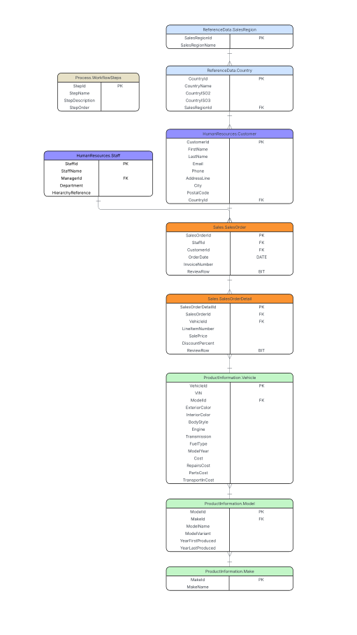

Slide 3
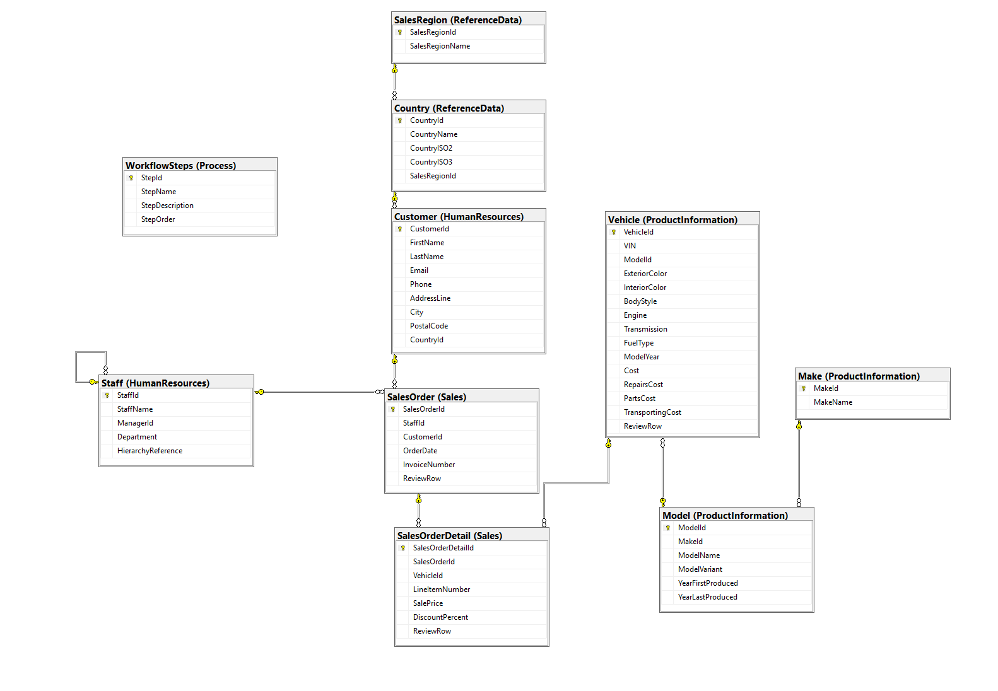

Slide 4
RENZO
HumanResources and Process

Slide 5
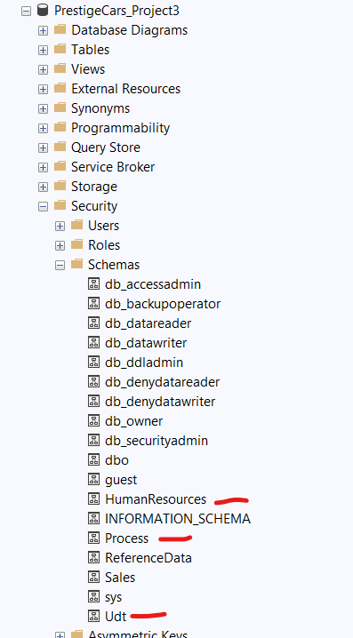
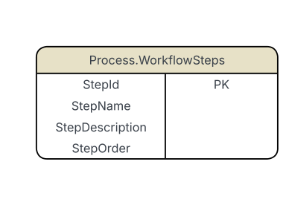
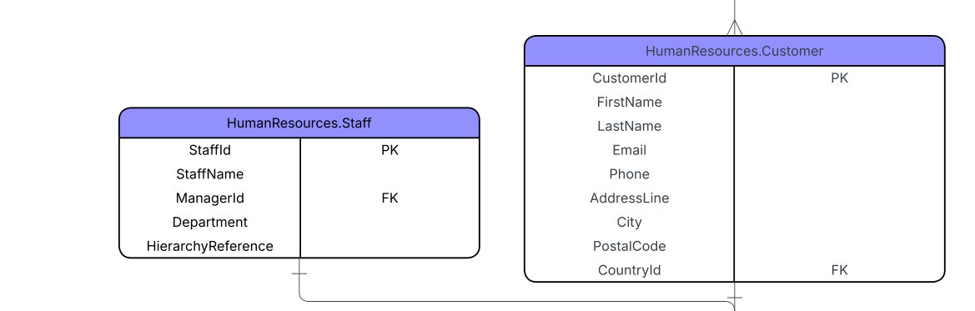
Schema
These are the schemas that I needed to create before I start creating my Udts, Tables and ITVFs
USE [PrestigeCars_Project3];
GO
CREATE SCHEMA Udt;
GO
CREATE SCHEMA HumanResources;
GO
CREATE SCHEMA Process;
GO

Slide 6
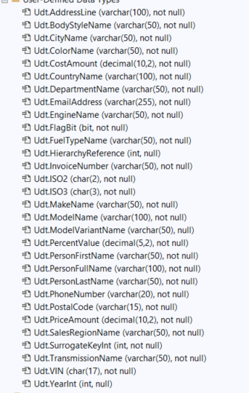
UDTs
CREATE TYPE Udt.SurrogateKeyInt
FROM INT NOT NULL;
CREATE TYPE Udt.PersonFirstName
FROM VARCHAR(50) NOT NULL;
CREATE TYPE Udt.PersonLastName
FROM VARCHAR(50) NOT NULL;
CREATE TYPE Udt.EmailAddress
FROM VARCHAR(255) NOT NULL;
CREATE TYPE Udt.PhoneNumber
FROM VARCHAR(20) NOT NULL;
CREATE TYPE Udt.AddressLine
FROM VARCHAR(100) NOT NULL;
CREATE TYPE Udt.CityName
FROM VARCHAR(50) NOT NULL;
CREATE TYPE Udt.PostalCode
FROM VARCHAR(15) NOT NULL;
CREATE TYPE Udt.PersonFullName
FROM VARCHAR(100) NOT NULL;
CREATE TYPE Udt.DepartmentName
FROM VARCHAR(50) NOT NULL;
CREATE TYPE Udt.HierarchyReference
FROM INT NULL;
UDTs that are used in the Tables under the HumanResources schema.
Reason for making UDTs is to ensure that the same data follows the same format and constraints/rules.

Slide 7

Tables
CREATE TABLE Process.WorkflowSteps(
StepId Udt.SurrogateKeyInt IDENTITY(1,1) PRIMARY KEY,
StepName VARCHAR(100) NOT NULL,
StepDescription VARCHAR(255) NULL,
StepOrder INT NOT NULL
);
With our Schemas and UDTs created, creating the tables are now cleaner and easier to read.
Data is also organized under different schemas.
USE [PrestigeCars_Project3];
GO
CREATE TABLE HumanResources.Customer(
CustomerId Udt.SurrogateKeyInt IDENTITY(1,1) PRIMARY KEY,
FirstName Udt.PersonFirstName NOT NULL,
LastName Udt.PersonLastName NOT NULL,
Email Udt.EmailAddress NOT NULL,
Phone Udt.PhoneNumber NOT NULL,
AddressLine Udt.AddressLine NOT NULL,
City Udt.CityName NOT NULL,
PostalCode Udt.PostalCode NOT NULL,
CountryId Udt.SurrogateKeyInt NOT NULL,
FOREIGN KEY (CountryId) REFERENCES ReferenceData.Country(CountryId)
);
GO
CREATE TABLE HumanResources.Staff(
StaffId Udt.SurrogateKeyInt IDENTITY(1,1) PRIMARY KEY,
StaffName Udt.PersonFullName NOT NULL,
ManagerId Udt.SurrogateKeyInt NULL,
Department Udt.DepartmentName NOT NULL,
HierarchyReference Udt.HierarchyReference NULL,
FOREIGN KEY (ManagerId) REFERENCES HumanResources.Staff(StaffId)
);

Slide 8

ITVFs
--Find the people under a specific department
CREATE FUNCTION HumanResources.GetStaffByDepartment
(
@DepartmentName VARCHAR(50)
)
RETURNS TABLE
AS
RETURN
(
SELECT StaffId,StaffName,Department
FROM HumanResources.Staff
WHERE Department = @DepartmentName
);
GO
--Retrieves Customers by their 2 letter Country Code
CREATE FUNCTION HumanResources.GetCustomersByCountryISO2
(
@CountryISO2 CHAR(2)
)
RETURNS TABLE
AS
RETURN
(
SELECT c.CustomerId,c.FirstName,c.LastName,c.Email,c.Phone,c.City, rf.CountryName,rf.CountryISO2
FROM HumanResources.Customer AS c
INNER JOIN ReferenceData.Country AS rf
ON c.CountryId = rf.CountryId
WHERE rf.CountryISO2 = @CountryISO2
);
--Retrieves Customers by their 3 letter Country Code
CREATE FUNCTION HumanResources.GetCustomersByCountryISO3
(
@CountryISO3 CHAR(3)
)
RETURNS TABLE
AS
RETURN
(
SELECT c.CustomerId,c.FirstName,c.LastName,c.Email,c.Phone,c.City,rf.CountryName,rf.CountryISO3
FROM HumanResources.Customer AS c
INNER JOIN ReferenceData.Country AS rf
ON c.CountryId = rf.CountryId
WHERE rf.CountryISO3 = @CountryISO3
);
GO

Slide 9

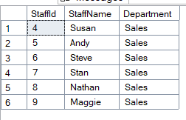
ITVFs - CONTINUED
SELECT *
FROM HumanResources.GetCustomersByCountryISO2('US');
SELECT *
FROM HumanResources.GetStaffByDepartment('Sales');
Examples of running the ITVFs to:
Find Customers that live in the US
Find the staff members working under the Sales department

Slide 10
CHALLENGES FACED
HOW THEY WERE OVERCOME
Had a hard time figuring out how to start with ITVFs and ideas of useful ones.
Then I had errors trying to create and calling them.
https://sabihullahsaleh.medium.com/table-valued-functions-tvfs-in-sql-8706a3c0288b
I found this medium article which explained things very well and helped me get started into making my own.

Slide 11
BRYAN
Production Information

Slide 12
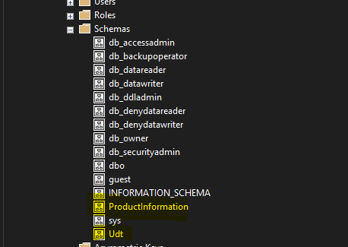
Schema
USE PrestigeCars_Project3
Go
CREATE SCHEMA Udt
CREATE SCHEMA ProductInformation
Product Information is created to encase all the tables that relate to the product
Udt is the schema created to differentiate the user data types. This way we are able to see everything we created in one spot

Slide 13
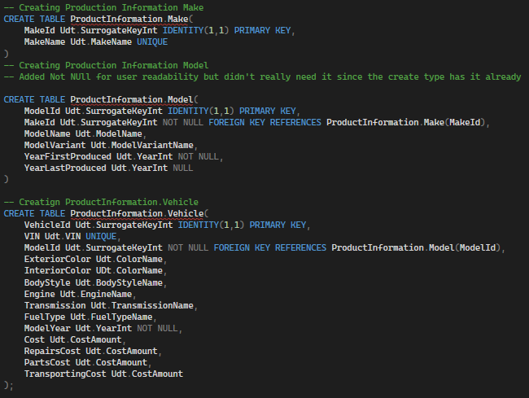
Tables
Each table use a Udt and make the table more easier to read and insert data into
All Id’s are surrogate key and have the ability to create their own unique id number and is a foreign key to multiple tables to be able to reference each of them

Slide 14
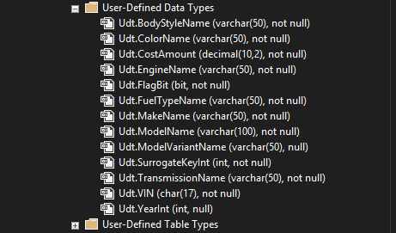
Udt’s Created
All Udt’s were created to be able to match the customization of each data type of the new normalized tables
Each of the data types are now required to match the actual data.
For example, VIN was turned from an INT data type to Udt.Vin that is now specific to Vin numbers and required to have the 17 characters.
Udt SurrogateKey Int is a Udt that is used in various tables for product information. This allows for the same data type to be concrete for the information of rows

Slide 15
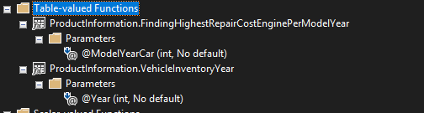
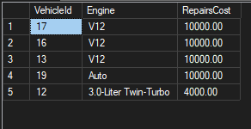
ITVF’s
CREATE FUNCTION ProductInformation.FindingHighestRepairCostEnginePerModelYear(@ModelYearCar Udt.YearInt)
Returns Table
AS
Return
(
Select TOP 5 VehicleId,Engine, RepairsCost
From ProductInformation.Vehicle
Where ModelYear >= @ModelYearCar
Order By RepairsCost Desc
)
Inline Table Valued functions are able to bring information quickly for various inputs: The ITVF’s here are used to analyze data without needing to re write the queries.
This is able to bring the top 5 vehicles that match the inputted year and above. This shows the most expensive repair costs to least expensive

Slide 16
CREATE FUNCTION ProductInformation.VehicleInventoryYear(@Year Udt.YearInt)
Returns Table
AS
Return
(
Select
V.vin,
MA.MakeName,
MO.ModelName,
V.ModelYear,
V.ExteriorColor,
V.BodyStyle,
V.Transmission,
(V.Cost + V.PartsCost + V.Transporting Cost + V.RepairsCost) AS TotalEstimatedCost
From
ProductInformation.Vehicle AS V
Inner Join ProductInformation.Model AS MO
ON V.ModelId = MO.ModelId
Inner Join ProductInformation.Make AS MA
ON MO.MakeId = MA.MakeId
Where
V.ModelYear = @Year
)
This ITVF showcases all the important information that is need when viewing vehicles. The function is using the model year, this way we can view all the cars per year and use it for analysis and reporting to businesses.

Slide 17
DEVAK

Slide 18
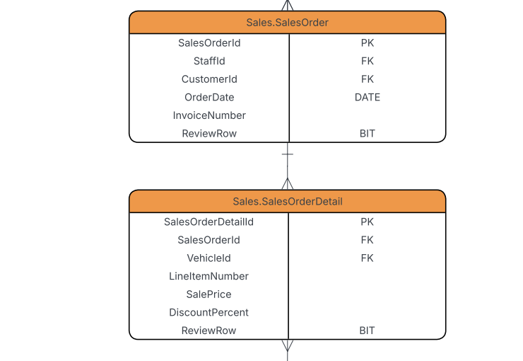
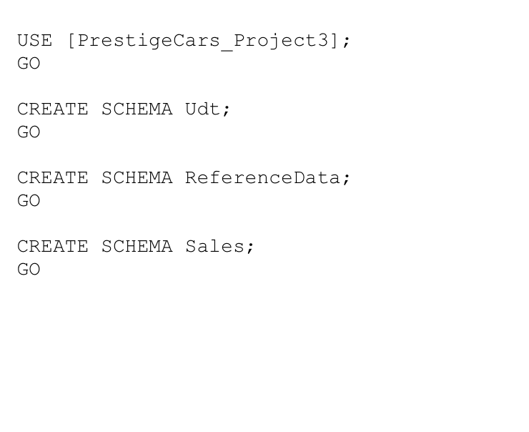
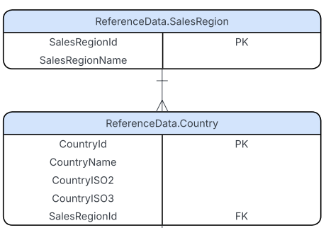
Schema
Sales schema handles all the transactions.
The ReferenceData has all our look up tables for regions and countries.

Slide 19
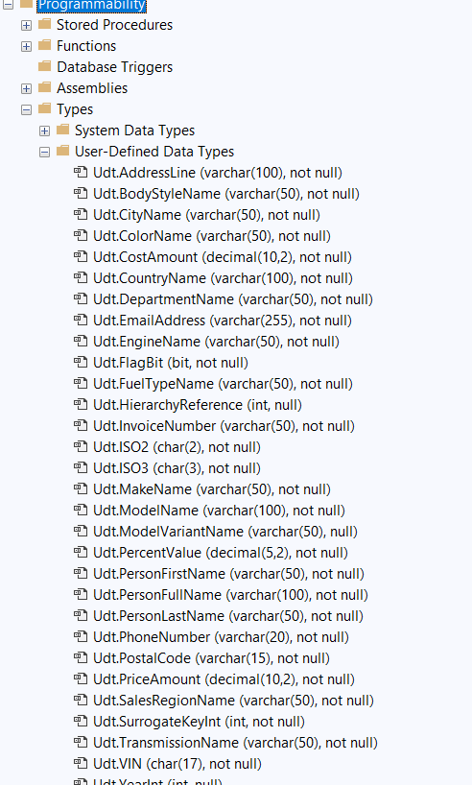
UDTs
Sales data is very important so it is crucial that it stays consistent which is why we defined these UDTs.
Makes it easier for all fields to follow the same rules.
CREATE TYPE Udt.InvoiceNumber
FROM VARCHAR(50) NOT NULL;
CREATE TYPE Udt.PriceAmount
FROM DECIMAL(10,2) NOT NULL;
CREATE TYPE Udt.PercentValue
FROM DECIMAL(5,2) NOT NULL;

Slide 20
Tables - Sales Schema
USE [PrestigeCars_Project3];
GO
CREATE TABLE Sales.SalesOrderDetail(
SalesOrderDetailId Udt.SurrogateKeyInt IDENTITY(1,1) PRIMARY KEY,
SalesOrderId Udt.SurrogateKeyInt NOT NULL,
VehicleId Udt.SurrogateKeyInt NOT NULL,
LineItemNumber INT NOT NULL,
SalePrice Udt.PriceAmount NOT NULL,
DiscountPercent Udt.PercentValue NOT NULL,
ReviewRow BIT NOT NULL,
FOREIGN KEY (SalesOrderId) REFERENCES Sales.SalesOrder(SalesOrderId),
FOREIGN KEY (VehicleId) REFERENCES ProductInformation.Vehicle(VehicleId)
);
These Sales tables connects customers, vehicles, and staff together.
Using these we can track a specific sales order to a specific customer and also find their location.
USE [PrestigeCars_Project3];
GO
CREATE TABLE Sales.SalesOrderDetail(
SalesOrderDetailId Udt.SurrogateKeyInt IDENTITY(1,1) PRIMARY KEY,
SalesOrderId Udt.SurrogateKeyInt NOT NULL,
VehicleId Udt.SurrogateKeyInt NOT NULL,
LineItemNumber INT NOT NULL,
SalePrice Udt.PriceAmount NOT NULL,
DiscountPercent Udt.PercentValue NOT NULL,
ReviewRow BIT NOT NULL,
FOREIGN KEY (SalesOrderId) REFERENCES Sales.SalesOrder(SalesOrderId),
FOREIGN KEY (VehicleId) REFERENCES ProductInformation.Vehicle(VehicleId)
);

Slide 21
Tables - Reference Schema
USE [PrestigeCars_Project3];
GO
CREATE TABLE ReferenceData.SalesRegion(
SalesRegionId Udt.SurrogateKeyInt IDENTITY(1,1) PRIMARY KEY,
SalesRegionName Udt.SalesRegionName UNIQUE NOT NULL
);
Using these tables, we can ensure that data stays consistent when referencing to countries or regions in other schemas.
Which in turn helps makes it easy to filter out sales orders or customers based by their region.
CREATE TABLE ReferenceData.Country(
CountryId Udt.SurrogateKeyInt IDENTITY(1,1) PRIMARY KEY,
CountryName Udt.CountryName NOT NULL,
CountryISO2 Udt.ISO2 NOT NULL,
CountryISO3 Udt.ISO3 NOT NULL,
SalesRegionId Udt.SurrogateKeyInt NOT NULL,
FOREIGN KEY (SalesRegionId) REFERENCES ReferenceData.SalesRegion(SalesRegionId)
);

Slide 22
ITVFs
Sales.GetOrdersByCountry
Retrieves sales orders based on the customer’s country using their ISO2 like US for United States or FR for France as an example.
Useful to see which countries generates the most sales.
Sales.GetOrdersByStaff
Returns all the sales linked to a specific staff member
Useful as this is something that multiple people will want to see, so no need to rewrite the code and use this function instead.
--Retrieve Orders by who sold them by passing the staff member's id
CREATE FUNCTION Sales.GetOrdersByStaff(@StaffId INT)
RETURNS TABLE
AS
RETURN
(
SELECT so.SalesOrderId,so.InvoiceNumber,so.OrderDate,c.FirstName + ' ' + c.LastName AS CustomerFullName
FROM Sales.SalesOrder AS so
INNER JOIN HumanResources.Customer AS c ON so.CustomerId = c.CustomerId
INNER JOIN ReferenceData.Country AS co ON c.CountryId = co.CountryId
WHERE so.StaffId = @StaffId
);
--Retrieve orders by the location that the customer was from
CREATE FUNCTION Sales.GetOrdersByCountry(@CountryISO2 CHAR(2))
RETURNS TABLE
AS
RETURN
(
SELECT so.SalesOrderId,c.FirstName + ' ' + c.LastName AS CustomerFullName, co.CountryName
FROM Sales.SalesOrder AS so
INNER JOIN HumanResources.Customer AS c ON so.CustomerId = c.CustomerId
INNER JOIN ReferenceData.Country AS co ON c.CountryId = co.CountryId
WHERE co.CountryISO2 = @CountryISO2
);

Slide 23
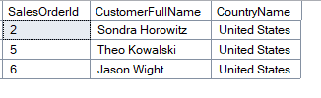
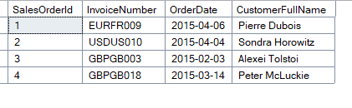
Running ITVFs and Results
SELECT *
FROM Sales.GetOrdersByCountry('US');
SELECT *
FROM Sales.GetOrdersByStaff(5);

Slide 24
GROUP 5
NACE COMPETENCIES

Slide 25
NACE COMPETENCIES - RENZO
Leadership - I split the group into a design and implementation team so that we could work in a nice clear order and avoid confusion. I created a Task structure so that both teams knew exactly what needed to be done and stay on track. My role was to connect both teams, so we could create a working PrestigeCars database.
Communication - Kept in touch through WhatsApp so I could assign tasks and share updates on progress.

Slide 26
NACE COMPETENCIES - Bryan
Technology- assisted with implementing UDTs, schemas, and table definitions across different domains. Supported testing and ensured database objects compiled correctly in order.
Teamwork- Coordinated with both design and implementation members to clarify missing attributes and constraints. Helped maintain consistency by reviewing shared scripts and resolving merge issues.

Slide 27
NACE COMPETENCIES - HTOO
Communication- Prepared domain documentation and explained schema purposes clearly for implementation. Provided timely feedback on naming conventions and attribute corrections.
Teamwork- Worked with the group to refine table structures and confirm foreign key paths. Helped synchronize design updates across all team members.

Slide 28
NACE COMPETENCIES - NADIA
Communication- Created clear ERD diagrams and schema definitions used by the implementation team. Explained domain relationships and clarified attribute requirements when questions came up.
Teamwork- Collaborated with other design members to finalize domain structures, constraints, and keys. Worked closely with implementation to keep design and code aligned.

Slide 29
NACE COMPETENCIES - ALEXANDER
Critical Thinking- Analyzed system requirements and translated them into accurate ERD relationships. Ensured the model reflected correct cardinalities and domain logic.
Collaboration- Actively supported implementation by reviewing scripts and confirming design details. Maintained open communication to resolve ambiguities quickly.

Slide 30
NACE COMPETENCIES - DEVAK
Technology- Used Docker, SQL Server, and DBeaver to build the full PrestigeCars_Project3 database. Implemented schemas, tables, UDTs, and ITVFs, and verified the database through testing.
Critical Thinking- Solved SQL errors by analyzing dependencies, fixing foreign keys, and adjusting script order. Ensured the final build executed successfully without conflicts.

Slide 31
SOURCES

Slide 32
SOURCES USED
ITVF
https://www.geeksforgeeks.org/sql/inline-table-valued-function-in-sql-server/
https://www.sqlservercentral.com/articles/creating-and-using-inline-table-valued-functions
https://www.sqlshack.com/sql-server-inline-table-valued-function/
https://sabihullahsaleh.medium.com/table-valued-functions-tvfs-in-sql-8706a3c0288b
Create Table
https://www.w3schools.com/sql/sql_create_table.asp
https://www.tutorialspoint.com/t_sql/t_sql_create_tables.htm
Create Schemas
https://www.geeksforgeeks.org/sql/create-schema-in-sql-server/
Self Reference Table
https://sudhass.medium.com/self-referencing-foreign-key-constraint-in-rdbms-and-self-join-b66186e672f7
Foreign Keys
https://www.w3schools.com/sql/sql_foreignkey.asp

