Slide 1
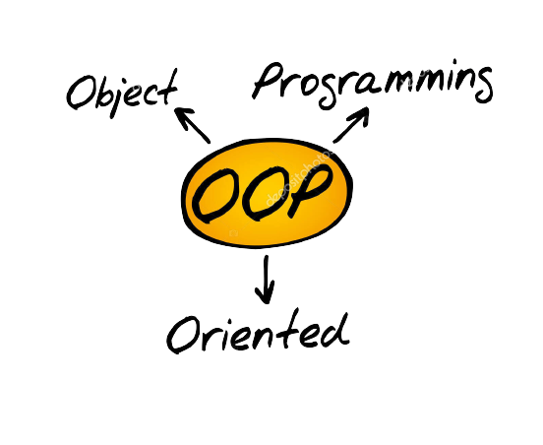
Object Oriented Programming(OOPs)
Prepared with efforts by Group B

Slide 2
Members:
Samar Ranjit
Bishram Bhusal
Krishan K Shah
Jasmine Basnet
Nikhil Bhandari
Rabindra Phuyal
Suyog Shah
Group B

Slide 3


# Procedural Programming
Procedural Programming is a computer paradigm In which codes are directly instructed to a device on how to finish a task in logical steps.
This paradigm uses a linear top-down approach and treats data and procedures as two different entities.
It is best suited to solve scientific and engineering problems.
Processor’s own language , machine code is procedural
Examples of procedural programming languages:
Basic, C, Fortan

Slide 4
Features of Procedural Programming:
Predefined function
Parameter Passing
Modularity
Local Variable
Global Variable
Open a file
Read a Number
Multiply By 3
Display the Product

Slide 5





Advantages of Procedural Programming
Easy to keep track of program flow
Suit for General Purpose Programming
Needs Less Memory

Slide 6



Lacks Security
And fear of exposure
Reduces Extensibility
Tiring for Programmers
Disadvantages of Procedural Programming

