Slide 1

JBIG
SEMINAR
3팀

Slide 2
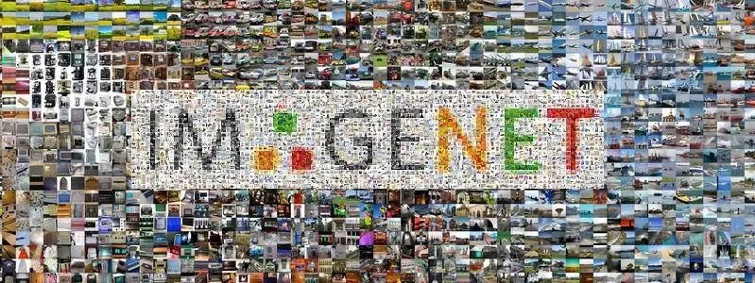
ImageNet Large Scale Visual Recognition Challenge (ILSVRC)

Slide 3
JBIG
CONTENTS
SEMINAR
01. AlexNet
02. VGGNet
03. ResNet

Slide 4
JBIG
SEMINAR

Slide 5
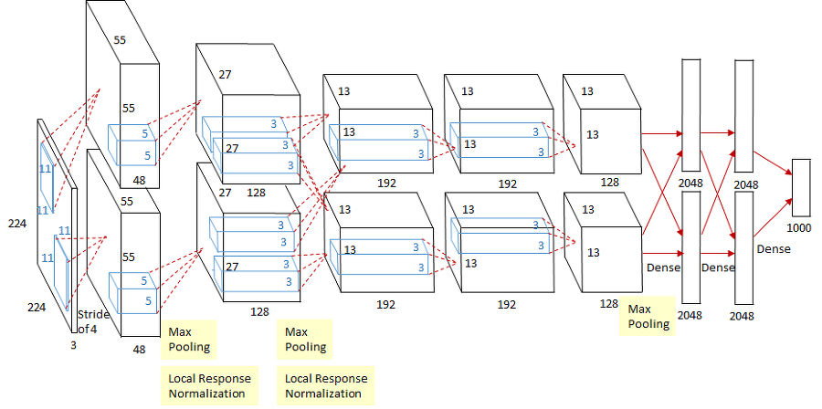
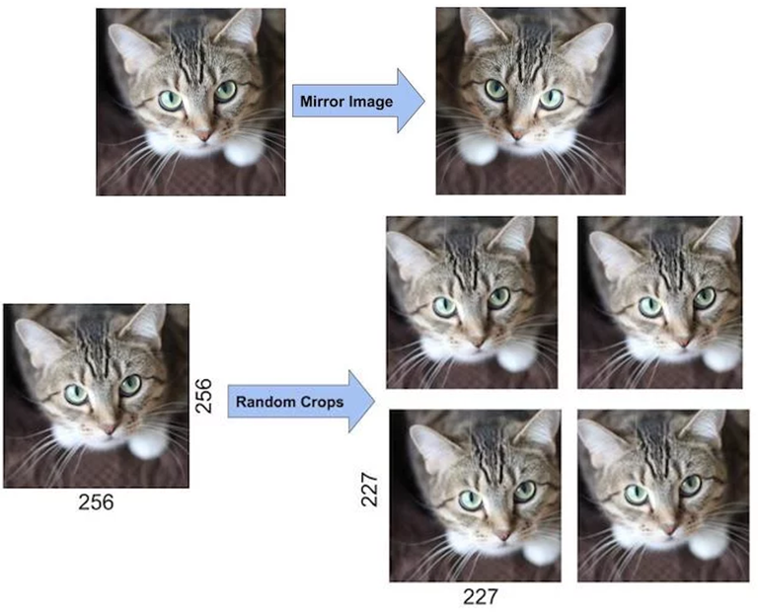
01
AlexNet
SEMINAR
Intuition
First CNN model
Fisrt use ReLU
8Layers (5Conv, 3FC)
Max Pooling
Local Response Normalization (LRN)
(Not anymore)
Mutiple GPUs
Drop-out
Data augmentation

Slide 6
JBIG
SEMINAR

Slide 7
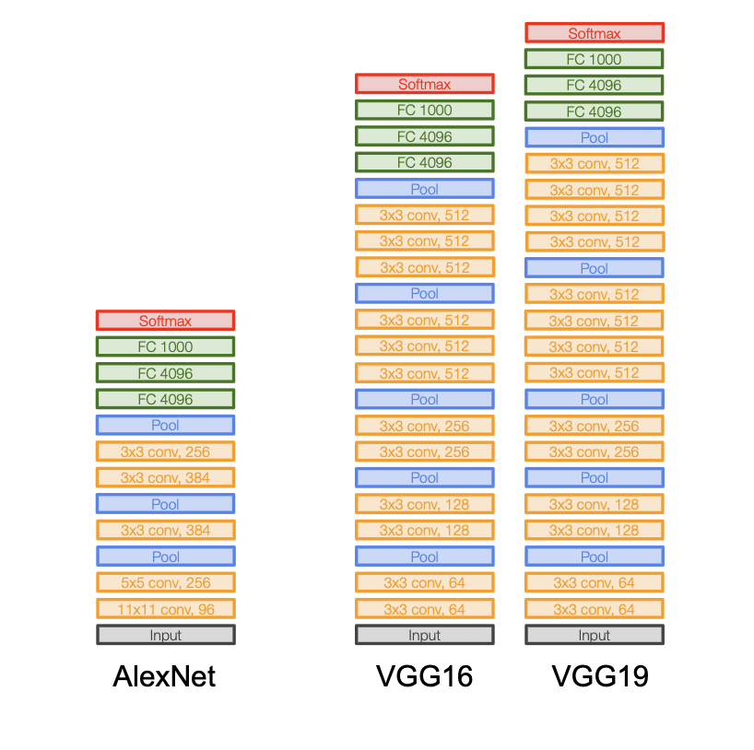
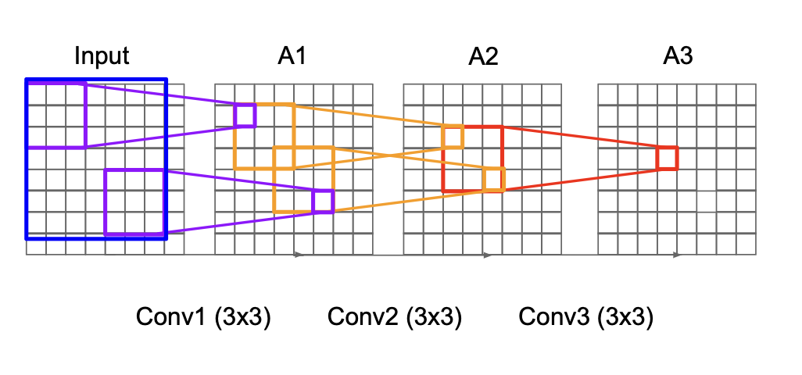
02
VGGNet
SEMINAR
Intuition
Use smaller filters
3x3 Conv *3 = 7x7 Conv
Fewer parameters
NO LRN

Slide 8
JBIG
SEMINAR

Slide 9
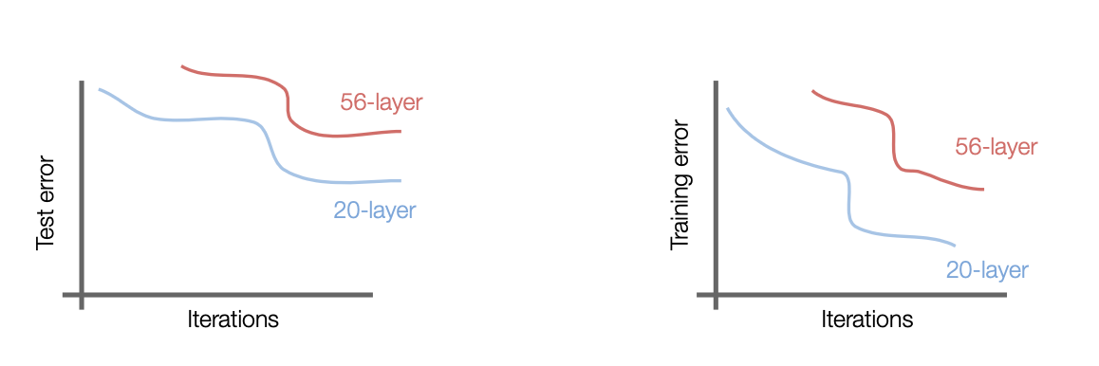
03
ResNet
SEMINAR
Then more deeper layer goes to more accuracy?
NO!
We need to fix optimal problem!

Slide 10
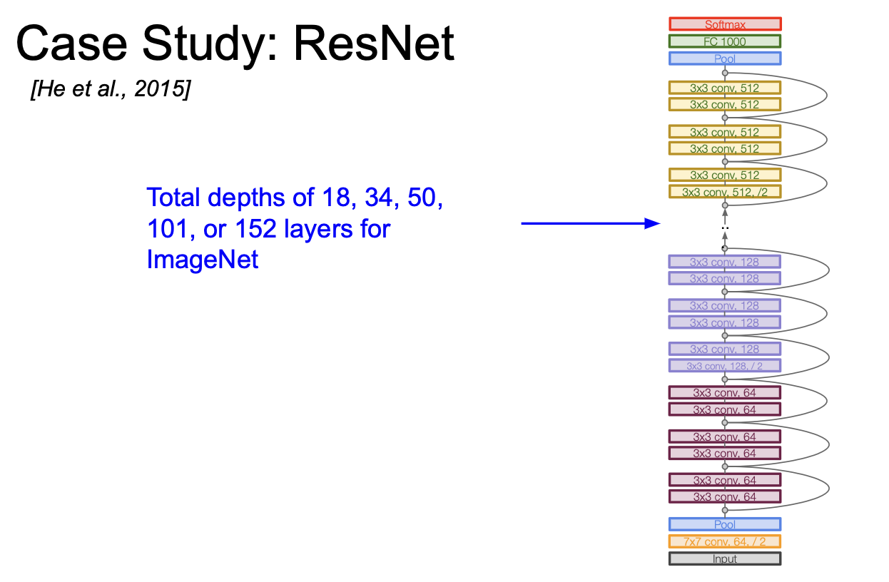
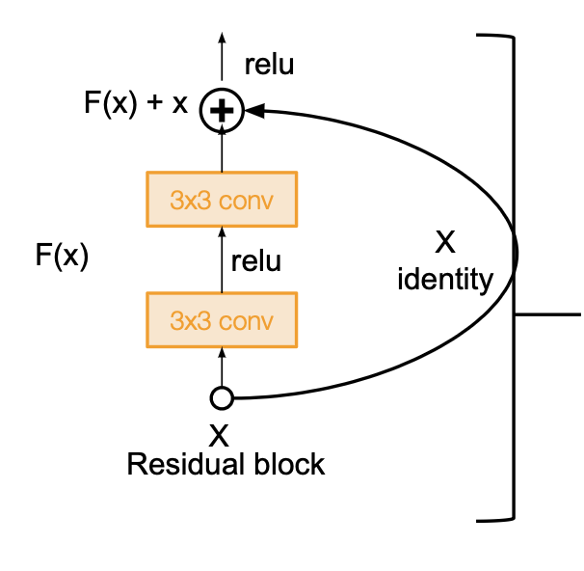
03
ResNet
SEMINAR
Intuition
Skip connection
Identity mapping

Slide 11
Q&A
Thank you

