Slide 1
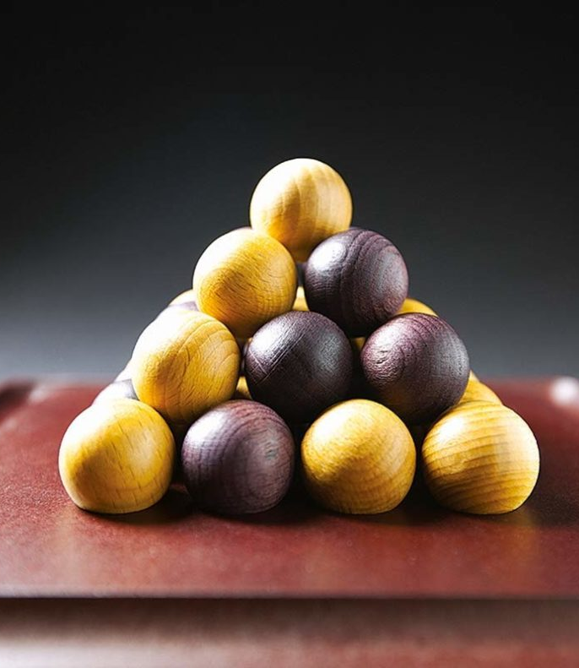
Pylos
- C. Lefevre -
- R. Permentier -

Slide 2
Inhoud
Best fit
Strategieën
Onderzoek
Zelf lerend systeem

Slide 3
Random Fit

Slide 4
Random fit
removeOrPass: 50/50 kans
Ongelijke kansen (semi random): TODO
Remove: past als het niet kan removen
random: speler die start heeft nadeel
steeds dezelfde resultaten (indien zeer groot aantal games) ookal geen seed
PylosPlayerRandomFit: bound-1, buitenste waarde nooit meegenomen

Slide 5
Random fit: 10k-battle (No seed)
50 | 25,01 | 53,90 | 45,62 | 0,48
100 | 48,87 | 48,93 | 50,51 | 0,56
Notes:
* % geprobeerd om te passen, maar als we removen, kan het zijn dat we wel nog passen

Slide 6
Random fit: 10k-battle
% pass_set | % pass_werkelijk
100 | 49,87
80
70 | 34,97
60
50 | 25,01
40
30 | 15,55
20
10
0

Slide 7
Best Fit
Notes:
De strategieën uitleggen, en die gaan vergelijken met elkaar

Slide 8
Strategiën
Offensief
Maak een vierkant (A1)
Leg in meest vertegenwoordigde vierkant (E)
Claim een zo hoog mogelijke locatie (G)
Defensief (A21, A22)
Combinatie
claim midden niveau 1 (B)
claim midden van randen op niveau 1 (C1, C21, C22)
Random (F)
(D: Midden op grond claimen, indien er geen L structuur aanwezig is)
Notes:
/* A. Check for 3/4 Square A1. 3/4 own color : put fourth A2. 3/4 other color A21. 1/4 own color : put on top A22. 1/4 empty : put forth (if not middle) B. CHECK IF MIDDLE 4/4 : put on top C. L1 MIDDLE IS TAKEN C1. MIDDLE SPHERE IS OWN COLOR : try put on middle of border C2. MIDDLE SPHERE IS OTHER COLOR C21. ONE (OR MORE) BLACK SPHERES ON L2 : try to put on opposite side C22. NO/ MULTIPLE BLACK SPHERES ON L2 : try put on middle of border D. CHECK IF L0 MIDDLE SQUARE IS NOT 3/4 FILLED : put in middle square E. SEARCH FOR SQUARE REPRESENTED MOST : put there F. IF NO MOVES COULD BE PERFORMED : put random, same as random fit G. PUTS AS HIGH AS POSSIBLE */

Slide 9
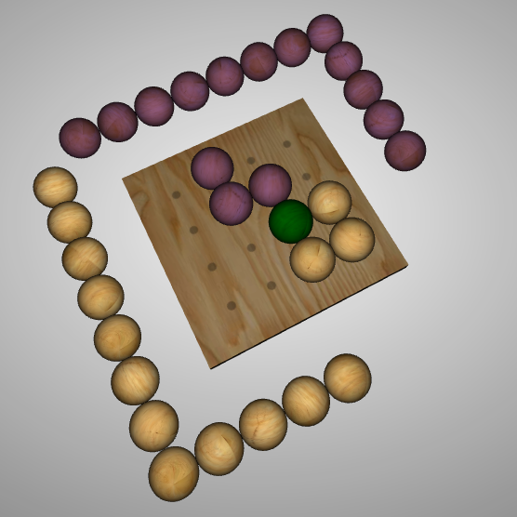
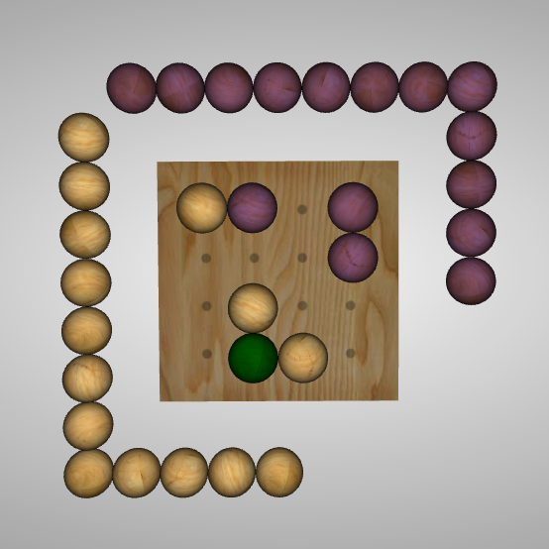
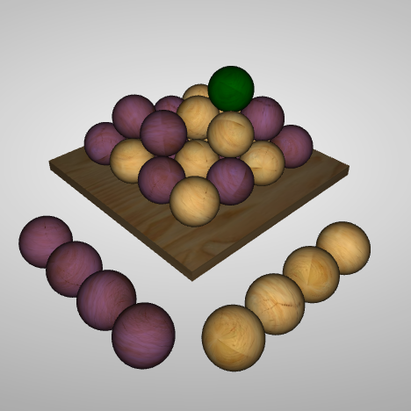
Offensief
A1
E
G
Notes:
/* A. Check for 3/4 Square A1. 3/4 own color : put fourth A2. 3/4 other color A21. 1/4 own color : put on top A22. 1/4 empty : put forth (if not middle) B. CHECK IF MIDDLE 4/4 : put on top C. L1 MIDDLE IS TAKEN C1. MIDDLE SPHERE IS OWN COLOR : try put on middle of border C2. MIDDLE SPHERE IS OTHER COLOR C21. ONE (OR MORE) BLACK SPHERES ON L2 : try to put on opposite side C22. NO/ MULTIPLE BLACK SPHERES ON L2 : try put on middle of border D. CHECK IF L0 MIDDLE SQUARE IS NOT 3/4 FILLED : put in middle square E. SEARCH FOR SQUARE REPRESENTED MOST : put there F. IF NO MOVES COULD BE PERFORMED : put random, same as random fit G. PUTS AS HIGH AS POSSIBLE */

Slide 10
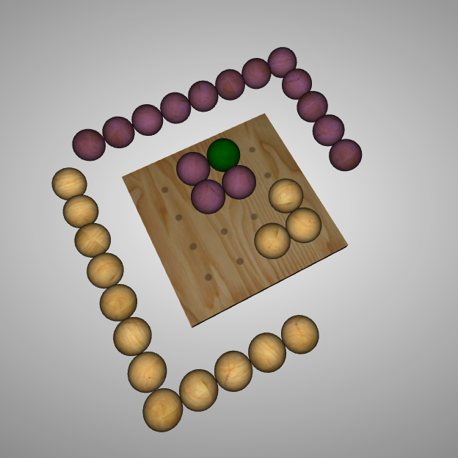
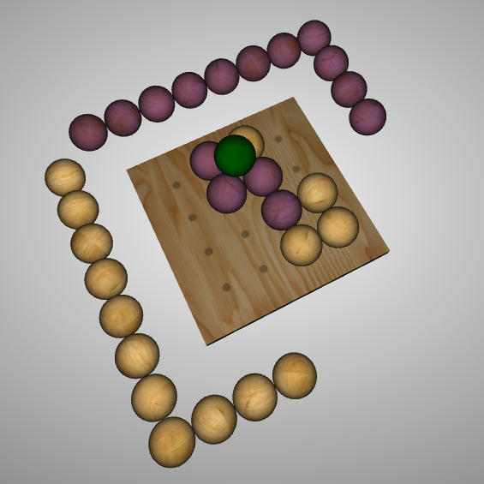
Defensief
A22
A21
Notes:
/* A. Check for 3/4 Square A1. 3/4 own color : put fourth A2. 3/4 other color A21. 1/4 own color : put on top A22. 1/4 empty : put forth (if not middle) B. CHECK IF MIDDLE 4/4 : put on top C. L1 MIDDLE IS TAKEN C1. MIDDLE SPHERE IS OWN COLOR : try put on middle of border C2. MIDDLE SPHERE IS OTHER COLOR C21. ONE (OR MORE) BLACK SPHERES ON L2 : try to put on opposite side C22. NO/ MULTIPLE BLACK SPHERES ON L2 : try put on middle of border D. CHECK IF L0 MIDDLE SQUARE IS NOT 3/4 FILLED : put in middle square E. SEARCH FOR SQUARE REPRESENTED MOST : put there F. IF NO MOVES COULD BE PERFORMED : put random, same as random fit G. PUTS AS HIGH AS POSSIBLE */

Slide 11
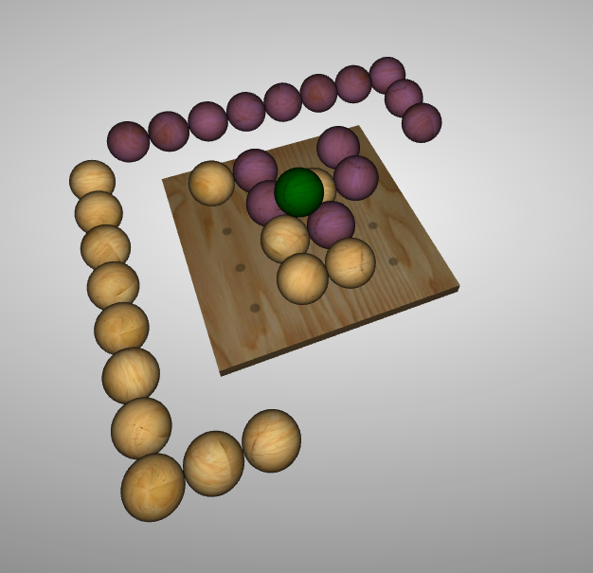
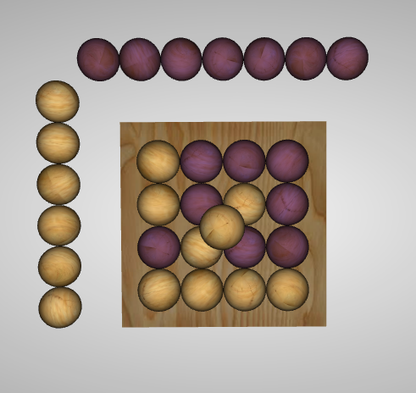
Combinatie
B
Waarom ?
Notes:
/* A. Check for 3/4 Square A1. 3/4 own color : put fourth A2. 3/4 other color A21. 1/4 own color : put on top A22. 1/4 empty : put forth (if not middle) B. CHECK IF MIDDLE 4/4 : put on top C. L1 MIDDLE IS TAKEN C1. MIDDLE SPHERE IS OWN COLOR : try put on middle of border C2. MIDDLE SPHERE IS OTHER COLOR C21. ONE (OR MORE) BLACK SPHERES ON L2 : try to put on opposite side C22. NO/ MULTIPLE BLACK SPHERES ON L2 : try put on middle of border D. CHECK IF L0 MIDDLE SQUARE IS NOT 3/4 FILLED : put in middle square E. SEARCH FOR SQUARE REPRESENTED MOST : put there F. IF NO MOVES COULD BE PERFORMED : put random, same as random fit G. PUTS AS HIGH AS POSSIBLE */

Slide 12
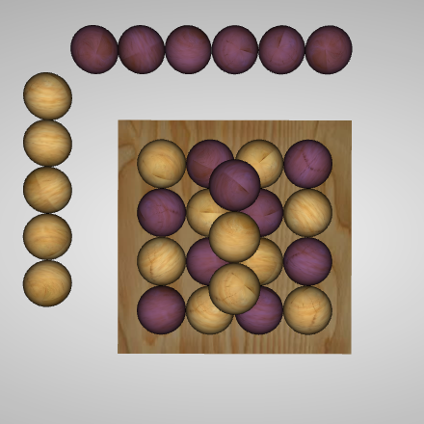
Combinatie
C1
C21, C22
Waarom ?
Notes:
/* A. Check for 3/4 Square A1. 3/4 own color : put fourth A2. 3/4 other color A21. 1/4 own color : put on top A22. 1/4 empty : put forth (if not middle) B. CHECK IF MIDDLE 4/4 : put on top C. L1 MIDDLE IS TAKEN C1. MIDDLE SPHERE IS OWN COLOR : try put on middle of border C2. MIDDLE SPHERE IS OTHER COLOR C21. ONE (OR MORE) BLACK SPHERES ON L2 : try to put on opposite side C22. NO/ MULTIPLE BLACK SPHERES ON L2 : try put on middle of border D. CHECK IF L0 MIDDLE SQUARE IS NOT 3/4 FILLED : put in middle square E. SEARCH FOR SQUARE REPRESENTED MOST : put there F. IF NO MOVES COULD BE PERFORMED : put random, same as random fit G. PUTS AS HIGH AS POSSIBLE */

Slide 13
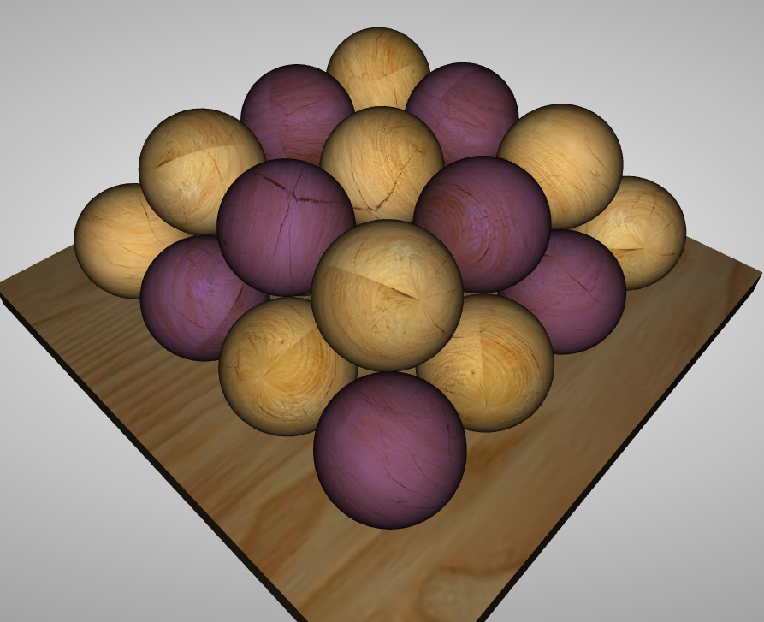
Strategieën
A: Zoeken naar L structuren
A1: L structuur eigen kleur
A2: L structuur andere kleur
A21: 4de plek eigen kleur
A22: 4de plek leeg
B: Midden van 1ste verdiep claimen
C: Midden van 1ste verdiep bezet
C1: Midden eigen kleur
C2: Midden ander kleur
C21: Eigen kleur op het midden van de rand
C22: Geen eigen kleur op het 1ste verdiep
Illustratie: ‘Belang van claimen middens’
Notes:
/* A. Check for 3/4 Square A1. 3/4 own color : put fourth A2. 3/4 other color A21. 1/4 own color : put on top A22. 1/4 empty : put forth (if not middle) B. CHECK IF MIDDLE 4/4 : put on top C. L1 MIDDLE IS TAKEN C1. MIDDLE SPHERE IS OWN COLOR : try put on middle of border C2. MIDDLE SPHERE IS OTHER COLOR C21. ONE (OR MORE) BLACK SPHERES ON L2 : try to put on opposite side C22. NO/ MULTIPLE BLACK SPHERES ON L2 : try put on middle of border D. CHECK IF L0 MIDDLE SQUARE IS NOT 3/4 FILLED : put in middle square E. SEARCH FOR SQUARE REPRESENTED MOST : put there F. IF NO MOVES COULD BE PERFORMED : put random, same as random fit G. PUTS AS HIGH AS POSSIBLE */

Slide 14
Onderzoek – Volgorde strategieën
Welke volgorde veroorzaakt grootste winst %?
Geen one-hit wonder (lucky shot)
totalDarkWin | totalDraw | totalLightWin | totalPlayTime | runs | order
96 | 0 | 4 | 0,015 | 100 | A1BA22GEA21C1C22C21
96 | 0 | 4 | 0,015 | 100 | A1BA22GEA21C1C22C21
96 | 0 | 4 | 0,015 | 100 | A1BA22GEA21C1C22C21
95 | 0 | 5 | 0,032 | 100 | A1A22EGA21C22C21C1B
95 | 0 | 5 | 0,015 | 100 | A1A22A21EC22C1C21BG
94 | 0 | 6 | 0,031 | 100 | A1A21GA22BEC1C22C21
94 | 1 | 5 | 0,031 | 100 | A1A21GA22EC22C1BC21

Slide 15
Onderzoek – Strategieën
Onderzoek naar de effectiviteit
RESULTATEN HIERONDER

Slide 16
Self-learning

Slide 17
Suggesties
Mini max algoritme:
Per zet, alle mogelijkheden simuleren, kostfunctie bepaald

