Slide 1

Café Le Marcy
By Debo, Ro, Thomas

Slide 2
Table of Contents
Café Scenario
Data Cleaning
Business Questions
Key Findings
Recommendations
Reflections
Questions?

Slide 3

Café Scenario
The owner of a popular café has tasked us to help clean & explore messy data to prepare for the launch of new marketing campaigns

Slide 4

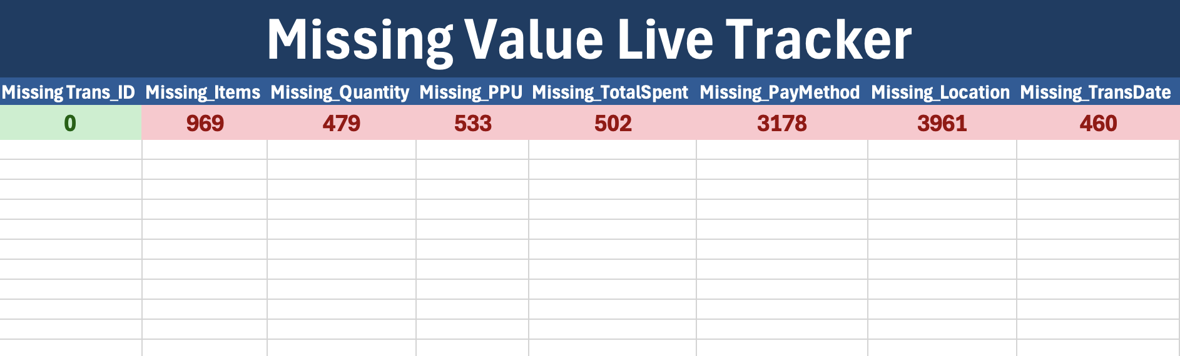
Data Cleaning
Excel
Python
Converted all ERROR and UNKNOWN to blanks.
Filled in 20 rows with mean Total Spent per Item.
Dropped 5 rows due to uninterpretable data.
Text 2

Slide 5

Business Questions
What are the peak sales months?
Are weekends busier than weekdays?
Are there any other findings that stand out and are relevant to the stakeholders?
How reliable was the data? What cleaning was needed?

Slide 6
Key Findings
Most Profitable Days
Thursday
Friday
Sunday
Most Profitable Months
June
October
January
Busiest Days
Friday
Sunday
Tuesday
Busiest Months
October
December
April

Slide 7
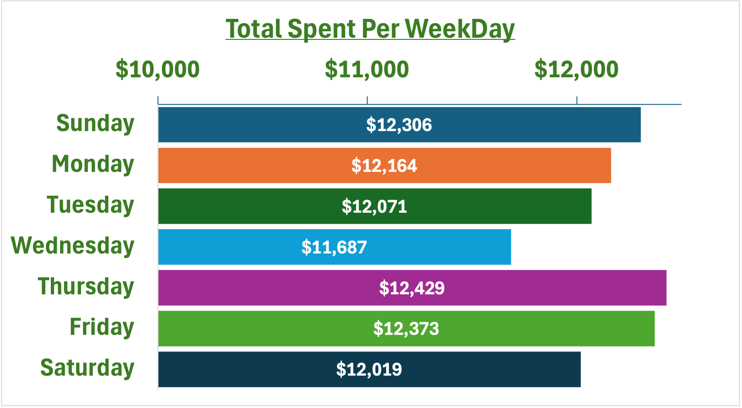
Most profitable Day
Computed through sum of Total Sales per each weekday

Slide 8
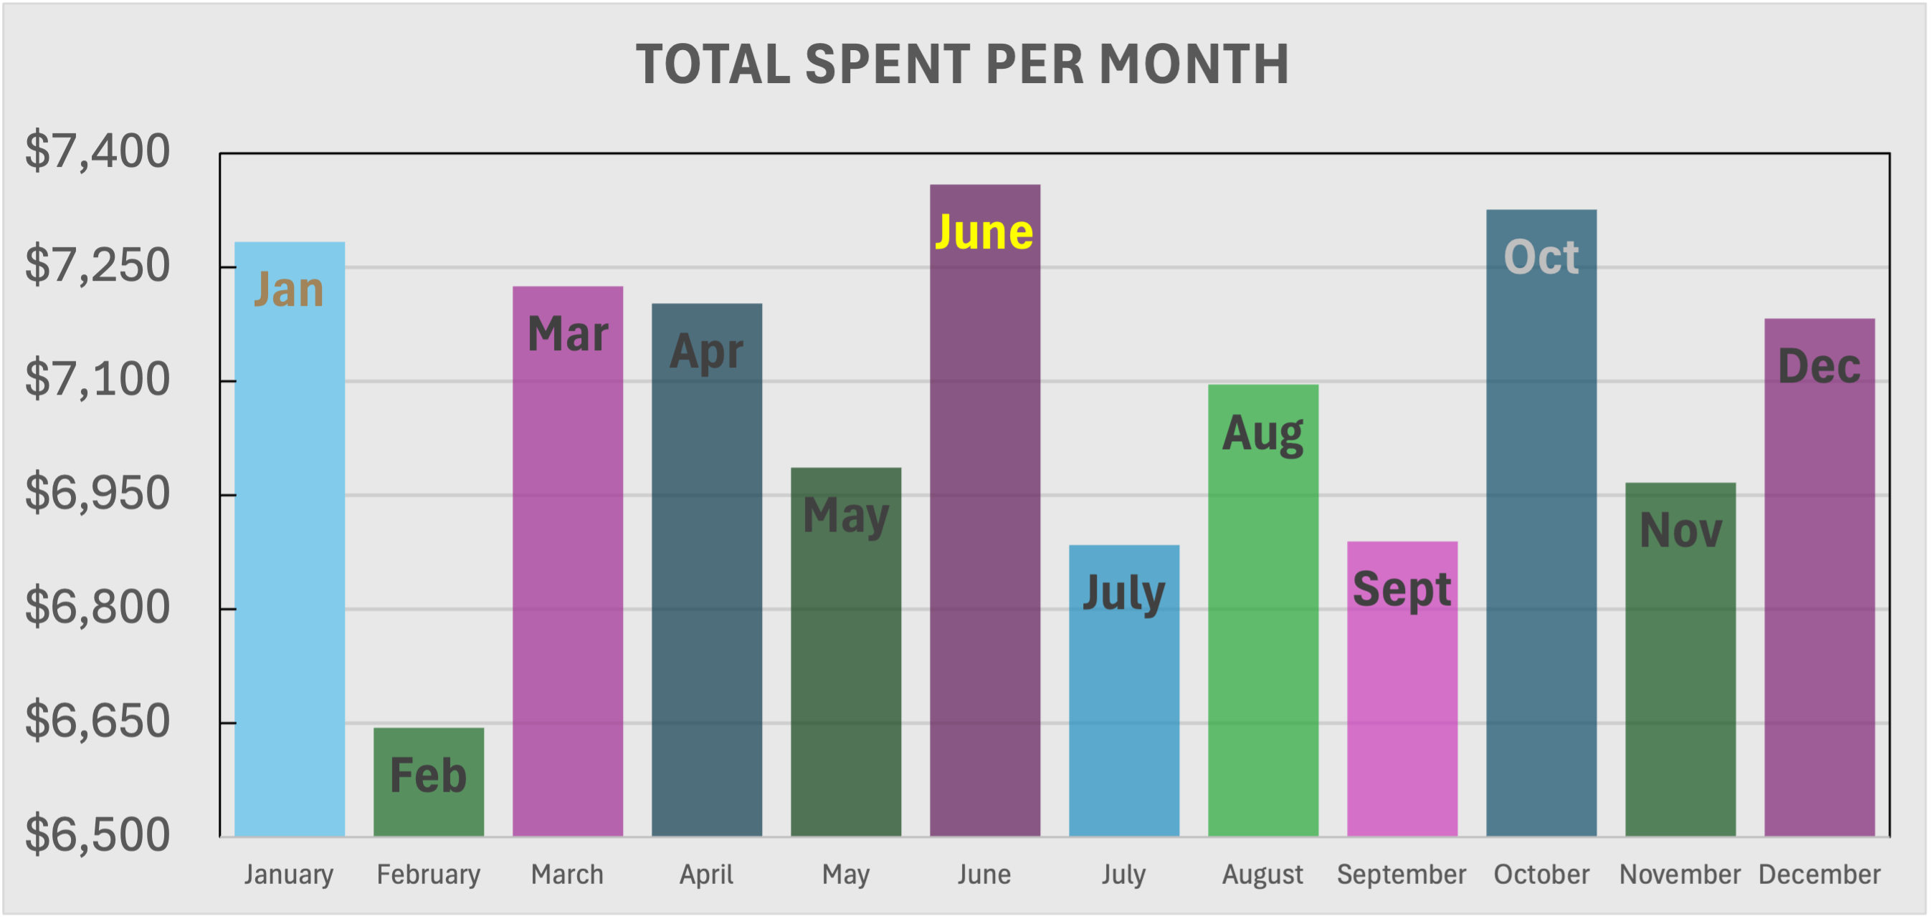
Most profitable Month
As shown. February with an unusually low revenue, likely due to missing data

Slide 9
Recommendations
Text

Slide 10
Reflections

Slide 11

Thank you
Questions?

